Slide 1
while loop day 2
10/21/2019

Slide 2
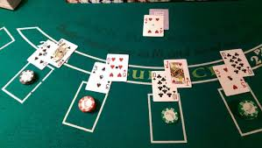
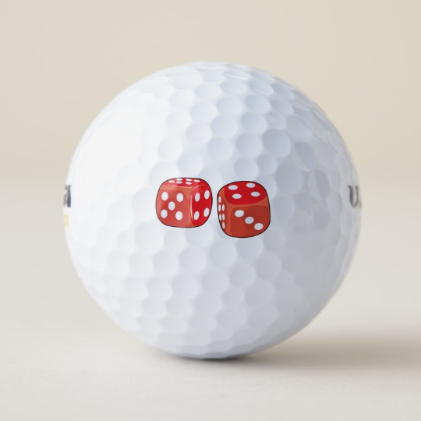
Learning Targets
Be able to fix a program that uses a while loop.
Be able to create a simple card game that uses the while loop.
Extension… Dice Golf

Slide 3
Open and fix the fixwhile.java program found on the class website

Slide 4
Black Jack: Complete one or more of the following. If stuck: Hands on, pseudocode, dry run, code
Level I
Write a program that allows a human user to play "blackjack" against a dealer.
Pick two values from 1-10 for the player. These are the player's "cards".
Pick two more values from 1-10 for the dealer.
Whoever has the highest total is the winner. Ties go to the dealer
There is no betting, no busting, and no hitting, but the user can ‘Play again’ This is the loopy part.
Level II
Don't worry about suits or face cards; "cards" will have values from 2-11, and all values are equally likely (that is, unlike a real blackjack game, there's no greater chance of drawing a card with value 10).
Draw two cards for the player and display them.
Draw two cards for the "dealer" and display one of them, keeping the other one hidden.
Allow the player to "hit" as many times as he/she would like.
If the player "busts" (gets a total over 21), the dealer automatically wins.
Allow the dealer to hit as many times as he/she would like. Dealer should probably hit on sixteen or lower.
If the dealer busts, the player automatically wins.
Assuming no one has busted, the player with the highest total wins. Dealer wins all ties.
Level III
Use realistic card values, with suits and faces from ace to king.
Incorporate wagering.
Display some sort of graphical cards.
Anything else interesting you can think of.

Slide 5
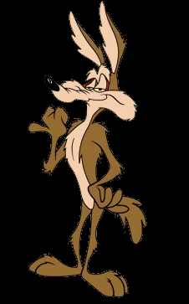
Program Options: Complete one of the following
Input: An unknown number of integers.
Output: The total , average, high and low values.
Input: None
Process: Roll a pair of six-sided dice and count how many rolls it takes for you to roll three sevens in a row.
Output: Each roll and the count for the number of rolls it takes to roll three sevens in a row.
Input: An unknown number of integers representing light sensor readings.
Output: A running average of the three most recent readings.
Determine how you will handle the first two readings and include your approach in your header notes.
Push: Modify the program so the user can enter how many readings to consider when calculating the average.

Slide 6
Dice Golf
Each player in turn rolls three six-sided dice and continues to throw them until a double is thrown.
Each throw that doesn't contain a double counts as a stroke.
The throw that contains a double counts as the hole.
The number of strokes and the throw that contained the double are counted and noted down for each player.
18 rounds are played representing the18 holes of a golf course and the player with the lowest total of throws at the end of the game, wins.

