Slide 1
Intro. to Engineering Design
Virtual Team Project
5/26/2017

Slide 2
Learning Targets
Understand the timeline for this project
Be able to open STEP files from Churchill
Understand your ‘next steps’ to complete the project
Plan what you will be able to complete by Wednesday

Slide 3
Due Dates
ALL Part Files complete by the end of class on Wednesday 5/31
All assemblies done 6/2 by the beginning of the class
Presentation models completed by the end of class 6/2 (Next Friday)
Working Drawings Complete 6/2 end of the day
Teams with Seniors need to complete their presentations in 6/2
Senior Teams present on 6/5
Non-Senior Teams Final Presentation 6/7

Slide 4
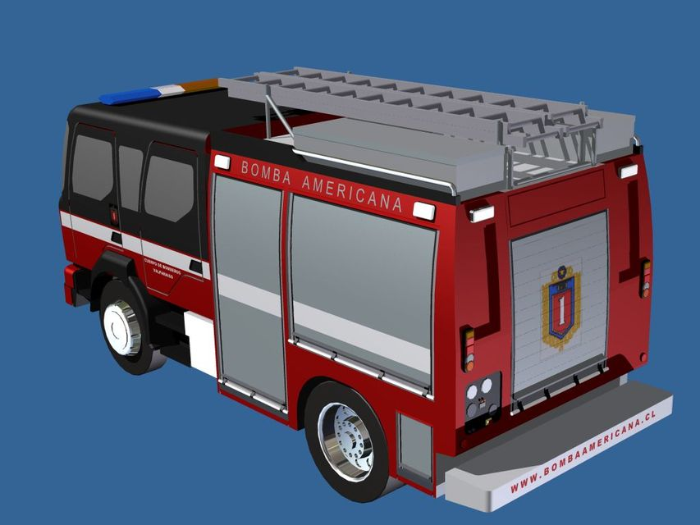
Opening Churchill Files
Churchill Part Files are saved as STEP files.
Tested with downloading the file, then open the file with Inventor

Slide 5
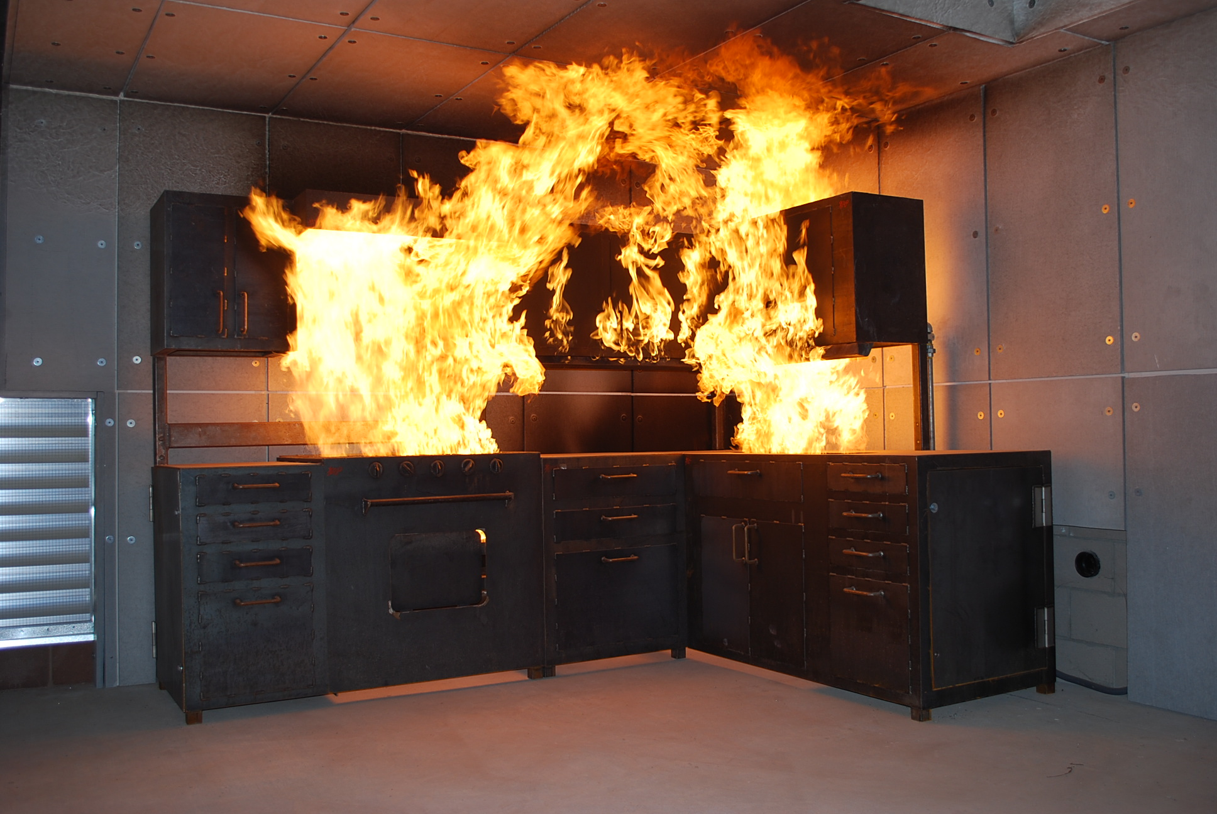
Desktop Teams
If No connection/No communication/No direction
Make an organizer with West Salem only members
Meet the design specifications
Base
Other modules
Simple connection method
Share files with Churchill

Slide 6
Miniature Golf Teams
Wed 5/31 All part files
Friday 6/2 Assemblies, working drawings and senior presentations
Monday 5/5 Senior Groups give presentation
Rest finish preparing presentation
Wednesday 5/7 Non-senior presentations
Design Engineers
Complete Base (20’x25’)
Add entry and exit points
Add fairway
Add hole
Add elements/obstacles
Project Manager
Make course shell showing the flow between holes.
Use 20’x25’x1’ extrusions for marking the spaces. Replace these as holes are completed and sent to you.
Tee-off pad
Scoring Podium
150 ft^2 podium
Retail / Rental | Hole 5
Hole 1 | Hole 4
Hole 2 | Hole 3

Slide 7
What is Turned in by Individuals: A PowerPoint with the following
Team members
Project Name
Team Norm Summary
Specifications and Constraints
Concepts
Concept Sketches: At least three solutions per member
Develop a Solution
Decision Matrix used to select the design direction (All team members will have the same matrix)
Construct and Test a Prototype
Your Inventor Part Files
Your Inventor Dimensioned Drawing files
Put screen captures in the PowerPoint.
Assembly of the Team Project
Show how all of the parts fit together and interchangeability of enhancements as appropriate.
Screen capture

