Slide 1
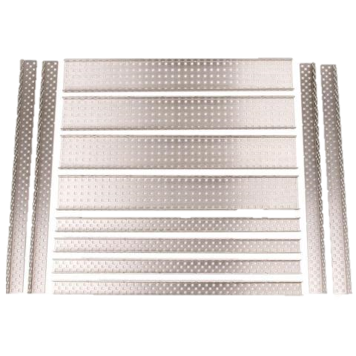
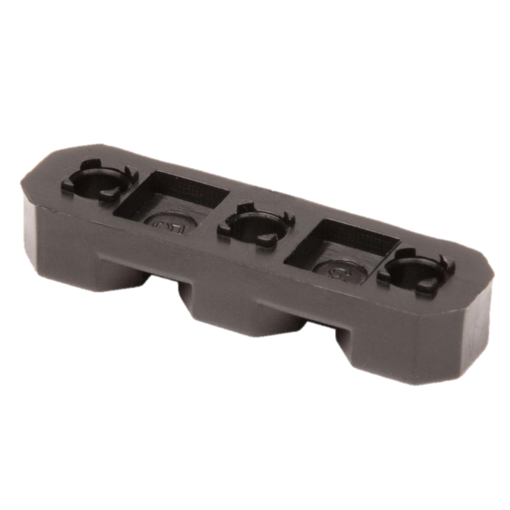
VEX Structure
The VEX structural pieces all contain square holes (0.182” sq) on a standardized 0.5” grid.
The smaller diamond holes are there to help users cut pieces using tin snips or fine toothed hacksaws without leaving sharp corners.
Steel and Aluminum

Slide 2
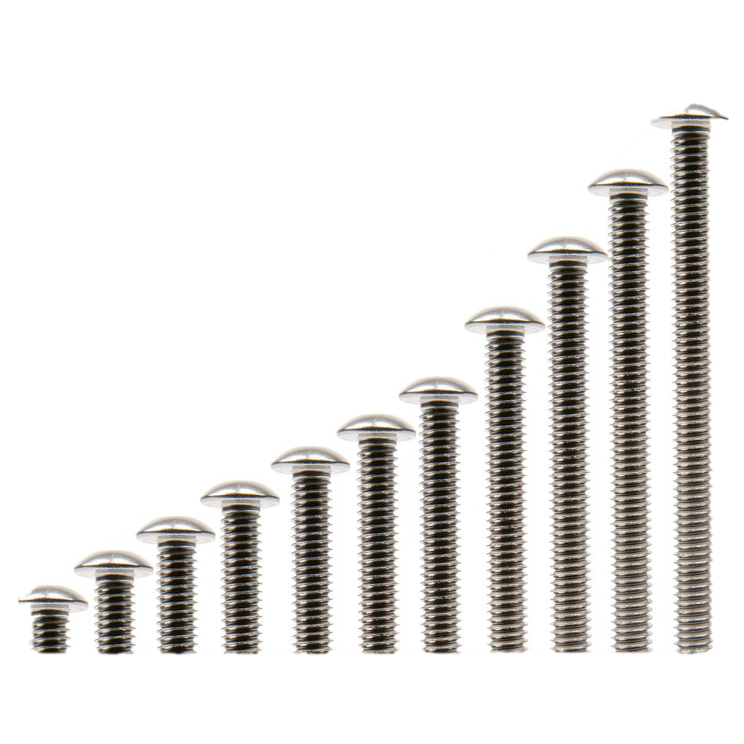
Screws
8-32 screws for attaching structure
Use 3/32” Hex Key
¼” to 2” Lengths
Locking Screws: Like normal screws but harder to remove (First 10-12 times)
Shoulder Screws (0.20” Long Shoulder)
½” Plastic Thumb Screws
6-32 Screws for Motors and Servos
Use 5/64” Hex Key
¼” and ½”
½” Locking

Slide 3
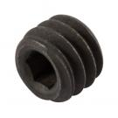
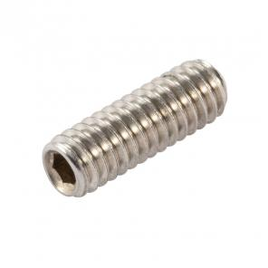
Screws
8-32 x 0.125” Setscrew for Shaft Collars
Couplers: 0.500” and 1.000”
Used for connecting Standoffs

Slide 4
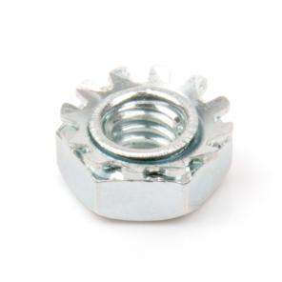
Nuts
8-32 Thread
Keps
Nylock
Hex

Slide 5
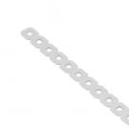
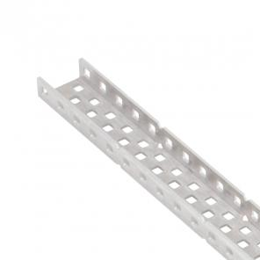
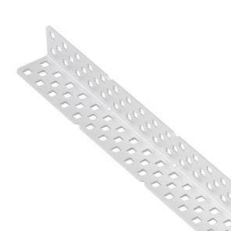
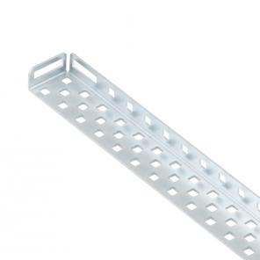
Bars, ‘C’-Channels, Angles, Rails
Bars (1x25)
Can be bent, but will never again be straight
C-Channel
1x2x1x35, 1x3x1x35, 1x5x1x25, 1x5x1x35
Added strength and twist resistance
Angles
2x2x25, 2x2x35, 3x3x35
Used for framing, good strength in two axis
Chassis Rails
2x1x25, 2x1x35
Tab at the end allows more connection options.
Notes:
http://curriculum.vexrobotics.com/curriculum/intro-to-robotics/vex-robotics-design-system

Slide 6
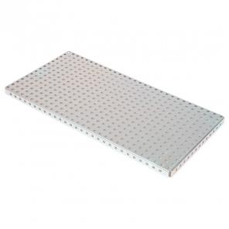
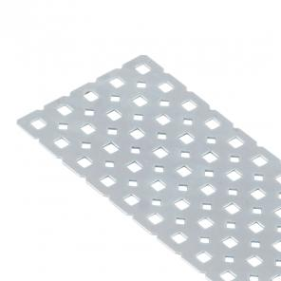
Structure: Plates and Base Plates
Base Plate
15 x 30
Create a large stationary robotic arm, or interlock them to build larger manufacturing type systems.
Plates
15x5 , 25 x 5

Slide 7
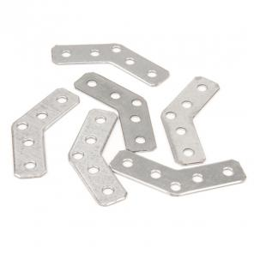
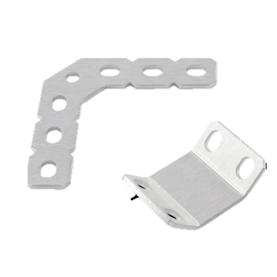
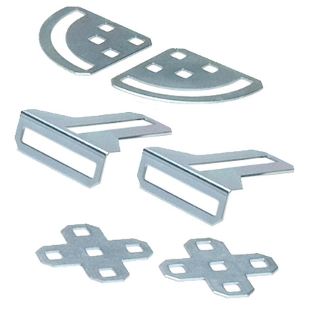
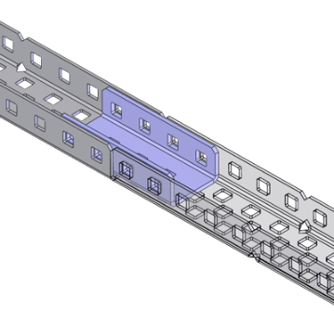
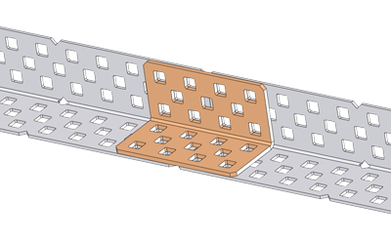
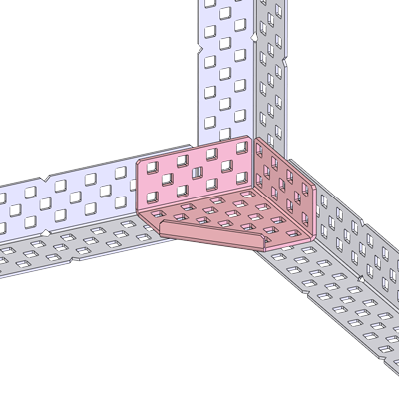
Structure: Gussets
45 Degree
90 Degree
Gusset Pack:
Pivot Gusset: Connect parts and angles 0 – 90 Degrees
Plus Gusset: Strengthen flat joints
Angle Gusset: Strengthen ‘T’ Joints
C-Channel Coupler: Connect two 1x2x1 ‘C’ Channels
Angle Coupler: Connect two 2x2 Angles
Angle Corner

Slide 8
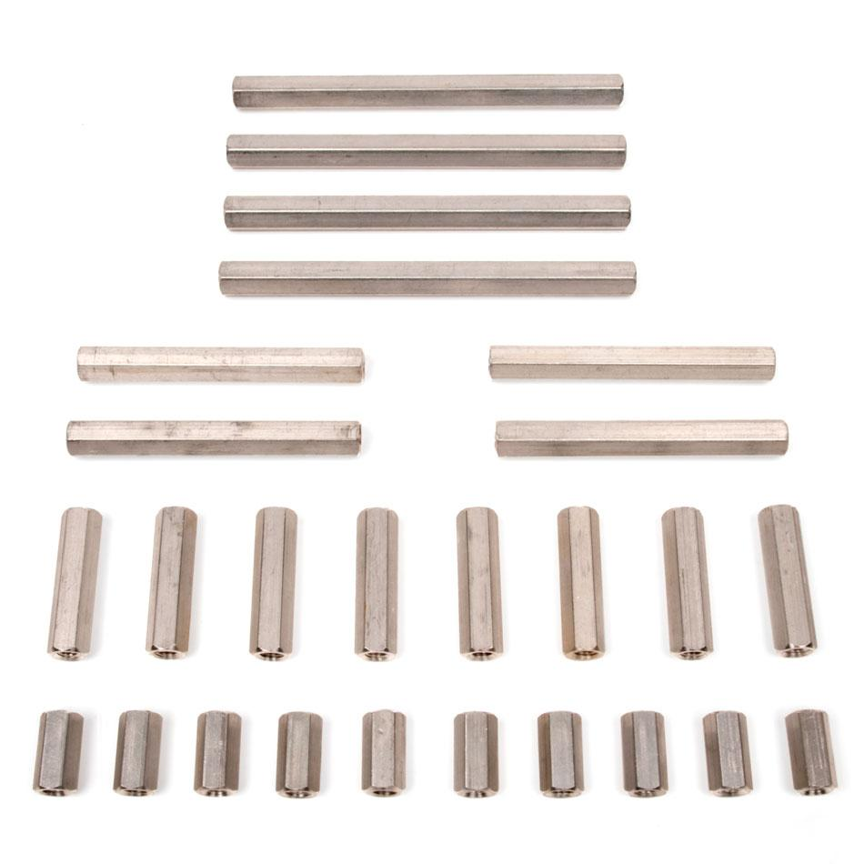
Structure: Standoffs (8-32)
0.25” – 6.00”
Tapped on both ends to fit 8-32 Screws
Add spacing

Slide 9
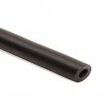
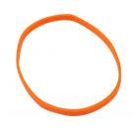
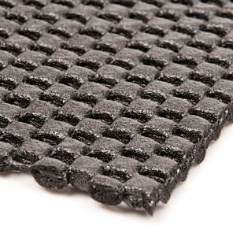
Structure: Other
Latex Tubing: Elastic
Rubber Bands (#32 or #64)
Zip Ties (4” and 11”)
Anti-Slip Math (Thin, Thick)

