Slide 1
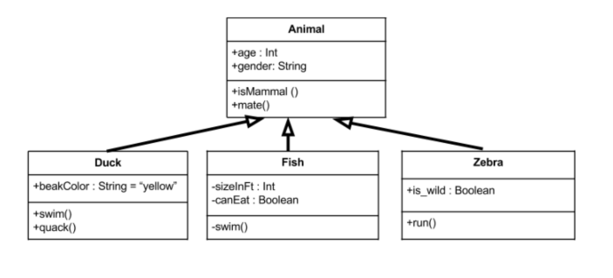
AP Java 3-9-2020
Strategies for success for FRQ
UML Diagrams
Marking Text

Slide 2
Learning targets
Be able to use a Unified Machine Language (UML) Diagram and text marking to help solve AP Free Response Questions (FRQs)

Slide 3
Program Design
Suppose you have to design a system.
Before implementing a bunch of classes, you’ll want to have a conceptual understanding of the system — that is,
what classes do I need?
What functionality and information will these classes have?
How do they interact with one another?
Who can see these classes?
And so on.
That’s where a Unified Machine Language (UML) class diagram can help

Slide 4
UML Diagrams
Class diagrams are a clever way of visualizing the classes in your system before you actually start coding them up.
They’re a static representation of your system structure

Slide 5
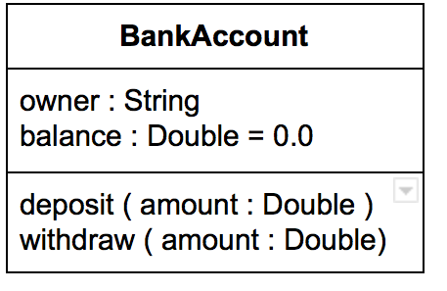
Getting Started with UML
Class Name
Instance Variables
Methods, including constructors
Diagram Parts
Each BOX Represents a class
+ public
- private
variableName:type
methodName(parameter:type):returnType

Slide 6
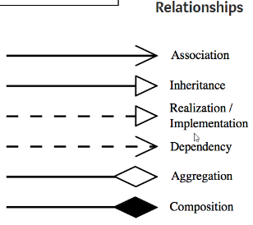
A system of classes

Slide 7
Attacking the Free Response Question
Mark the Text
Underline variables
Put boxes around the methods and associated descriptions
Circle the values returned
Mark the text up to part a)
Discuss with neighbor
Part a)
Part b)
Part c)
Create a UML Diagram for this question

Slide 8
Solve the problem
Write in BlueJ
Or
By hand

