Slide 1
Tank Game
Part 4 of 6

Slide 2
Description of the Pick up Weapons
Rocket
Behave like a shell, but automatically starts moving in the direction of the enemy tank.
We’ll set it up much like we did with the shells
Bouncing Bomb
Behaves like a shell, but bounces off of walls
Shields
Will let you temporarily make your tank invincible.

Slide 3
Making the Parent Rocket
1) Create Sprite
2) spr_rocket
3) Load Sprite
4) resources\chapter10\Rocket

Slide 4
Center the rocket Sprite
1) Center

Slide 5
Obj_rocket_parent
2) obj_rocket_parent
1) Create object
5) Set Alarm
4) Add Event
Create
6) Number of steps: 60
In alarm no.: Alarm 0
3) Parent: obj_shell_parent
7) OK

Slide 6
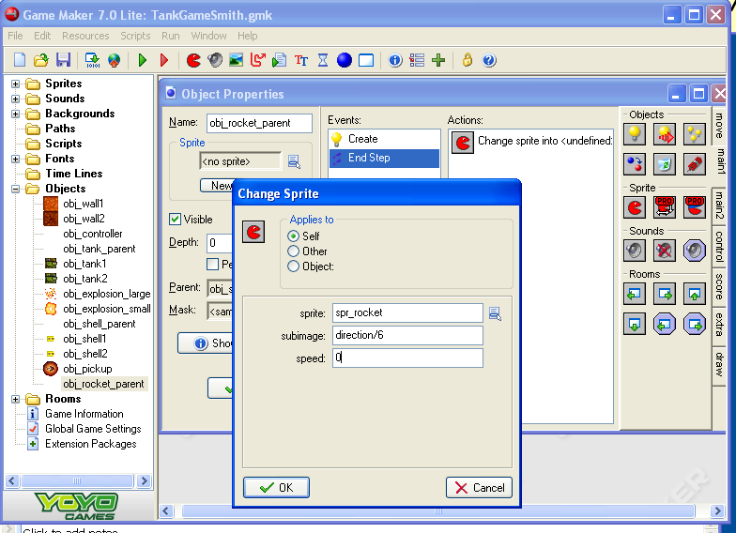
End step
4) Change Sprite
Add Event
Step
End step
5) Sprite: spr_rocket
Subimage: direction/6
Speed:0
6) OK

Slide 7
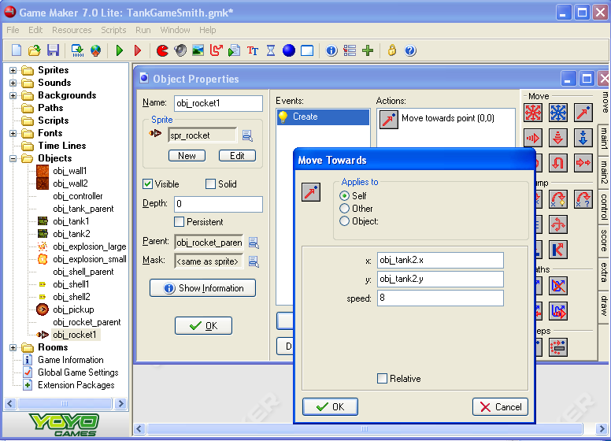
Obj_rocket1
2) obj_rocket1
1) Create Object
6) Move Towards
3) spr_rocket
7) x: obj_tank2.x
Y: obj_tank2.y
Speed: 8
4) Parent:obj_rocket_parent
5) Add Event
Create
8) OK

Slide 8
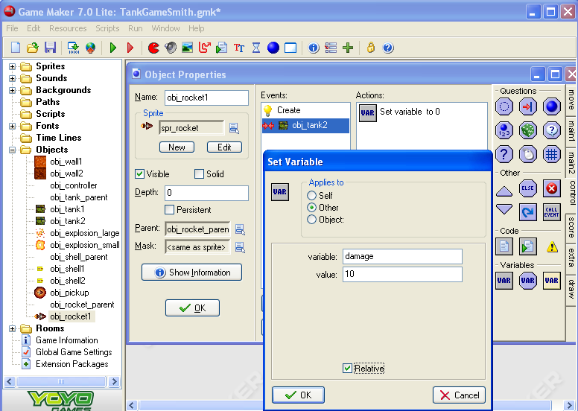
Rocket Hits Tank 2
4) Set Variable
Add Event
Collision
Obj_tank2
5) Applies to: Other
Variable: damage
Value: 10
6) Check the relative box
7) OK

Slide 9
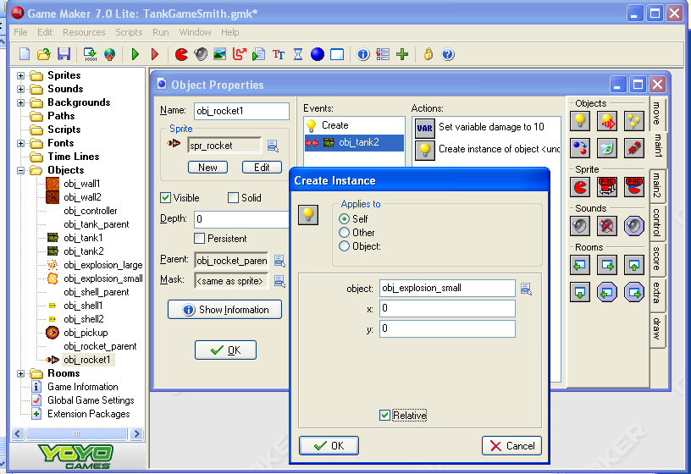
Small Explosion
1) Create Instance
2) Object: obj_explosion_small
X:0
Y: 0
3) Check the relative box
4) OK

Slide 10
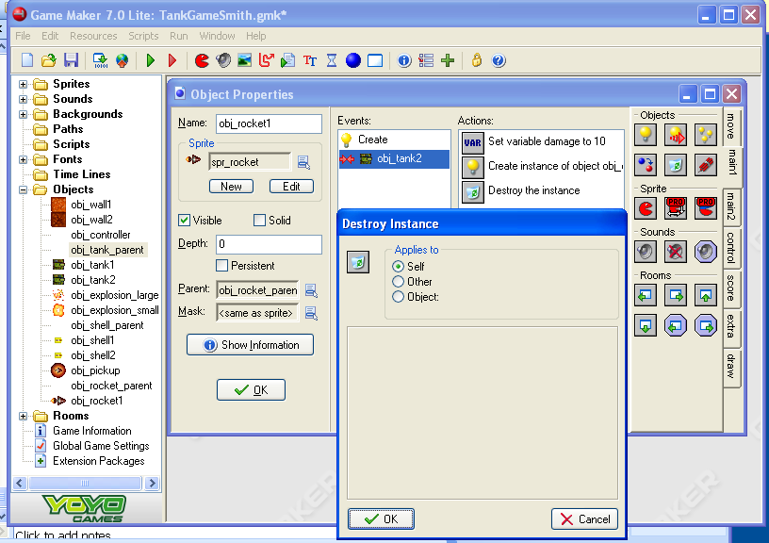
Destroy The rocket
1)Destroy Instance
2) OK

Slide 11
Now make obj_rocket2
Repeat slides 7-10
Next to have the tanks fire the rockets.
First check to see if the tank has a weapon and ammo in the Key Press event of the secondary fire key.
If they do, then create the rocket and decrease the ammunition.
When ammo reaches 0, set the weapon to -1 to disable it.

Slide 12
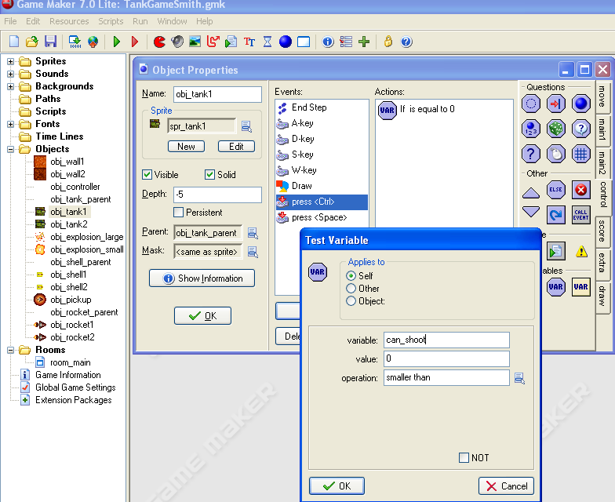
Tank1’s Shooter: If no ammo…
1) Open obj_tank1
3) Test Variable
2) Add Event
Key Press
<ctrl>
4) variable: can_shoot
Value: 0
Operation:smaller than
5) OK

Slide 13
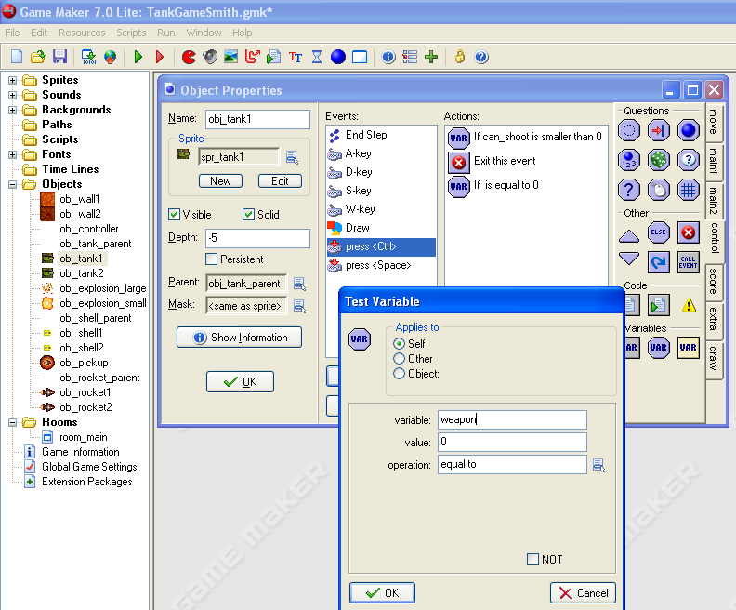
Exit or…if weapon = 0 (Rocket)…
1) Exit
3) Variable: weapon
Value: 0
Operation: equal to
2) Test Variable
4) OK

Slide 14
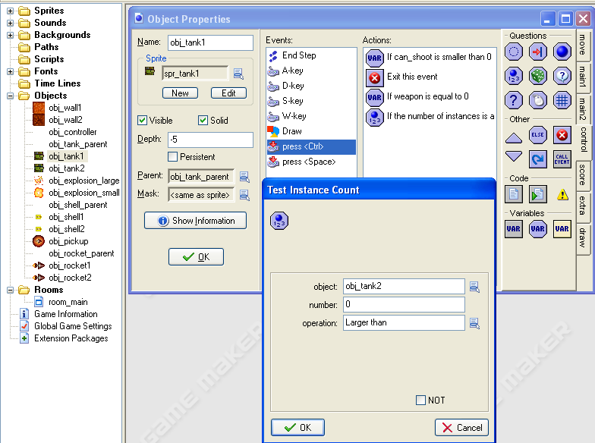
Can shoot, weapon = rocket, and if there is an obj_tank2 to shoot at…
1) Test Instance Count
2) object: obj_tank2
Number: 0
Operation: Larger than
3) OK

Slide 15
…Fire!!
1) Create Instance
2) object:obj_rocket1
X: 0
Y:0
3) Check the relative box.
4) OK

Slide 16
Lower the Ammo Count by 1
1) Set Variable
2) Variable: ammunition
Value: -1
3) Check the Relative Box
4) OK

Slide 17
If no more ammo…
1) Test Variable
2) Variable: ammunition
Value: 1
Operation: smaller than
3) OK

Slide 18
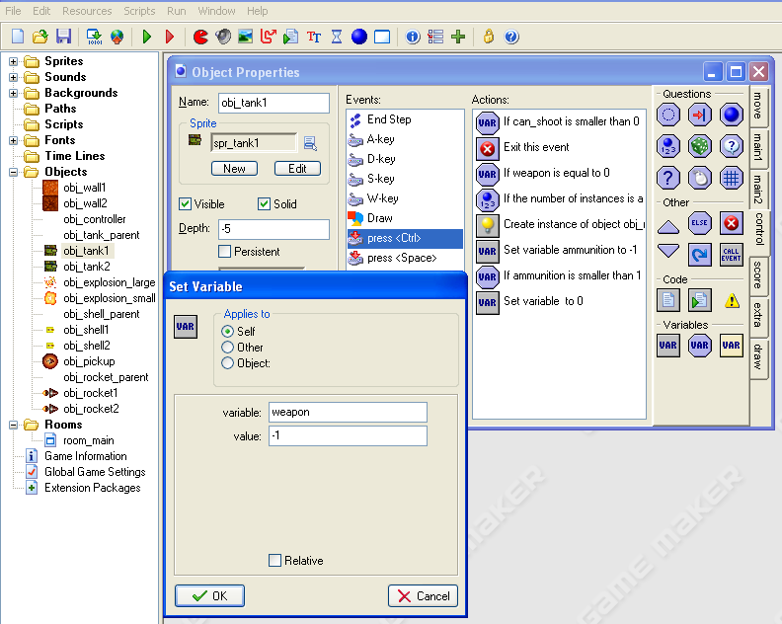
Then set the weapon to -1
1) Set Variable
2) variable: weapon
Value: -1
3) OK

Slide 19
Set Can_shoot = -10
1) Set Variable
2) variable: can_shoot
Value: -10
3) OK

Slide 20
Repeat Slides 12-19 for Tank 2 Add Event -> Key Press -> Others -> <Delete>
Test Variable action (If you can’t shoot then…_
Variable: can_shoot
Value: 0
Operation: smaller than
Add Exit Event action (… exit)
Test Variable action (If you have a weapon.._
Variable: weapon
Value: 0
Operation: equal to
Test Instance Count action (… and there is something to shoot at)
Object: obj_tank1
Number: 0
Operation: Larger than
Create Instance action (Shoot the rocket)
Obj_rocket2
Enable relative
Set Variable action (Minus 1 from the amount of ammo you have)
Variable: ammunition
Value: -1
Check the Relative box
Test Variable action (If you are now out of ammo…)
Variable: ammunition
Value: 1
Operation: smaller than
Set Variable action (…then set you can’t use the weapon)
Variable: weapon
Value: -1
Set Variable action (set can_shoot to -10)
Variable: can_shoot
Value: -10

Slide 21
Test it
Now when you pick up the Rocket item you should be able to shoot the rocket (CTRL, DEL) and it should go towards the enemy

