Slide 1
Tank Game
Part 2 of 6

Slide 2
Firing Shells
Coming up…
Players Scores
Large Explosions
Small Explosions
Damage
Health Bars
Parent Shell
Destructible Walls Reappear
Creating shell objects
Firing Events

Slide 3
Recording the Players score in the Controller Object
1) Create Font
2) fnt_score
3) Arial
4) Bold
5) Digits
6) OK

Slide 4
Setting The Scores
1) Open the obj_controller
2) Open the ‘Game Start’ event
3) Set Variable
4) variable: global.score1
value: 0
5) OK

Slide 5
Now Set Score2
1) Open the ‘Game Start’ event
2) Set Variable
3) variable: global.score2
value: 0
5) OK

Slide 6
Draw Event for Setting the Font
1) Add Event
Draw
2) Set Font
3) Font: fnt_score
Align: right
4) OK

Slide 7
Make it Dark Red
1) Set Color
2) Click Here
3) Select Dark Red
4) Ok, OK

Slide 8
Draw the score1 Variable
1) Draw Variable
2) variable: global.score1
X: 300
Y: 10
3) OK

Slide 9
Set Font to Align Left
1) Set Font
2) Font: fnt_score
Align: left
3) OK

Slide 10
Make it Blue
1) Set Color
2) Click Here
3) Select Dark Blue
4) OK, OK

Slide 11
Draw score2
1) Draw Variable
2) Variable: global.score2
C: 340
Y:10
3) OK

Slide 12
Summary of Draw Event

Slide 13
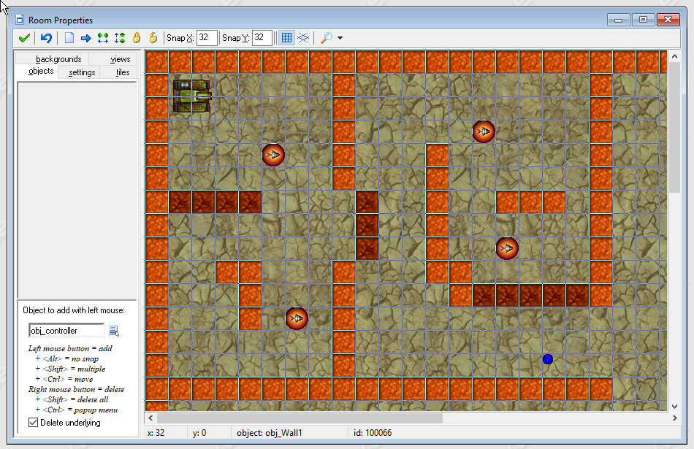
Now Add a Controller Object to your Room
Since the controller object does not have an associated sprite it will only show up as a question mark.

Slide 14
Explosions!!
2) spr_explosion_large
1) Create a sprite
3) Load
Explosionlarge from resources/chapter10
4) Center

Slide 15
Large Explosion Sound
1) Create Sound
2) snd_explosion_large
4) Explosion_large
3) Load Sound
5) Open
6) OK

Slide 16
obj_explosion_large
1) Create Object
2) obj_explosion_large
3) snd_explosion_large
6) PlaySound
4) depth: -10
7 Sound: snd_explosion_large
Loop: false
5) Create Event
8) OK

Slide 17
Animation End
Add Event
Other
Animation end

Slide 18
Restart Room
1) Restart Room
2) You can add a transition if you would like
3) OK
Notes:
Error: obj_explosion_large, end game, restart current room- Slide 52

Slide 19
Small Explosion Object
1) Create Sprite
2) spr_explosion_small
3) Load Sprite
Resources/chapter10/Explosion_small
4) Center the origin

Slide 20
Explosion Small Sound
1) Create Sound
2) snd_explosion_small
3) Load Sound
Resources/chapter10/Explosion_Small

Slide 21
Obj_explosion_small
1) Create Object
2) obj_explosion_small
6) Play sound
3) spr_explosion_small
7) snd_explosion_small
Loop: false
4) Depth: -10
5) Add Event
Create

Slide 22
Animation End Event
Add Event
Other
Animation end

Slide 23
Destroy Instance
1) Destroy Instance
2) OK

Slide 24
Time For Damage
The Parent Tank object will be responsible for initializing the damage variable, checking for damage, and drawing the tank’s health bar on the screen.
It will also be responsible for blowing up the tank when the damage reaches 100.
But... Since the parent is the parent to both tanks we need a mechanism for determine who gets the points for the kill

Slide 25
Parenting
object_index is a variable that records a number corresponding to the type of object it is.
Every object has its own unique number which is accessed by using the object name as a variable (object_tank1, object_tank2, …)
By competing object_index with obj_tank1 we can tell if the instance is an instance of player one’s tank or an instance of player two’s.

Slide 26
Stepping into Damage
We’ll check the tank’s damage in the Step event of the parent tank object and increase the appropriate score if it is larger than 100.
Then we’ll create a large explosion and destroy the tank.
The large explosion will automatically restart the room once the animation is finished.

Slide 27
Damaging Parents
1) Open obj_tank_parent
2) Open the Create event
3) Set Variable
4) Variable: damage
Value:0
5) OK

Slide 28
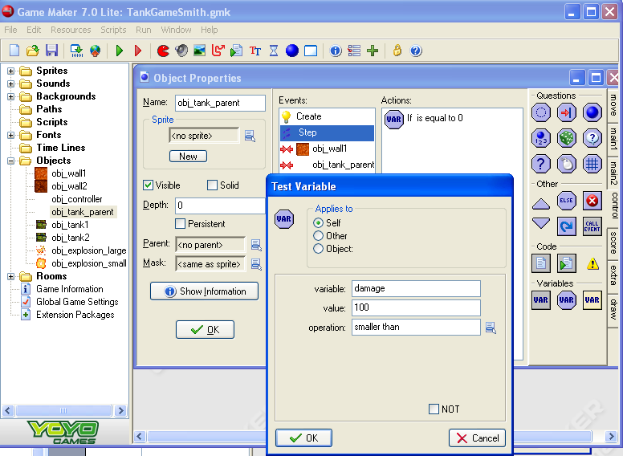
Checking Damage
4) Test Variable
5) Variable: Damage
Value:100
Operation: smaller than
Add Event
Step
Step

Slide 29
Exit if Damage < 100
1) Exit

Slide 30
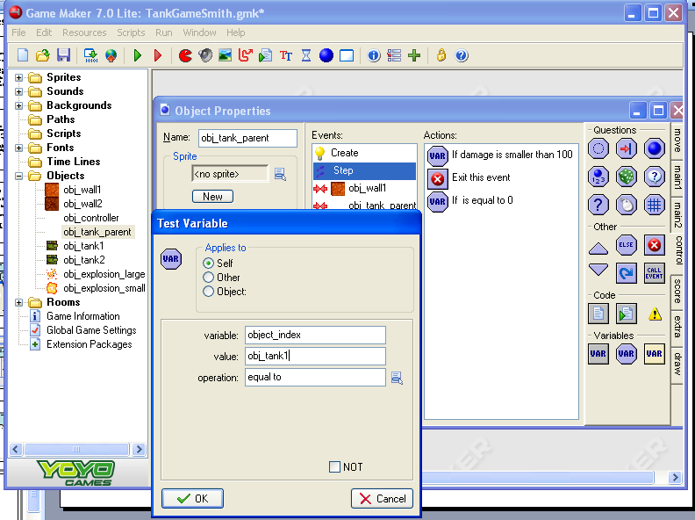
Check the Index
2) variable:
object_index
Value: obj_tank1
Operation: equal to
1) Test Variable
3) OK

Slide 31
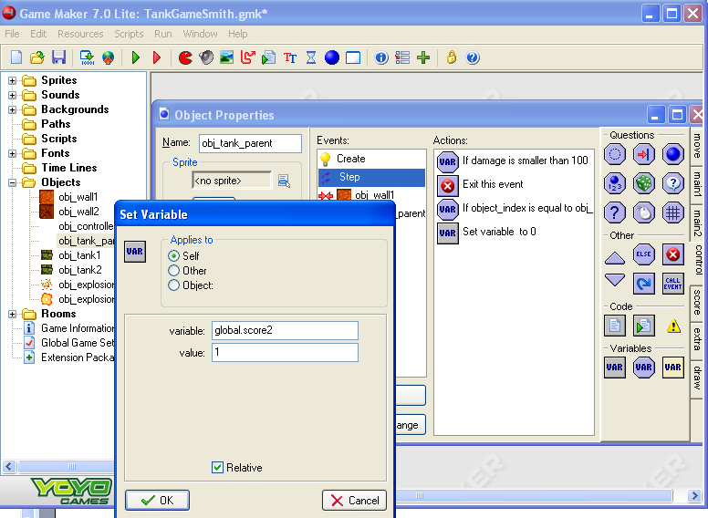
If Tank1 is shot, add 1 to tank_2’s score
1) Set Variable
2) variable: global.score2
Value:1
4) OK
3) Check the relative box.

Slide 32
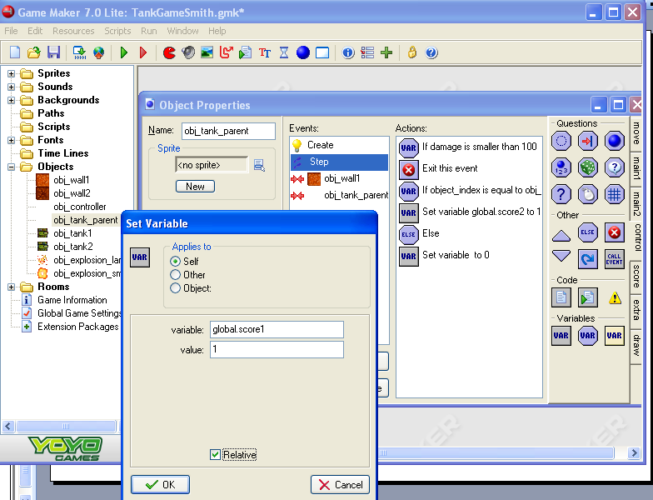
Else add 1 to tank_1’s score
1) Else
2) Set Variable
3) variable: global.score1
Value: 1
5) OK
4) Check the Relative box

Slide 33
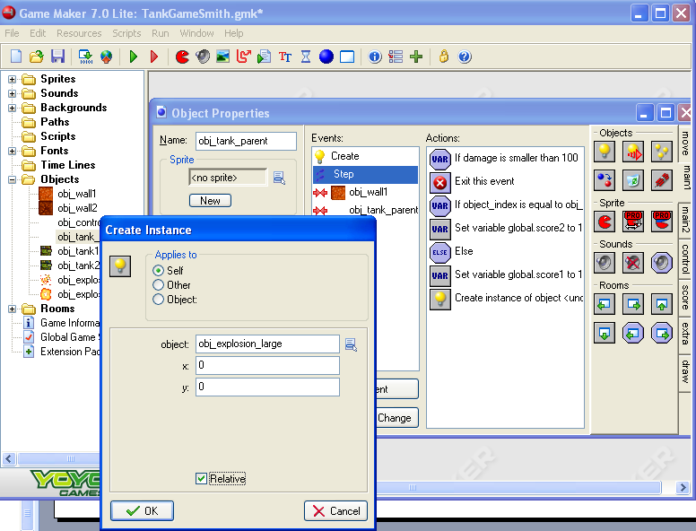
Explode!!!!!!
1) Create Instance
2) object: obj_explosion_large
4) OK
3) Check the Relative box

Slide 34
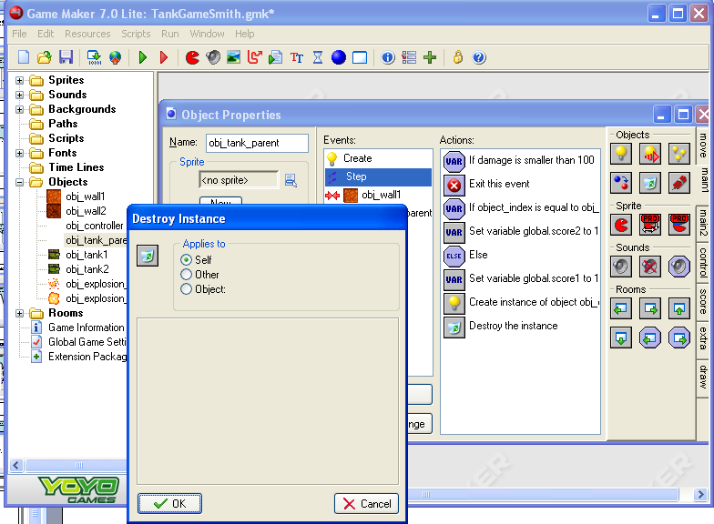
Destroyed!
1) Destroy Instance
2) OK

Slide 35
Parents and Health Bars
It would be easiest to use draw the health bar form the parent, but the two tanks have their own draw events which would take priority. So…
We will use the Call Parent event action in the two tanks’ own Draw event to make sure that the parent’s Draw event is called as well.

Slide 36
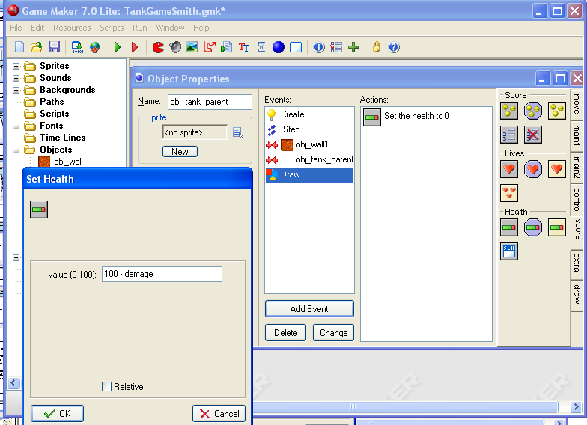
Setting Health
1) Still in the obj_tank_parent
3) Set health
4) 100 - damage
2) Add Event
Draw
5) OK

Slide 37
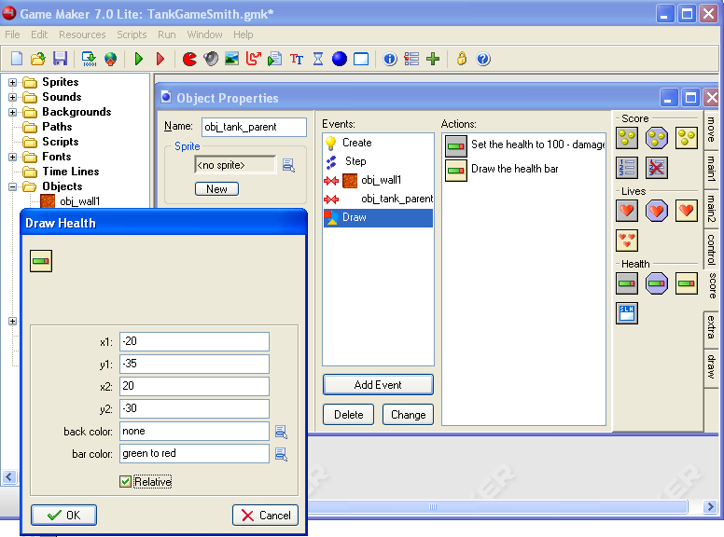
Drawing Health
1) Draw Health
2)
X1: -20
Y1: -35
X2: 20
Y2: -30
4) OK
This will draw the tank’s health bar just above the tank itself.
3) Check the Relative Box

Slide 38
Phone Home
1) Open obj_tank1
2) Open the Draw Event
3) Call Parent
4) OK

Slide 39
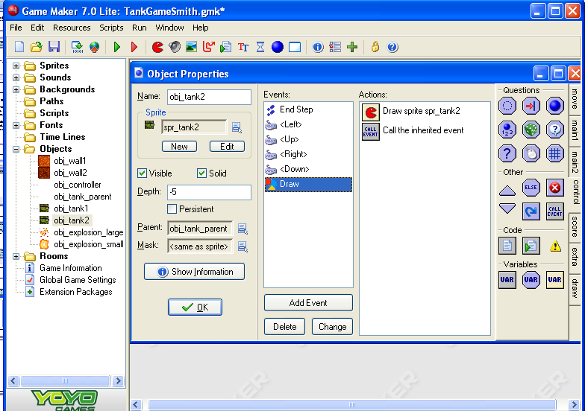
Do the same with Tank2
1) Open obj_tank2
2) Open the Draw Event
3) Call Parent
4) OK

Slide 40
Now to the Shells
Only want the tank shells to damage the opponent
We will create a separate shell object for each tank and put common behavior in a shell parent object
We’ll also use an alarm clock to give shells a limited life span( ie range)
Alarm clocks will also be used to temporarily demolish the second wall type when they are hit by shells.
We’ll move the walls outside the room and use an alarm event to bring them back to their original position after a period of time.

Slide 41
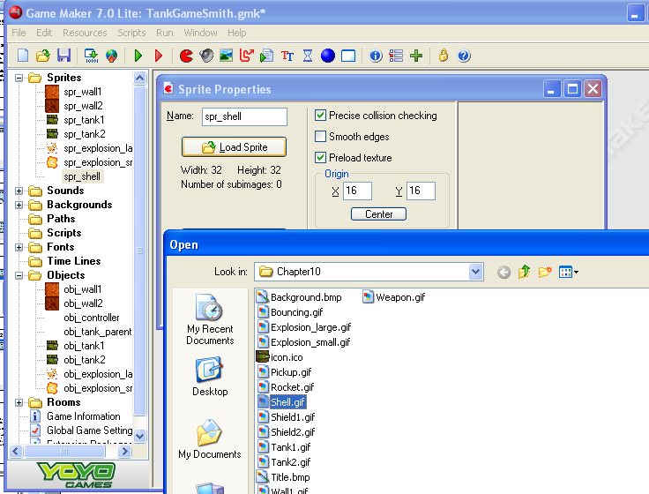
Parent Shell
1) Create Sprite
2) spr_shell
3) Load Sprite: resources\chapter10\Shell.gif
4) center

Slide 42
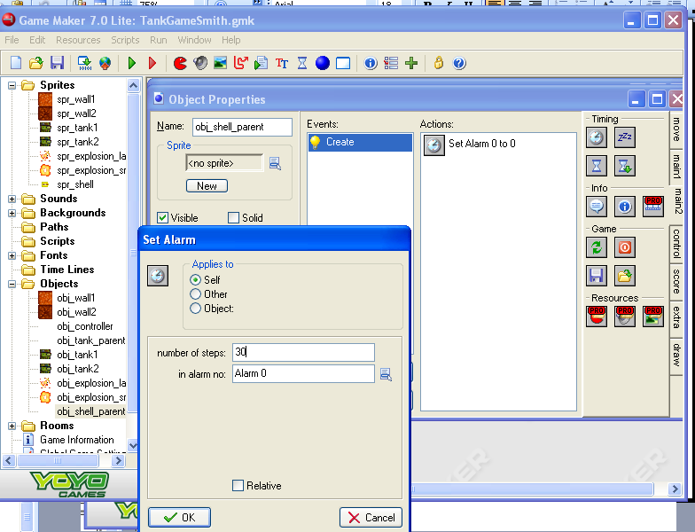
Obj_shell_parent…Alarm
5) Create Alarm
1) Create Object
3) No sprite
2) obj_shell_parent
4) Add event, Create
5) Number of Steps: 30
6) OK

Slide 43
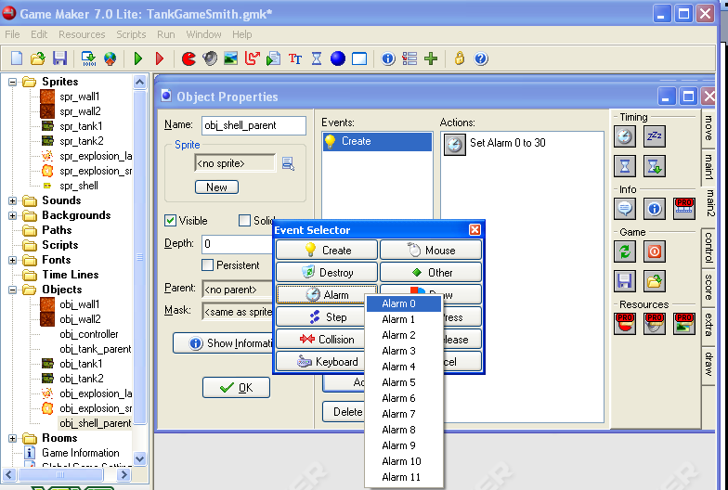
Add Alarm Event
2) Alarm
Alarm 0
1) Add Event

Slide 44
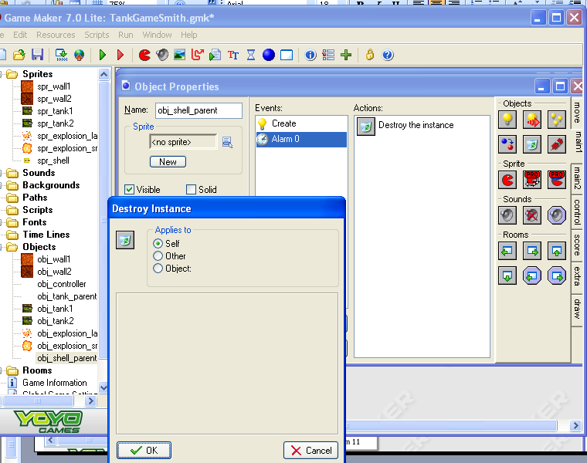
Destroy
1) Destroy Instance
2) OK

Slide 45
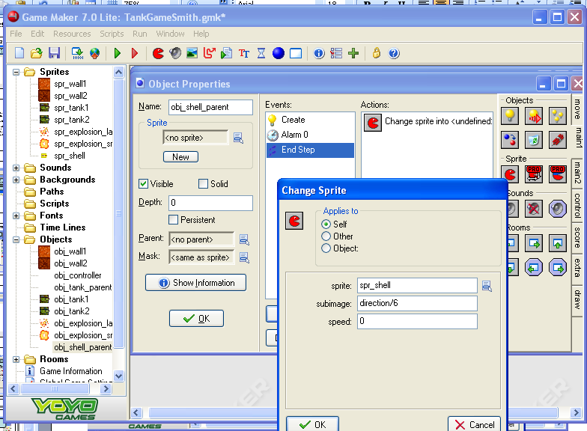
End Step
4) Change Sprite
5) sprite: spr_shelll
Subimage: direction/6
Speed: 0
Add Event
Step
End Step

Slide 46
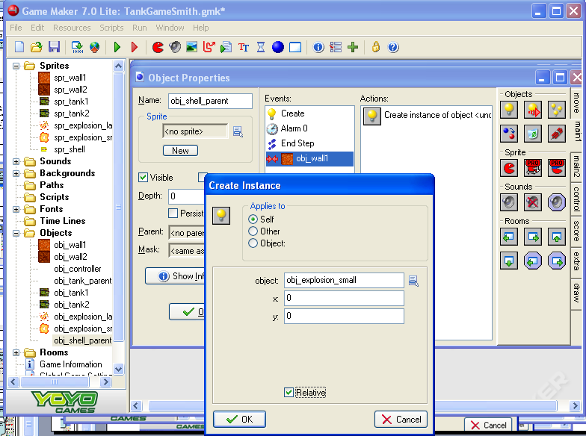
Small Explosion
4) Create Instance
Add Event
Collision
Obj_wall1
5) object: obj_explosion_small
6) Check

Slide 47
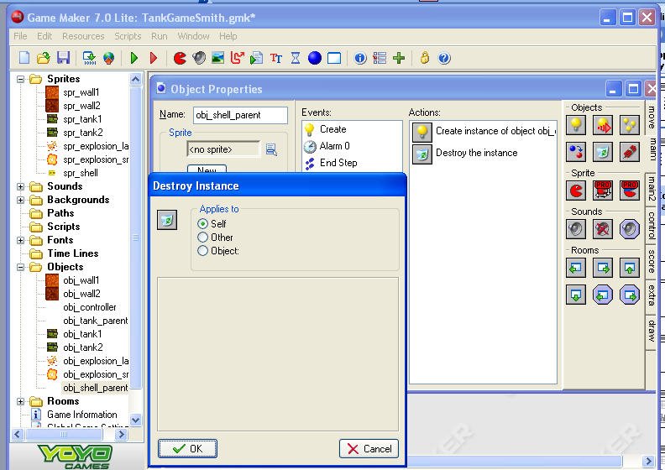
Destroy the Shell
1) Destroy Instance
2) OK

Slide 48
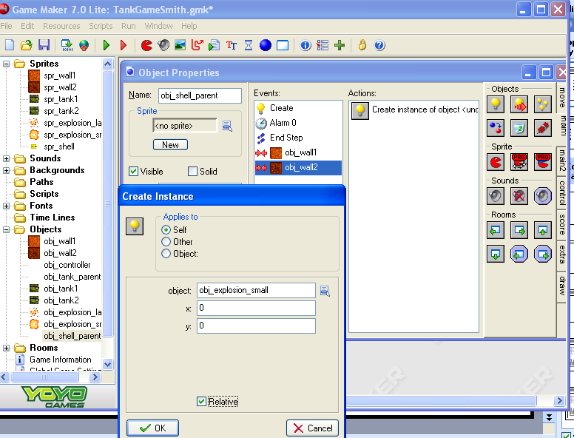
Hitting Wall2
4) Create Instance
Add Event
Collision
Obj_wall2
5) obj_explosion_small
7) OK
6) Check the Relative Box

Slide 49
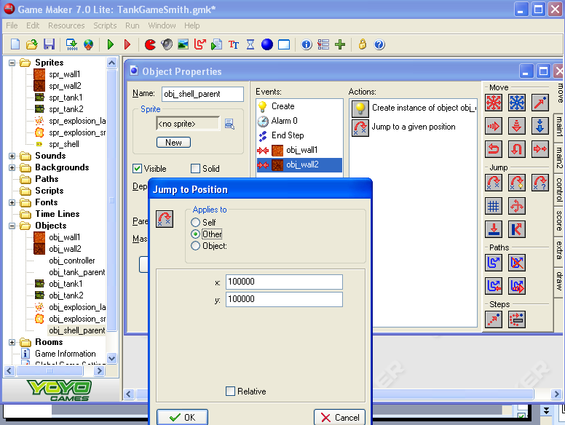
Move the Wall
1) Jump to Position
2) Applies to Other
3) x: 100000
Y: 100000
4) OK

Slide 50
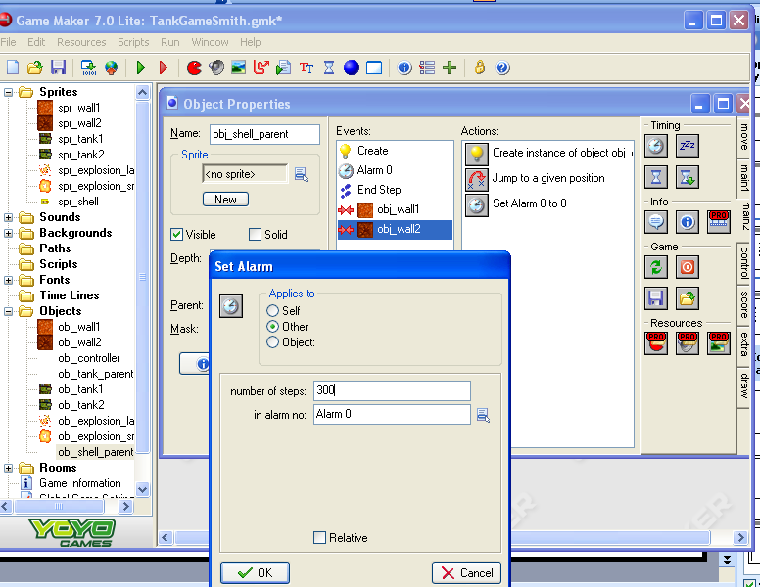
Set Alarm for the Wall
1) Set Alarm
2) Applies to: OTHER
3) Number of steps: 300
In alarm no: Alarm 0
4) OK

Slide 51
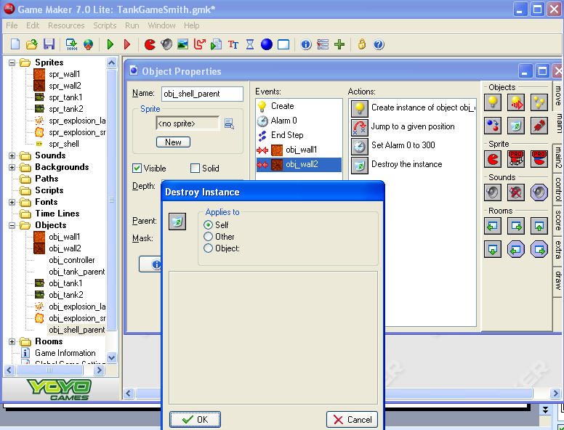
Destroy the Shell
1) Destroy Instance
2) OK

Slide 52
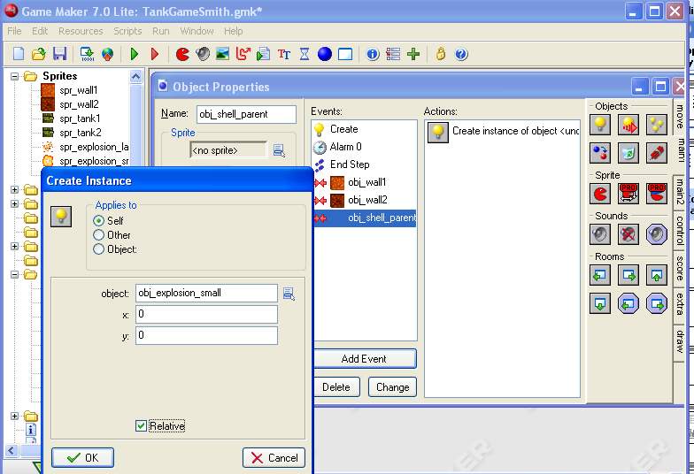
Shell Hitting Shell
Add Event
Collision
Obj_shell_parent
4) Create Instance
5) Obj_explosion_small
7) OK
6) Check the Relative box

Slide 53
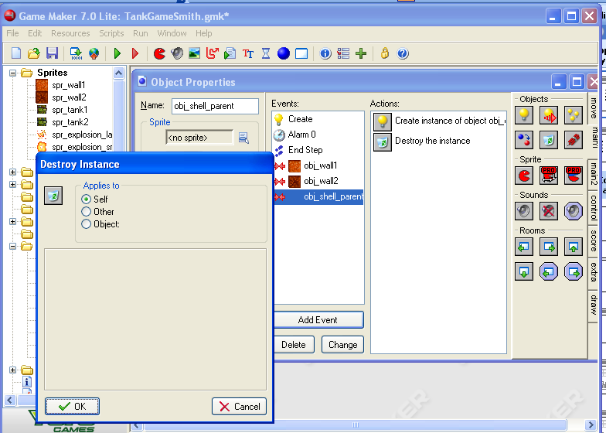
Destroy Shell
1) Destroy Instance
2) OK

Slide 54
Where’s Wall2-y?
Now we need to have obj_wall2 return.

Slide 55
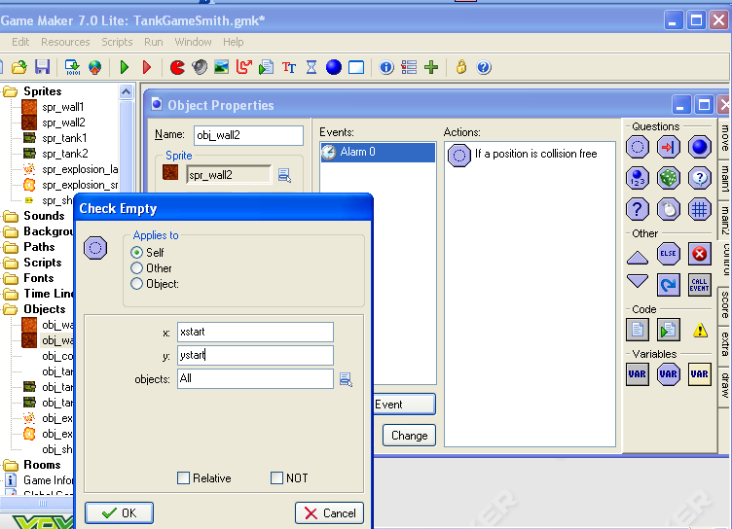
Check if old spot is Empty
2) Add Event
Alarm
Alarm 0
3) Check Empty
1) Open obj_wall2
4) x: xstart
Y: ystart
Objects: ALL
5) All

Slide 56
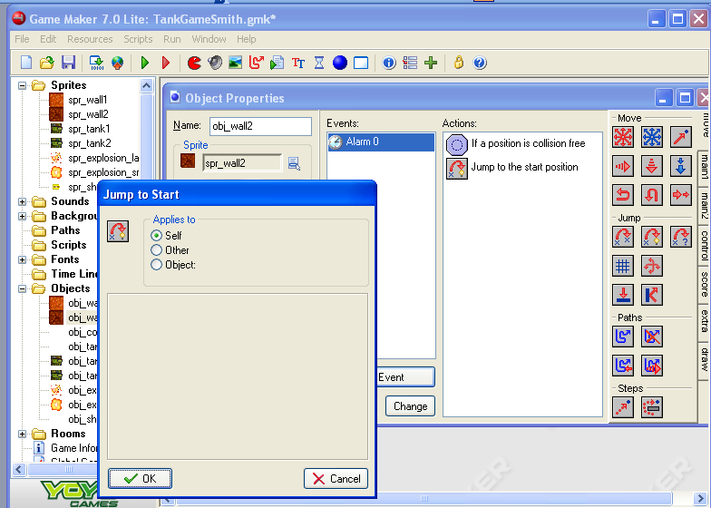
Jump to Start
1) Jump to Start
2) OK

Slide 57
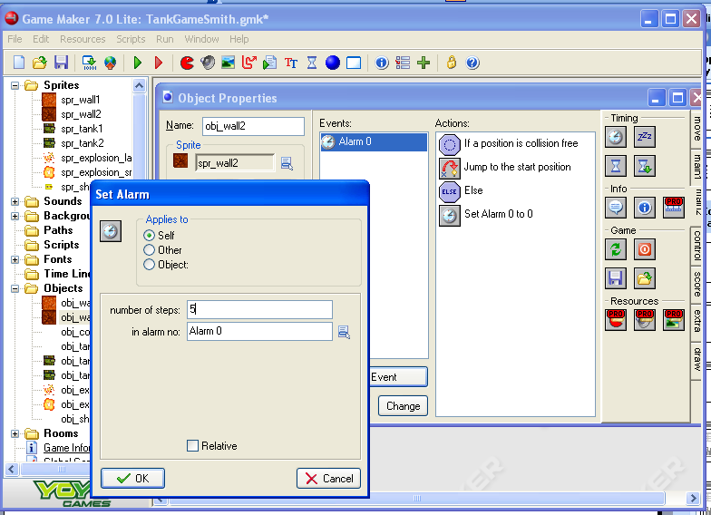
Else Have the Alarm Count Down 5
1) Else (in the control tab)
3) Number of steps: 5
In alarm no: Alarm 0
2) Set Alarm
4) OK

Slide 58
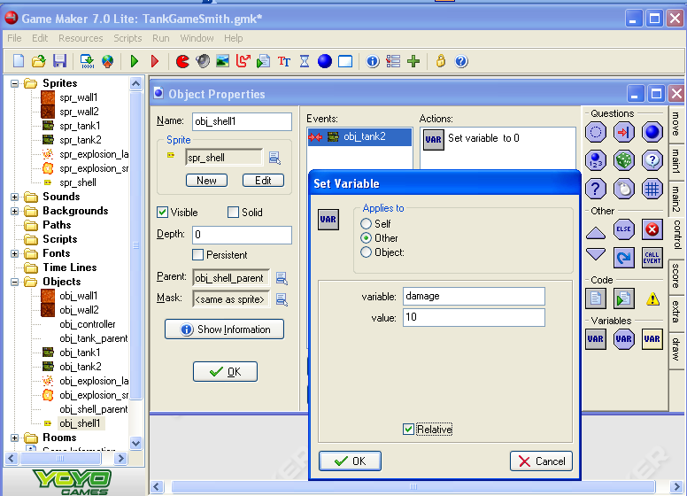
Obj_shell1
1) Create Object
2) obj_shell1
3) spr_shell
6) Set Variable
4) obj_shell_parent
7) Other
5) Add Event
Collision
Obj_tank2
8) Variable: damage
Value 10
9) Check the Relative box.
10) OK

Slide 59
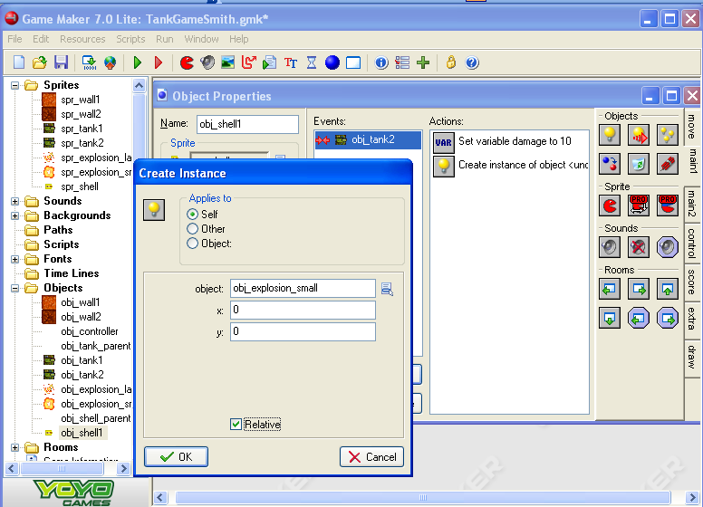
Create Small Explosion
1) Create Instance
2) obj_explosion_small
3) Check the Relative box.
4) OK

Slide 60
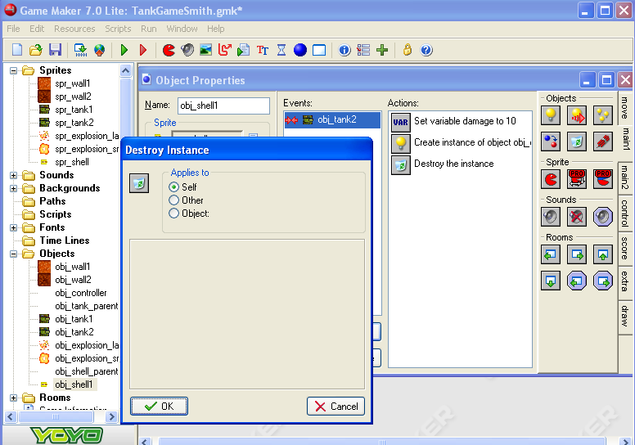
Destroy the Shell
1) Destroy Instance
2) OK

Slide 61
For the Other Shell
Do the same for Shell2
Copy duplicate obj_shell1
Rename it as obj_shell2
On the Collision event, right click -> Change Event -> Collision -> obj_tank1

Slide 62
Fire in the Hole
Now to make the tanks fire shells
Tank1 will fire obj_shell1 when the space bar is pressed.
Tank2 will shoot obj_sheel2 when the Enter key is pressed
We’ll also limit the speed with which the player can fire shells using a can_shoot variable
To create bullets moving in the same direction as the tank, we will use the Create Moving action and pass in the tank’s own direction variable.

Slide 63
Tank Shooting Events
3) Set Variable
1) Open the obj_tank_parent
2) Select the Create event.
4) variable: can_shoot
Value: 0
5) OK

Slide 64
Each Step add to can_shoot
1) Put a Set Variable on the top of the actions list.
2) Variable: can_shoot
Value: 1
4) OK
3) Check the relative box

Slide 65
Obj_tank1 Key Press – Space Bar for shooting
Add Event
KeyPress
<space>

Slide 66
Check can_shoot
1) Test Variable
2) variable: can_shoot
Value_0
Operation: smaller than
3) OK

Slide 67
Exit

Slide 68
Start the shell
1) Create Moving
2) object: obj_shell1
X: 0
Y: 0
Speed: 16
Direction: direction
3) Check Relative
4) OK

Slide 69
Set the can_shoot to -10
1) Set Variable
2) variable: can_shoot
Value: -10
3) OK

Slide 70
Now for Tank2
Repeat slides 65-69 for Tank2 but use the Key Press <Enter> event and obj_shell2 for the create moving.

Slide 71
Time For Testing and Correcting
Do both tanks drive correctly?
Do the scores show up in red and blue?
Do the health bars work?
What happens when one tank destroys another tank?
When you shoot an obj_wall2 does it disappear and return later?
…

