Slide 1
Tank Game
Part 5 of 6

Slide 2
Bouncing Bomb Objects
Behaves like a shell, but bounces off of walls

Slide 3
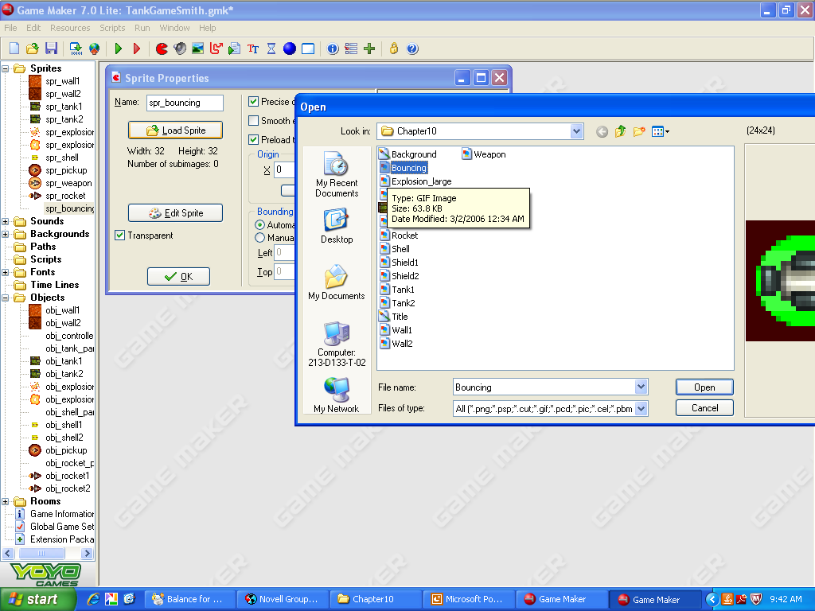
Create Bouncing Sprite
1) Create Sprite
2) spr_bouncing
4) bouncing
3) Load Sprite

Slide 4
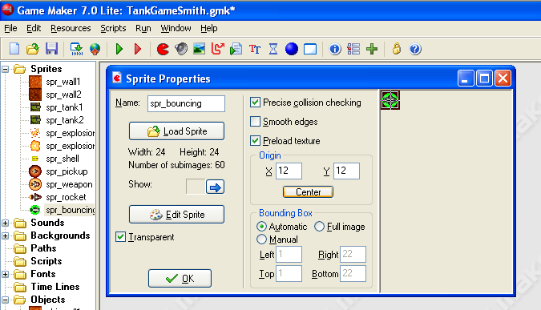
Center the Origin
1) Center

Slide 5
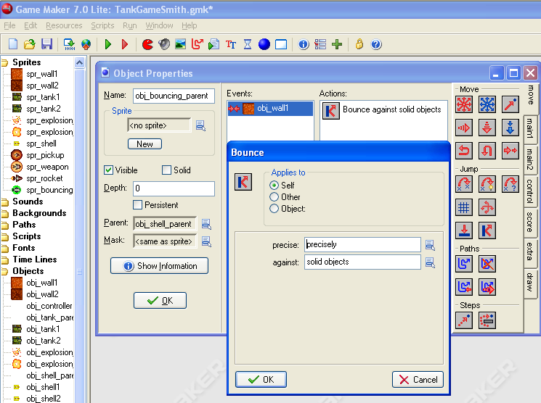
Obj_bouncing_parent
2) obj_bouncing_parent
1) Create Object
5) Bounce
3) Parent: obj_shell_parent
6) Precisely
4) Add Event
Collision
Obj_wall1
7) Solid Objects
8) OK

Slide 6
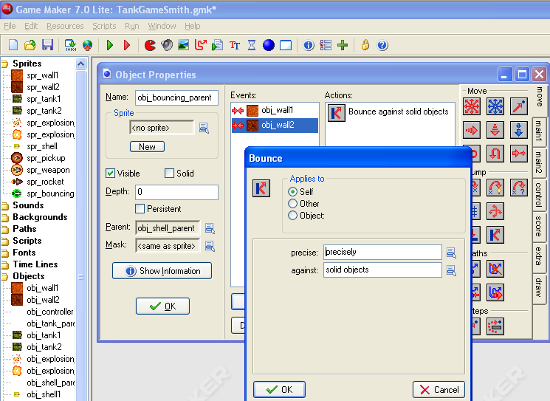
Also Collision with obj_wall2
4) bounce
5) Precisely
Solid Objects
Add Event
Collision
Obj_wall2
6) OK

Slide 7
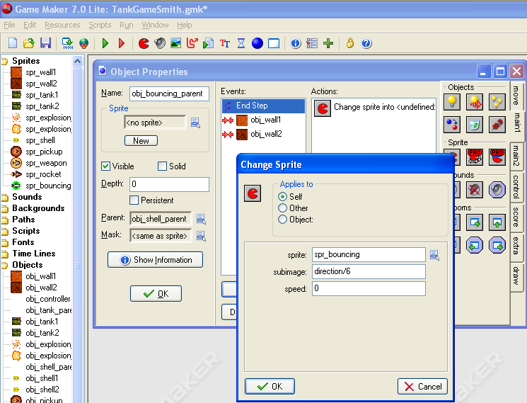
End Step for Direction
4) Change Sprite
Add Event
Step
End step
5) sprite: spr_bouncing
Subimage: direction/6
Speed: 0
6) OK

Slide 8
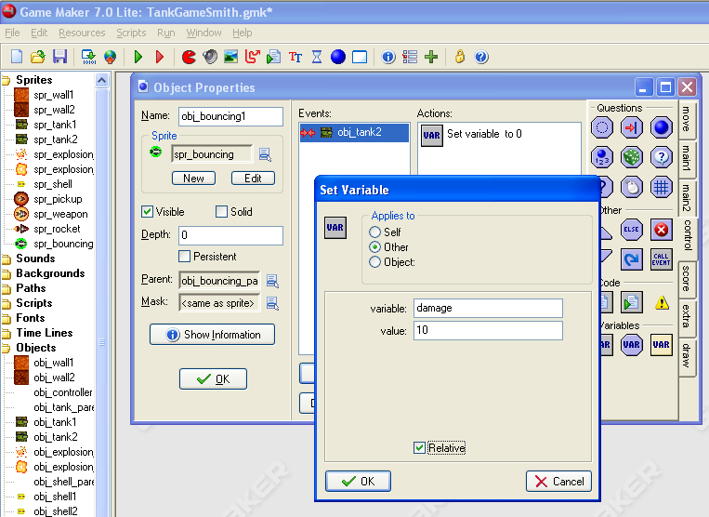
Obj_bouncing1
2) obj_bouncing
1) Create Object
3) spr_bouncing
5) Set Variable
5) Add Event
Collision
Obj_tank2
7) Check the relative box
6) Applies to: Other
Variable: damage
Value: 10
4) parent:obj_bouncing_parent
8) OK

Slide 9
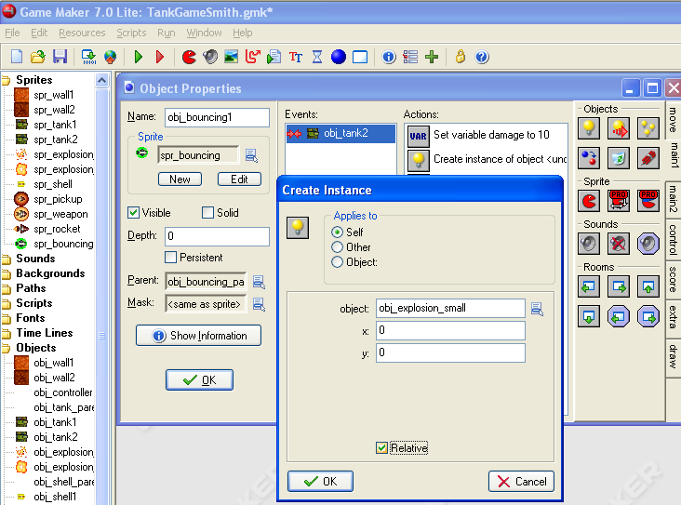
Create a Small Explosion
1)Create Instance
2) obj_explosion_small
3) Check the relative box
4) OK

Slide 10
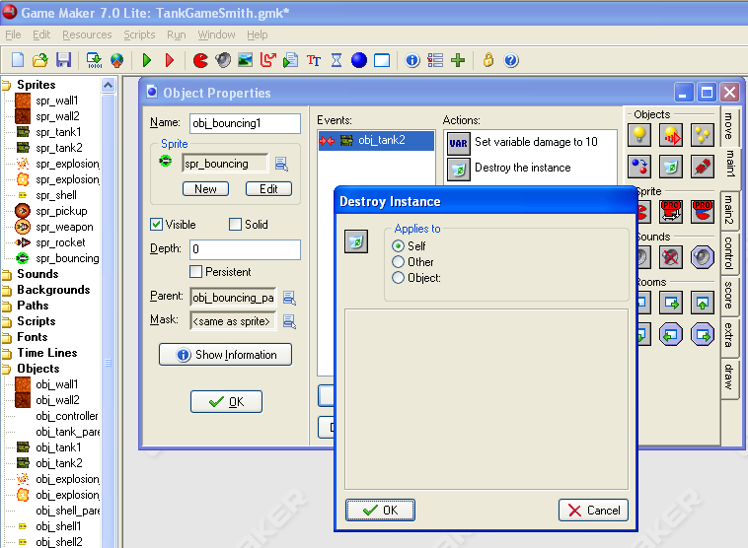
Destroy Instance
1) Destroy Instance
2)OK

Slide 11
Repeat for obj_bouncing2
Slides 8-10 but the collision event will be with obj_tank1

Slide 12
The Shield
Before we add actions for the tank shooting the bouncing shells, we’ll create the shield
Shield = Invincible
  Set a variable shield to 40 and have it count down to 0 to keep track of how long you will be invincible.
  Shield will be decreased each step.
  The shield will be checked each time the tank is hit to determine and increase the damage only if the shield is 0.

Slide 13
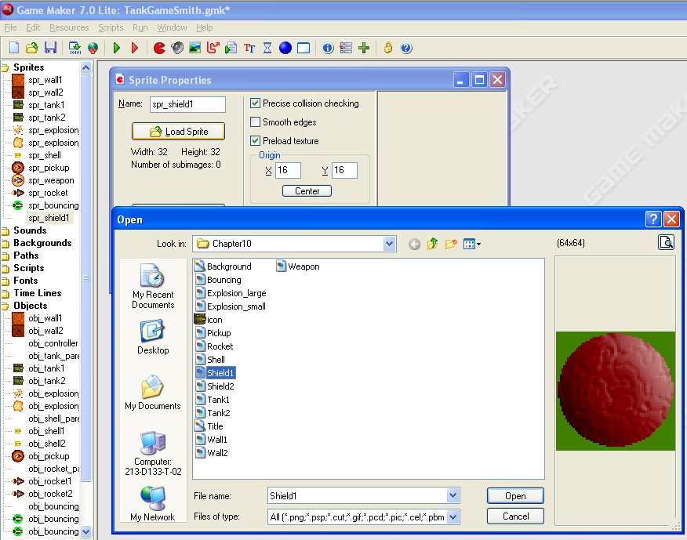
Create Shield1 Sprite
1) Create Sprite
2) spr_shield1
4) Center the Origin
3) Load Sprite
Shield1

Slide 14
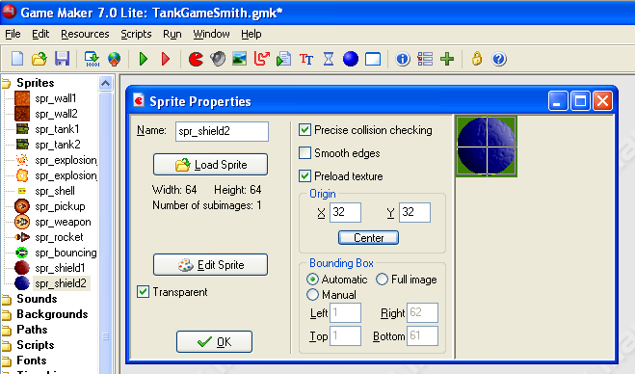
Shield2 Sprite
1) Create Sprite
2) spr_shield2
4) shield2 sprite
3) Load Sprite
5) Center

Slide 15
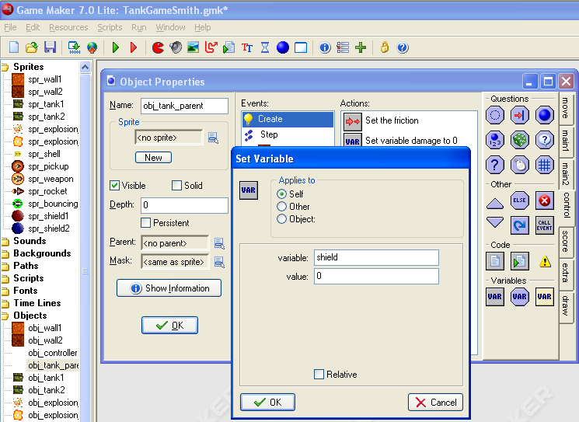
Open the obj_tank_parent
1) obj_tank_parent
2) Select the Create event
3) Set Variable
4) variable: shield
Value: 0
5) OK

Slide 16
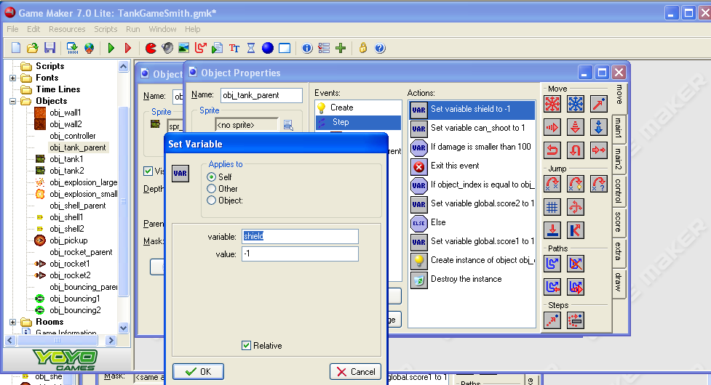
Modify the step method
1) Select the Step event
2) Place the Set Variable action on the top of the list of actions.
3) Variable: shield
Value: -1
4) Check the relative box
5) OK

Slide 17
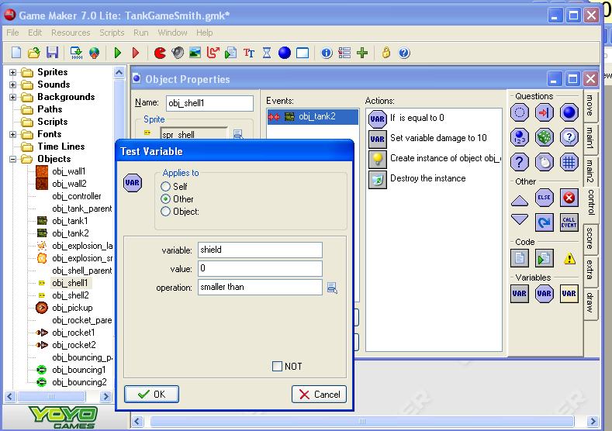
Obj_shell1 Collision with obj__tank2
2) Put a Test Variable action BEFORE the Set variable damage to 10 action.
1) Open obj_shell1
3) Applies to Other
4) variable: shield
Value: 0
Operation: smaller than
5) OK
Now the damage will only be increased when the tank has no shield.

Slide 18
Repeat
Now you need the shield to protect the tanks from the other weapons.
To do this…
Repeat the previous slide for obj_shell2, obj_rocket1, obj_rocket2, obj_bouncing1 and obj_bouncing2 collision events with the enemy tank.
The next few slides provide descriptions.

Slide 19
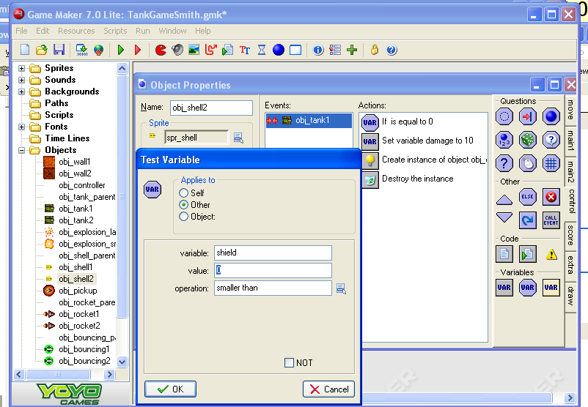
Obj_shell2

Slide 20
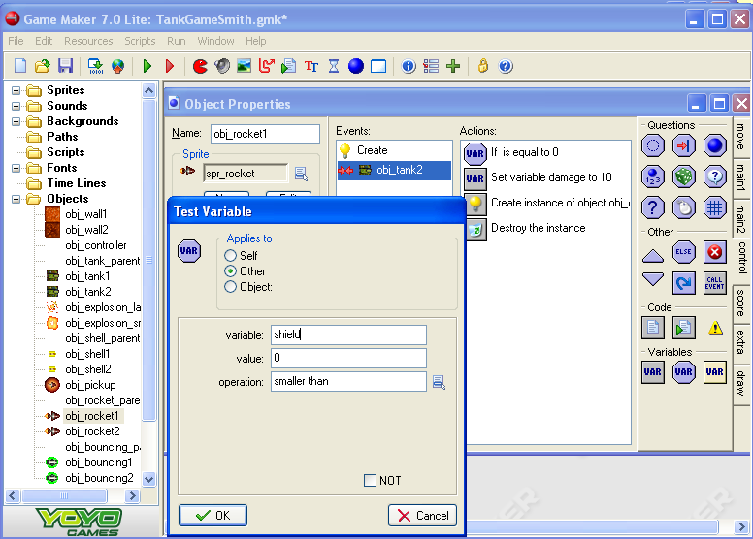
Obj_rocket1

Slide 21

Obj_rocket2

Slide 22
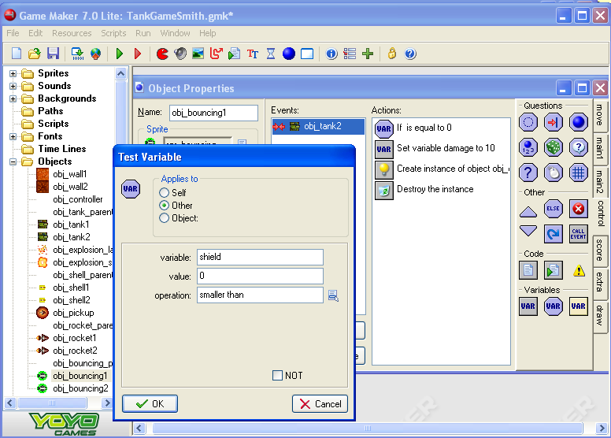
Obj_bouncing1

Slide 23

Obj_bouncing2

Slide 24
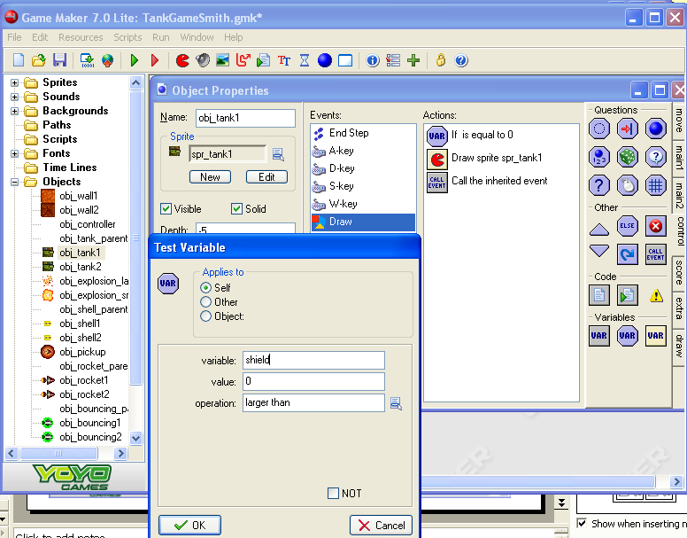
Show Shield on Tank1
1) Open obj_tank1
2) Open the Draw event.
3) Add a Test Variable action to the top of the actions list.
4) variable: shield
Value:0
Operation: larger than
5) OK

Slide 25
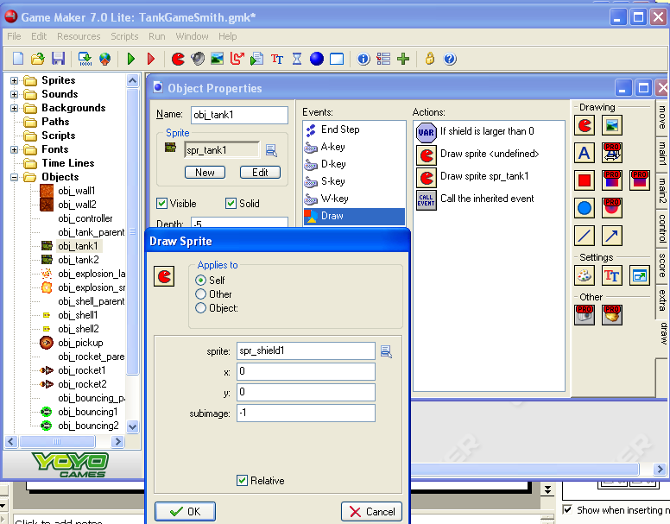
Draw the Shield
1) Select the Draw tab
2) Place a Draw Sprite action just under the Test Variable action
3) sprite: spr_shield
4) Check the Relative box
5) OK

Slide 26
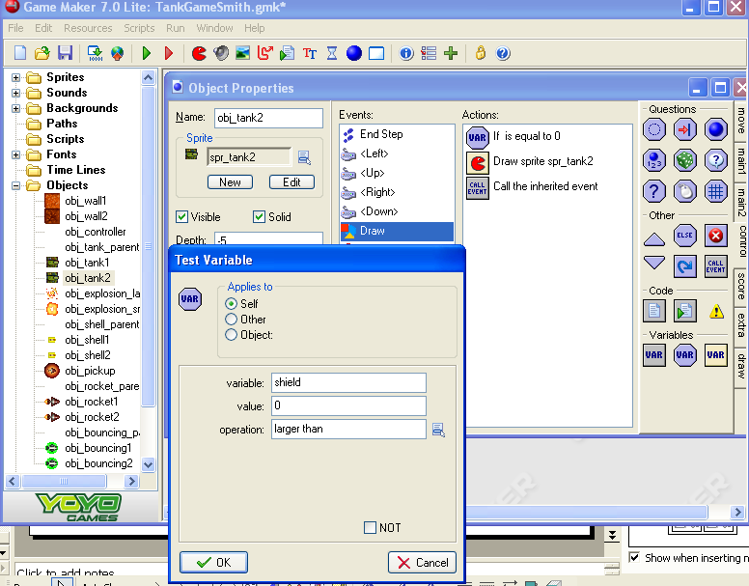
Now to repeat for Tank2

Slide 27

Draw Shield2 Sprite

Slide 28
Now…
Adapt the tanks so that both the bouncing bombs and the shields can be used

Slide 29
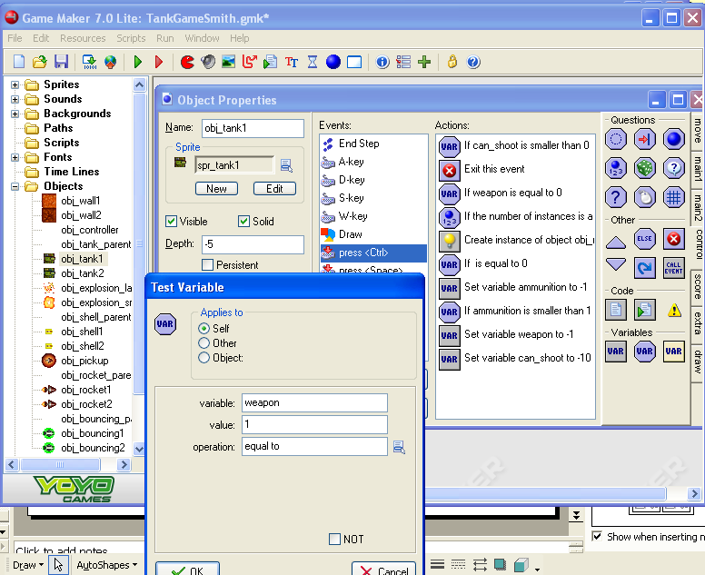
Test for a bouncing weapon
3) Place a ‘Test Variable’ action just after the Create instance action.
1) Open obj_tank1
2) Open the press<ctrl> event
5) OK
4) variable:weapon
Value: 1
Operation: equal to

Slide 30
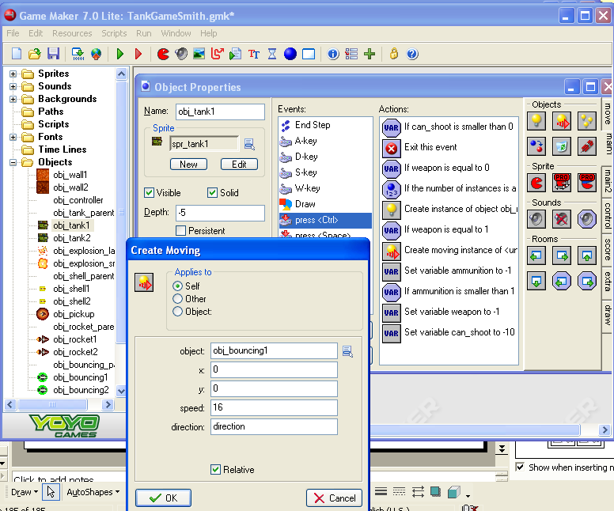
Create obj_bouncing1
1) Add a ‘Create Moving’ action right after the Test Variable weapon action.
3) Check the Relative box.
4) OK
2) Applies to obj_bouncing1
Speed:16
Direction: direction

Slide 31
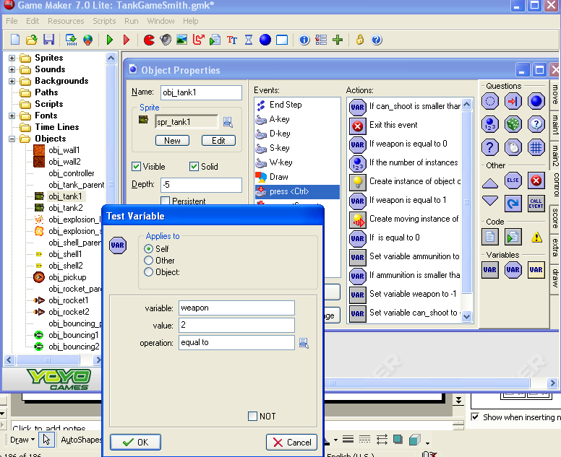
Checking for a shield
1) Put a ‘Test Variable’ action under the last ‘Create Moving Action’
3) OK
2) variable: weapon
Value: 2
Operation: equal to

Slide 32
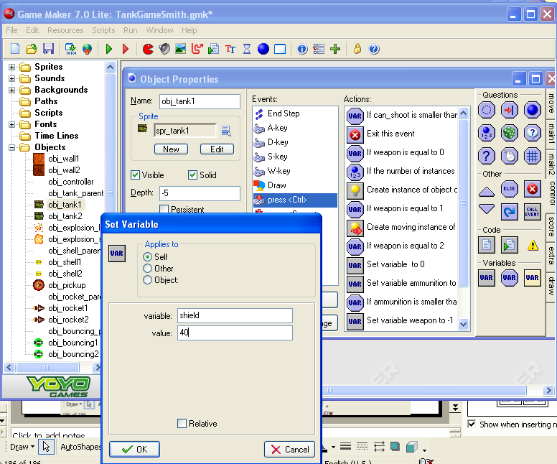
Set the Shield Variable
1) Set Variable just below the Test Variable
2) variable: shield
Value: 40
3) OK

Slide 33
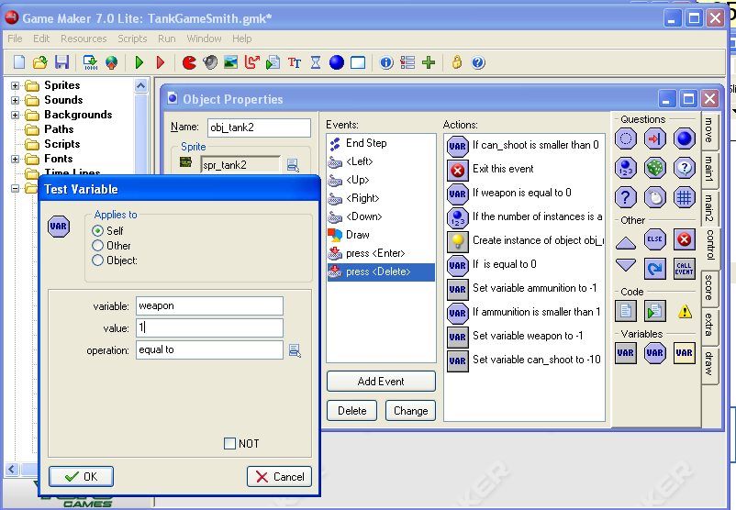
Check for bouncing for obj_tank2
1) Open obj_tank2
2) Open the ‘press <Delete> action
3) Place a ‘Test Variable’ action just after the ‘Create Instance’ action.
4) variable: weapon
Value: 1
Operation: equal to
5)OK

Slide 34
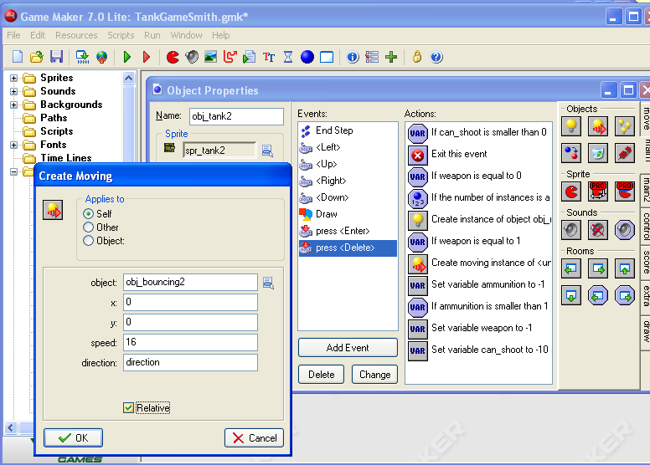
Create Moving
1) Place a ‘Create Moving’ action just below the Check Variable
2) object: obj_bouncing2
Speed: 16
Direction: direction
4) OK
3) Check the relative box.

Slide 35
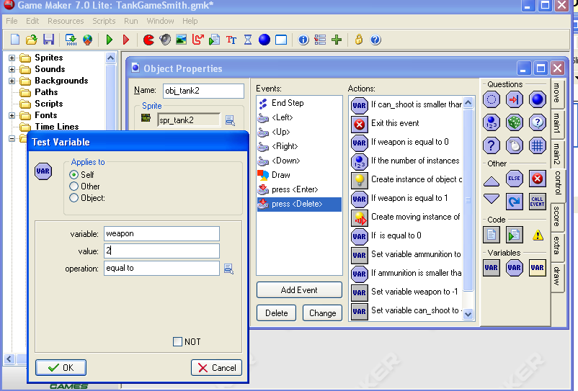
Test for the Shield
1) Place a ‘Test Variable’ action under the ‘Create Moving’ action
2) Variable: weapon
Value: 2
Operation: equal to
3) OK

Slide 36
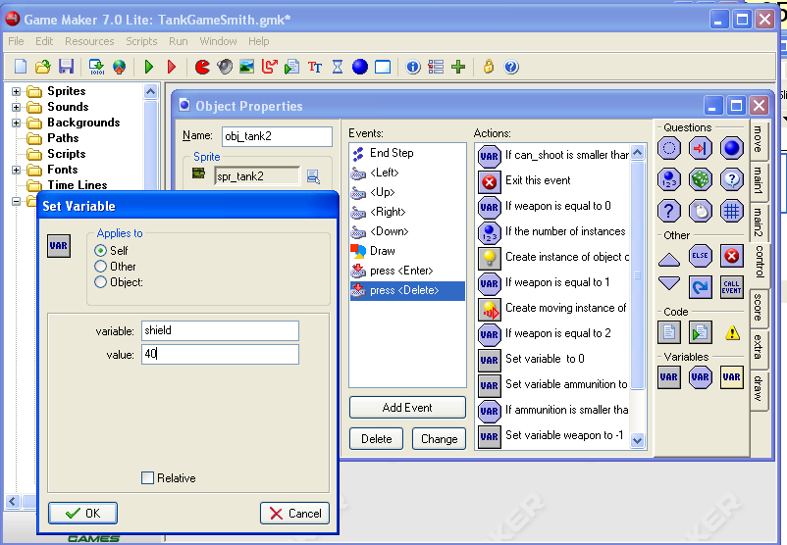
Set the Shield to 40
1) Place a ‘Set Variable’ action just under the Test Variable action
2) Variable: shield
Value: 40
3) OK

Slide 37
Test It!!
The game should be fully functional with secondary weapons, repair, ….
Partner up with someone and play the game for a while to see if everything works.
Then try to trace down the errors.

