Slide 1
Robotics Projects
Scrum: Daily Stand Up Meeting

Slide 2
If you did not complete this on Monday
Select Product Owner: Quality Control
Select Scrum Master: Team Leader
Build Sprint Backlog:
Tasks you can get done by next Friday

Slide 3
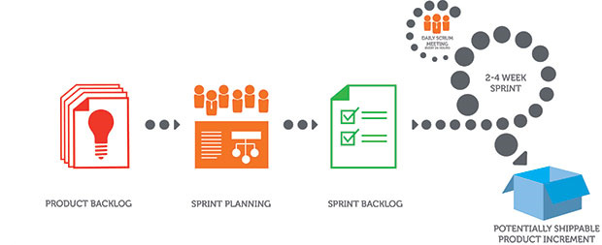
Sprint…
Daily Scrum Meeting:
What was done yesterday?
What do you intend to do today?
What is getting in your way of success?
Work:
Select a task
Add your name to the sticky note
Move the note to the ‘Doing’ column
When you finish a task, demonstrate it to your Product Owner. If it passes, the product owner signs off and the note is moved to the ‘Done’ Column.
At the end of the sprint your team will demonstrate the ‘Done’ items.

