Slide 1
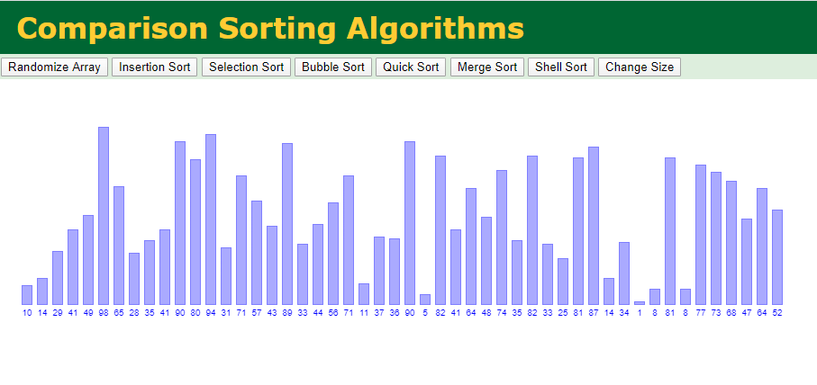
Array Review Selection Sort
_{Get out your notes.}

Slide 2
Learning Objectives
Review how the Bubble Sort works.
Be able to dry run programs that use arrays.
Understand and be able to implement a Selection Sort.

Slide 3
Bubble Sort
Speed =
Stability =
How it works =

Slide 4
Warm up
Show the following after each pass of the Bubble Sort
High Low
20 10 8 14 61 90

Slide 5
Dry Run 1
_{int[] array = { 1, 4, 3, 6 };}
_{int what = 0;}
_{// scan the array}
for ( int index=0; index < array.length; index++ )
{
_{what = what + array[ index ] ;}
}
_{System.out.println( what );}

Slide 6
2) Fill in the blank in the following code fragment so that each element of the array is assigned twice the value of its index.
_{int[] array = new int[10];}
_{// scan the array}
for ( int index=0; index < array.length; index++ )
{
_______________________
}

Slide 7
Dry Run 4
public static void main (String [] args)
{
int [] a = { 10, 11, 4, 8, 2 } ;
int pass, check, mark;
int dummy;
for (pass=0; pass<a.length-1; pass++)
{
mark = pass;
for(check=pass+1; check<a.length; check++)
if(a[check] < a[mark] )
mark = check;
dummy = a[pass];
a[pass] = a[mark];
a[mark] = dummy;
for (int s:a)
System.out.print(s +" ");
System.out.println();
} // end for(pass)
}

Slide 8
Selection Sort
View Animation
Describe the process.

Slide 9
Selection sort
How it works
Example
Low High
2 6 8 3 15 1 7
Stability
Speed
Your turn
High Low
8 2 5 3 9 4 6 1 7
Check, mark, switch
Not stable
O(n²)

Slide 10
Selection Sort
int pass, check, mark;
int dummy;
for (pass=0; pass<a.length-1; pass++)
{
mark = pass;
for(check=pass+1; check<a.length; check++)
if(a[check] < a[mark] )
mark = check;
dummy = a[pass];
a[pass] = a[mark];
a[mark] = dummy;
for (int s:a)
System.out.print(s +" ");
System.out.println();
} // end for(pass)
How will this need to be modified for sorting Strings?
if (a[check].compareTo(a[mark])<0)

Slide 11
First Program Check for Understanding
import java.util.Scanner; // program uses class Scanner
public class SelectionSort
{
public static void main(String args[])
{
String[] names = new String[5];
String name;
// create Scanner to obtain input from command window
Scanner input = new Scanner( System.in );
for (int count = 0 ; count < names.length; count++)
{
System.out.println("Please enter a name");
names[count] = input.next();
}
for (int j=0; j<names.length; j++)
{
System.out.println(names[j]);
}
//Insert Sort Code here
System.out.println("The names ...");
for (String temp: names) // For each String temp in the array names.
System.out.println(temp);
}
}
Enter this into BlueJ and test to make sure it is sorting.
YourNameSelectionCheck.
Note: You will need to modify the < with .compareTo() since you are sorting Strings.

Slide 12
Selection Sort Program
Input 11 scores in main body
Output:
Numbers in sorted order (Low to High):
Mean (average):
Median (Middle number after sorting):
Pushes:
Use the outline on the next slide to break the program into methods
Find the mode: The most often occurring value. Multiple modes? No mode?
Let the user tell you how many scores prior to entering the scores
Add a method that will return an array of the 5 highest scores.
Add a method that will return the modified average.
If the pre-sorted scores are in increasing order (continual improvement), it will return the average of the top 3 scores, otherwise with will return the entire average.

Slide 13
import java.util.Scanner;
public class SortOfFun
{
public static void main(String [] args)
{
}
public static void selectionSort(int [] unsortedArray)
{
}
public static void show(int [] arrayToShow)
{
}
public static int meany(int [] theArray)
{
}
public static int medianfinder(int [] theArray)
{
}
}
_{Shell for the Selection} Sort program
Don’t forget the ‘return’ on the methods..

