Slide 1
“Name Goes Here”
A Point and click horror game
Made in scratch
By Greyson/kalen
Notes:
The title of our game is “Name Goes Here.” It is a point and click horror game.

Slide 2
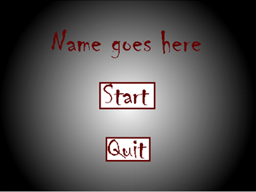
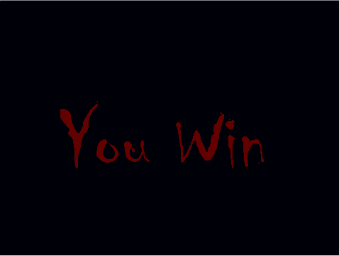
Main Objective Of The Game
Begin outside of an old abandoned house.
By clicking on areas of the screen, progress through the rooms.
Find the keys to unlock the final door and escape the house.
Notes:
The game begins outside of an old abandoned house. By clicking areas of the screen, you can progress through a series of rooms and hallways, and search for the two keys that allow you to escape

Slide 3
Division of Work
Name | Task 1 | Task 2 | Task 3
Greyson | Backgrounds | Click Code | Sound
Kalen | Sprites | Jumpscares | Item Ideas
The project was split into 2 parts:
Design
Coding
Notes:
The work was divided into two parts, Design and coding. Greyson worked on the Backgrounds, Click Code and Sound, and Kalen worked on the Sprites, Jumpscares and Item Ideas.

Slide 4
Process of Making the Game
Brainstorm ideas for the project
Design sprites/backgrounds to fit ideas
Code these sprites/backgrounds to interact with the game.
Ideas
Designing
Coding
Notes:
The process of making the game went through 3 steps. Firstly, we had to brainstorm ideas for the project. Then, we needed to design the sprites/backgrounds to fit the ideas and themes we set for the game. Finally, we coded these sprites into the game, and added their interaction with the game.

Slide 5
Positive and Negative Aspects
Positive Aspects
Negative aspects
Creating Sprites/Backgrounds
Brainstorming the concept/path of the game
Adding interactions between sprites.
Coding long processes repeatedly
Fixing bugs and glitches
Rewriting code after changing an interaction
Notes:
While making the game, we came across several positive and negative aspects of the game making process. Some positive aspects were creating the designs for the sprites and backgrounds, brainstorming the concept of the game, and adding interactions between sprites. On the other hand, some negative aspects were coding long processes repeatedly, fixing bugs and glitches, and rewriting code after changing an interaction.

Slide 6
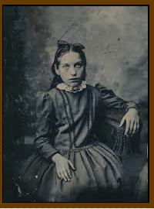
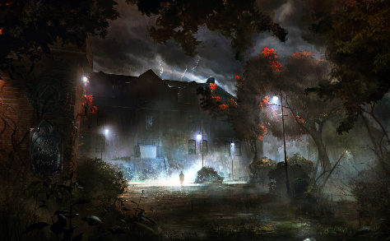
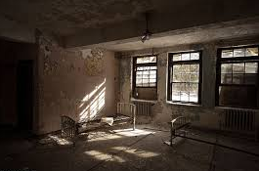
Images from the Game
Notes:
These are some images from the game.

Slide 7
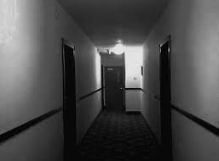
Game description
The game starts outside of an abandoned house.
You enter the house, and immediately go upstairs.
You are given a choice of two rooms to explore and search for the two keys.
The keys unlock the third and final door to escape.
Game Type: Point & Click
Genre: Horror
Art Style: Photo Realistic
Notes:
The game starts outside of an old abandoned house, and so you choose to enter it. (Who knows why) Both hallways to the left and right are blocked off, and you are forced to go upstairs. You are given a choice of two rooms to explore, and try to find the two keys. The keys unlock the final door which warrants your escape.

Slide 8
Testing the Game
Problem
solution
Mouse click being double registered
Text bars wouldn’t show
Areas wouldn’t register being clicked
Added a wait time for click registering
Brought text sprites to front
Set up a X/Y command to check for mouse clicks.
Notes:
While testing the game, we found a few bugs that needed to be fixed. First of these was that the mouse sometimes registered two clicks rather than one, taking you to the wrong location. We fixed this by adding a wait time for click registering. The second problem we face was that text bars wouldn’t show over the backgrounds. This was easily fixed by bringing the text sprites to the front upon entry. The final issue was that some areas on the screen wouldn’t register being clicked, so we added a chunk of code that checked the location of the mouse at all times.

Slide 9
Conclusion
Ideas
Concept
Design
Coding
Bug Fixing
In conclusion, we went through the game making process, developed ideas and concepts, and faced challenges. Through these challenges we found solutions, which in the end greatly benefited the final game.
Notes:
In conclusion, we went through the game making process, developed ideas and concepts, and faced challenges. Through these challenges we found solutions, which in the end greatly benefited the final game.

