Slide 1
Robotics Projects
Introductions:
Name
Goal for the year
Roles you would like to have on a team(Mechanical Engineer, Software Engineer, Electrical Engineer, Engineering Manager, Anything the team needs),
Time you can and are willing to work on the Robot
Introductions
Vision for the Course
Schedule for the Year
Grading
Setup Engineering Notebooks

Slide 2
Introduction to Engineering Design Today’s Schedule
Introductions
Student Expectations
Lab Rules
Course Overview
Questions
Log in /Set up Shortcuts

Slide 3
Student Expectations
Behavior/Discipline Plan:
Students are expected to be safe, responsible and respectful.
Students not following these expectations may expect: verbal warnings, removal from class pending conference, parent contact, or referral to administration.

Slide 4
To be successful in this course:
Stay focused and productive in the classroom
Excellent attendance
Let your projects, daily work, quizzes and tests display your best effort
Feel free to talk with me about your projects, questions, etc.

Slide 5
Computer Lab Rules
No gum in class
No food or drink in the lab (except water with a lid at approved locations)
No headphones or music except on days selected by teacher
Absolutely no off-task Internet usage (e-mail, games, chat, etc – anything other than class related)
Absolutely no off-task Computer usage (ask teacher permission to use equipment for anything other than class assignments)
Do NOT download any software (games, utilities, music, etc.)
Do NOT use any “chat” software
No CELL PHONE use in class without permission of Mr. Smith.

Slide 6
Robotics at West 2017-2018: Smith’s Vision
Have fun
Students design, build, program robots to competed in the VEX Robotics Competitions.
Prototyping with FTC, LEGO, PVC, .. parts available. Parts could be a little tight so you might need to be creative in your designs.
Sportsmanship
Atmosphere where it is OK to make mistakes, ask questions, encourage others, take chances, and make mistakes.
Hustle
All Teams incorporate the Scrum Framework for developing robots.
All students are actively engaged in training activities and their team’s robot.
Students complete training challenges
Teams create quality engineering notebooks
Teams maximize their time to meet the goals
Students take advantage of open lab times.
Students willing to do what it takes to keep the team successful.

Slide 7
Smith’s Performance Goals
Teams
Six + teams compete in VEX Robotics Challenge
Two + teams submit an Online Challenge entry
Four + teams compete in the Platinum Division at the State Championship.
Dream … Win the State Championship
Dream… Qualify at least one team for VEX Words!
Dream… Division Quarterfinalist at Worlds!!!!!!!!
Autonomous score
All robots score points in autonomous mode.
Dream… to win a match in autonomous mode!!
Dream … to qualify for Worlds based on the Programming Skills Challenge.
Captain
Have every team be in a position to be an alliance captain at some point in the season.
Dream…Captain the State Champion Alliance
Students can add individual goals.

Slide 8
Team Goal Attainment
Six + Vex Robotics Teams
Attain funding (Need $$ for this year to compete at State)
Concessions help (Can sign up now to get on the list)
Hosting VEX Tournaments
Networking computers for Titan Auction
Letter writing and visiting campaign
Pursue student contacts.
Build quality robots with quality team members
Incorporate the Scrum Framework
Do the little things
Be creative in prototyping/testing when parts are not available
Encourage others
Improve another’s idea if the team so decides
Do your team role with excellence!!

Slide 9
VEX Events
10/14 VEX Idea Factory (Host)
10/28 Sandy
11/11 Redmond
12/2 Tournament at West (Host – All compete)
1/13 Sandy
1/13 Toledo
1/20 Bend
1/26 Tournament at West (Host – All help)
1/27 Tournament at West (Host – All Compete)
2/17 North Marion
3/9-3/10 State All compete
4/20-21 SkillsUSA Student Leadership Conference
4/25-4/28/2018 VEX World Championship, Louisville, KY.

Slide 10
Autonomous Score Achievement
Autonomous score
Incorporate training in programming in RobotC
Some for all
More for programmers
Have running drive trains for the programmers by the 2nd week of class
VEX Squarebot or Clawbot for rookie teams
Always have a running test bed for programmers and drivers!!!
Create in-house challenges based on this years challenge.

Slide 11
To be Captain
Incorporating Scrum (an Agile Product Development strategy) into the engineering design cycle this season to help create quality products more rapidly.
Maintain an excellent Engineering Journal.
Document the journey
Update at least twice a week: Monday’s and Fridays
At least one
Have teams create a rigorous method for evaluating their design that can also be used for scouting other teams.
Practice, practice, practice
Plan for anything
Take advantage of open lab times.
Always have a running test bed for programmers and drivers!!!

Slide 12
Grading for Robotics Projects
To get a ‘B’ in the class complete the following
Engineering Notebooks (10 points / week)
Tasks, activities, pictures, reflections for the week.
Add Value/Participation (10 points per week)
Activities ( 5 – 50 points each)
Setup Dec 1st (10) Dec 2nd tournament (20) and Dec 2nd Cleanup (10) points)
January 26th Setup and Host (10), January 27th Tournament (20), January 28th Cleanup (10)
To get an ‘A’ in class you will need to complete one of the following ‘Above and Beyond’ activities every six weeks.
Outreach
Help at October In-service
Help at Concessions/Fund raising activity.
Help with new VEX Team(s) outside of West High.
Help FIRST LEGO League/ VEXiQ team(s)
Time spent outside of class on robot, Three hours per 6 weeks.
Submit a quality VEX ‘Online Challenge’ entry.
WORK MUST BE DOCUMENTED IN YOUR ENGINEERING NOTEBOOK.
… If you have a proposal, check with Smith.
Everyone needs to have a journal!
Once teams are determined, if you are updating the ‘Team’ journal you do not need a separate individual journal.

Slide 13
Grading Scale
‘A’ 90%+
‘B’ 80 – 89 %
‘C’ 70 – 79%
‘D’ 60 – 69 %
‘F’ Below 60%

Slide 14
Log in and Create Class Folder
Log onto the network
Your log in number is on your student ID number
Your password is your First Initial Last Initial Birthdate.
Example
Susie Kalahan 1/1/2002
sk112002
Jose Mahindra 10/15/2001
jm10152001
Open YourName Folder
In to top left of the desktop
Make a new folder called RoboticsProjects
Keep your RoboticsProjects Folder open

Slide 15
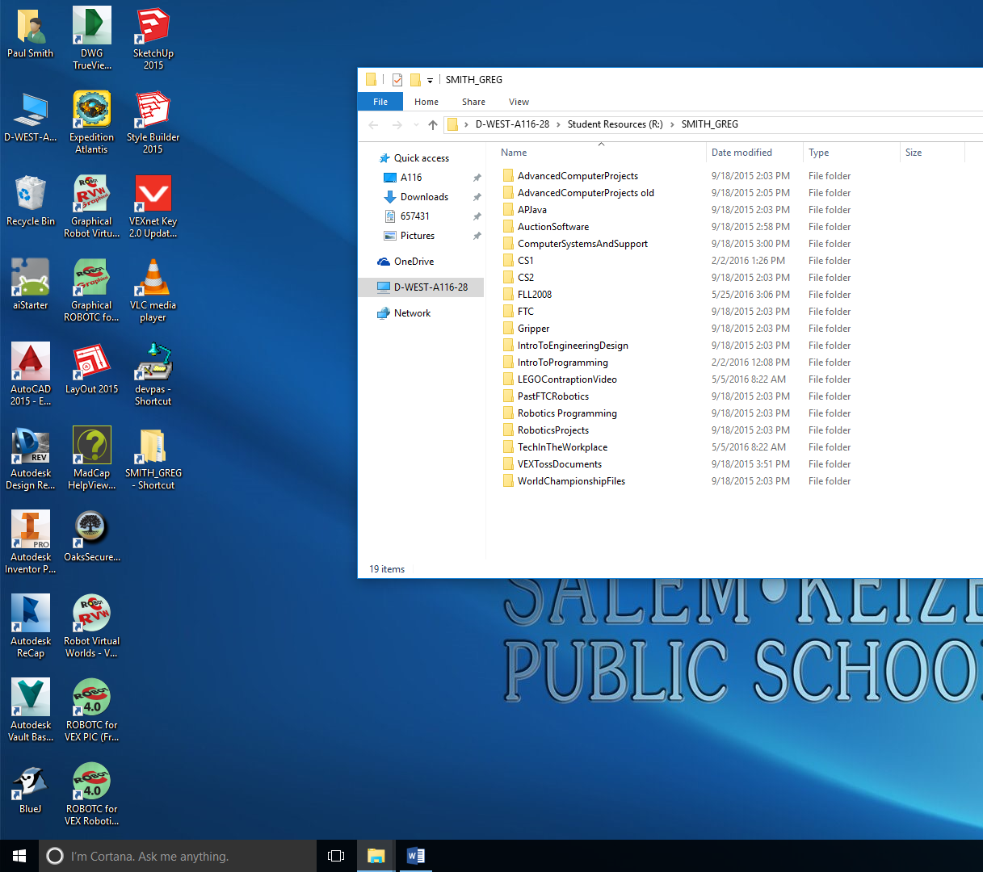
Creating Shortcuts
2) Double Click on the ‘RoboticsProjects’ Folder
1) Double Click on SMITH_GREG-Shortcut

Slide 16
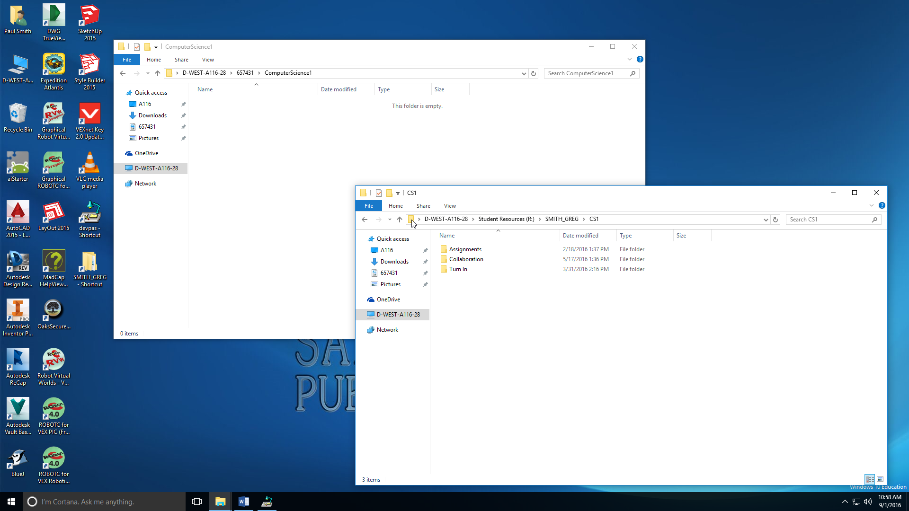
Drag and Drop into your ‘Engineering Design’ Folder.
Drag and Drop Into Your ‘Robotics Projects’ Folder
Drop

Slide 17
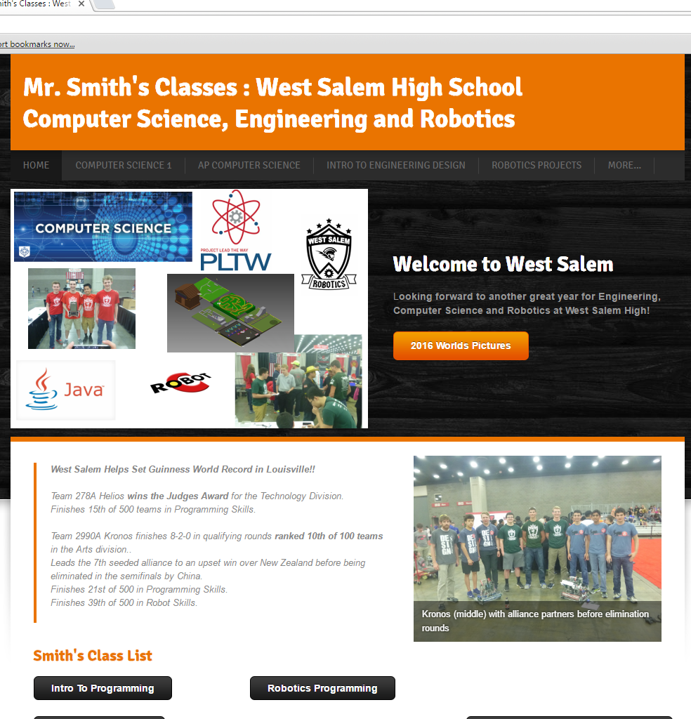
Shortcut to Class Website
www.smithcsrobot.weebly.com
Click on ‘Robotics Projects’

Slide 18
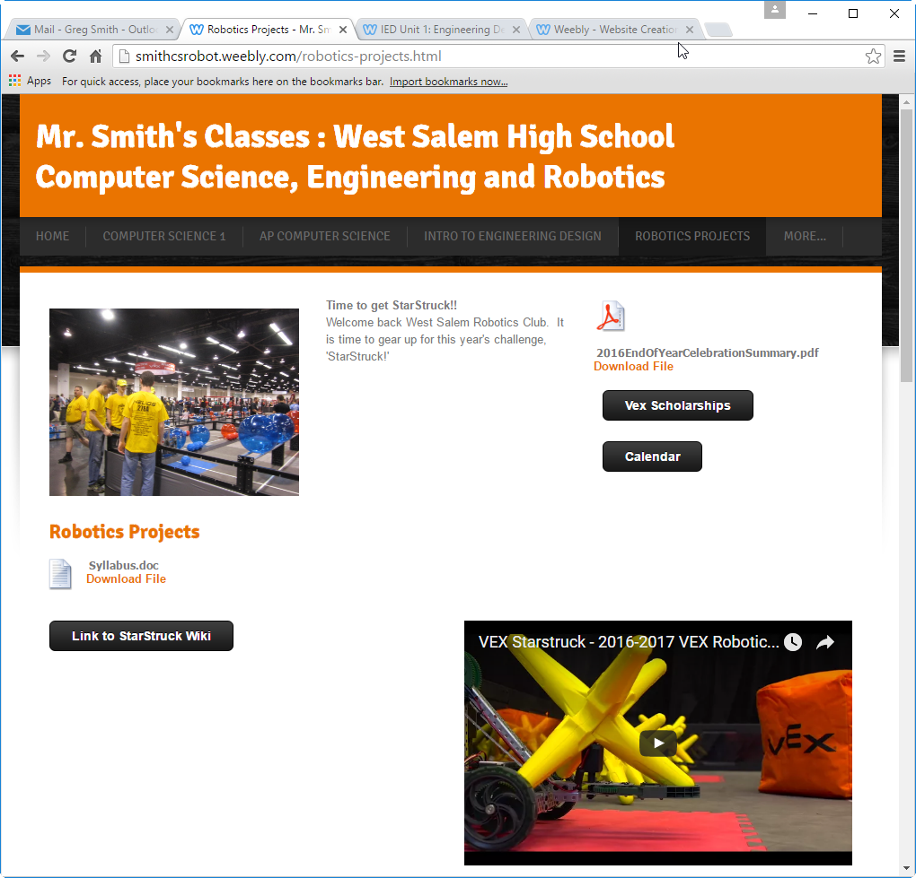
Print out the Syllabus at Home, get it signed and returned.

Slide 19
Today
Create a gmail account if you do not have one.
Create a Google ‘Slides’ document for your engineering notebook.
Log in (create if needed) to your gmail account
Name it ‘YourNameEngineeringNotebook2017-2018’
Share it with
‘SmithTitanRobotics@gmail.com’
When teams are finalized you will need to share it with your teammates as well.

Slide 20
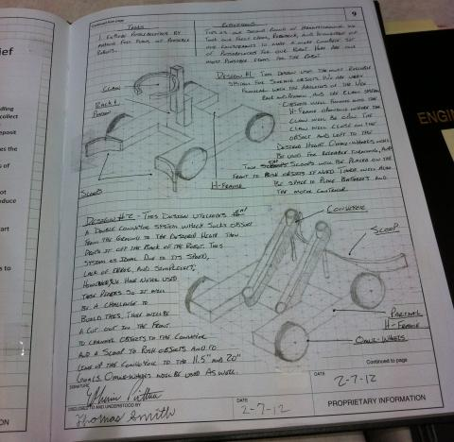
Individual Engineering Notebook
Page 1:Introduction
Name, age, Picture of you, year in school
Hobbies interests, If you had to pick a career, what would it be?
Page 2
Table of Contents
Page 3
The time commitment you are willing to put into your team.
Are you taking this class one, or both semesters
Skill Set: Classes, abilities, skills that you bring to the robotics team.
Roles you would like to take: Builder, programmer, captain, driver, research, promotions, fund raising, product owner, Scrum master…
Page 4 (Delete names from the page)
Describe a ‘Dream Team’. Focus on skill sets, not names. I will talk individually with you about people you are willing to have on your team. No guarantees, but it will help me in finalizing the teams.

Slide 21
Page 5: The Challenge
Research and describe the Challenge for this season
You can work solo or in groups of up to two. Each person will document their description in their notebook.
Resources
Smithcsrobot.weebly.com
Robotics Projects
Watch the Video
‘Link to In The Zone Documents’
Be prepared to share your description of the challenge, and your goals toward completing the challenge with another group.

Slide 22
First Attempt at Teams
Meet your teammates
Share each team members description of the challenge
Pick two people to coordinate the notebook. This will eventually move down to one person
As a team put together an outstanding description of the challenge.
Your team will share it with Mr. Nelson or Mr. Smith

Slide 24
Page 6: Design Process: Brainstorming Approaches
Describe different approaches to the challenge
Ex.: Control mobile goal, stack on mobile goal, stack on high goal, …
In Teams
Scribe: Writes all ideas. (Whiteboard)
Every idea is a good idea, no judging!!!
Brainstorm: 5 minutes
Copy the ideas in scribes journal
Rotate roles
At the end put ideas in your journal (Copy, picture, …)

Slide 25
Slide 7: Design Process: Select Approach
In groups of 1 – 2 (Your first Group?)
Select an approach and describe why this was chosen and others alternatives were not chosen.
If your approach will be to do several things, prioritize them.

Slide 26
Defend your Position with Another Team
Group 1 Share : Group 2 listens
Group 2 ask clarifying questions
Group 2 shares: Group 1 listens
Group 1 asks clarifying questions
Both groups return and refine their Positions as needed.

Slide 27
Day 3: Learning Objectives
Using your team strategy and problem statement develop specifications and constraints for your robot.
Begin brainstorming ideas for your robot design.

Slide 28
Specifications and Constraints
Specifications: What your robot can do/be
Stable: Will not tip over if placed on a 45 degree angle
High Traction: Will not slip when pushed with 8 lb. force
…
Constraints: What your robot can’t do/be
Must fit into an 18”x18”x18”
May not use more than 12 motors, or 10 with pneumatics
As a team develop at least 8 specifications and 8 constraints for your robot. Use your team strategies to guide the specifications and constraints that you see as important to your design. Record these in your team and individual journals.
Notes:
Science/Engineering: ETS1A: Defining and Delimiting an Engineering Problem
Literacy: Summarizing the required specifications and constraints.

Slide 29
Brainstorming
The goal is to generate as many ideas as possible to help you develop the best product as early as possible
Brainstorming Rules
Every person and every idea has equal worth
Every (school appropriate) idea is a good idea!
Encourage wild and exaggerated ideas
Go for quantity at this stage, not quality
Build on ideas put forward by others
Notes:
Science/Engineering: ETS1B: Developing Possible Solutions.

Slide 30
Time for the Storm
Team Roles
Recorder (Into the team Engineering Journal)
Encourager
Thought provoker(s) (Idea generators)
Rotate roles every 3 minutes
Brainstorm and record ideas for your robot I’ll will tell you when to rotate rolls
Notes:
Science/Engineering: ETS1B: Developing Possible Solutions.
Technology: ISTE 1: Creativity and Innovation

Slide 31
Day 5 Learning Objectives
Research to find options for your design.
Continue to brainstorm ideas for your design.
Start assembling ideas, specifications and constraints to help in selecting your robot design.

Slide 32
Research
Each individual will use the internet to research ideas for your robot designs
Research 5 minutes
Share 5 minutes (Every person shares!)
Add ideas to your brainstorm list
Research 5 minutes
Share 5 minutes (Every person shares!)
Add ideas to your brainstorm list
Notes:
Science/Engineering: ETS1B: Developing Possible Solutions.
Technology: ISTE 3: Research and information fluency

Slide 33
Return of the Storm:
Using your past ideas and ideas from your research, continue to brainstorm solutions for your robot.
Combine some of the previous ideas and what your found in research to create new ideas.
Roles
Recorder
Encourager
Thought provoker (random idea)
Rotate roles every 3 minutes
Notes:
Science/Engineering: ETS1B: Developing Possible Solutions.

Slide 34
Selecting your Design Direction
The team will be using a Decision Matrix to help in determining your direction.
Record this in your team journal and copy into your individual journal
Notes:
Science/Engineering: ETS1B: Developing Possible Solutions
Science/Engineering: ETS1C: Optimizing the Design Solution
Technology: Critical thinking, problem solving and decision making

Slide 35
Prioritize: What is the best idea?
Weigh the advantages and disadvantages of each alternative?
Set up alternatives in a matrix for analysis (See next slide.)
Mark the grid (Can use other scales)
+ = 1: Better. (Above Average)
0 = 0: No appreciable difference. (Average)
- = -1: Worse. (Below Average)

Slide 36
Simple Decision Matrix
Put your Specifications and Constraints along the top row
Specifications / Constraints | Economical | Feasible | Practical | Reliable | Size | Performance | Total
Alternatives
Tracts
Dune Buggy
2 Legs
Propeller
Rack and Pinion+Diff.
Helicopter
Hoover Craft
6-wheel:Banana Split
Rate (+, 0, -) each alternative for each specification/constraint in the grid.
Total the score for each alternative in the totals column.
Place your brainstorm and researched ideas along the first column. Do not include the ‘off-the-wall’ suggestions.
Notes:
Science/Engineering: ETS1B/C. Developing Possible Solutions/ Optimizing the Design Solution
Technology: ISTE 6. Technology operations and concepts.

Slide 37
Weighted Decision Matrix Option
Specifications and Constraints
How the alternative rates x Importance of specification = score in grid
Specifications | Economical | Feasible | Practical | Reliable | Size | Performance | Total
Weighted Importance of specification/ constraint (1 to 5) | 1 | 4 | 5 | 5 | 2 | 5
Alternatives
Trackbot with Scissor | 5x1=5 | 5x4=20 | 4x5=20 | 4x5= 20 | 3x2 =6 | 3x5=15 | 86
Omni-bot with 6-bar | 4x1=4 | 4x4=16 | 4x4=16 | 3x5= 15 | 5x2 =10 | 3x5=15 | 76
Rack and Pinion + Differential | 3x1=3 | 1x4=4 | 3x4=12 | 3x5= 15 | 3x2 =6 | 3x5=15 | 55
6 wheel: Banana Split | 4x1=4 | 3x5=15 | 5x5=25 | 5*5= 25 | 4x2 =8 | 5x5=25 | 102
Weights based on the importance of the specification/constraint.
Score = Weight x Rating of alternative
Alternatives
Totals
Notes:
Science/Engineering: ETS1B/C. Developing Possible Solutions/ Optimizing the Design Solution
Technology: ISTE 6. Technology operations and concepts.
Math: Number and quantity, algebra (Formulas in spreadsheet)

Slide 38
Day 6 Learning Objective
Time to select your team robot design.

Slide 39
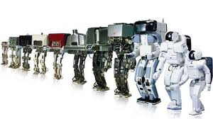
Select your design
Use the rating from the Decision Matrix to help you select the design.
You do not have to select a particular design that rated highest in the Decision Matrix.
Sometimes a robot that is OK at everything but good at nothing comes out high in the ranking
Your team has the final say in your design direction, but you should be able to justify it.
Record your design choice and why in your engineering journal.
Notes:
Science/Engineering: ETS1B/C. Developing Possible Solutions/ Optimizing the Design Solution
Technology: ISTE 4. Critical thinking, problem solving and decision making.

