Slide 1
Robotics Projects
Programming your Robot

Slide 2
Learning Objectives
Be able to configure your robot in RobotC
Be able to create a simple autonomous program
Be able to write a driver controlled program that includes
  Direct mapping controller to motor
  Eliminating ‘creep’
  Modifying the Power
Be able to incorporate buttons from the remote into your program.

Slide 3
Getting Started: Needed Parts
Cortex
7.2 Volt Battery
At least one motor, two is better
Cortex Remote and power supply (Might need to share this)
USB A-A cable (Share)
VEX Net Keys (Share?)

Slide 4
Software Setup
Downloading the Firmware for the Cortex and the Joystick
The default mapping after the firmware is completed.
Tuesday we will describe you ‘programming’ in RobotC

Slide 5

Updating Cortex Firmware: Video
Hyperlink Address
http://www.education.rec.ri.cmu.edu/products/cortex_video_trainer/lesson/2-2WirelessSystemConfiguration1.html
Notes:
http://www.education.rec.ri.cmu.edu/products/cortex_video_trainer/lesson/2-2WirelessSystemConfiguration1.html

Slide 6

Updating VEXnet Joystick Firmware
Hyperlink Address:
http://www.education.rec.ri.cmu.edu/products/cortex_video_trainer/lesson/2-2WirelessSystemConfiguration2.html
Notes:
http://www.education.rec.ri.cmu.edu/products/cortex_video_trainer/lesson/2-2WirelessSystemConfiguration2.html

Slide 7
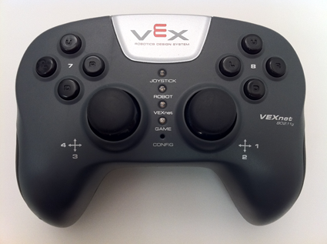
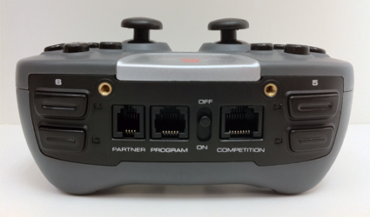
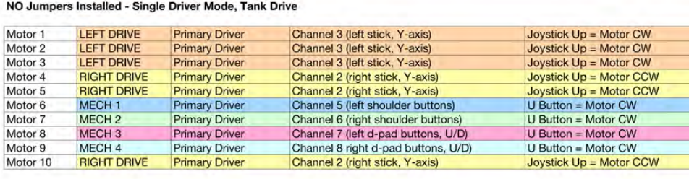
Default Code Control Mapping

Slide 8

Programming: Autonomous
Programming Autonomous Discussion
Setting up and naming the Motors
Look at two commands that will be enough to get your robot up and moving.
Open up RobotC

Slide 9
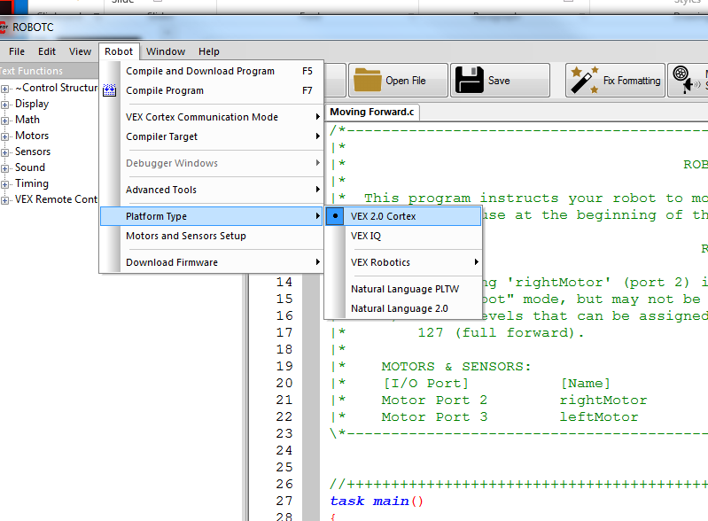
Programming: Make sure RobotC is ready for Cortex
Go to Robot -> Platform Type -> VEX 2.0 Cortex

Slide 10
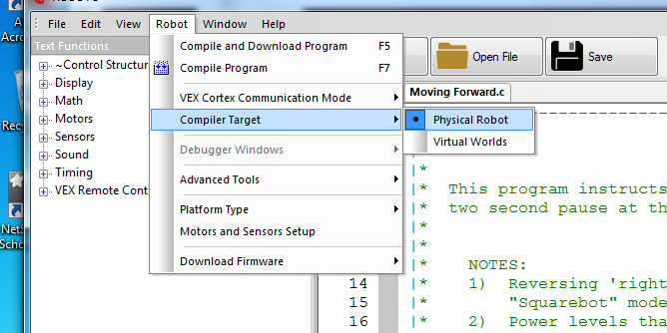
Make Sure it is in the ‘Real-World’
Robot -> Compiler Target -> Physical Robot

Slide 11
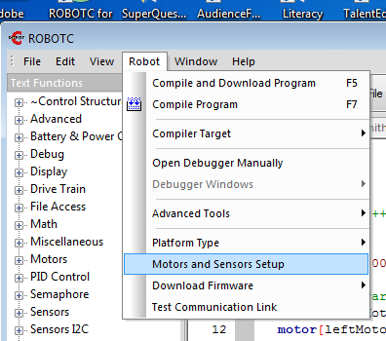
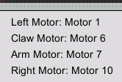
Configuring the Robot: Focus on Motors
Robot -> Motors and Sensors Setup
Select the motor
  Currently can only purchase 393 Motors, also modify for internal gearing (high speed, turbo speed)
Naming Convention
  Rules
    Start with a letter
    No spaces, punctuation or reserved words (blue)
  Style
    Describes what it represents
    First letter is lowercase
    otherWordsStartWithUppercaseLetters
  For these motors
    leftMotor
    clawMotor
    armMotor
    rightMotor

Slide 12
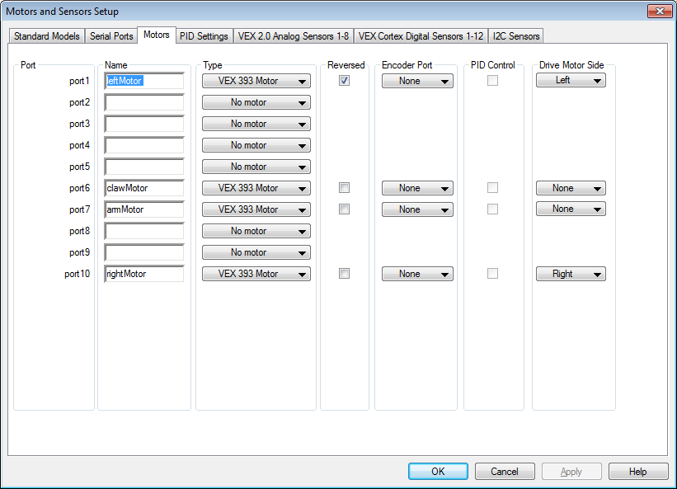
Motors and Sensors Setup Page
1) Select the ‘Motors’ tab.
3) Use the pull down menus to select the motor.
4) The left motor will need to be reversed so the robot does not go in circles.
2) Name the motor in the desired port.
5) Select the side for drive motors.
6) Complete the setup for the remaining motors.
7) Click on Apply to remember the changes.
Notes:
Note: Select the motor ports to match where your motors are plugged.

Slide 13
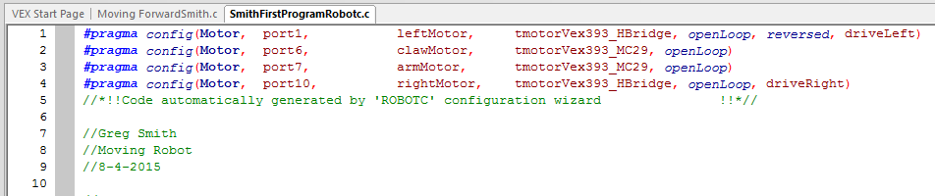
Code the setup creates
‘pre-processor directives’

Slide 14
Now we can start looking at RobotC
motor[motorName] = motorPower;
wait1Msec(milliseconds);

Slide 15
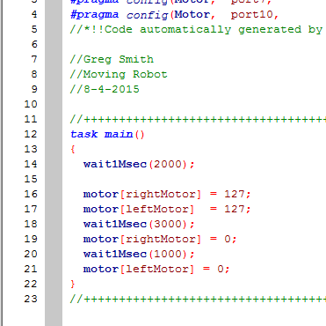
Vocabulary
//
Comment
task
main()
motor[]
motorB. motorC
{}
wait10Msec()
;
=
Header
Code
Compile
Download
Run
The Header
// In front of the line makes this line a comment
/* */ for multiple line comments.
What do you think this code will do?
{}
Marks the begin and end of a block of code
task main()
Marks the beginning of the instructions for the Robot.
RobotC Is CaSe SeNsItIvE!
; is used to mark the end of a command.
motor[motorB] = 127;
motor[] Used to select the motor.
rightMotor = This represents the place where the motor is attached.
motor[port10] = 127; does the same thing.
= 127;
127 = full power
-127 = Reverse
0 = stop
wait1Msec(2000);
The robot continues what it was doing for (2000) milliseconds.
Two seconds in this case.
Code Break. Create an autonomous that has your robot move!
Notes:
Advanced students can also download the program to their physical robot.

Slide 16
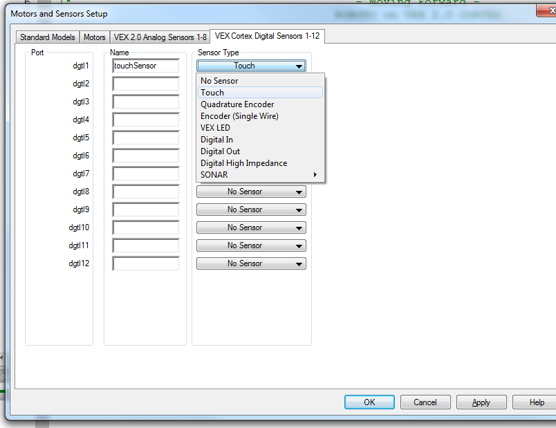
Adding a Sensor: Configure and Name
1) Robot -> Motors and Sensors Setup
2) Select the VEX Cortex Digital Sensors 1-12 Tab
3) Name the Sensor. (Same rules as for motors.)
- Start with a letter
- No spaces or punctuation
-no reserved words
should describe the sensor
4) Apply / OK

Slide 17
Go forward until the touch sensor is touched.
Plug a touch sensor into port 1.
#pragma config(Sensor, in1, touchSensor, sensorTouch)
task main()
{
wait1Msec(2000); //Robot waits for 2000 milliseconds while(SensorValue(touchSensor) == 0) // 0 == not touched, 1 == touched
{
motor[port2] = 63; //Motor on port2 is run at half (63) power forward
motor[port3] = 63; //Motor on port3 is run at half (63) power forward
}
motor[port2] = 0;
motor[port3] = 0;
}

Slide 18
Programming: Remote Control

Slide 19
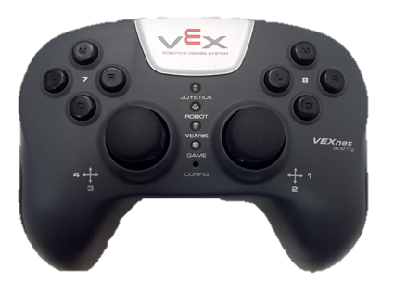
Looking at the Joysticks on the Remote
Ch4
Right = 127
Middle = 0
Left = -127
Ch1
Right = 127
Middle = 0
Left = -127
Ch3
Up = 127
Middle = 0
Down = -127
Ch2
Up= 127
Middle = 0
Down = -127
Notes:
http://education.rec.ri.cmu.edu/products/cortex_video_trainer/lesson/4-2JoystickMapping1.html

Slide 20
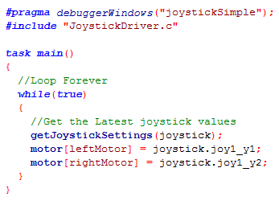
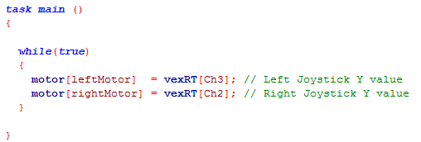
Example Using the Remote Values to Drive the Motors
Physical Robot
Virtual World
Can also give the port value in the motor command.
motor[port10] = vexRT[Ch2];

Slide 21
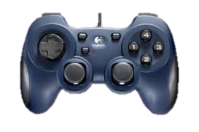
Joystick Mapping: Virtual
Joystick Mapping: Physical
Note: If you copy-paste these into your program, you will need to retype in the “”.
<- Ch4 ->
Up - Ch3 - Dn
<- Ch1 ->
Up - Ch2 - Dn
x1
y1
x2
y2
//Place before task main()
#pragma debuggerWindows(“joystickSimple”);
#include “JoystickDriver.c”;
//Place inside the loop prior to joystick. Command
getJoystickSettings(joystick);
Channel | Left/Down | Middle | Right/Up
vexRT[Ch1] | -127… | 0 | …127
vexRT[Ch2] | -127… | 0 | …127
vexRT[Ch3] | -127… | 0 | …127
vexRT[Ch4] | -127… | 0 | …127
Channel | Left/Down | Middle | Right/Up
joystick.joy1_x2 | -127… | 0 | …127
joystick.joy1_y2 | -127… | 0 | …127
joystick.joy1_y1 | -127… | 0 | …127
joystick.joy1_x1 | -127… | 0 | …127

Slide 22
Online Time: Configure the motors and code the following
Physical Robot
Virtual World
Configure the motors tied to ports on the Cortex:
leftMotor, port 1 reversed
rightMotor, port 10.

Slide 23
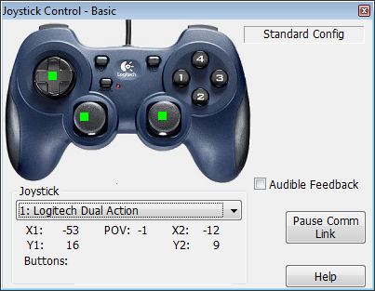
Robot Creeping?
Y1 and Y2 values might not go exactly to ‘0’ when you release the buttons which can cause your robot to creep.
Can correct this in the code.
Pseudo Code
  If the joystick reading is close to 0, say +/- 20
    Give a 0 power value to the motor
  Else
    Give the joystick reading to the motor

Slide 24

A Little RobotC Math to Help
RobotC Function | Description | Example
abs() | Finds the absolute value of a number | float x; x = abs(5-10);
pow() | Calculates a power | float x; x = pow(10,3); //Calculates and returns 10^3
sqrt() | Finds the square root of a number | float x; x = sqrt(8);

Slide 25
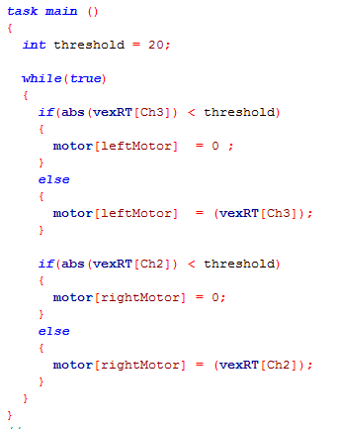
Physical:
Getting Rid of the Creep
Using a variable to make threshold changes easier
Using the abs command to simplify the condition.
if (vexRT[Ch3] >(-threshold)) && (vexRT[Ch3] < (threshold))
Would give the same results.
Executes this line of code when the above condition is true.
Executes the commands in the ‘else’ when the above condition is false.
Does the same for the rightMotor

Slide 26
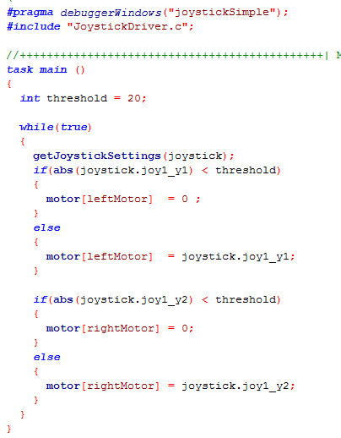
Virtual Getting Rid of the Creep
Add the pragma directive and include file. If you copy and paste from the PowerPoint you will need to retype in the “”.
Add the getJoystickSettings(joystick); command.
Replaced
vexRT(Ch3) with joystick.joy1_y1
Replaced
vexRT(Ch2) with joystick.joy1_y2

Slide 27
More Control Options
To fight motors timing out, you can modify the drive code to lower the power sent to the motors.
  Go half-power
  Create an equation that maps remote input to output. Had some math wizzes that used a 5th degree polynomial to provide more control when going slow.
  Can put together a bunch of ‘stepped’ if elses to give different power values for different ranges of input values.

Slide 28
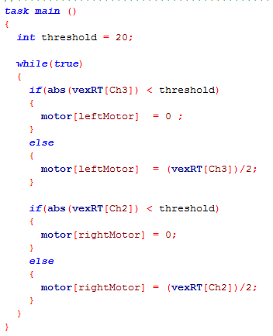
No Creep, Half Power
Half Power

Slide 29
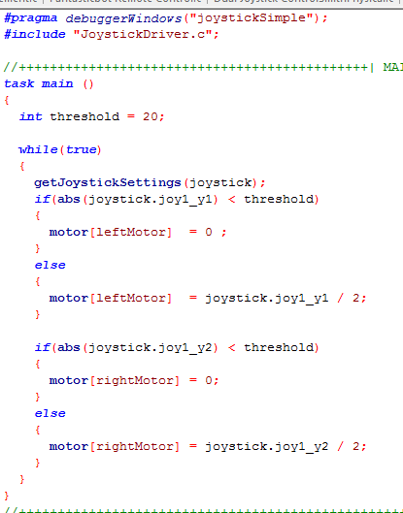
No Creep Half Power: Virtual
Online Time: Test it on the Utilities -> Huge Table
Half Power

Slide 30
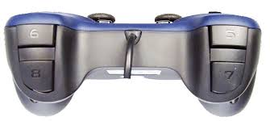
Buttons
Learning Objectives
Be able to use the buttons to control motors on your robot.
Complete challenges that incorporate buttons.

Slide 31
Joystick Buttons: Physical
Buttons return a value of ‘1’ when pushed and ‘0’ when not pushed
Button | Description | Example
5U | Top button on back left | vexRT[Btn5U]
5D | Bottom button, back left | vexRT[Btn5D]
6U | Top button, back right | vexRT[Btn6U]
6D | Bottom button, back right | vexRT[Btn6D]
7U | Button 7 up | vexRT[Btn7U]
7D | Button 7 down | vexRT[Btn7D]
7R | Button 7 right | vexRT[Btn7R]
7L | Button 7 left | vexRT[Btn7L]
8U | Button 8 up | vexRT[Btn8U]
8D | Button 8 down | vexRT[Btn8D]
8R | Button 8 right | vexRT[Btn8R]
8L | Button 8 left | vexRT[Btn8L]

Slide 32

Using the buttons to control the arm motor
Name and set the claw and arm motors.
Reverse the Arm Motor for Virtual Clawbot. Might need to reverse for physical robot also.
First we need to go to Motors and Sensors setup to configure the arm and claw motor.
Clawbot
  Arm: Port 7
  Claw: Port 6
Robot -> Motors and Sensors setup
3) Click Apply and OK when finished.

Slide 33
Looking at Arm Control using buttons: Pseudo-Code
If button 6U is pushed
  raise the arm (Send a signal of 127)
Else if button 6D is pushed
  Lower the arm (Send a signal of -127)
Else
  Stop the arm (Send a signal of 0)

Slide 34
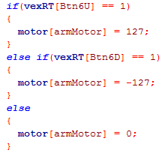
Looking at the Arm: Pseudo-Code to Code
If button 6U is pushed
  raise the arm (Send a signal of 127)
Else if button 6D is pushed
  Lower the arm (Send a signal of -127)
Else
  Stop the arm (Send a signal of 0)
Style Note: Indent between the {} to make the code easier to read.

Slide 35
Virtual World Buttons
joy1Btn(10)
joy1Btn(6)
joy1Btn(5)
joy1Btn(1)
joy1Btn(8)
joy1Btn(7)
joy1Btn(9)
Mode
joy1Btn(4)
joy1_TopHat
0 1
-1 2
5 4 3
joy1Btn(3)
joy1Btn(2)
joy1Btn(11)
joy1Btn(12)

Slide 36
Joystick Buttons
Virtual World
Buttons return a value of ‘1’ when pushed and ‘0’ when not pushed, except the TopHat.
Button | Description | Example
1 | Left | joy1Btn(1)
2 | Bottom | joy1Btn(2)
3 | Right | joy1Btn(3)
4 | Top | joy1Btn(4)
5 | Back, top left | joy1Btn(5)
6 | Back, top right | joy1Btn(6)
7 | Back, bottom left | joy1Btn(7)
8 | Back, bottom right | joy1Btn(8)
9 | Small button, top left | joy1Btn(9)
10 | Small button, top right | joy1Btn(10)
11 | Left joystick button | joy1Btn(11)
12 | Right joystick button | joy1Btn(12)
TopHat | Returns values -1 (Not pushed) or 0, 1, … 7 depending on which part is pushed. | joystick.joy1_TopHat
joy1_TopHat
0 1
-1 2
5 4 3
Notes:
Note: Leaving off TopHat buttons for now

Slide 37
Back to the Arm Movement Pseudo-Code but for Virtual Remote
If button 6 is pushed
  raise the arm (Send a signal of 127)
Else if button 8 is pushed
  Lower the arm (Send a signal of -127)
Else
  Stop the arm (Send a signal of 0)

Slide 38
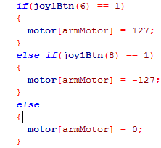
Arm Pseudo-Code to Code: Virtual World
If button 6 is pushed
  raise the arm (Send a signal of 127)
Else if button 8 is pushed
  Lower the arm (Send a signal of -127)
Else
  Stop the arm (Send a signal of 0)

Slide 39
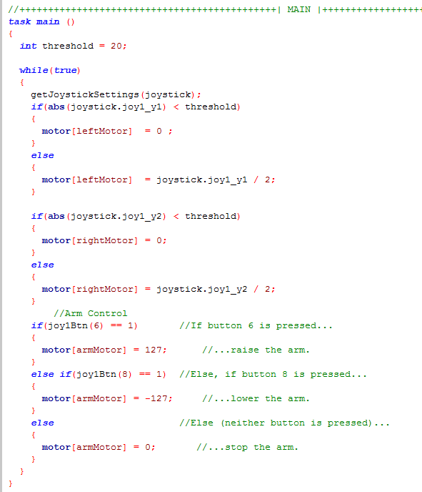
Where does this code go?
Since you want the robot to continually check for the buttons being pressed, it needs to go inside the while(true) loop.

Slide 40
Online Time: Test Arm Movement
Implement the code for the arm movement and test it in the Virtual or Real World.
Try to use what you have learned to program the Claw motor as well using the back left buttons.
Test your robot on the ‘Huge Table.’

Slide 41
Any problems?
Arm floating down when button not pushed?
  How can you combat this?
Arm didn’t move

Slide 42
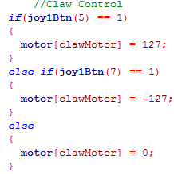
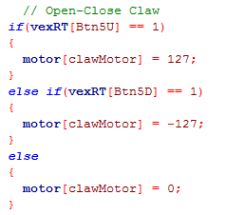
Claw Motor
Virtual
Pseudo Code
  If the back, top, left button is pushed
    Close the claw (127)
  Else if the back-bottom-left button is pushed
    Open the claw (-127)
  Else
    Leave the claw (0)
Physical

Slide 43
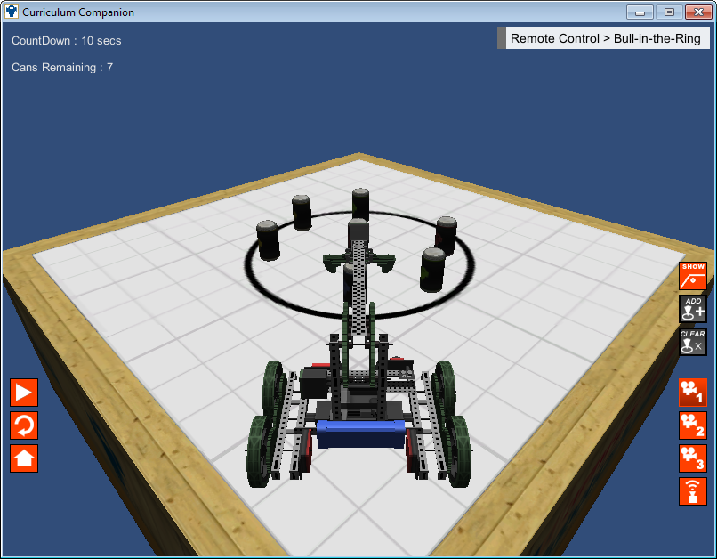
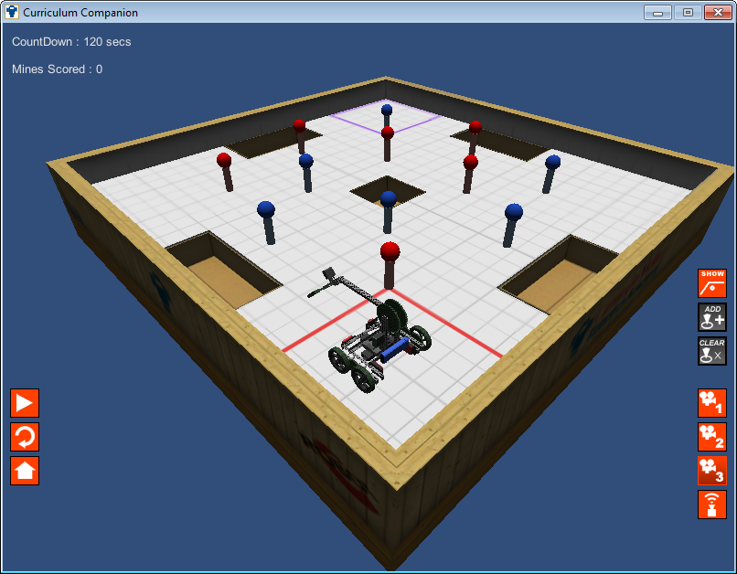
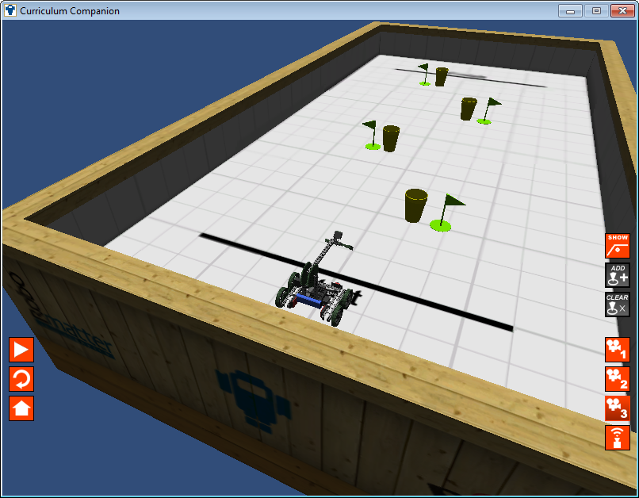
Online Time
Complete and test the drive code with the Anti-Creep code
  Test to see if the code works in the Utility -> Huge Table
In the Virtual Worlds go to the Remote Control Tab
  Bull in the Ring: Knocking out cans in < 10 sec
  Minefield Challenge: Clearing the table of bad mines while not disturbing others
  Robo Slalom I: Driving through a course. A good time to practice refining remote to controller mapping to make driving more accurate
  Round up: How many laps can you complete in one minute? The code will need to stop you from driving!

