Slide 1
Robotics Programming Using Shaft Encoders

Slide 2
Learning Objectives
Be able to use shaft encoders to control robot behavior.
Understand how a shaft encoder works
Understand the parts of a while loop
Be able to set up RobotC so you can watch the values of the sensors
Be able to write a program that uses Shaft Encoders to solve mazes.

Slide 3
Movement using Shaft Encoders
Configure (Motors and Sensors Setup)
We will look at the following in this section
SensorValue[]
while
Conditions (<, >, <=, >=, !=, ==)

Slide 4
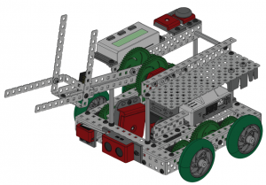
Getting Started/ Review
Open RobotC
Set up a Squarebot
rightMotor: port2
leftMotor: port3
Add code to make it go forward for 1 second and test in the Labyrinth Challenge Virtual World.
Make sure you select ‘VEX Squarebot’ from the ‘ROBOTS’ menu in the virtual world.
Make sure the robot moves forward and not just spins.

Slide 5
Taking a Look at Shaft Encoders
Cortex Video Training
Shaft Encoder Video #1
Key Questions:
What is a shaft encoder?
How many ticks per revolution?
http://dgaixldln.curriculum.cs2n.org/vcvt/lesson/3-4ShaftEncoders1.html

Slide 6
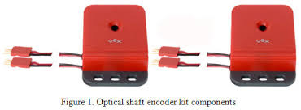
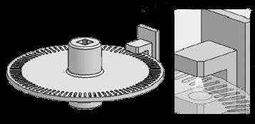
Quadrature/Shaft/Rotation Encoder
360 Ticks per revolution
Counts up going forward, down going backwards
Takes two digital input ports on the Cortex
If the wires are plugged in in reverse order, then the counter will count backwards.

Slide 7
Configuring the Encoders
Configure the encoders on your warm-up code.
Robot -> Motors and Sensors Setup
In your notes, summarize how to set up the Shaft Encoders.

Slide 8
Name and Select
1) Select the VEX Cortex Digital Sensors 1-12 tab.
2) Name the encoder. (Start with a letter, no spaces, no punctuation, no reserved words, descriptive.)
3) Select the Sensor Type. Quadrature Encoder in this case.
4) Click ‘Apply’ and ‘OK’
Note: On the Cortex the quadrature encoder cables must be plugged in next to each other.

Slide 9
pragma Statements Created

Slide 10
Cortex Video: Using the While loop
Key Questions
What are the three parts of a while loop?
Why is clearing the encoders important?
Is the while loop constantly checking its condition?
Shaft Encoders Video 3

Slide 11
Initializing and Reading the Encoder
SensorValue[rightEncoder] is used to initialize (set to 0 in this case) and read encoder values.
Initializes both encoder values to 0.
While the value of the left encoder is less than 1800 it will go through the loop again.
while (condition)
{
}

Slide 12
While Loops
A while loop is a structure within ROBOTC which allows a section of code to be repeated as long as a certain condition remains true.
There are three main parts to every while loop.

Slide 13
1. The word “while”
Every while loop begins with the keyword “while”.

Slide 14
2. The Condition
The condition controls how long or how many times a while loop repeats. While the condition is true, the while loop repeats; when the condition is false, the while loop ends and the robot moves on in the program.
The condition is checked every time the loop repeats, before the commands between the curly braces are run.

Slide 15
3. Commands to be Repeated
Commands placed between the curly braces will repeat while the (condition) is true when the program checks at the beginning of each pass through the loop.

Slide 16
Boolean Logic
Decisions robots make must always based on questions which have only two possible answers: yes or no, true or false.
Statements that can be only true or false are called Boolean statements, and their true-or-false value is called a truth value.

Slide 17
Boolean Logic Conditions: True or False
Conditions: Compare two items and return a true or a false value
RobotC Comparison Operations
< Is less than
> Is greater than
<= Is less than or equal to
>= Is greater than or equal to
== Is equal to
!= Is no equal to

Slide 18
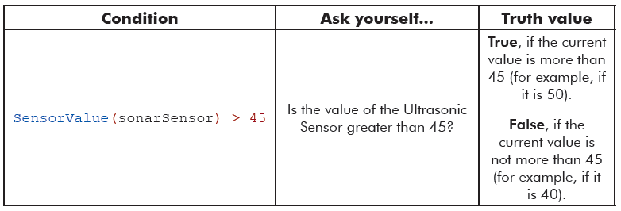
Boolean Logic

Slide 19
Back to the Encoder Example
SensorValue[rightEncoder] is used to initialize (set to 0 in this case) and read encoder values.
Initializes both encoder values to 0.
While the value of the left encoder is less than 1800 it will go through the loop again.
while (condition)
{
}
What happens if you add a
wait1Msec(12000);
command inside the while loop?
Test this code in the Virtual World.

Slide 20
Encoder Video 4: The Sensor Debug Window
Key Questions:
How do you watch the values of the sensors change while the robot is running?
Link to Video

Slide 21
Debugging: Watching the Sensor Values
Open Debugger window for Sensors
Robot->Degugger Windows -> Sensors

Slide 22
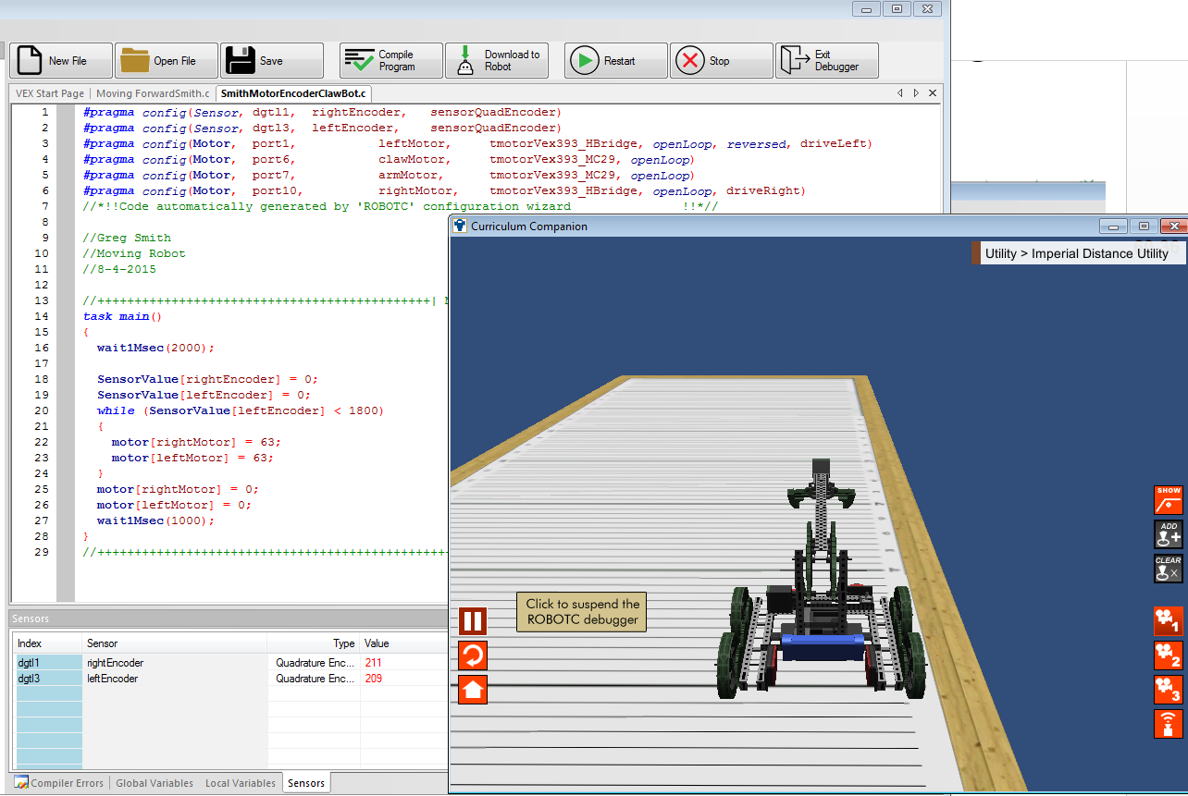
Watch the Values
Run the program in the Virtual World
Watch the sensor values change
Sensor Values

Slide 23
Video #5: Forward and Turning
Key Questions:
What does it mean when the values are going down?
What happens if you do not reset the shaft encoder values?
Link to Video

Slide 24
Online Time
Motor Encoder Movement Challenges using only encoders, no wait1Msec().
Basketball Drills
Turning Investigation
Labyrinth Challenge

