Slide 1
Is there an alternative to copy-paste for repeating code?
Today we will look at a way to have robotC repeat code without having to copy..paste..copy..paste…

Slide 2
Learning Targets
Be able to create and use a variable
Be able to read a program that uses a for loop
Be able to write a program that uses a for loop.

Slide 3
For loop to the rescue
Great for repeating a chunk of code a set number of times
Like
Sentry Simulation
Basketball drills
…
We will incorporate this into the Basketball drills program, then let you implement it on the Sentry Simulation

Slide 4
Looking at Potential Solutions to Basketball Drills
Pseudo Code
Go forward long enough to cross the first line
Come back
Go forward long enough to cross the second line
Come back
Go forward lone enough to cross the third line
Come back
With enough guessing and checking, you can get the correct values for the wait1Msec()

Slide 5
Using a Variable to help with changes
Variable name rules. An integer variable.
Start with a letter
No spaces – punctuation
Not a reserved word
Describes what it is storing.
If there was only a way to repeat a chuck on code without having to copy - paste

Slide 6
For loop in RobotC
When to use it
When you want to repeat something a set number of times
Syntax
for(int line = 1; line<=3; line++)
{
//Code repeated
}
Declares an integer variable called line and gives it an initial value of 1
If the line variable is less than or equal to 3 when it reaches this, it will do the loop another time.
After completing the loop, it will add 1 to the variable line.
In this example it will repeat the code inside the {} three times.
Once when line = 1
Once when line = 2
And
Once when line = 3

Slide 7
Describe how the robot would move with the following code
int x = 1000;
for(int line = 1; line<=3; line++)
{
motor[leftMotor] = 50;
motor[rightMotor] = 50;
wait1Msec(x*line);
motor[leftMotor] = -50;
motor[rightMotor] = 50;
wait1Msec(x*line);
}
for(int line = 1; line<=3; line++)
{
motor[leftMotor] = 50;
motor[rightMotor] = 50;
wait1Msec(1000);
motor[leftMotor] = -50;
motor[rightMotor] = 50;
wait1Msec(1000);
}
for(int line = 1; line<=3; line++)
{
motor[leftMotor] = 50;
motor[rightMotor] = 50;
wait1Msec(1000*line);
motor[leftMotor] = -50;
motor[rightMotor] = 50;
wait1Msec(1000*line);
}

Slide 8
No loop vs. for loop

Slide 9
For loop example
Since line = 1 the first time through this loop
line*timeToLine is the same as
1*2400 = 2400
the first time through this loop.
Then
2*2400 = 4800
the second time and
3*2400 = 7200
the third time.
RobotC does the math inside the () before executing the wait1Msec() command

Slide 10
Today
Complete the Movement Challenges
Incorporate the for loop
For each Challenge you complete using the for loop to help with the solution, you get 10% Extra Credit for the assignment

Slide 11
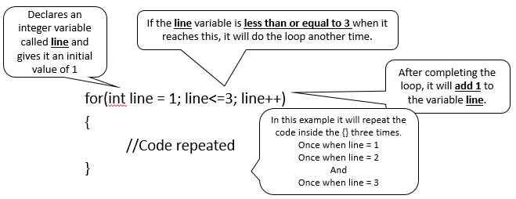
For loop

