Slide 1
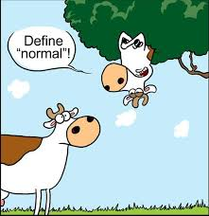
Probability and Statistics
Open note Chapter 3 Test on Friday
What is normal?

Slide 2
Statistics Review/ Excel: Objectives
Be able to find the mean, median, mode and standard deviation for a set of data.
Be able to make a Histogram for a set of data.
Be able to analyze probability distributions and determine if they are Normal.
Be able to use the tools in Excel to analyze larger sets of data.

Slide 3
Review: In your notebook
Calculate the mean, median, mode and standard deviation for the following set of data
10, 10, 13

Slide 4
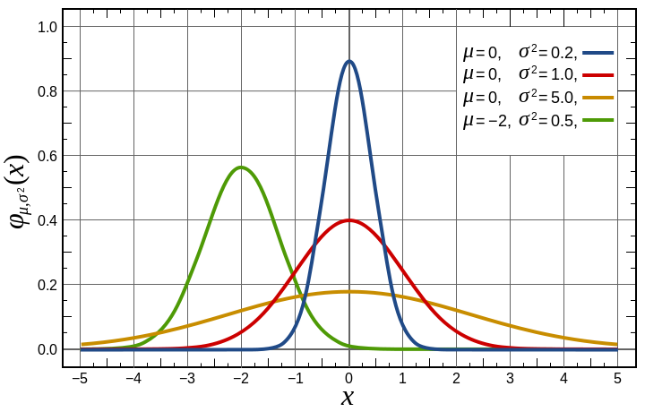
Probability Distribution
Notes
Definition
Sketch of Distribution
A distribution of all possible values of a variable with an indication of the likelihood that each will occur
A probability distribution can be represented by a probability density function
Normal Distribution – most commonly used probability distribution
http://en.wikipedia.org/wiki/File:Normal_Distribution_PDF.svg
Notes:
We often use probability distributions to represent and help quantify data. [click]
A function (which can be represented by a graph or an equation), called a probability density function, can be used to find the probability that a data value will fall within a specific range of values. [click].
It is not important that you know the equation for a normal probability density function, but you should know that a normal probability density function is represented by a bell shaped graph.

Slide 5
Normal Distribution Distribution
Summarize in Notes
“Is the data distribution normal?”
Translation: Is the histogram/dot plot bell-shaped?
Does the greatest frequency of the data values occur at about the mean value? (Mode = mean)
Does the curve decrease on both sides away from the mean?
Is the curve symmetric about the mean?
Notes:
A normal distribution has a bell shaped probability density function and is informally known as a bell curve.
This image shows a graph of examples of the density functions for several normal distributions.
To determine whether a data is distributed normally, take a look at the histogram or dot plot of the data. [3 clicks]

Slide 6
Normal Distribution Distribution
Bell shaped curve
Frequency
-6
-5
-4
-3
-2
-1
0
1
2
3
4
5
6
Data Elements
Notes:
Let’s look at an example data set. This dot plot is the same one you saw in a previous presentation.
[click] If you smooth out the dot plot (or histogram) with a continuous curve, the line will appear bell shaped when the data is normally distributed.
In this case, the data does appears to form a bell shaped curve [click] and this data set looks to be normally distributed. But let’s look a little closer.

Slide 7
Normal Distribution Distribution
Does the greatest frequency of the data values occur at about the mean value?
Mean Value
Frequency
-6
-5
-4
-3
-2
-1
0
1
2
3
4
5
6
Data Elements
Notes:
YES. In this example, the highest frequency of values occurs at zero, which is approximately the mean value of the data set.

Slide 8
Normal Distribution Distribution
Does the curve decrease on both sides away from the mean?
Mean Value
Frequency
-6
-5
-4
-3
-2
-1
0
1
2
3
4
5
6
Data Elements
Notes:
YES. In this case, the curve decreases away from the peak (mean) on both sides.

Slide 9
Normal Distribution Distribution
Is the curve symmetric about the mean?
Mean Value
Frequency
-6
-5
-4
-3
-2
-1
0
1
2
3
4
5
6
Data Elements
Notes:
And, YES, in this example the curve is symmetric about the peak (mean).
Again, the data values appear to be normally distributed.

Slide 10
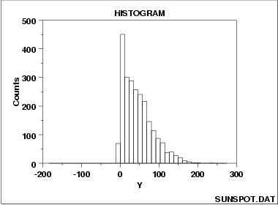
What if the data is not symmetric?
Histogram Interpretation: Skewed (Non-Normal) Right
Notes:
Although a normal distribution is the most common probability distribution in statistics and science, some quantities are not normally distributed. A visual analysis can help you decide if a normal distribution is a good representation for your data (although mathematical tests are usually necessary). If the data is skewed you should not assume a normal distribution of data.
This histogram shows that the data is skewed to the right, that is, there is a longer “tail” to the right.

Slide 11
What if the data is not symmetric?
A normal distribution is a reasonable assumption.
Notes:
In many cases, the histogram will not appear “exactly” symmetric, but a normal distribution can be justified – especially if the number of data values is small.
In this case, it appears that the mean is approximately 4.05. And although the bars of the histogram are not perfectly symmetric about the mean, if a smooth curve is used to approximate the tops of the bars, a bell shaped curve is reasonable. [click]
There are an equal number of data values on either side of the mean, and the curve does drop on both sides away from the mean.

Slide 12
Back to Excel… Functions
Open the Excel ‘Heightsworksheet’ document with the heights from class website
Use functions to find the following statistics for the set of height measurements
Mean
Mode:
Standard Deviation (population)
Minimum
Median
Maximum
Use your notes to find the formulas.

Slide 13
Making a Histogram: Loading the Analysis Toolpak
File -> Options
Click Add-Ins -> Manage box -> Excel Add-ins
Go
Add-Ins available box, Select the Analysis ToolPak check box ->OK

Slide 14
Frequency Chart and Histogram
Frequency Chart
indicates the frequency of occurrence within a class interval
Histogram
graphical representation of the Frequency Chart
Notes:
[Allow students time to input bin values.] Note that the class interval boundaries are typically chosen such that the boundary values contain one decimal place more than the measurement values. For simplicity, we will use zero in the last decimal place.

Slide 15
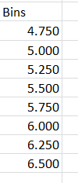
Frequency Chart and Histogram
Select class intervals
Use 0.250 ft intervals for height data
Define Bin values
Bins give the boundary point between class intervals
Values less than or equal to bin value (but greater than previous bin value) are counted
1) Create the Bin chart for the decimal height measures.
Notes:
[Allow students time to input bin values.] Note that the class interval boundaries are typically chosen such that the boundary values contain one decimal place more than the measurement values. For simplicity, we will use zero in the last decimal place.

Slide 16
Frequency Chart and Histogram
Select the Data Analysis Tool
Data tab > Analysis panel
Notes:
[Allow students time to input bin values.]

Slide 17
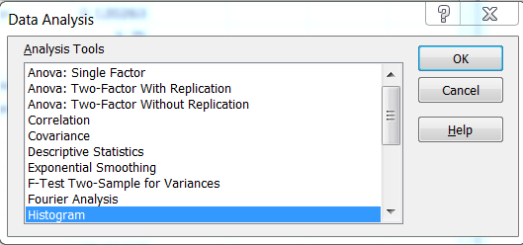
Frequency Chart and Histogram
Select the Data Analysis Tool
Data tab > Analysis panel
Choose Histogram tool
OK
Notes:
[Allow students time to input bin values.]

Slide 18
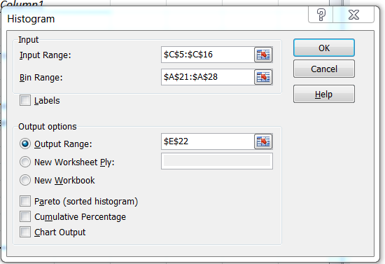
Frequency Chart and Histogram
Select the Data Analysis Tool
Data tab > Analysis panel
Choose Histogram tool
OK
Select Input Range
Select Bin Range
Choose Output Range
Select a cell on the worksheet
Select ‘Chart Output’
OK
x
Notes:
[click through arrow display and allow students time to complete steps.]
The result should be a frequency chart similar to this. [click]

Slide 19
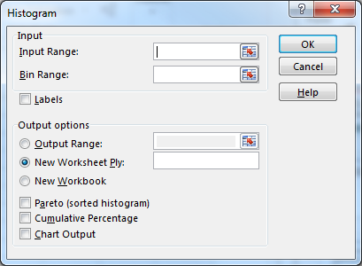
Selecting Input Range
1) Click on
2) Click and Drag to Select the Values to Graph
3) Hit ‘Enter’

Slide 20
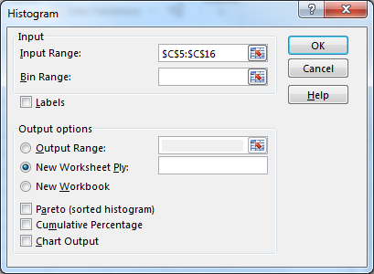
Selecting Bin Range
1) Click on
2) Click and Drag to Select the Bin Values
3) Hit ‘Enter’

Slide 21
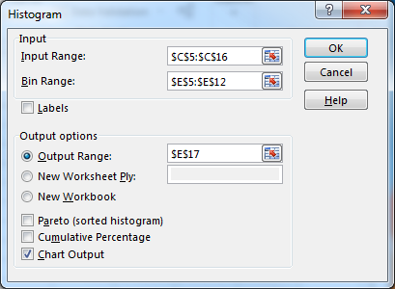
Chart Output
1) Click on ‘Output Range’ Button
2) Click to check ‘Chart Output’
3) Click on a Cell on the Worksheet to select where the Histogram will show up.
4) Click ‘OK’

Slide 22
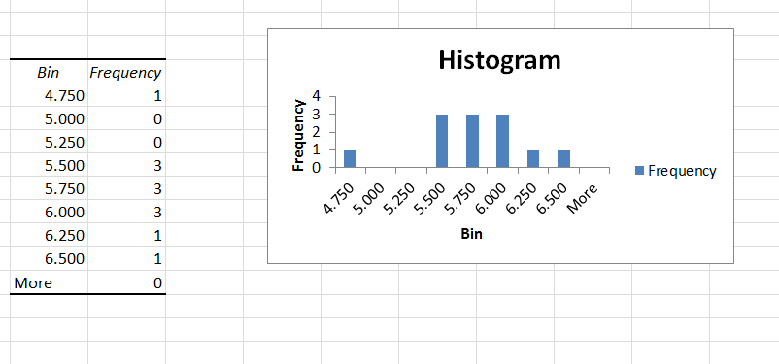
Frequency Chart and Histogram
Histogram
Frequency Chart
Notes:
This is a version of the output that is generated for this data.

Slide 23
Correct Data Labels
1) Double click on ‘Histogram’ and change to ‘Heights of Students’
3) Double click on ‘Frequency’ and delete it.
4) Turn it in as YourNameHeights.
2) Double click on ‘Bin’ to ‘Height’

Slide 24
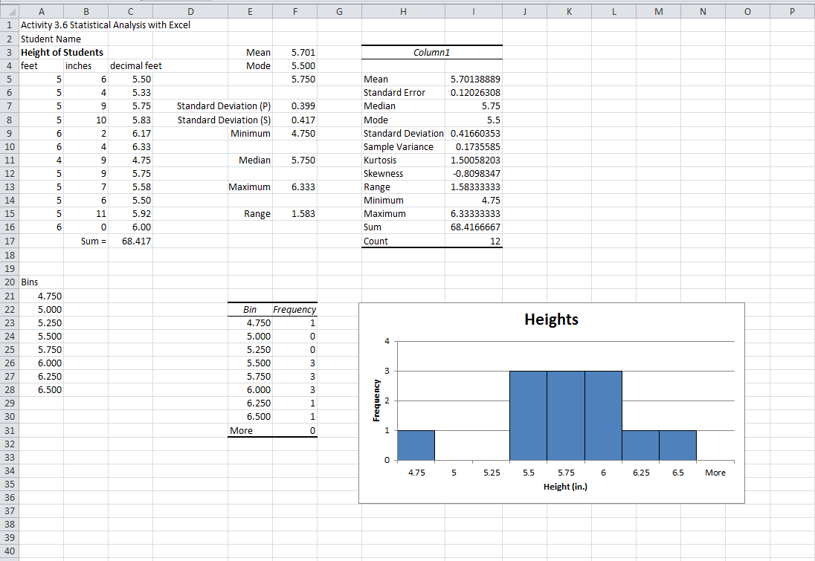
Excel Worksheet
Using the data from the Cube Measures
Find the Mean, Median, Mode, Standard Deviation and create a histogram of the data.
Push: Experiment with the Histogram, display other statistics on the data.
YourNameCubeStatistics
Continue on the 3.3 Worksheet

