Slide 1
Inventor 2015 Training

Slide 2
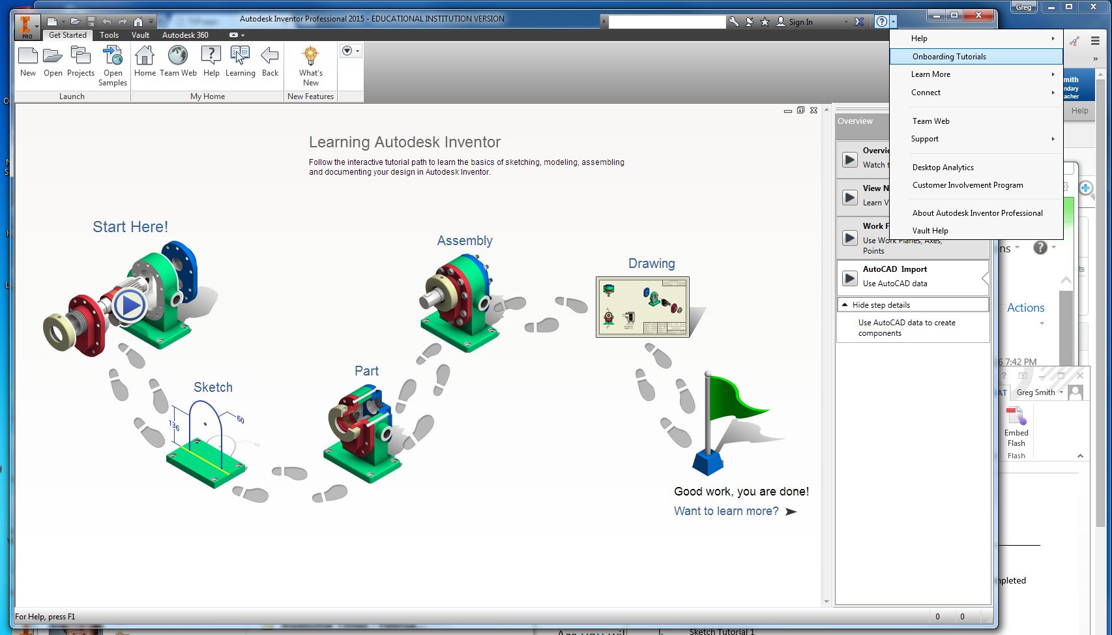
Open Inventor 2015 ‘Onboarding Tutorials’
Click on the ‘?’ and select ‘Onboarding Tutorials’

Slide 3
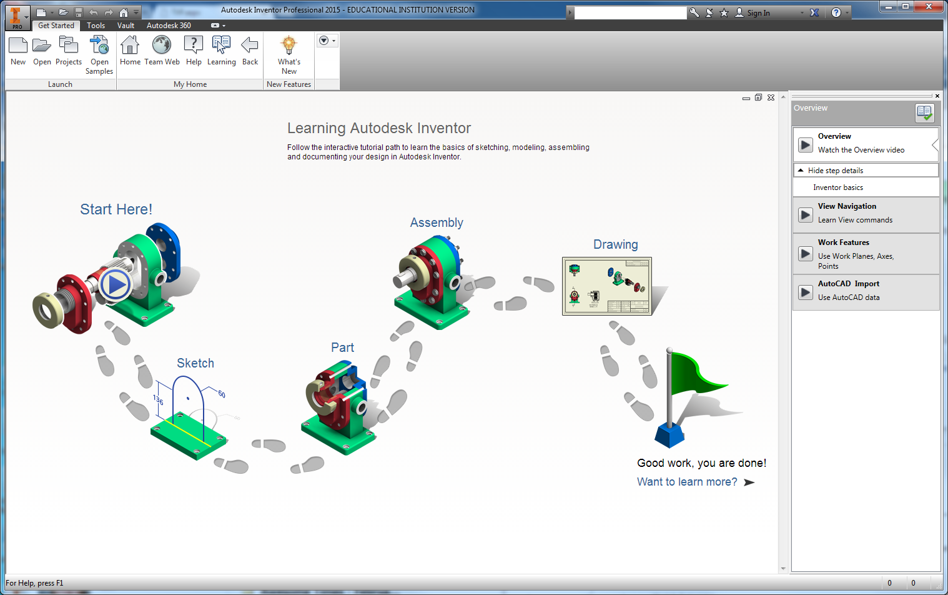
Watch and Take Notes on the ‘Start Here’ Videos
The right panel has 4 videos.
Click on the ‘Play’ button to play each video.

Slide 4
Sketch Tutorial
Click on the ‘Sketch’ tutorial

Slide 5
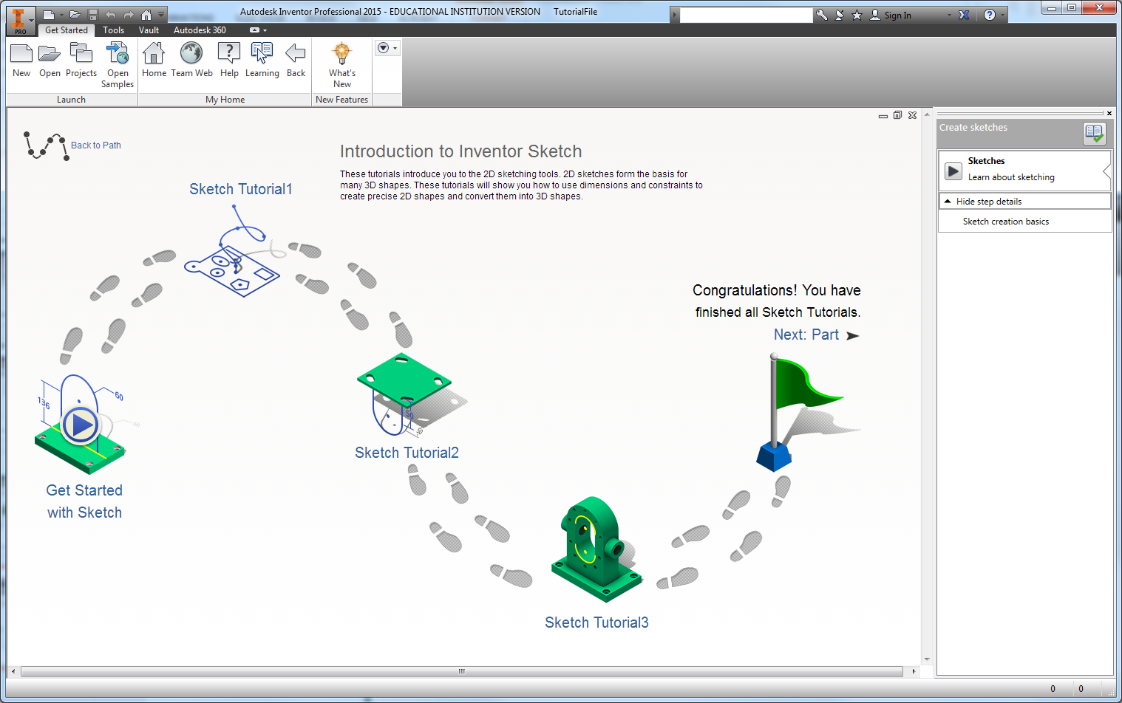
Watch and take notes on the Get Started with Sketch Section
2) Click on the play button to watch the video and take notes.
1) Click on ‘Get Started with Sketch’.

Slide 6
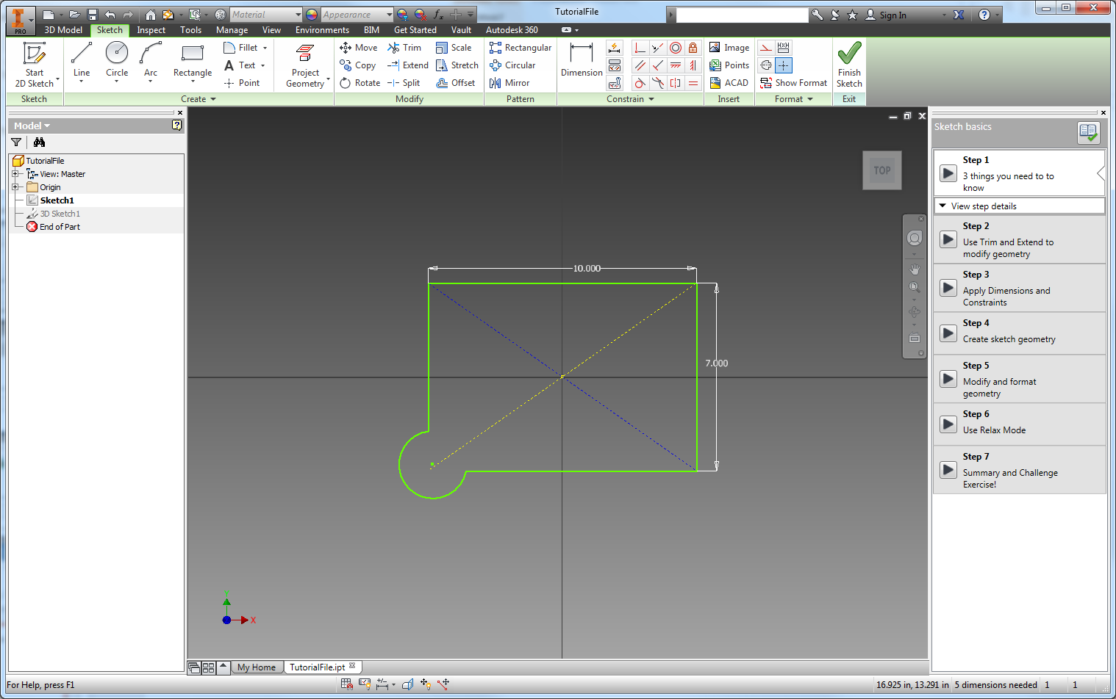
Complete the Sketch Tutorials
1) This panel has videos and exercises that you will complete in the main window to the left.
Have the teach sign off on the steps you complete.
2) When you complete the exercise, show it to the teacher and have the paper initialized.

Slide 7
Continue Training
Have the instructor sign off on the completed activities

Slide 8
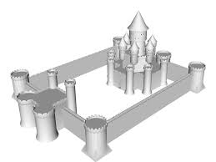
Castle Project
Build a Castle in Inventor
Towers
Windows
Doors
Moat
….
Use this activity to experiment with the features you just learned.

