Slide 1
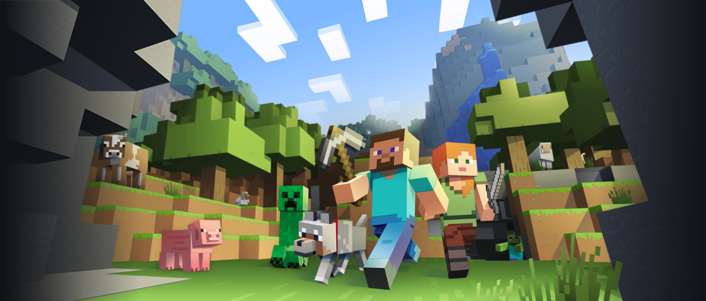
Intro to Engineering Design

Slide 2
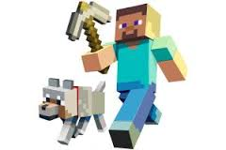
Learning Objective
Improve in creating Three-Dimensional Drawings

Slide 3
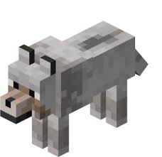
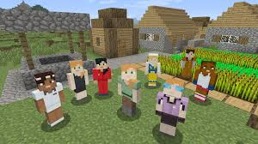
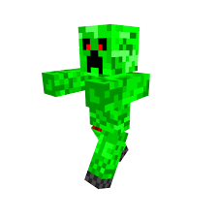
Outline for Today
Complete the one-Point and Two-Point sketching activities
Create a Minecraft Character, Scene, or Object using one of the methods for creating 3D images:
Isometric, Oblique, or Perspective

