Slide 1
Importing a Sprite from another Project

Slide 2
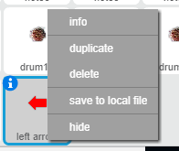
Save the Sprite
Right Click on the Sprite
‘save to local file’
Navigate to a place where you can find the sprite.

Slide 3
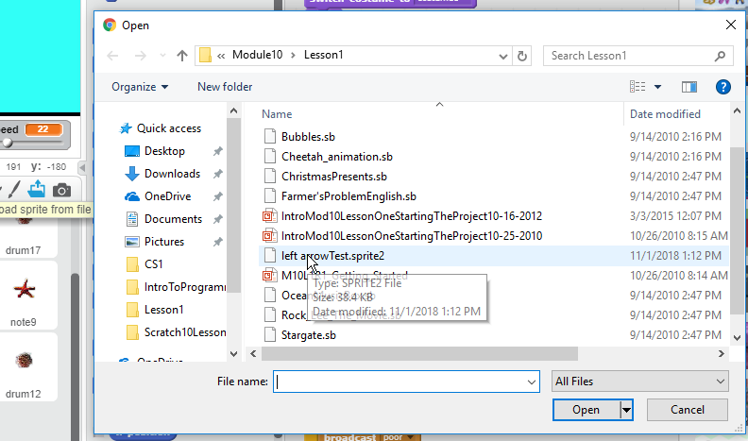
Open the Destination Project
1) Click on Load Sprite
2) Navigate windows to find the sprite.
Select it and open

