Slide 1
Helicopter scratch project
By Erik Hoffman and Zack Ketrow
Notes:
Introduction

Slide 2
Division of work
Erik figured out the movement of the helicopter and the scoring system.
Zack made the backgrounds, fireball, and small improvements.

Slide 3
Description of project
The helicopter needs to reach the end of the level two to win. If a fireball hits it the game is over.
When the helicopter goes through a loop you gain a point and once you get enough points you go to the next level.

Slide 4
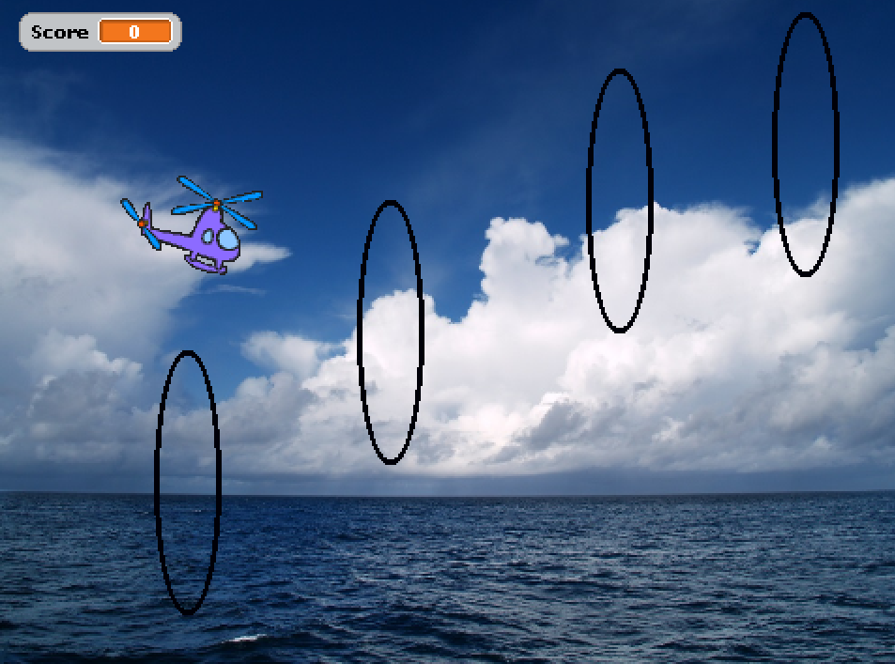
Testing problems/solutions
The loops went through many design phases and functions but we decided that when the helicopter touched the loop it would disappear and you would get a point.
Also the helicopter movement needed adjusting and the scoring system was tricky.

Slide 5
Things we enjoyed
Getting the movement we wanted was tricky at first. We started with just arrow keys moving you but went to copying a movement design already on the computer.
The loops were also fun to try to get working.

Slide 6
conclusion
In the end everything works great. The helicopter flies well, the loops disappear when you hit them, and you lose when to hit a fireball.

