Slide 1
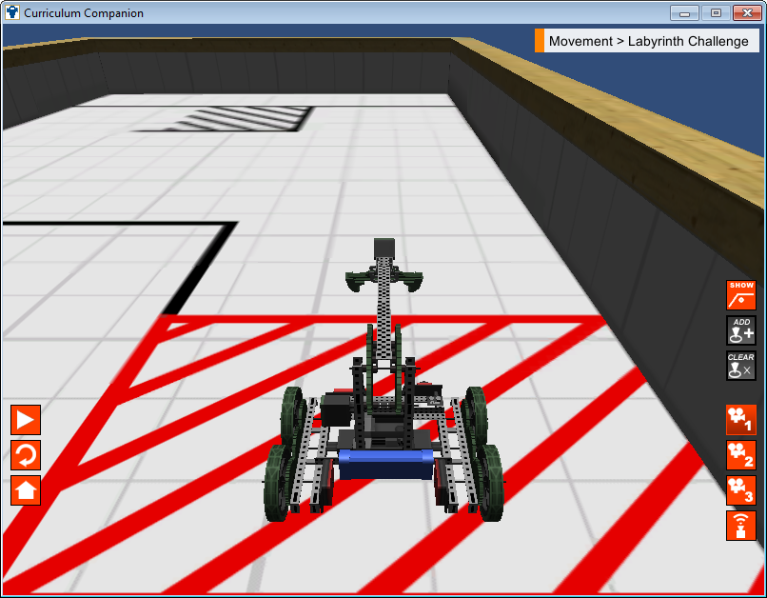
Getting Started in RobotC
Take out your notes.
// Comment
task
main()
motor[]
{}
wait1Msec()
;
=
Header
Code
Compile
Download
Run

Slide 2
Learning Objectives
Understand the fundamentals of programming a robot.
Programmer and Machine
Planning and Behavior
Basic RobotC Rules
Understand how to use the Motors and Sensors Setup to configure your robot.
Write a program for a Robot to complete some simple tasks.

Slide 3
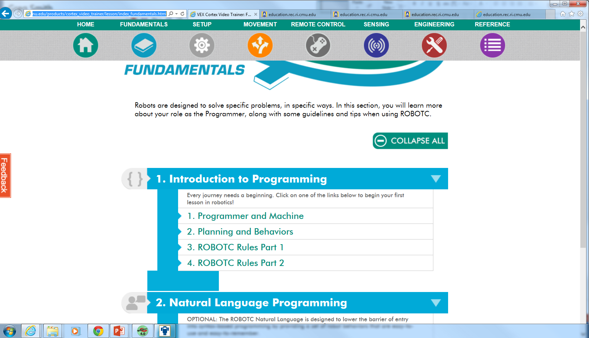
Fundamentals
Take notes (Ideas, commands, punctuation..)
Be prepared to share one thing you learned or was reinforced in the video.
Click on Fundamentals
Watch and take notes on these four short videos.

Slide 4
Introduction to Programming
Search VEX Cortex Video Trainer or go to the following website.
http://education.rec.ri.cmu.edu/products/cortex_video_trainer/
There is also a link on the class website.
Click on the ‘Fundamentals’ button
Watch and take notes on the videos for
2. Planning and Behaviors
3. RobotC Rules Part 1
4. RobotC Rules Part 2
Be prepared to share one thing from each of the videos.
Take the quizzes that are after the videos to check for understanding.

Slide 5
Getting Started in RobotC
Open RobotC
Select VEX 2.0 Cortex Platform
Robot-> Platform ->VEX 2.0 Cortex
Make the robot compile to Virtual Worlds
Robot-> Compiler Target -> Virtual Worlds
Select Virtual World
Window->Select Virtual World to Use -> Curriculum Companion
Start a new file
File – New File

Slide 6
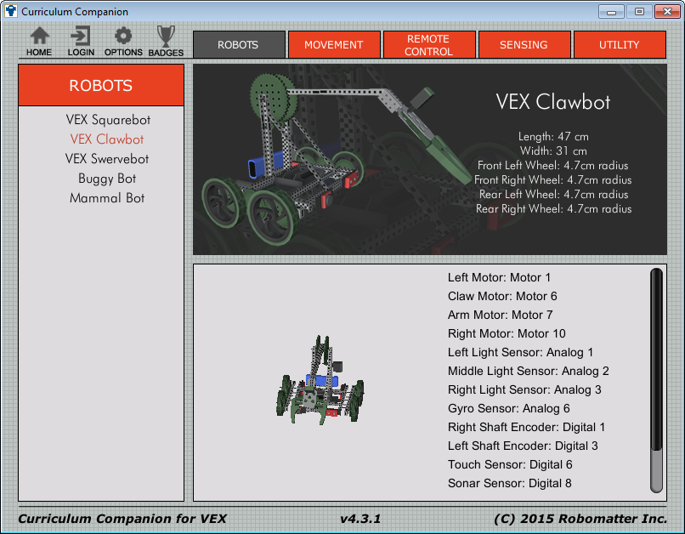
Your Robot

Slide 7
Configuring the Robot: Focus on Motors
Robot -> Motors and Sensors Setup
Select the motor
Currently can only purchase 393 Motors, also modify for internal gearing (high speed, turbo speed)
Naming Convention
Rules
Start with a letter
No spaces, punctuation or reserved words (blue)
Style
Describes what it represents
First letter is lowercase
otherWordsStartWithUppercaseLetters
For these motors
leftMotor
clawMotor
armMotor
rightMotor

Slide 8
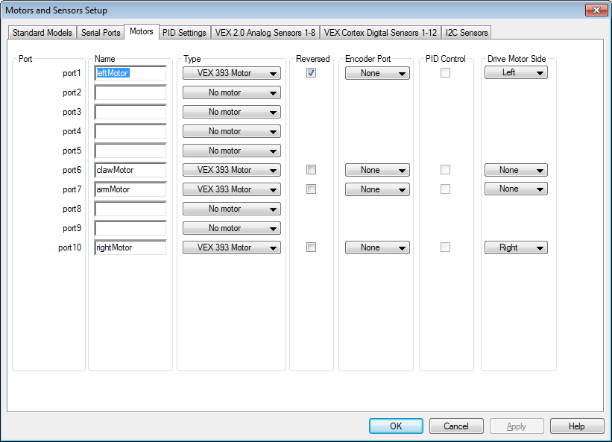
Motors and Sensors Setup Page
1) Select the ‘Motors’ tab.
3) Use the pull down menus to select the motor.
4) The left motor will need to be reversed so the robot does not go in circles.
2) Name the motor in the desired port.
5) Select the side for drive motors.
6) Complete the setup for the remaining motors.
7) Click on Apply to remember the changes.

Slide 9
Motors and Sensors setup creates ‘pre-processor directives’

Slide 10
Now we can start looking at RobotC
motor[motorName] = motorPower;
wait1Msec(milliseconds);

Slide 11
Vocabulary
//
Comment
task
main()
motor[]
{}
wait1Msec()
;
=
Header
Code
Compile
Download
Run
The Header
// In front of the line makes this line a comment
/* */ for multiple line comments.
What do you think this code will do?
{}
Marks the begin and end of a block of code
task main()
Marks the beginning of the instructions for the Robot.
RobotC Is CaSe SeNsItIvE!
; is used to mark the end of a command.
motor[rightMotor] = 127;
motor[] Used to select the motor.
rightMotor = This represents the place where the motor is attached.
motor[port10] = 127; does the same thing.
= 127;
127 = full power
-127 = Reverse
0 = stop
wait1Msec(2000);
The robot continues what it was doing for (2000) milliseconds.
Two seconds in this case.
Code Break. Open RobotC, configure the motors and enter the above code.
Notes:
Advanced students can also download the program to their physical robot.

Slide 12
Testing the Program
Compile the program
Changes into machine code that the robot understands.
Download the program
Moving the machine language to your Virtual or Physical Robot
Virtual Robot
Log in
Select Robot
Select Challenge
Start Activity

Slide 13
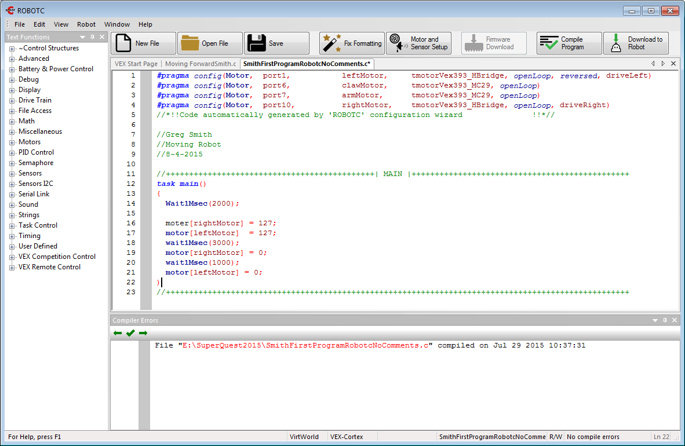
Compiling the Program

Slide 14
Oops!
The compiler catches syntax (typing) errors and gives some hints on how to fix them.

Slide 15
Errors
Red X = error
Yellow X = Warning
Errors and hints on the bottom of the page. If you click on an error it will highlight the line of the error.
Any guesses on how to fix these mistakes?

Slide 16
Corrected and Compiled

Slide 17
Download the program
Since we set it up to map to Virtual Worlds it will download to a Virtual Robot.

Slide 18
Set up and Account with CS2N. It will track progress. Can log in locally as a guest without tracking.
Create an Account for you in CS2N

Slide 19
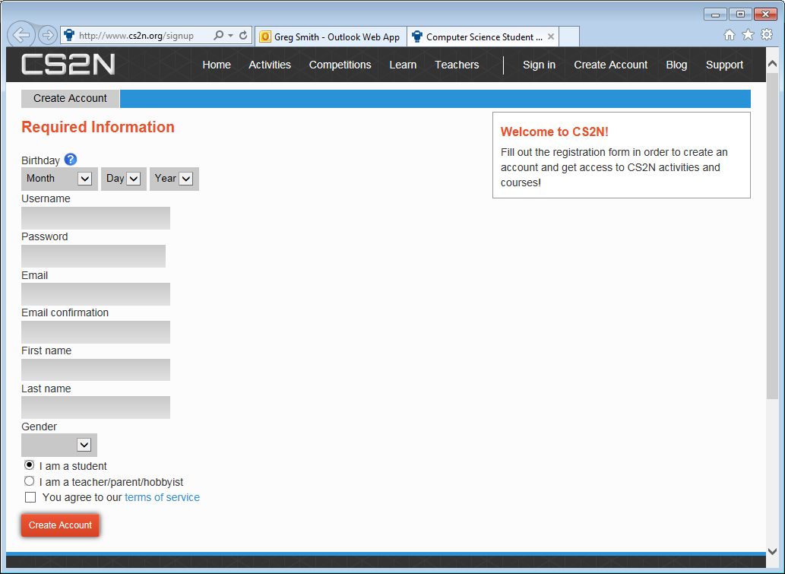

Slide 20
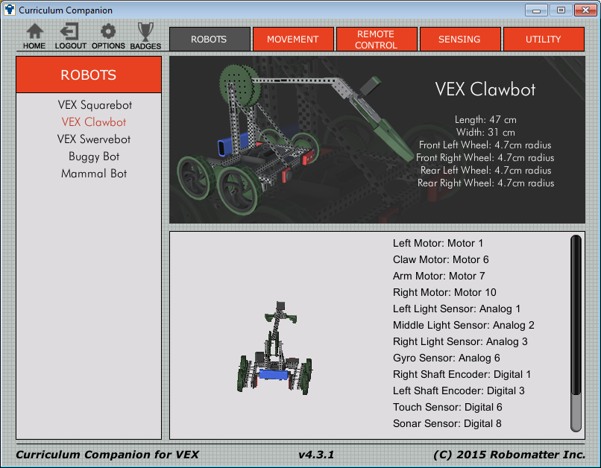
Select Your Robot
1) Robots Tab
2) I will be using the Clawbot for discussion

Slide 21
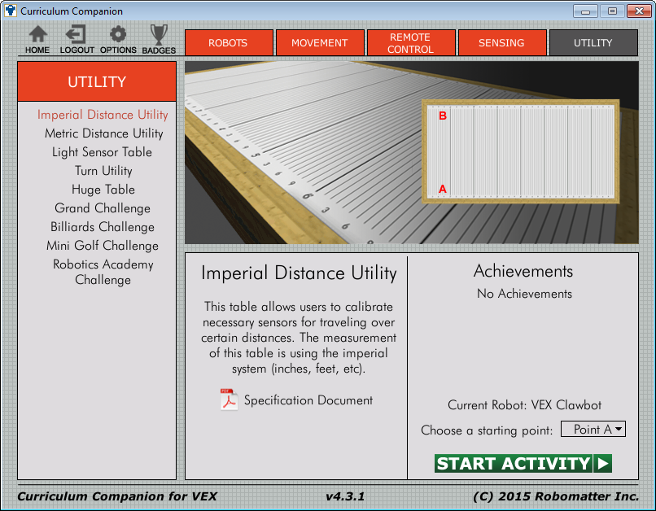
Select Activity: Utility-> Imperial Distance Utility
2) Imperial Distance Utility
1) Utility Tab
3) Start Activity

Slide 22
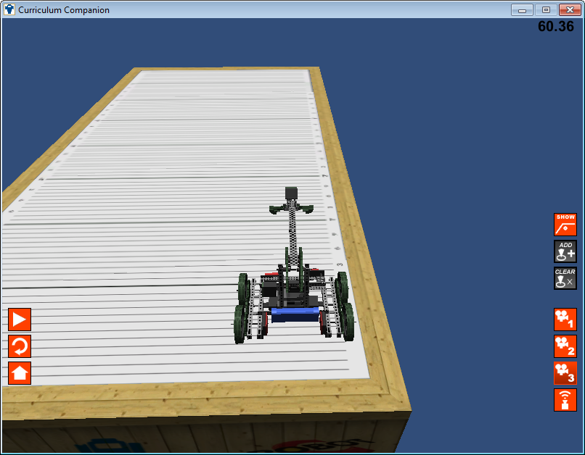
Select Camera and Go
Follows Right
Scroll: Zoom
2) Top Down View
Play: Run the program
3) Free Movement:
Scroll: Zoom
Click-Drag: Rotate View
Reset
Home
Show Sensors Toggle

Slide 23
Your Turn
Enter the Sample program
Motors and Sensors Setup
task main() and code
Compile and correct errors
Download to the virtual robot
Run the program
Reference Website:
http://education.rec.ri.cmu.edu/products/cortex_video_trainer/
Click on Movement for much of the material covered
Notes:
http://education.rec.ri.cmu.edu/products/cortex_video_trainer/lesson/index_movement.html

Slide 24
How the Challenges are Graded
Movement: Basketball Drills
Programming (10 Points = 100%)
___ Program compiles (4 points)
___ Header complete with names, description and date (2 points)
___ Code is properly indented (2 points)
___ Comments in the program describing the code (2 points)
Performance (10 points = 100%)
____ Completed

Slide 25
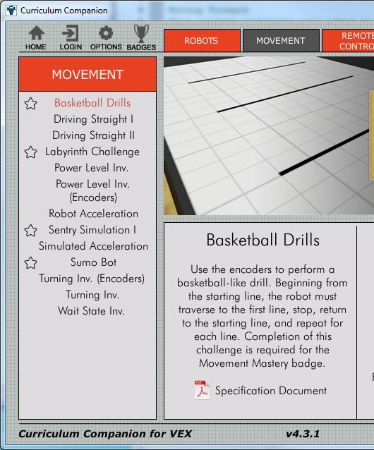
Assignment
Complete the following Challenges
Basketball Drills
Sentry Simulation I
Labyrinth Challenge.
For each Challenge, demonstrate the solution to Mr. Smith and have your code graded.
Save your Solutions in the Movement Challenges Folder.

