Slide 2
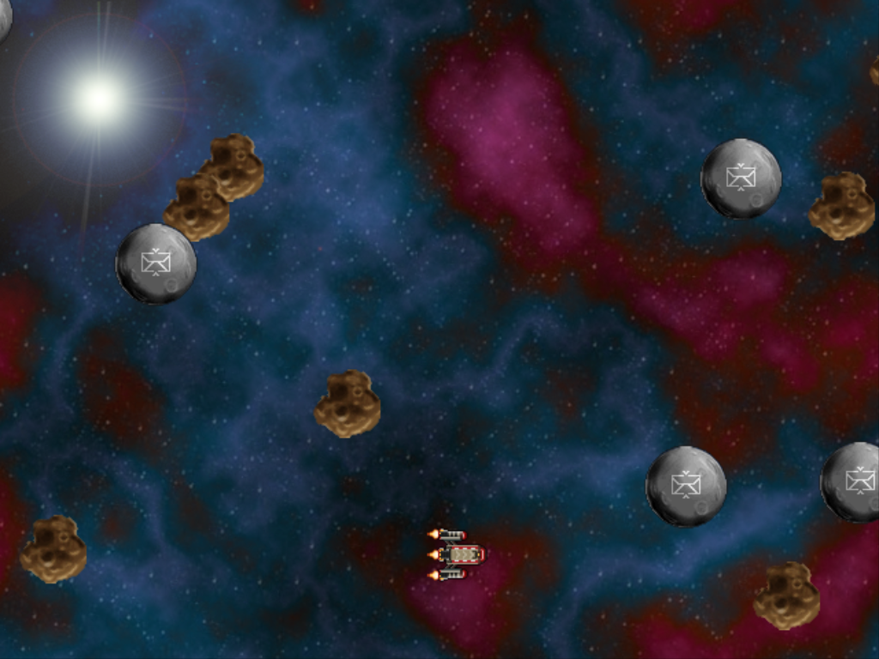
Game Maker
Galactic Mail
Advanced Group:
Complete Galactic Mail, then start developing an independent project.

Slide 3
Galactic Mail
You play an intergalactic mail carrier who must deliver mail to a number of inhabited moons.
You must safely steer a course from moon to moon while avoiding dangerous asteroids.
The mail carrier is paid for each delivery he makes, but pay is deducted for time spent hanging around on moons.
This adds pressure to the difficult task of orienting his rickety, old rocket, which he cannot steer very well in space.

Slide 4
When the rocket is on a moon, the arrow keys will rotate it to allow the launch direction to be set.
The spacebar will launch the rocket, and the moon will be removed from the screen to show that its mail has been delivered.
In flight, the rocket will keep moving in the direction it is pointing in, with only a limited amount of control over its steering using the arrow keys.
When things move outside the playing area, they reappear on the other side to give the impression of a continuous world.
The player will gain points for delivering mail, but points will be deducted while waiting on a moon.
This will encourage the player to move as quickly as possible from moon to moon.
There will be different levels, with more asteroids to avoid. The game is over if the rocket is hit by an asteroid, and a high-score table will be displayed.

Slide 5
Galactic Mail
This game includes
Rocket ships
Moons
Asteroids
Scoring, with deductions
Different Levels

Slide 6
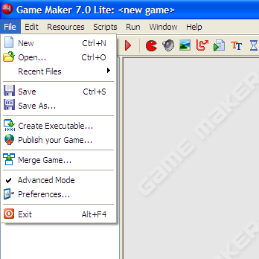
Getting Started
Make sure that you are in advanced mode.
File and make sure that Advanced is checked.

Slide 7
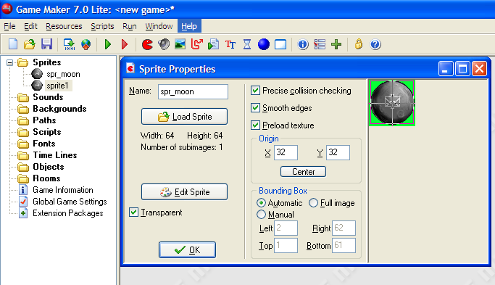
Making Sprites
Moon.gif
Remember to center and smooth.
Do the same for
Asteroid.gif ->spr_asteroid
Explosion.gif -> spr_ explosion
Landed.gif -> spr_landed
Flying.gif -> spr_flying
Click on ‘Smooth edges’
Create Sprite
Spr_moon
Move the origin to the center.
Load Sprite
resources\chapter3

Slide 8
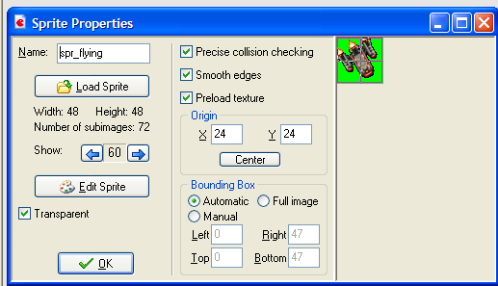
Looking a the Flying Ship
This sprite is made up of 72 images. These are for the ship pointing in different directions.
You can click the arrows to see the different images.

Slide 9
Loading some Sounds
Create sounds for…
Snd_explosion
Snd_bonus
Music_background

Slide 10
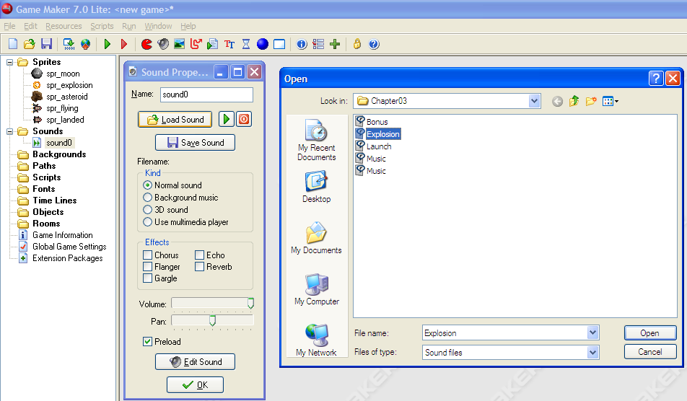
Explosion
Click on ‘Create a Sound’
Double click on Explosion
Label is as
Snd_explosion
Other Sounds
Snd_explosion
Snd_bonus
Music_background
Click on Load Sound
Click OK

Slide 11
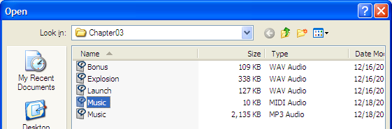
More Sounds
Also load sounds for bonus (bonus.wav) and music background (music.midi)

Slide 12
Moon Objects
Start moving in a random direction
Wrap

Slide 13
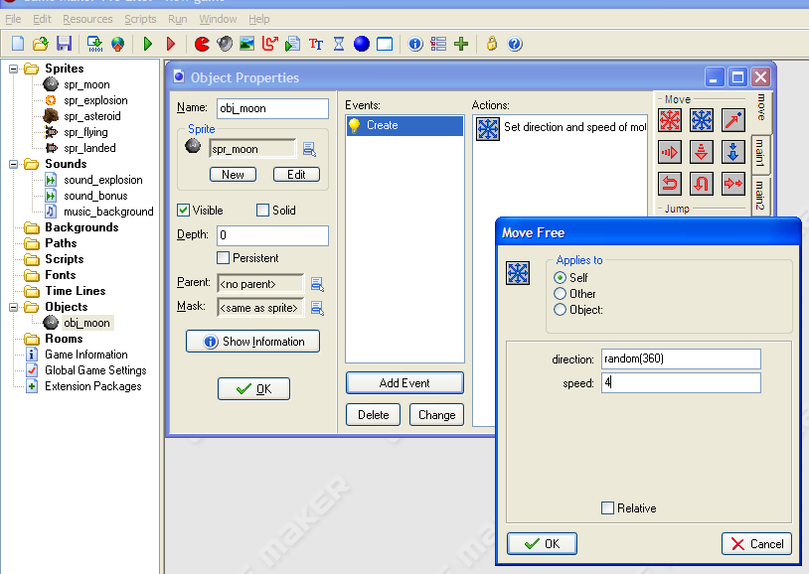
Moon
Create Object
Drag ‘Move Free’
Select the spr_moon
Set the random direction.
random(360)
Add Event
Create
Give it a speed of 4

Slide 14
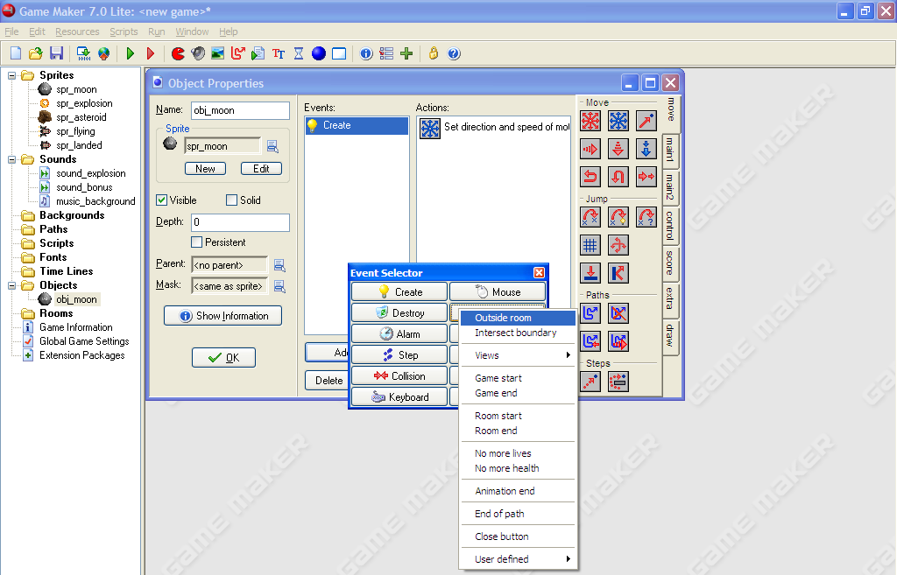
Wrap the Moon
Other
Outside Room
Add event

Slide 15
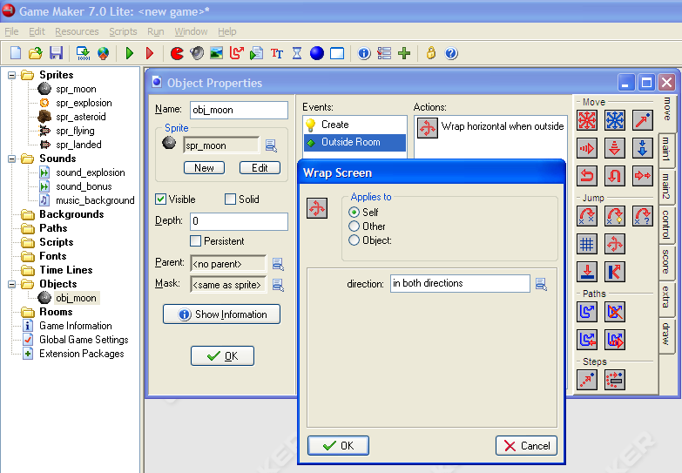
Select ‘Wrap Screen’
Open a room, add a moon and test that the wrapping works.
Select
‘in both directions’
OK

Slide 16
Asteroids
Act like the moon but…
They need to go behind the other objects. (Depth)

Slide 17
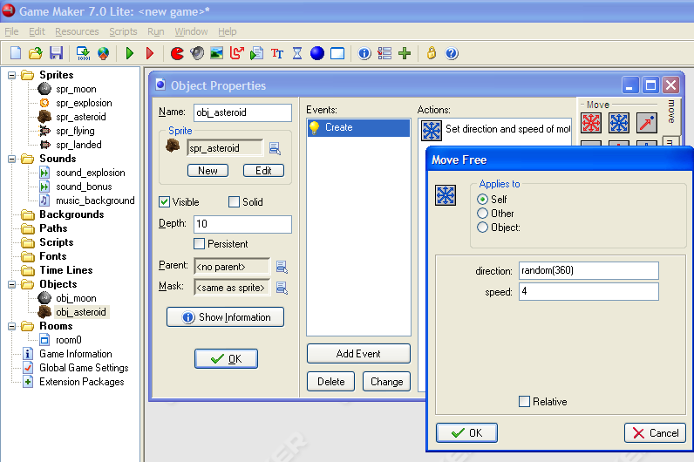
Asteroid
Move Free
Create Object
Select sprite
Spr_asteroid
Set the depth to 10.
random(360)
Speed 4
Add Event, create

Slide 18
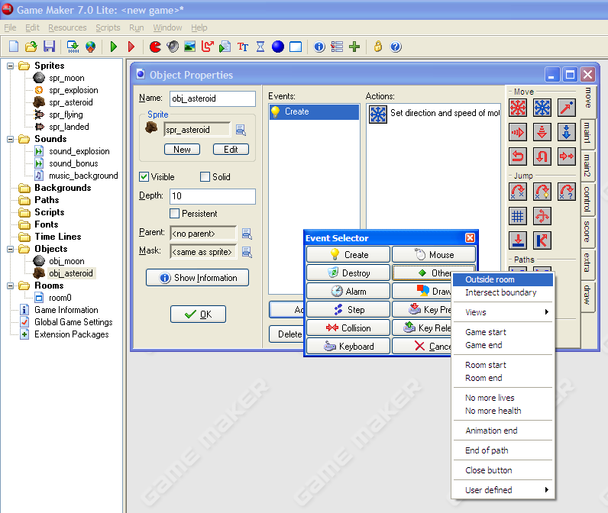
Wrapping
Other
Outside Room
Add Event

Slide 19
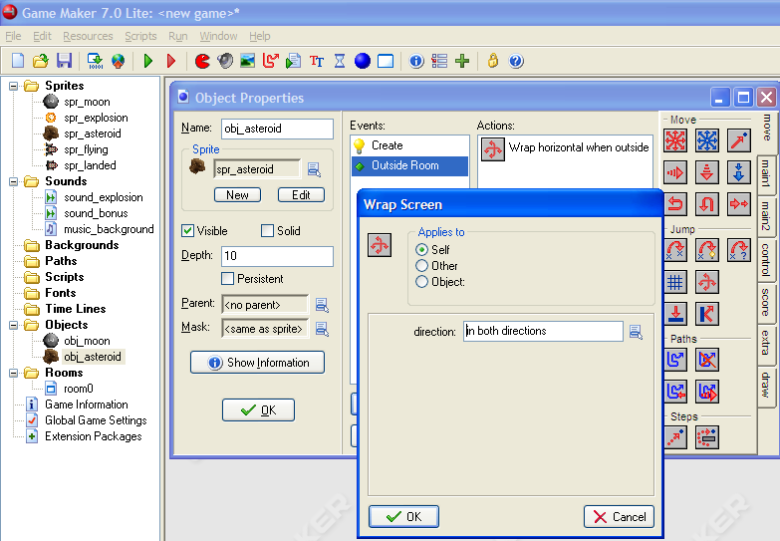
Open the room and add Asteroid and Moon objects to test.
Wrap Screen
In both directions

Slide 20
Make a room
Create a background
Create a room

Slide 21
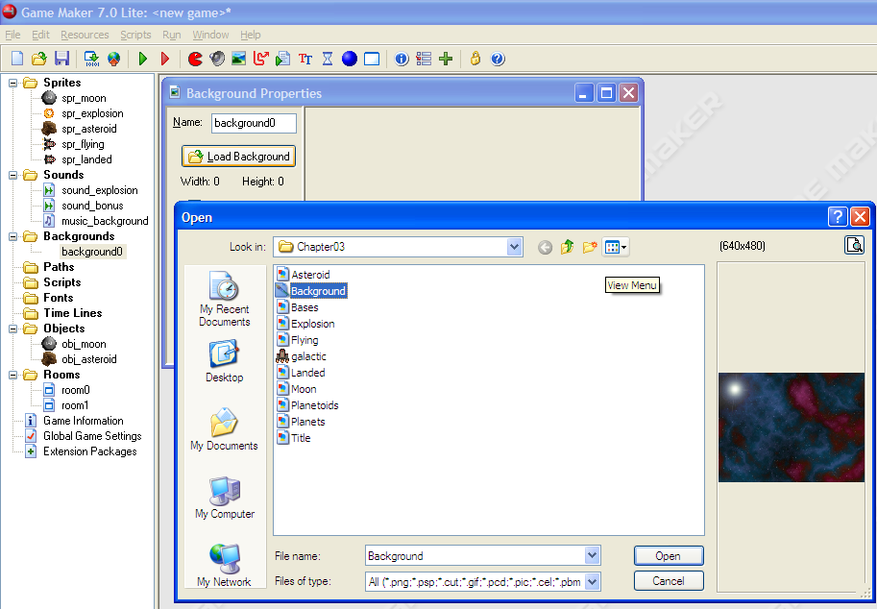
Create a Background
Name it background_main
Load Background
Select Background

Slide 22
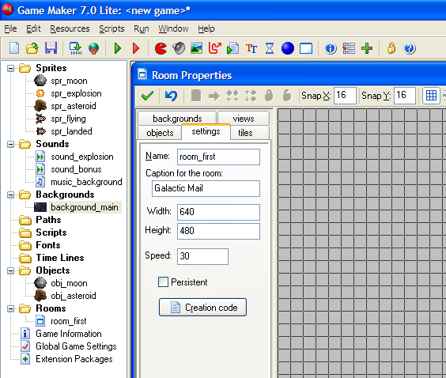
Create a Room
Name it room_first
Give the room a caption like
Galactic Mail

Slide 23
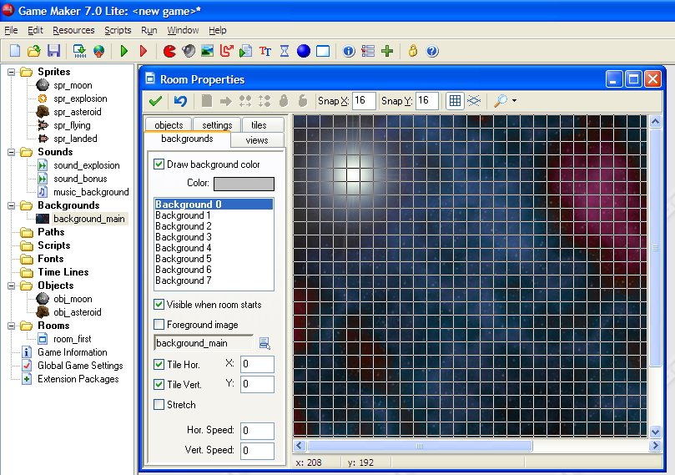
Background
Click on the ‘backgrounds’ tab.
Select background_main

Slide 24
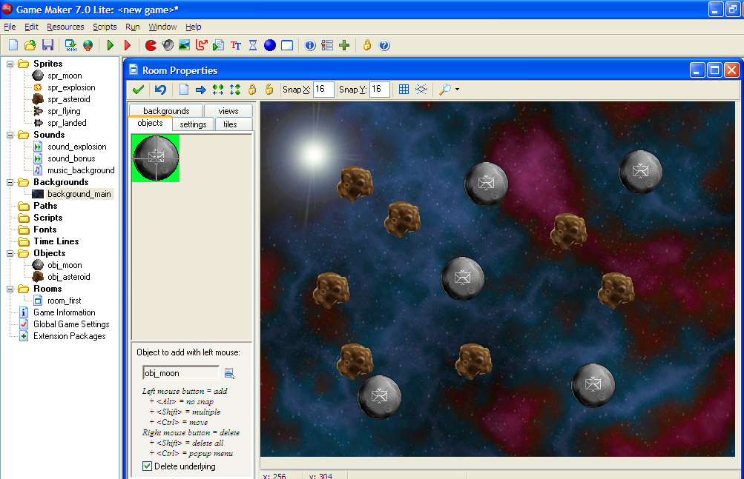
Add Objects
Click on the objects tab.
Time to Test:
Now save (yourNameGalacticMail) and run the game.
Select obj_moon and obj_asteroid to add objects to the room

Slide 25
Now Lets Fly
We want two moon objects.
  Creating a moon that the landed rocket will follow. So it stays on the moon
Two rocket objects
  One for Flying
  And one for when it has landed
Since each of these have different behaviors, we use two objects

Slide 26
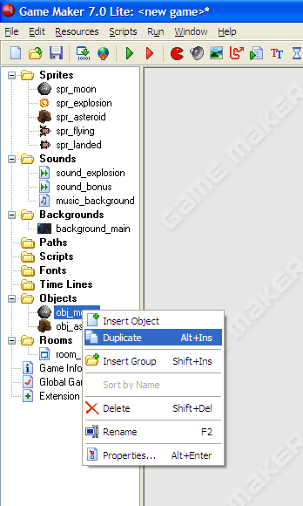
New Moon
Copy the moon and save it as a special moon.
Right click on the moon and duplicate.

Slide 27
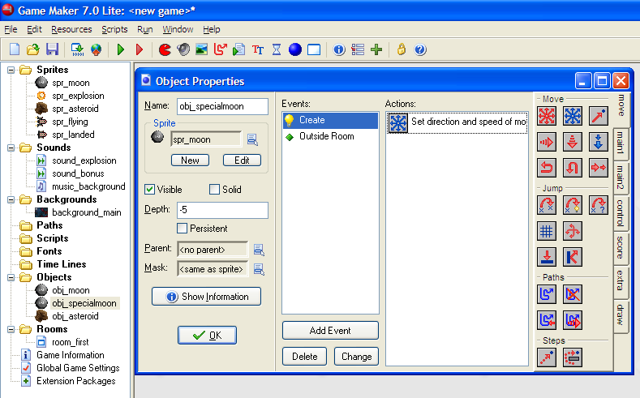
Rename the moon to
Obj_specialmoon
Set the depth to -5 (So it will be in front)

Slide 28
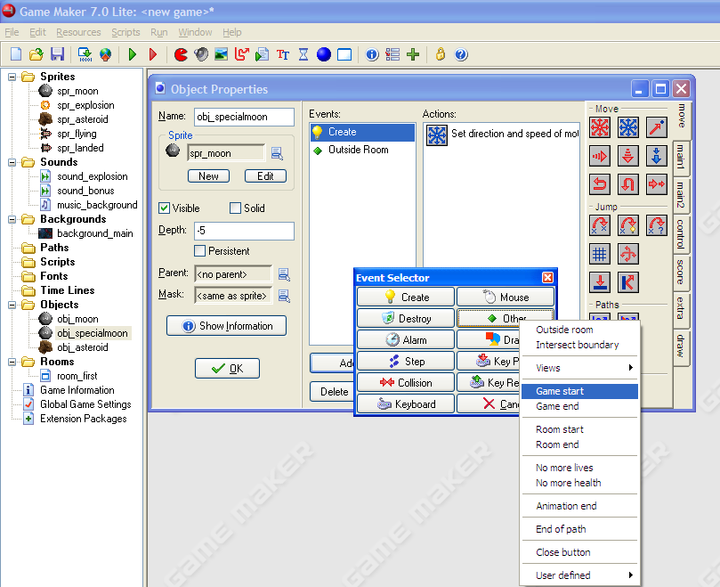
Other
Game Start
Add Event

Slide 29
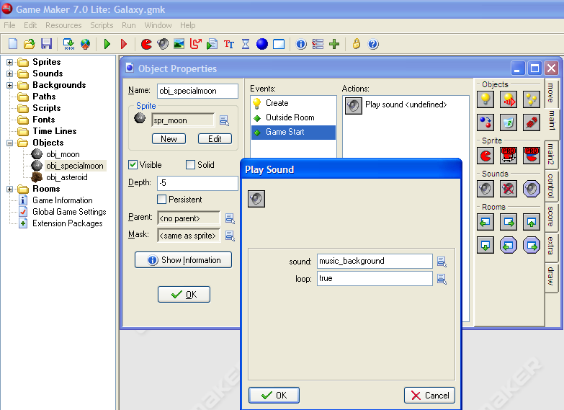
Drag the ‘Play sound’ event
Pick music_background
OK
Make loop ‘true’

Slide 30
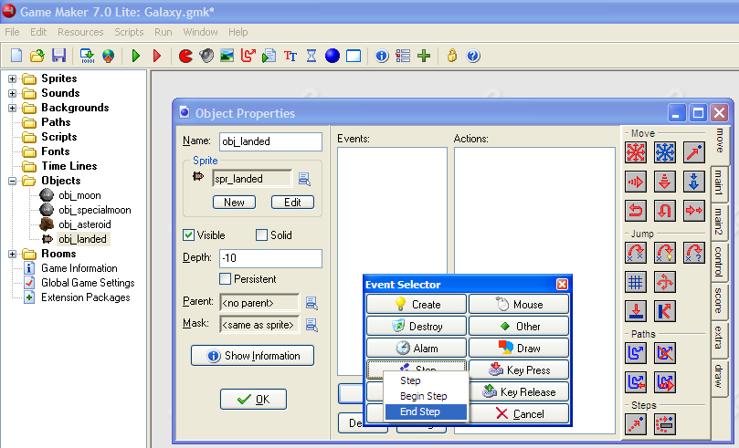
Create the Landed Rocket
Create Object
Name it obj_landed
Use the spr_landed sprite.
Set the depth to -10 so it will be in front
Step
End Step
Add Event
End step events are calculated just before the screen is redrawn

Slide 31
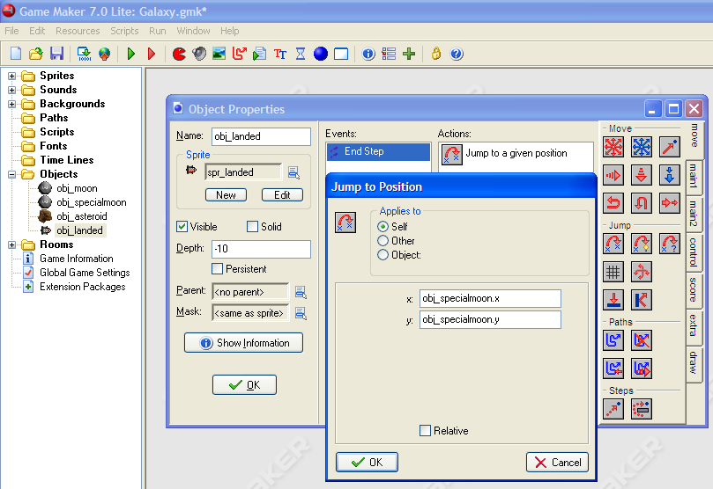
Set this up so the ship will stick with the moon (obj_specialmoon) when it is ‘landed.’
Jump to Position
Need to enter the values for the x and y coordinate of the special moon.
obj_specialmoon.x
And
obj_specialmoon.y

Slide 32
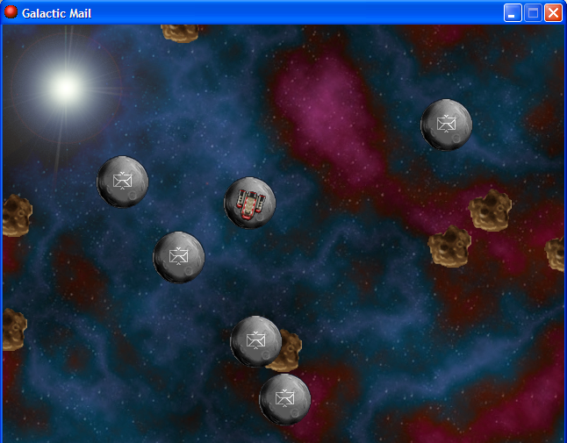
Place an obj_specialmoon and obj_landed in the room and test.
Obj_landed should be traveling on the moon.
Note:
The rocket is continually spinning. Game maker automatically cycles through the images (72 of them) for the given sprite.
We will use this later for turning the rocket.

Slide 33
Stop the spinning
Game maker’s default choice is to cycle through the different images of the sprite.
To stop the spinning you need to set the direction of the sprite using the change sprite method

Slide 34
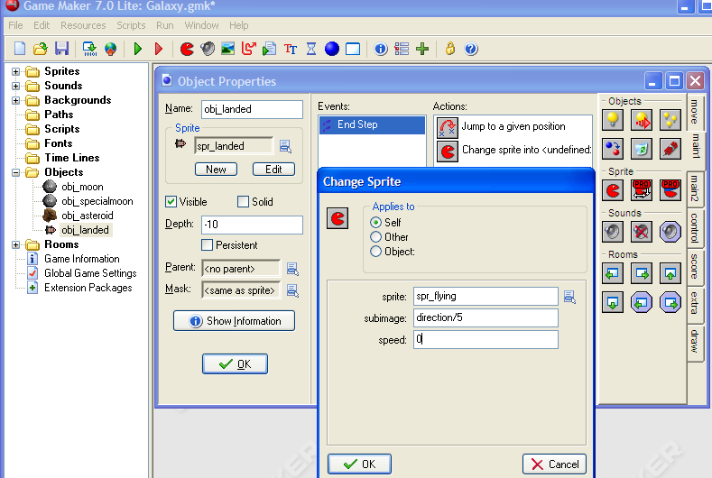
Open the obj_landed object
Open the End Step method.
Select ‘Change Sprite’
Each Object has a property called direction. We will use this to pick the correct image for the landed object.
Select the spr_flying sprite.
Since there are 72 images for 360 degrees we will pick image direction/(360/72)
Or direction/5
Set the speed to 0 so it will stop animating (rotating) on its own.

Slide 35
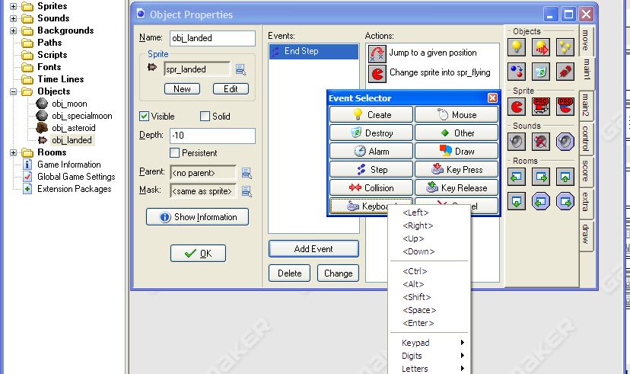
Changing the direction the ship is facing based on the user input
Keyboard
Add Event
<Left>
Spin to the Left

Slide 36
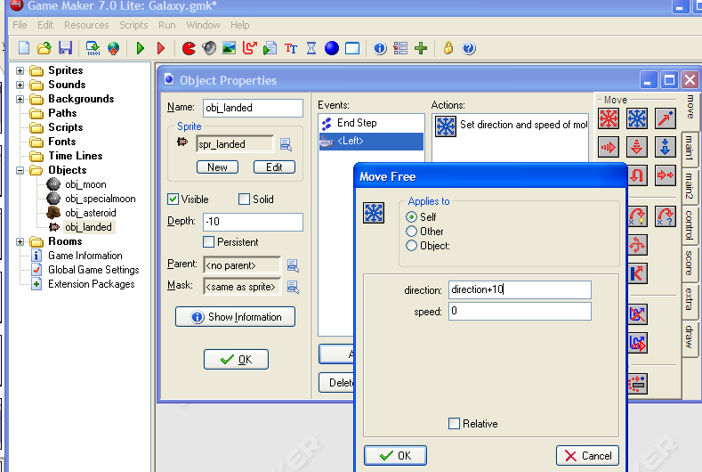
Move Free
direction+10
This will rotate the object 10 degrees.
speed = 0
This is so the rocket does not move off of the moon.

Slide 37
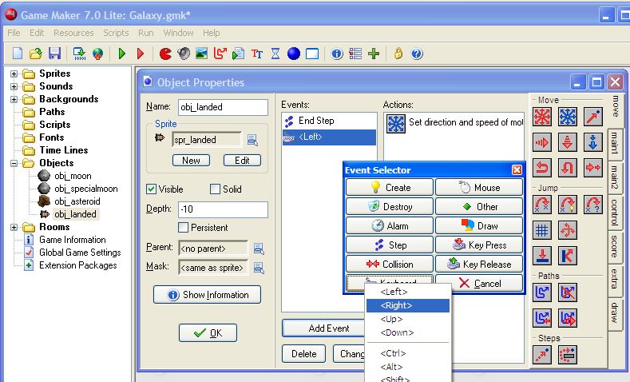
Do the same for right
Keyboard
Add Event
Right

Slide 38
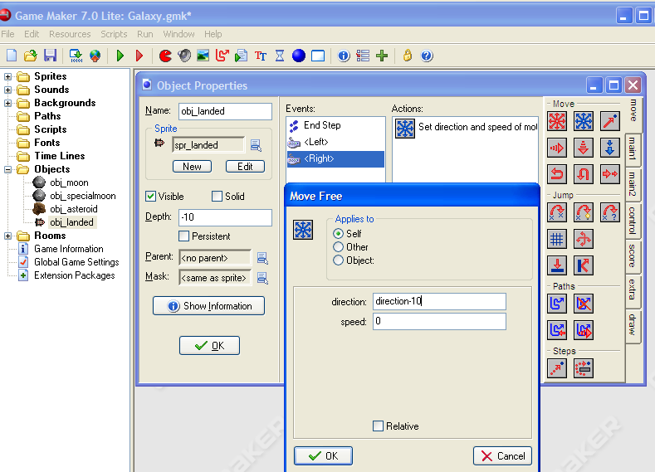
Move Free
direction-10
Test it!
If all is going well, you should be able to steer the spacecraft as it is traveling on the moon.

Slide 39
Make the ship fly
Create a object_flying
Set it’s depth so it can go in front of people
Make it wrap around the screen
Set its image to change directions with the keys being pressed
Set its movements

Slide 40
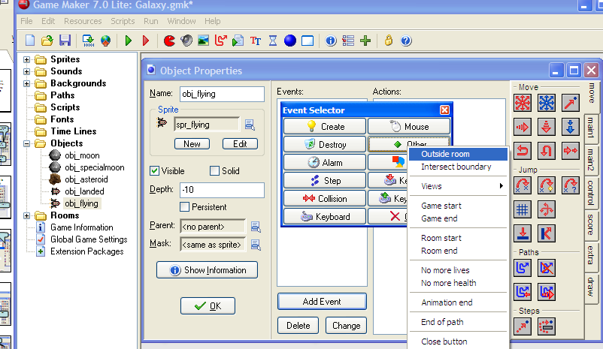
Create the Flying Object and start the wrap.
Create Object
Outside room
Obj_flying
Set the depth to -10
Add Event

Slide 41
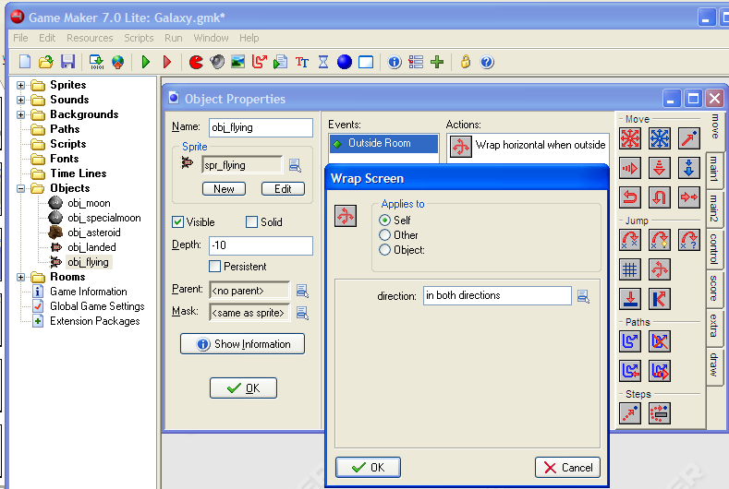
Wrapping continued
Wrap Screen
In both directions

Slide 42
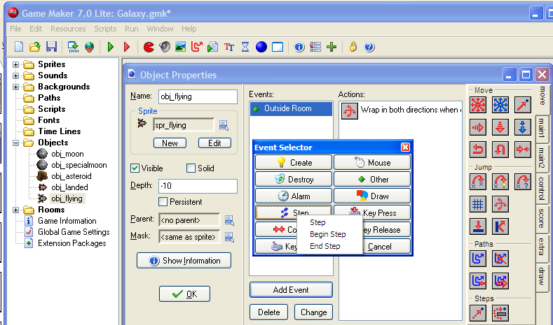
Change the Direction of the Sprite to match up with the keyboard
Step
End Step
Add Event

Slide 43
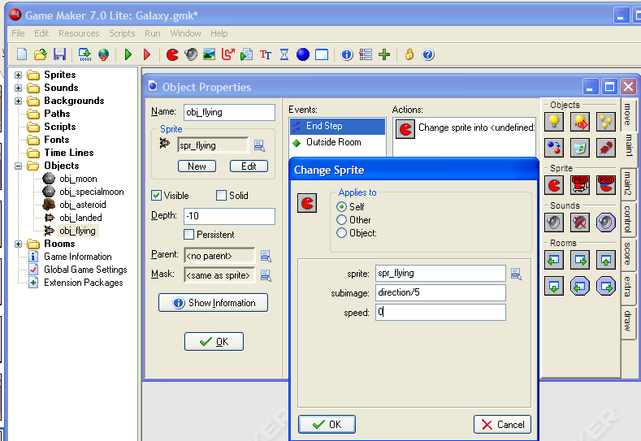
Change Sprite
Subimage direction/5
(Recall 360 degrees divided into 72 images, 360/72 = 5)
OK
Spr_flying

Slide 44
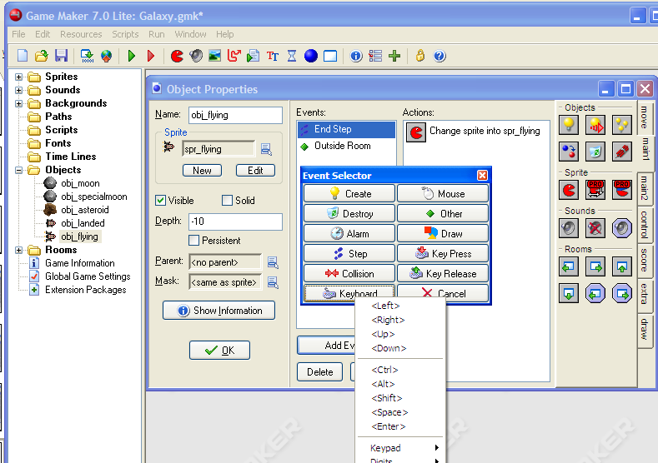
Now turn left and Right
Keyboard
Add Event
Left

Slide 45
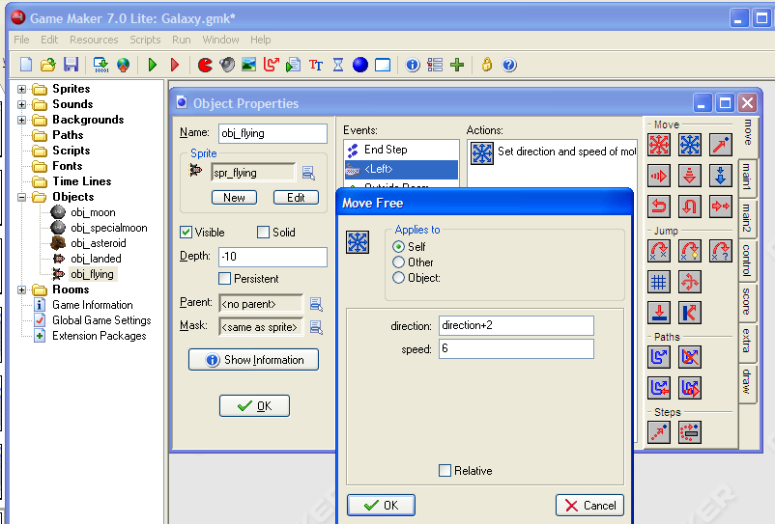
Move Free
Direction+2
So the current direction is increased by 2 degrees.
Set the speed to 6.

Slide 46
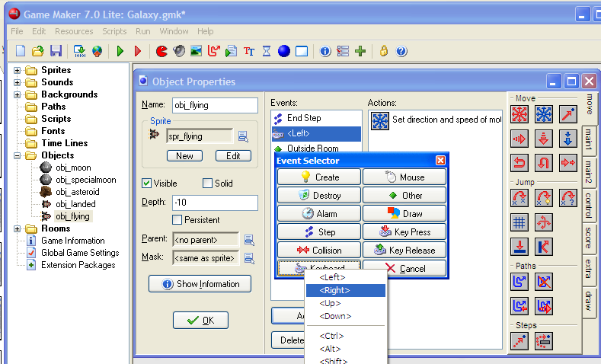
And turn right
Keyboard
Add Event
Right

Slide 47
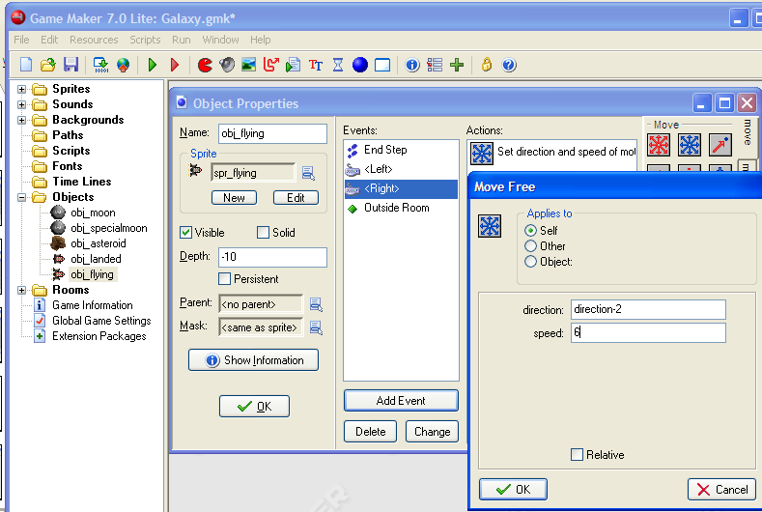
Move Free
Direction-2
Speed of 6

Slide 48
Our Progress
You’ve got most of the pieces in place
Next
When a flying rocket reaches the moon a couple of things must happen
  The Flying rocket needs to change into a landed rocket
  The moon needs to change into a special moon so the landed rocket will stay on it.
When the flying rocket hits an asteroid, it will restart the game.

Slide 49
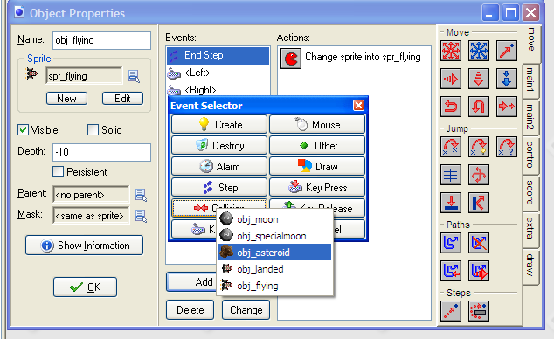
Hitting an Asteroid
Collision
asteroid
Add Event

Slide 50
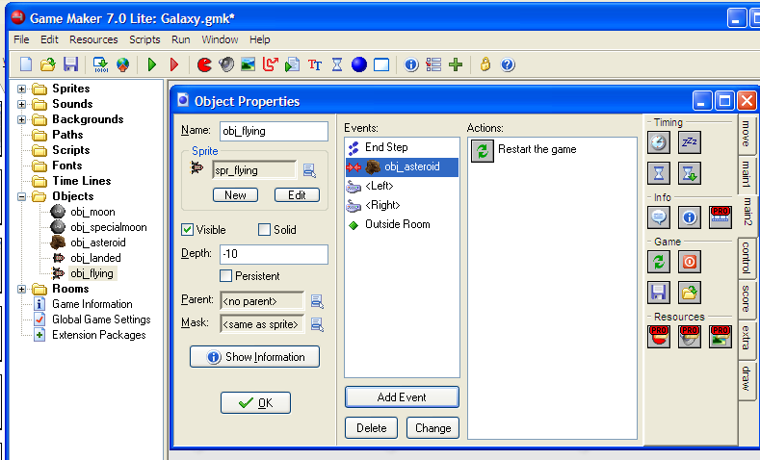
Restart Game
Restart Game
We’ll add explosions later.

Slide 51
Landing on a Moon
Change to a obj_landed
Change to obj_specialmoon

Slide 52
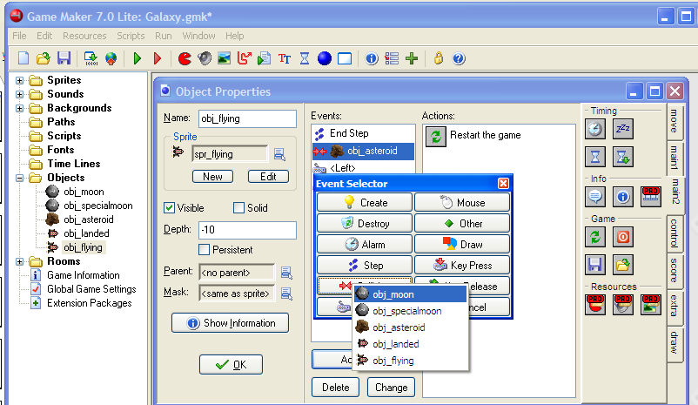
Collide with Moon
Collision
Moon
Add Event

Slide 53
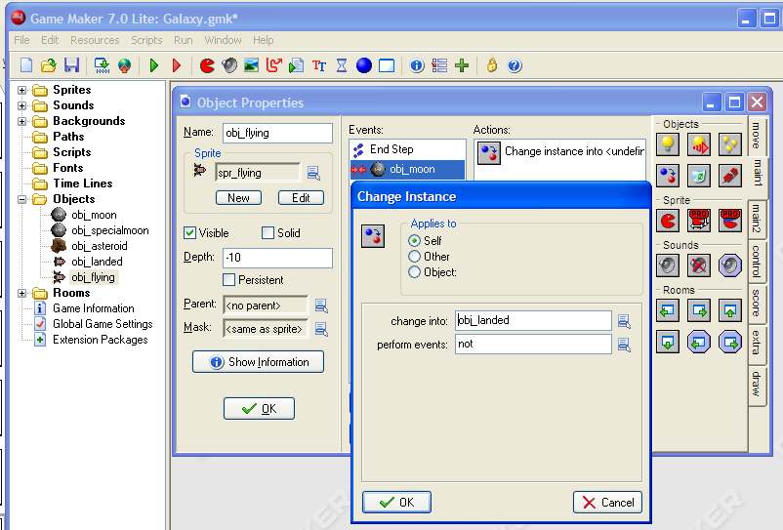
Change to obj_landed
Change Instance
obj_landed

Slide 54
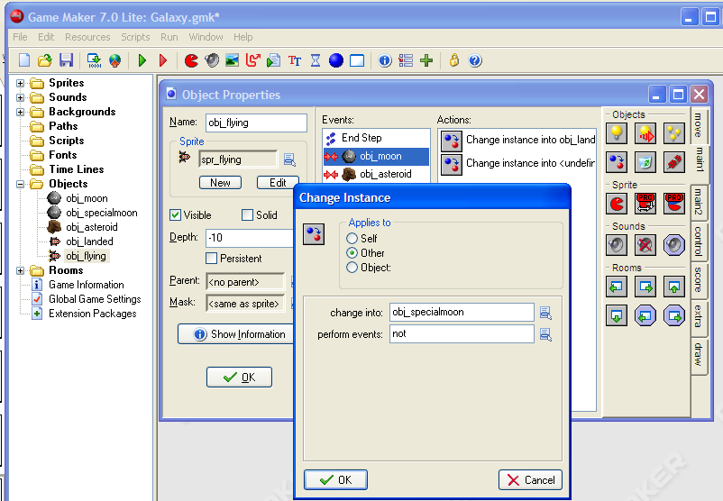
Change moon to specialmoon
Change Instance
Obj_specialmoon
Applies to
Other. This selects the other object involved in the collision.

Slide 55
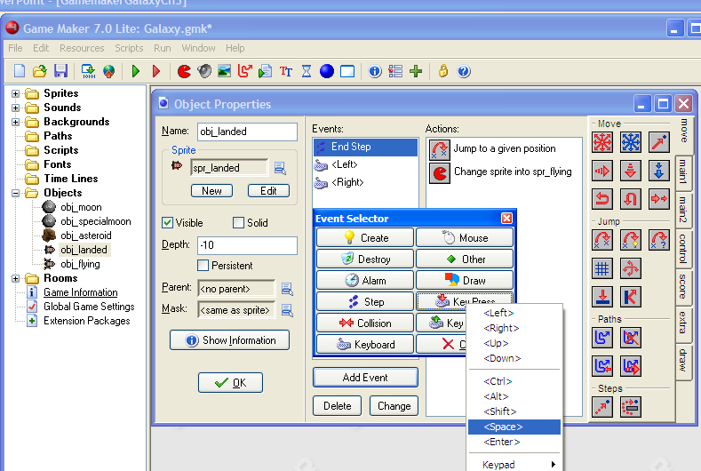
Taking off, landed to flying
Open up the obj_landed object
KeyPress
<Space>
Add Event

Slide 56
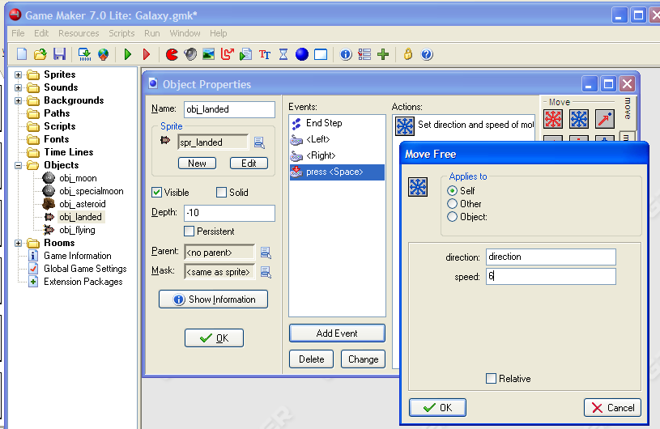
Flying
Move Free
direction.
This will have the movement go in the direction the object is facing
Speed 6

Slide 57
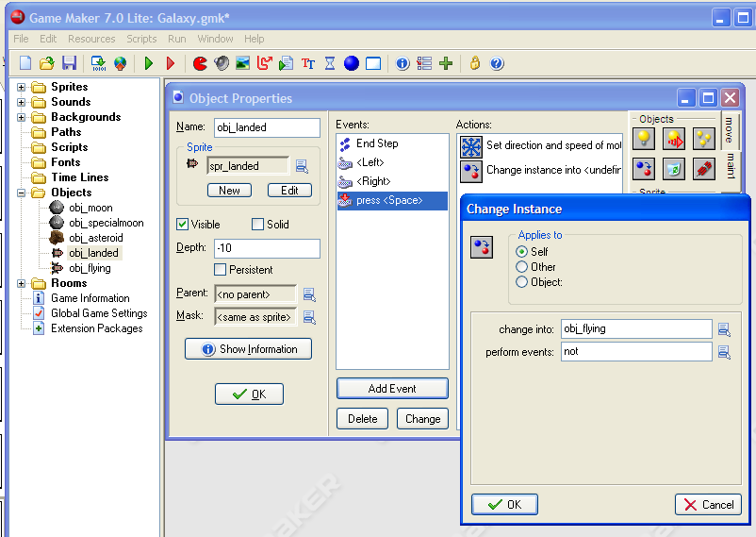
Change to a Flying Object
Change Instance
Obj_Flying

Slide 58
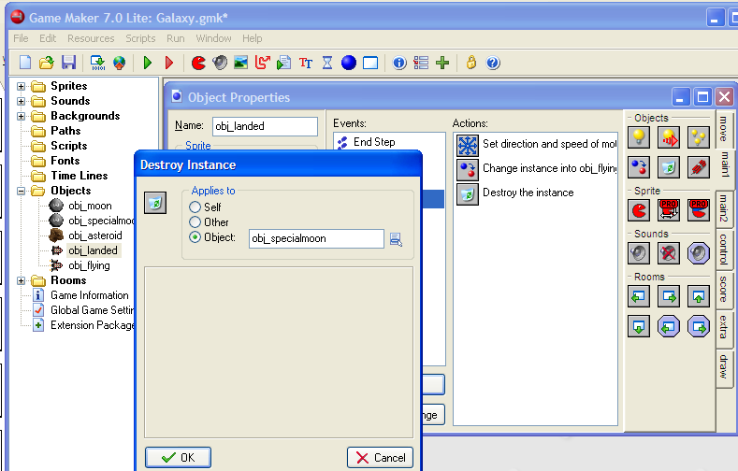
Delete the Moon (It has already been visited.)
Destroy the instance
Applies to Object
obj_specialmoon
Note, this will delete all special moons in the game. Since there is only one special moon, it will work in this case.

Slide 59
Test it.
You should be able to..
Turn the ship on the moon.
Jump off the moon when you hit space bar.
Land on a moon when you collide with it.
Steer the flying rocket.
The game should restart when you hit an asteroid.
Can you change how quickly the ship can turn?

