Slide 1
Galactic Mail Part 2

Slide 2
Winning and Losing
Exploding Asteroids
Including Scoring
Adding Levels
And more

Slide 3
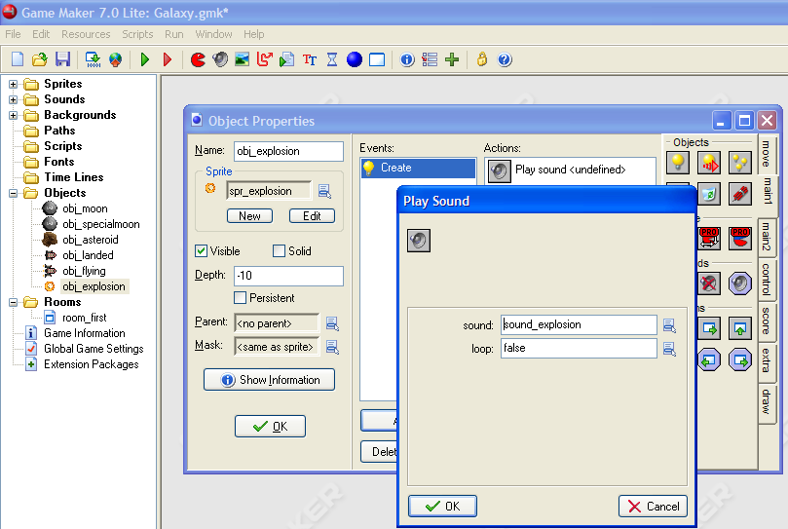
Explosions
Create Object
Tie it to the spr_explosion.
Name it
obj_explosion
Play Sound
Set the Depth to to -10.
Now add the sound.
Add Event
Sound_explosion

Slide 4
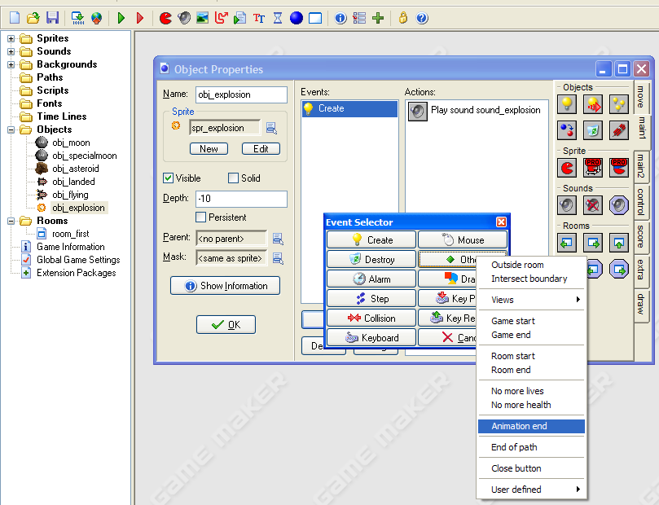
Ending the Animation
Add Event
Other
Animation end

Slide 5
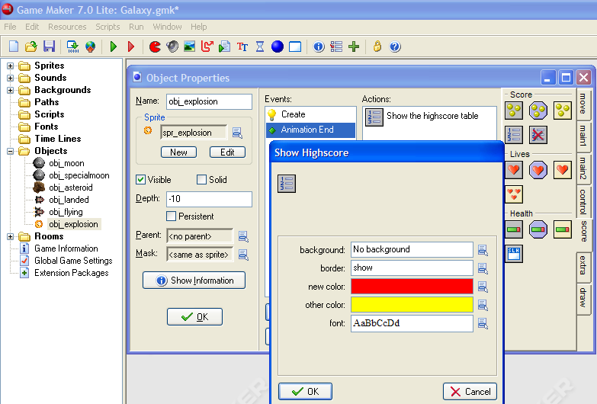
The show the Highest Score
Show highscore
Change the ‘other color’ to go with the background.

Slide 6
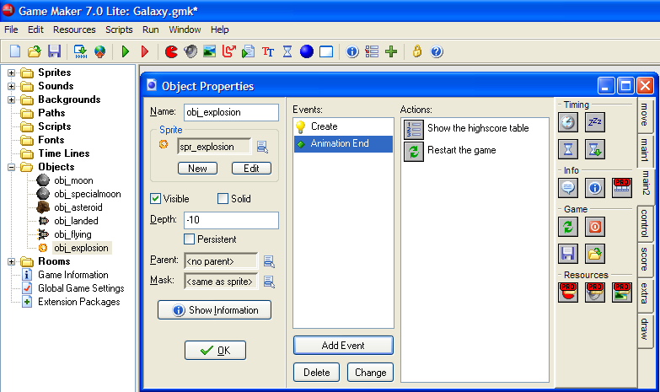
And restart the game
Restart

Slide 7
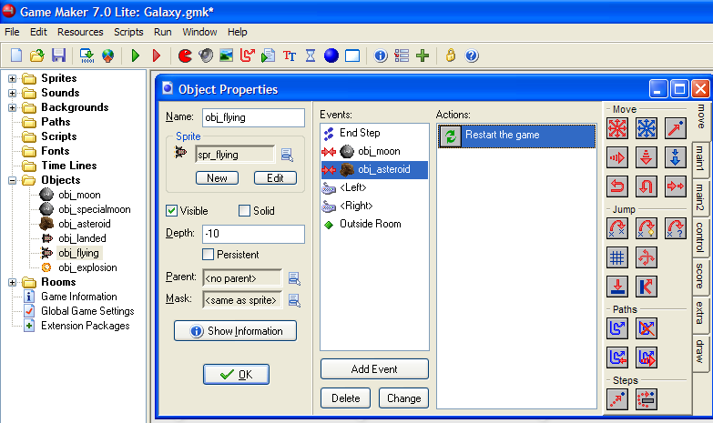
Explode
Open the obj_flying
Select the collision event with obj_asteroid
Select, right click and delete.

Slide 8
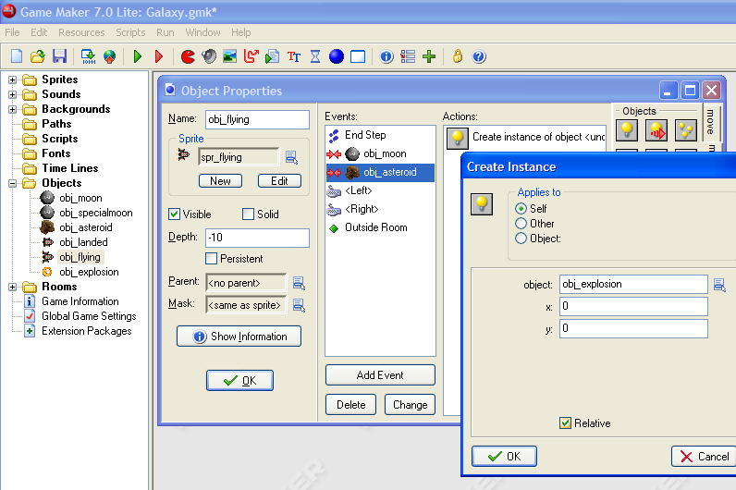
Create an Explosion object
Still in the collision event with an obj_asteroid.
Create Object
Obj_explosion
Relative

Slide 9
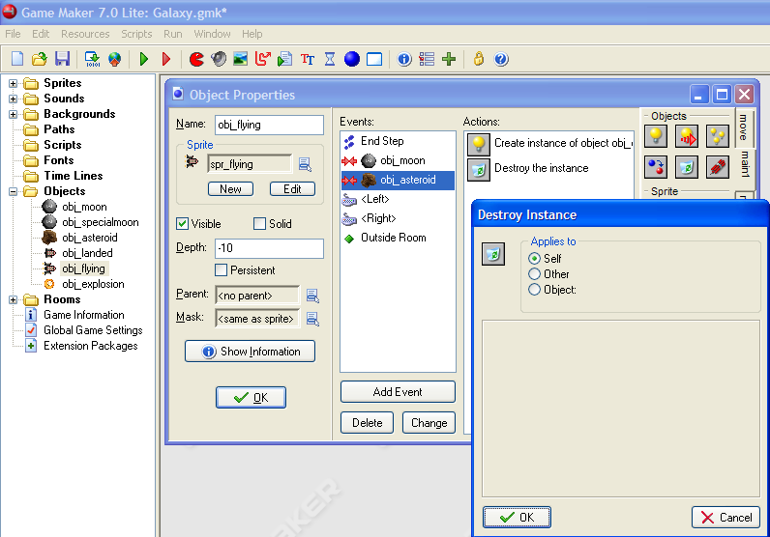
Destroy the Ship
Test the game.
The ship should explode when it hits an asteroid.

Slide 10
Scores
Get points for delivering mail
Lose points for staying on a moon.
Since both of these events involve interaction with the specialmoon, we will look at the specialmoon

Slide 11
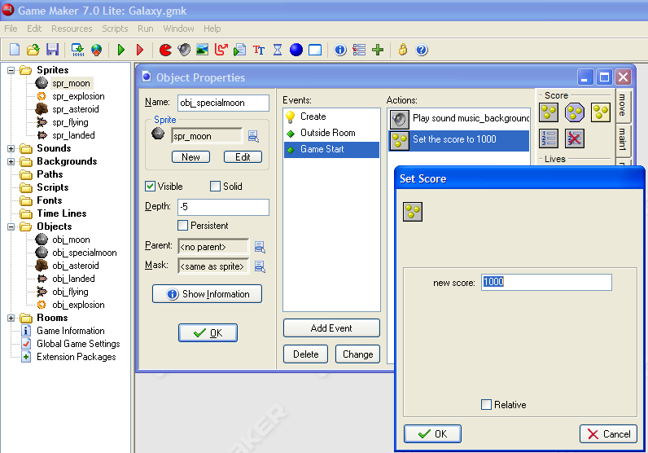
Set the startingscore with obj_specialmoon
Open the Game Start Event
Drag in the Set Score method
Set the starting score to 1000
OK
Open the obj_specialmoon

Slide 12
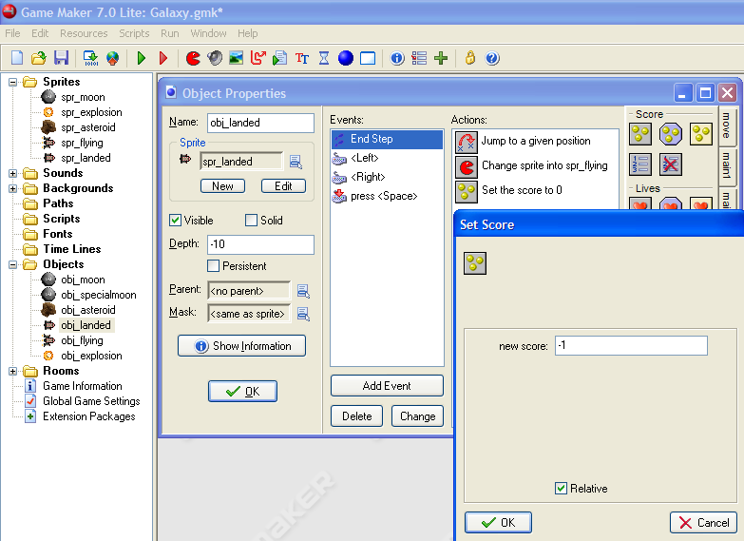
Taking points away when the rocket is waiting on the moon.
Drag a Set Score method into the actions.
Open the End Step Event
Open the obj_landed object
Enter a score of -1, so it will take away from the score.
Check relative so it lowers the score rather than replacing the score with a -1. This will take 1 point away every step, or 30 points per second!!

Slide 13
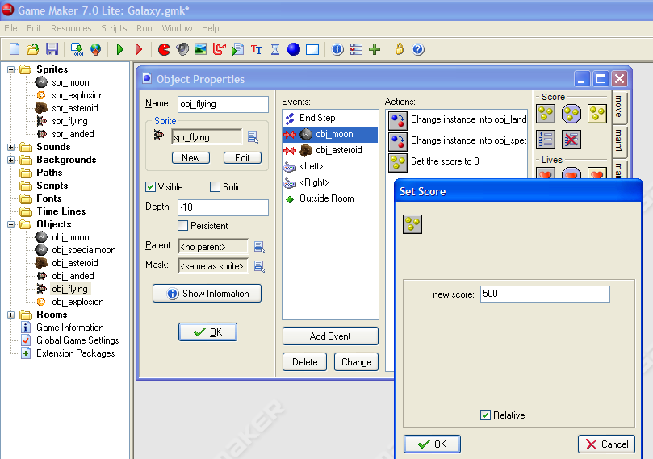
Add 500 points when the Rocket initially lands on the moon.
Drag in a Set Score method into the actions window.
Select the collision with obj_moon event.
Select obj_flying
Give it a new score of 500.
Click on Relative so it will be added to your score.

Slide 14
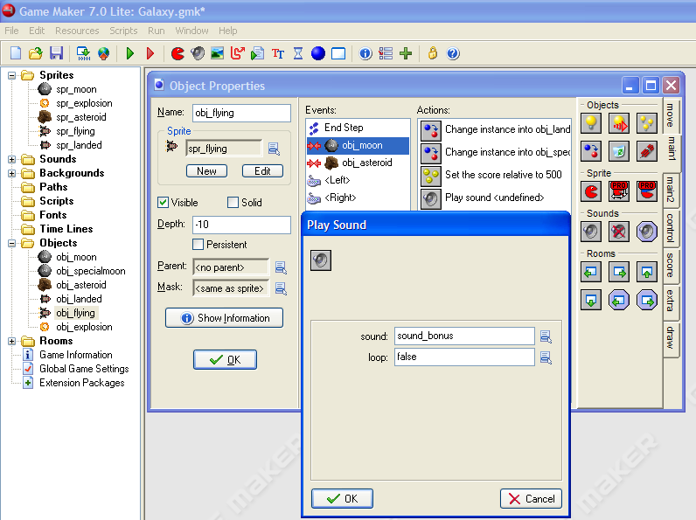
Play a sound when you score.
Drag in a Play Sound method into the actions window
Still with obj_flying and in the Collision with obj_moon event.
Time to Test your game!!
Select sound_bonus
OK

Slide 15
Levels
What happens now when you complete all of the levels?
Next we will look at adding more levels to the game.
We’ll do this by adding more rooms.
The order of rooms, determines the order of levels.
If you need to change this order, just drag and drop the rooms into the correct location.

Slide 16
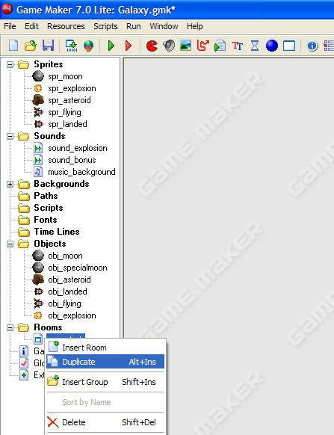
Making the new room
Right click on room_first and select Duplicate.

Slide 17
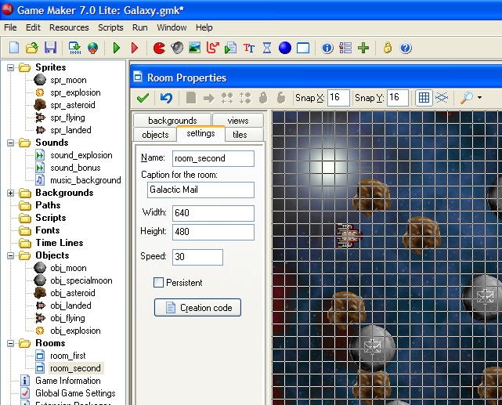
Name the Room
Select the settings tab.
Rename the room to room_second.
On original games you can pick your room names.

Slide 18
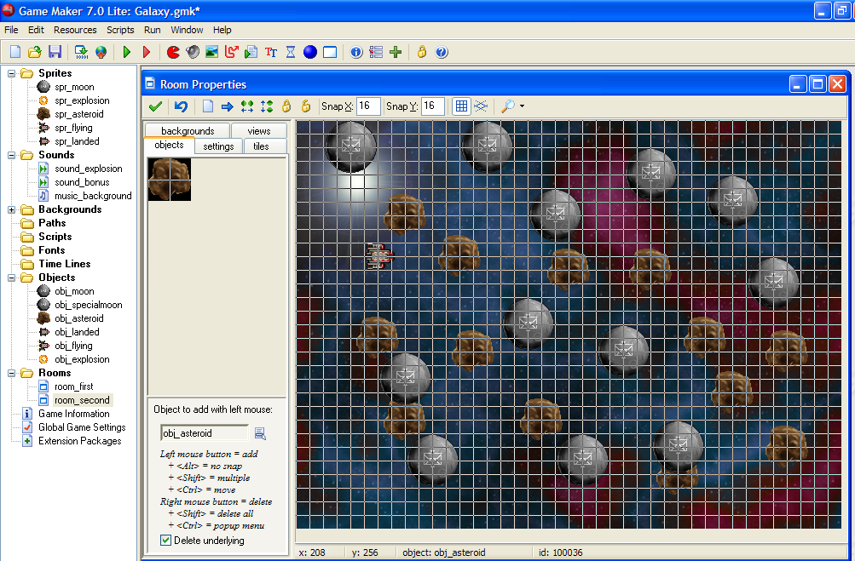
Change the number of objects in the new room
Make sure there is one and only one obj_specialmoon and obj_landed

Slide 19
Getting to the new room
When: When there are no moons remaining
We need to have the game check. If there are no moons remaining, then go onto the next level, otherwise continue on the current level.

Slide 20
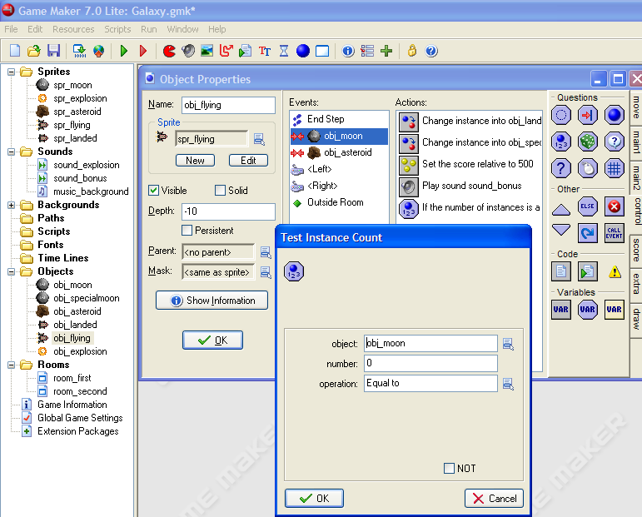
Checking if ‘0’ moons
Open the obj_flying object
Select the collision with obj_moon event
Drag the Test Instance Count method into the Actions window
Checking for the number of instance of obj_moon are remaining.
This will be true if there are ‘0’ obj_moons remaining.

Slide 21
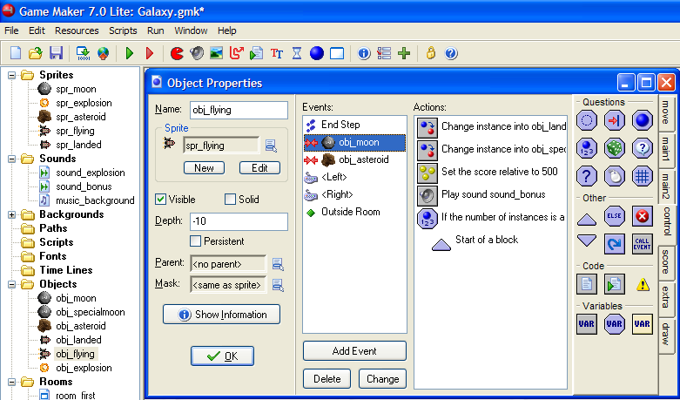
Blocking in Commands
Drag a Start Block into the Action window
Between the Start Block and the End Block will go all of the actions you want to occur when there are no moons left

Slide 22
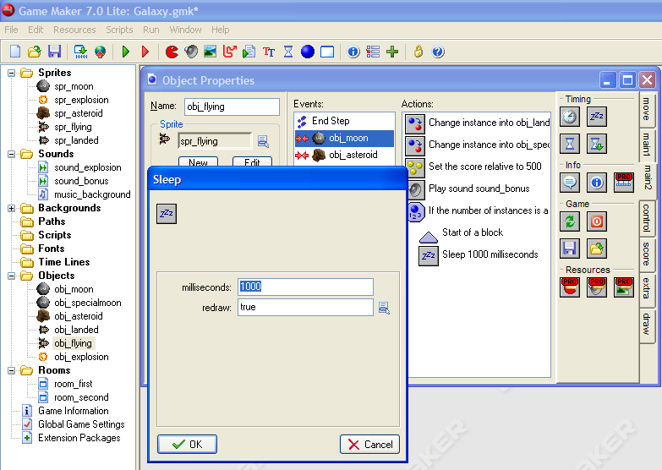
Let the Game Pause for a Second
Drag a Sleep method into the Actions window.
1000 ms = 1 second

Slide 23
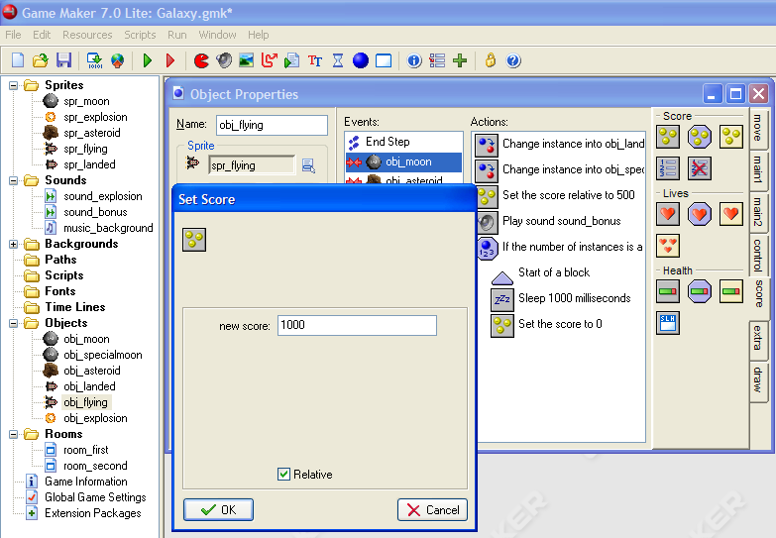
Give 1000 pts for completing the level
Drag a Set Score method into the Actions window
Enter the 1000 points
Check Relative so it will be added to the score.

Slide 24
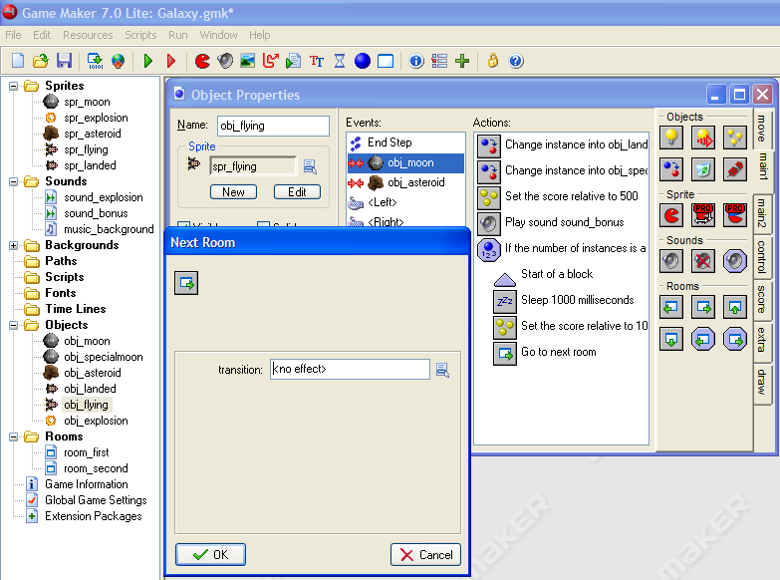
Go to the Next Room
Drag a Next Room method into the Actions window.
I’ll not add a transition. You can if you want.

Slide 25
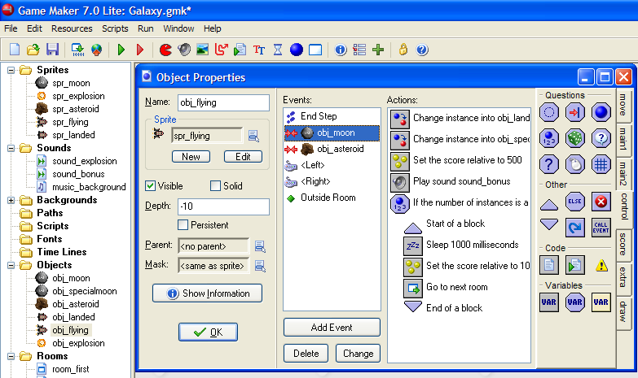
End the Block
Drag End Block into the actions window.
Test it!!
Extensions
Add another room

Slide 26
Finish Touches
Title Screen
Winning the game
Adding visual variety
Adding a help screen/ instructions
Experiment

Slide 27
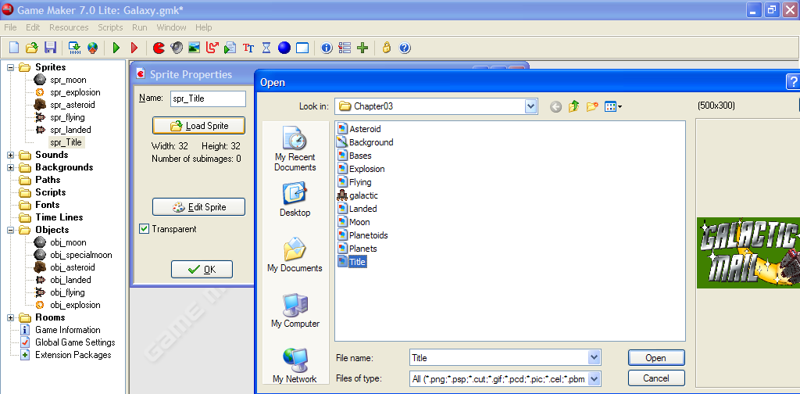
Creating a Title Screen:
Create a Title Sprite
Create a Sprite
Load the Title.gif
Load Sprite

Slide 28
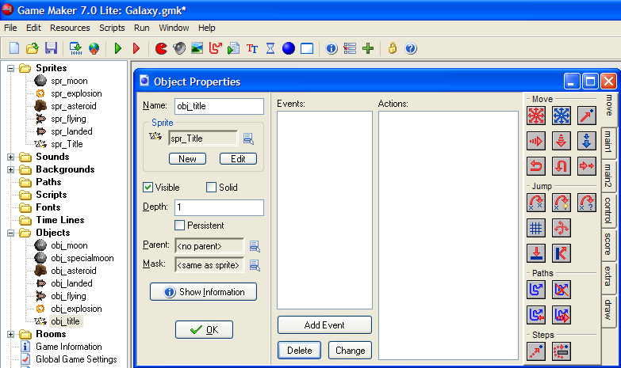
Create a Title Object
Create an object
Label it as obj_title
Set the Depth to 1

Slide 29
Create Event: Start Music/Set Score
These are currently tied to the special moon
So we will move them from the special moon Object

Slide 30
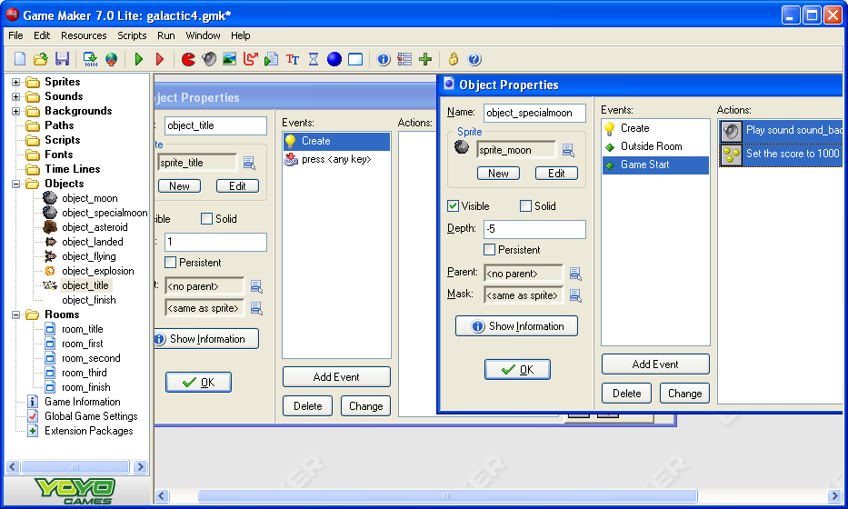
2) Open the object_specialmoon
Game Start Event
1) Open the object_title
Create Event
3) Drag and Drop the Play sound and Set the score Actions into the titles Create actions
4) After doing this the Game Start event for the special moon should be empty and delete itself.

Slide 31
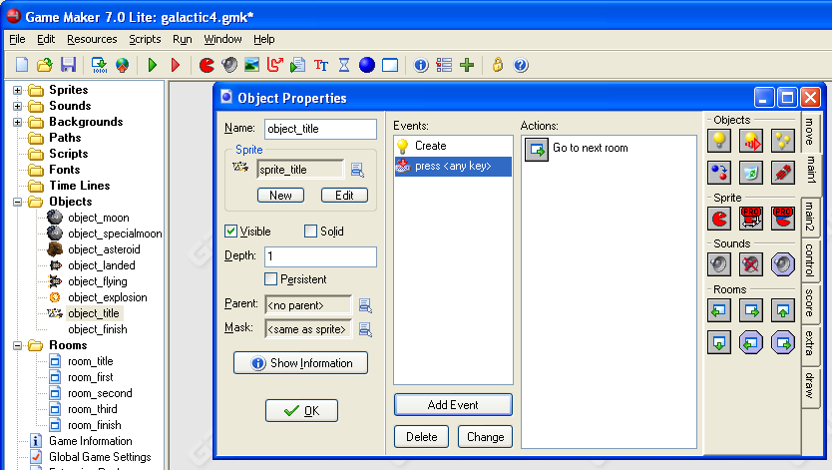
Move from Title to Game with a Keypress
Go to next room
Add Event
KeyPressed
<any key>

Slide 32
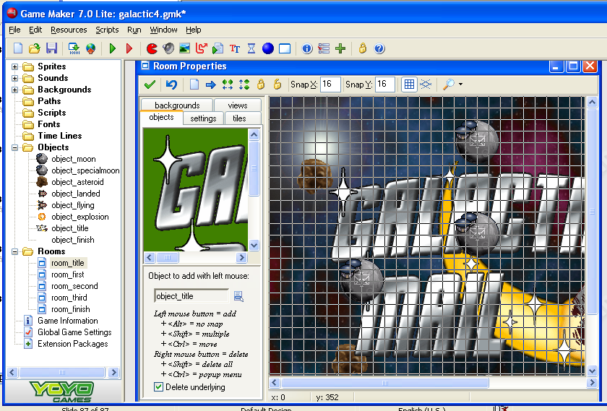
Making a New Room for the Title
1) Make a New Room
2) Name it
room_title
Test it.
4) Add some moons and asteroids.
5) Drag the room to the top of the list of rooms so it will be the first room in your game.
3) Add one instance of the object_title to the middle of the room.

Slide 33
Winning the Game
Now to give a congratulations to the winner (instead of running out of rooms and crashing)
We will create a finish object and finish room to display a message, then give the player a 2000 point bonus, show the high scores and restart the game.

Slide 34
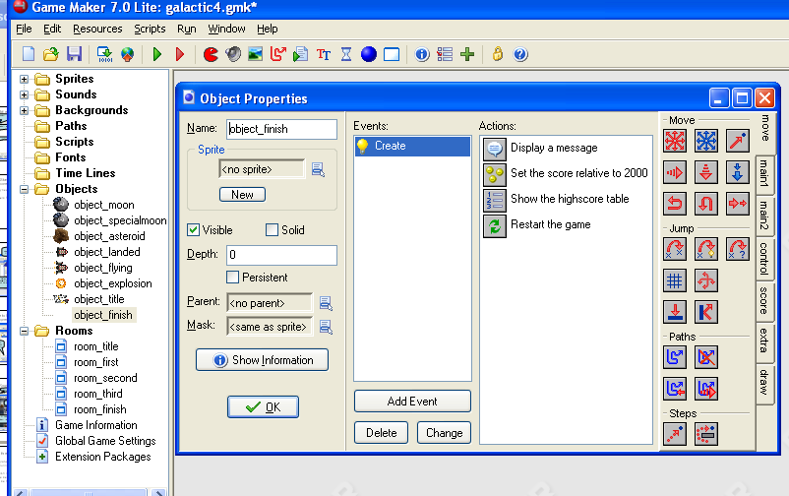
Finish Object
4) Drag in a Display a Message Action.
“Congratulations, You have delivered the mail.
3) Add a Create Event
1) Create and name an object_finish
2) We do not need a sprite for this object
5) Give a 2000 point bonus
6) Show the highscore table.
7) Restart the game

Slide 35
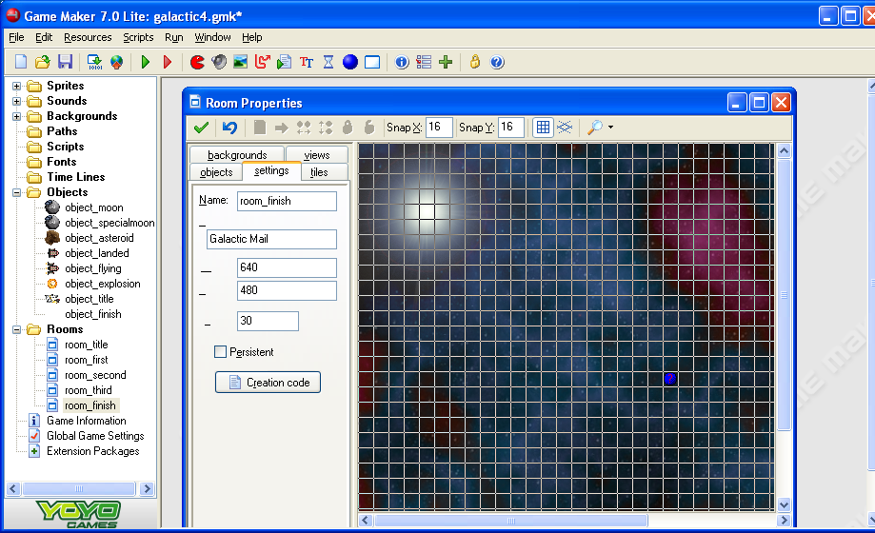
Finish Room
1) Create a Room
2) Name it room_finish
3) Give it a background
4) Add an object_finish
Test it.

Slide 36
Adding Visual Variety
Currently all of the moons look the same and the asteroids rotate in unison
So you will add random inhabitants to the moons and
Randomly determine the sub image of the asteroid..

Slide 37
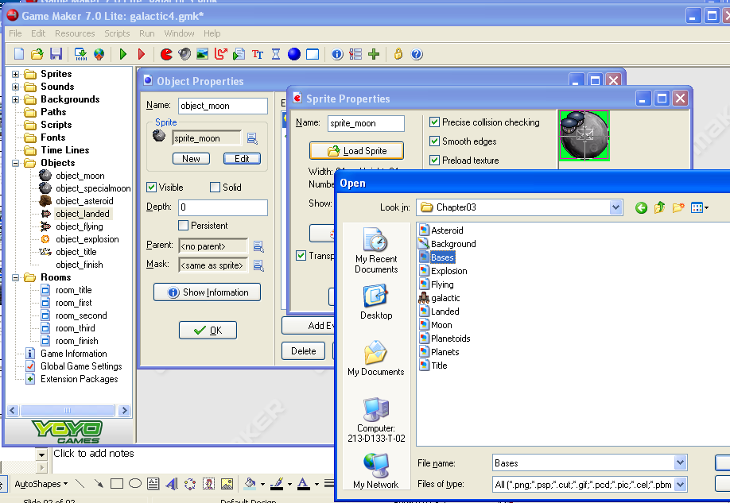
Moons
1) Open the object_moon
2) Edit
3) Load Sprite
4) Double click on Bases.
This is a GIF with 8 sub images with moons containing different bases.
5) Click ‘OK’ to close the Sprite Properties.

Slide 38
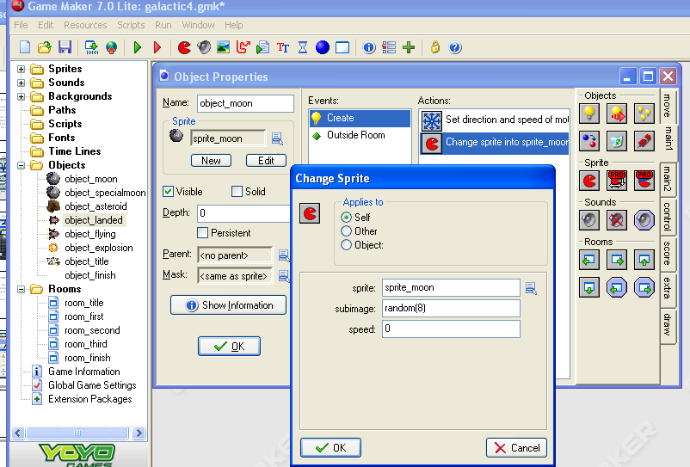
Pick a Random Moon
2) Pull in a Change Sprite action.
1) Open the Create Event
3) Enter random(8) in the subimages to randomly select from one of the 8 moon images.
5) Test it
4) Click ‘OK’
6) Do the same with the moon_special object

Slide 39
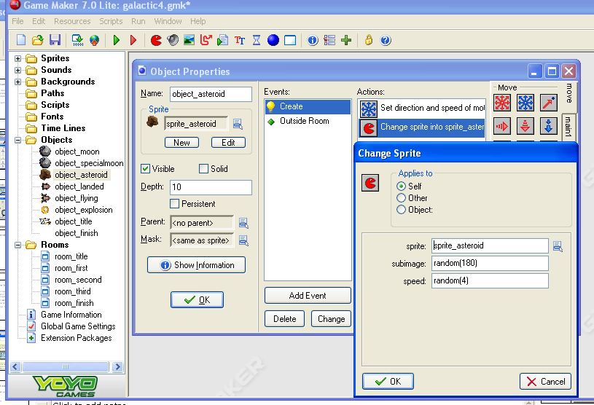
Asteroid Randomness
1) Open the Asteroid Object
2) Open the Create Event
3) Change to random(180) in the subimage.
4) ‘OK’ and Test

Slide 40
Adding Game Information
Now that you have created a masterpiece, it is time to impart your wisdom on those wanting to play your game.
Create a help sheet describing how to play your game, what the controllers do, ….
You will do this using ‘Game Information’

Slide 41
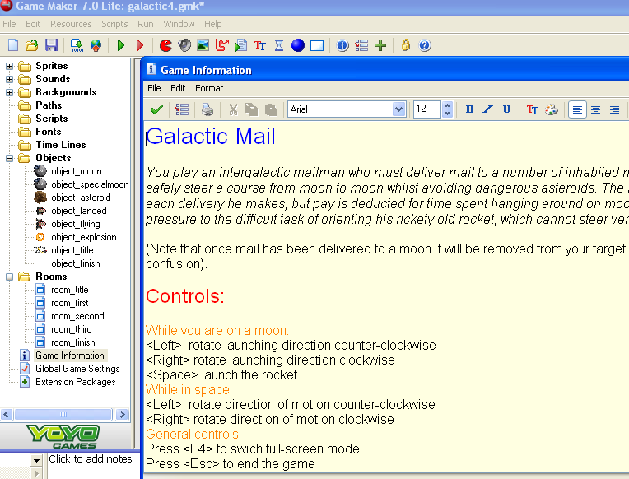
This will show up when the user hits the ‘F1’ key while playing the game.
Double click on Game Information and add descriptions for your game.
Name of the Game, Authors, goals of the game, and a list of controls.

Slide 42
Congratulations
You have completed your third game.
Extensions
  Add levels with
    Faster moving objects
    Smaller moons
    Larger and smaller planets
    …

