Slide 1
Welcome to Advisory
November 8, 2018

Slide 3
Learning Target
Today I will reflect on my learning progress, and I will refocus my SMART Goal to help keep me moving toward academic success!

Slide 4
Did you know?
Tuesday, Wednesday, Thursday, Friday
2:30-3:15
In the library
All subjects!
Tutoring Support at West!!
Wednesdays, Thursdays
2:30-3:15
National Honor Society Student Tutors
B107 (McKean’s room)

Slide 5
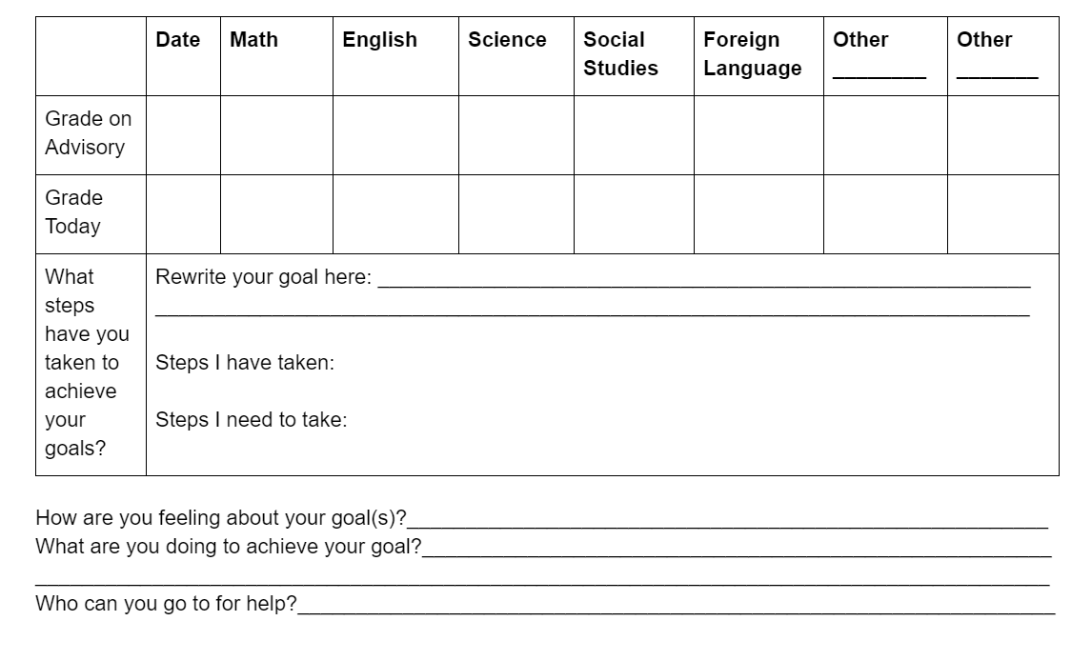
Goal revisiting based on October’s goal
October
Would after school tutoring help?
Could your Advisory teacher or another student help you get focused?
Staple half sheet to original goal sheet

Slide 6
Climate Survey
We need to hear from YOU!
How can you help us make West Salem High School the best possible academic, social, and emotional experience for you?

