Slide 1
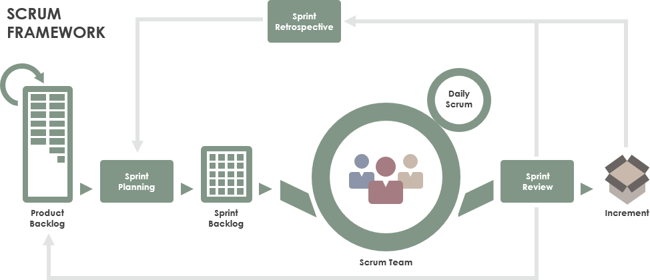
Robotics Projects
Ending first sprint and starting Sprint #2
Bookkeeping:
1) Make sure you have shared the team engineering notebook with
smithtitanrobotics@gmail.com!!!
2) Last page of notebook documents above and beyond for the first 6 weeks for each team member.
- Document if you will be helping at the ‘VEX Idea Factory’ on Saturday

Slide 2
Learning Targets
Incorporate the Scrum framework in developing an awesome robot!
Today (and tomorrow if needed) we will focus on ..
Sprint Review
Spring Retrospective
Revisiting and Improving on your team’s design direction
Creating a Sprint Backlog
After the next sprint is our first tournament!!

Slide 3
Sprint Review (New page/slide in the engineering notebook)
Demonstrate what is ‘Done’
Include a picture of the robot in the current state
Describe what is done on the robot.
Include software. Autonomous, driver control
Describe what you are currently working on
Describe how your robot performed at the first scrimmage.

Slide 4
Sprint Retrospective (New page in notebook)
Focusing on how the team worked during the last spring
Answer the following questions in your notebook
What went well during the sprint
What did not go well during the sprint
What improvements will you incorporate during the next sprint

Slide 5
Design Review/Reevaluation (New slide)
Using what you have learned in the last sprint evaluate you design direction
What are your priorities?
Stacks
Towers
Autonomous
…
What improvements do you want to incorporate into your design?
What to you want to keep
After the team discussion include your design
Drawing (Take a picture of hand drawing and include in notebook)
Description

Slide 6
Sprint Backlog (10/7 – 11/6)
Build a list of tasks that you commit to completing during the next sprint
Break them down into tasks that can be completed during one class period.
Prioritize the items by their highest Return On Investment (ROI)

