Slide 1
Computer Science 1
Fix’n the For loop
Random Numbers

Slide 2
Learning Targets
Be able to fix a program that uses a for loop.
Be able to read and write code needed for creating and using random numbers

Slide 3
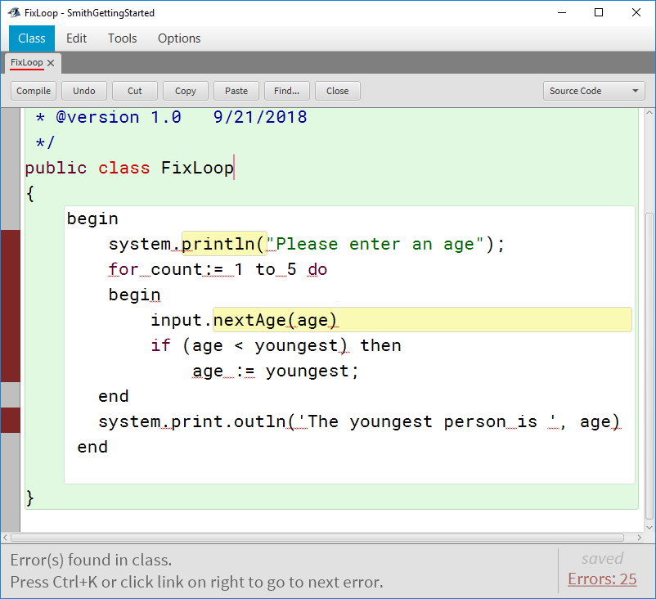
Fix IT!
Open from the class website ‘fixloop.java’ file and fix the program.
It is supposed to input 5 ages and find the youngest age.

Slide 4
What do you think this program does?
Type it in BlueJ and test it.
public class Rolling
{
public static void main( String [] args)
{
int roll;
for (int count = 1; count < 10; count++)
{
roll = (int)(6*Math.random())+1;
System.out.print(roll);
}
} // end main
}

Slide 5
Math.random();
Add to your notes.
Returns a double value in the range 0<=Math.random() < 1.
You can change its type from double to int by type casting. It truncates the double into an integer.
roll = (int)(6*Math.random())+1;
What is wrong with …
roll = (int) 6 *Math.random() + 1;
Order of Operations
()
(int) Type cast
* / %
+ -

Slide 6
Random Practice
Describe the range of random values generated from the following.
int one = (int)(6*Math.random()) + 1;
int roll = (int)(10*Math.random()) + 6;
int roll = (int)(20*Math.random()) - 3;
int roll = (int)(14*Math.random()) + 10;
int roll = (int)(30*Math.random()) - 8;

Slide 7
More Random Practice
Write the code needed to generate the following ranges of random numbers.
2 to 7
-5 to 5
50 to 70
8 to 40
-6 to 15
20 to 60
A pair of 6-sided dice
Flipping a two sided coin

Slide 8
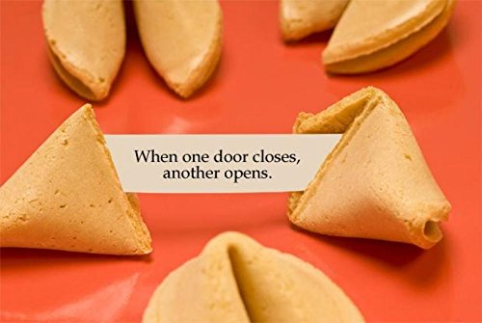
Program options
Flip a coin 100 times, show the total number of heads and tails AND which occurred the most often.
Roll a pair of 6-sided dice 100 times. Find out which occurs most often, 3 or 11. Show how often each of these rolls occur and which occurs most often.
Fortune Cookie:
Write a program that will generate a random fortune cookie saying.
You will need to include at least three different fortune cookie saying options.

