Slide 1
Welcome to Advisory
February 22, 2019

Slide 2
Agenda
Screencast to learn about forecasting for next year’s classes and questions (10 min-15.)
A brief examination of my transcript using a graphic organizer.(10 min.)
A survey about EPIC here at West.(3 min)
Some fun and games-time permitting (5-10 min.)

Slide 3
Learning Target
Today I will learn about forecasting for classes next year and understand the information in my transcript, identifying areas that need to be addressed before I can graduate.

Slide 4
Forecasting Video

Slide 5
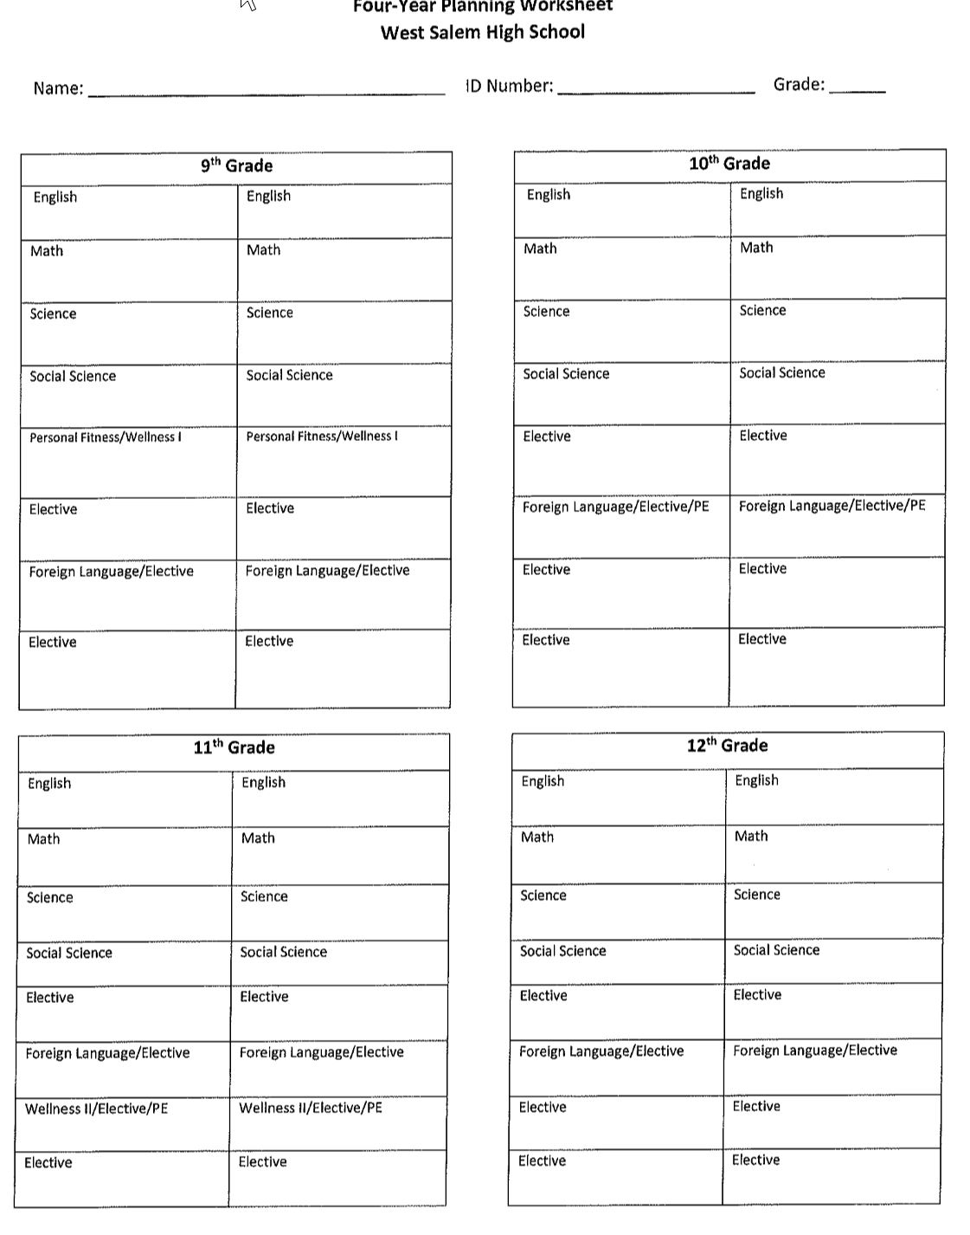
Transcript Analysis graphic organizer
Take a few minutes to record your classes into the appropriate box.

Slide 6
EPIC survey
We need your feedback to make West better. Please answer the following survey questions about EPIC positive recognition here at West.
https://docs.google.com/forms/d/e/1FAIpQLSe4WBJrYiy6qj64E5v1KDd-raDiY1FM4eMnLj0aNNHH6ne43g/viewform?vc=0&c=0&w=1
Advisory Survey
Notes:
STAFF- PLEASE SEND THE ABOVE LINK OUT TO YOUR ADVISORY STUDENTS BEFORE ADVISORY ON FEBRUARY 22. THAT WAY THEY WILL BE ABLE TO OPEN THE LINK VIA THEIR SMARTPHONE.

Slide 7
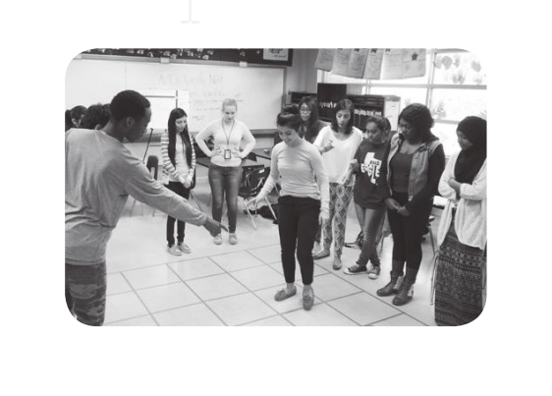
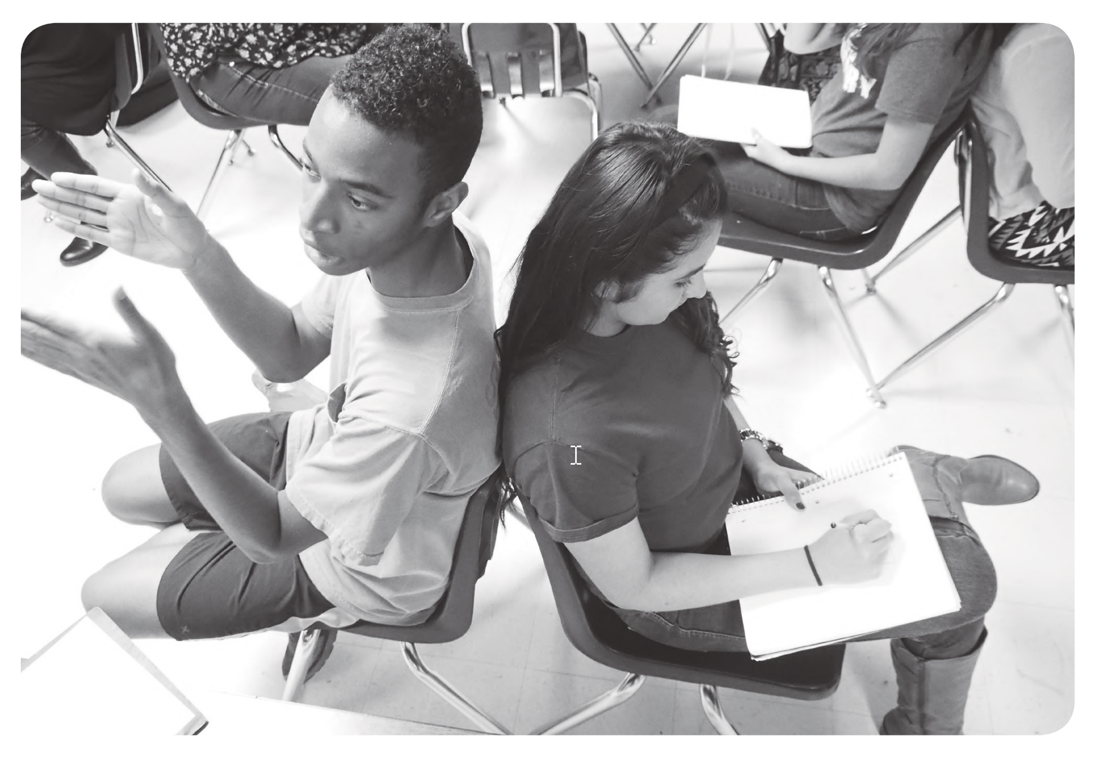
Let’s have some fun!
Option #2- I Love My Neighbor
Option #1- Partner Draw
Notes:
Teachers: you have two options in terms of team/community building: 1) a level one quick and easy partner draw and debrief (slides 8-10 & 12), and 2) a more involved but potentially more interesting opportunity for students to take positive risk in sharing-- the I Love My Neighbor game (slide 11-12). There is an optional debrief at the end of both activities on slide 12.

Slide 8
Option One: “Partner Draw”
Each student will need a sheet of paper and a writing or drawing implement. Have students find a partner, and then sit back-to-back with their partner. One partner faces front and the other faces the back of the classroom.
Show one of the pictures (see next slides).The partner facing the screen (or drawing if you do not have the ability to project) will have one minute to describe what is on the screen. The partner with their backs to the screen will draw with their partner describes.
After one minute, have both partners look at the screen to see how accurately they portray the actual picture.
Then switch roles so the describer for the first picture is now the drawer, and the drawer is now the describer. Show the next picture and repeat the minute.
Repeat both partners looking at the screen to see how accurately they have portrayed the picture.
Notes:
Teachers: you have two options in terms of team/community building: 1) a level one quick and easy partner draw and debrief (slides 8-10 & 12), and 2) a more involved but potentially more interesting opportunity for students to take positive risk in sharing-- the I Love My Neighbor game (slide 11-12). There is an optional debrief at the end of both activities on slide 12.

Slide 9
Picture #1
Notes:
Teachers: you have two options in terms of team/community building: 1) a level one quick and easy partner draw and debrief (slides 8-10 & 12), and 2) a more involved but potentially more interesting opportunity for students to take positive risk in sharing-- the I Love My Neighbor game (slide 11-12). There is an optional debrief at the end of both activities on slide 12.

Slide 10
Picture #2
Notes:
Teachers: you have two options in terms of team/community building: 1) a level one quick and easy partner draw and debrief (slides 8-10 & 12), and 2) a more involved but potentially more interesting opportunity for students to take positive risk in sharing-- the I Love My Neighbor game (slide 11-12). There is an optional debrief at the end of both activities on slide 12.

Slide 11
Option 2: “I love my neighbor” game
The Gist: 1)Arrange your chairs in a circle, making sure there is one less chair than there are students. Sit in the chairs. The one student without a chair is your volunteer for step 3.
2)Using a notecard, have students form responses (at least two) that complete the following phrase: “I love my neighbor, especially those …”. For example, a student might finish the phrase with, “who are wearing blue.”
3)To begin the game, ask a volunteer to step in the middle. This student’s job is to complete the phrase, “I love my neighbor, especially those….” Then those fitting the phrase will have to STAND UP and MOVE at least 2 chairs away. The volunteer will also have to find a seat. The student left without a chair is the new volunteer. Repeat/rotate as many times as needed.
Notes:
MATERIALS NEEDED: paper or notecards to record several answers finishing the phrase: “I love my neighbor, especially those…”
MODIFICATIONS: Split your group in 2 and rotate half way through the allotted activity time.

Slide 12
Game Debrief for both options
On the back of your drawing (Partner Draw) or notecard (I love my neighbor) answer the following questions:
What was your favorite/least favorite part of this activity?
What was something new you learned about yourself or your classmates in this activity?
How did this activity make you feel? Were there statements or comments that made you feel uncomfortable?
How did this statement impact you or the group? How could we rephrase this statement in the future?

Slide 13
It is your future!!

