Slide 1
Using Classes to Analyze Complex Numbers
Learning Target: Be able to create a class and application to model Complex Numbers.

Slide 2
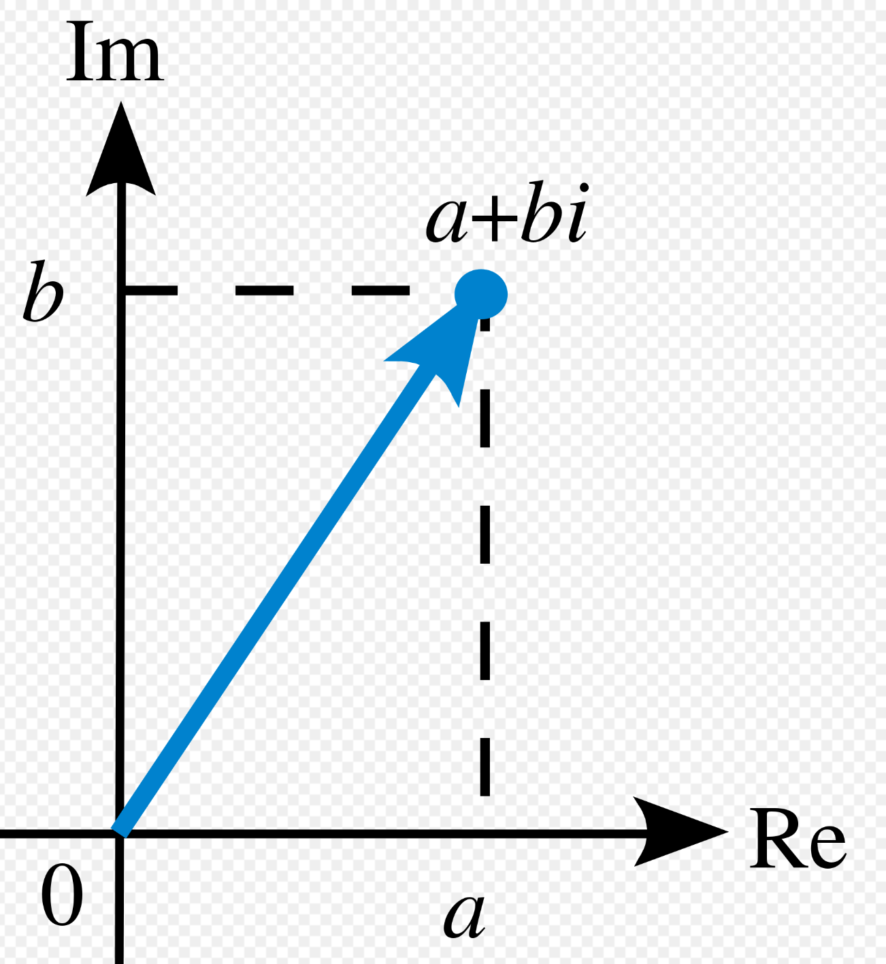
Complex Numbers (Wiki)
A complex number is a number that can be expressed in the form a + bi, where a and b are real numbers, and i is a solution of the equation x² = −1.
Because no real number satisfies this equation, i is called an imaginary number.
For the complex number a + bi, a is called the real part, and b is called the imaginary part.
Despite the historical nomenclature "imaginary", complex numbers are regarded in the mathematical sciences as just as "real" as the real numbers, and are fundamental in many aspects of the scientific description of the natural world

Slide 3
Complex Art: Fractals and the Mandelbrot Set
https://www.youtube.com/watch?v=NGMRB4O922I&feature=youtu.be
f(z) = z^2 +c such that f(z) <=2.

Slide 4
Creating a Complex Number Class
Instance Variables
double realPart
double imaginaryPart
Constructors
Default
Sent a real part and an imaginary part
Methods
String toString()
void add(Complex number)
void integerDivide(int)
int compareTo(Complex)
Compare the magnitude. For the complex number a+bi it’s magnitude is sqrt(a^2 + b^2)
d.compareTo(e) >0 when d>e
d.compareTo(e) <0 when d<e
d.compareTo(e) ==0 when d==e
Extensions
Methods
Mutators/Setters
void setRealPart(double)
void setImagPart(double)
Getters
double getRealPart()
double getImagPart()
void pow(int)
Raises the imaginary number to an integer power.
var.pow(2) will square the imaginary variable var.

Slide 5
Application Options
Turn in both your application class and your Complex class.
Total, average, highest and lowest.
Input an unknown number of imaginary numbers and output the total, average, highest and lowest values entered.
Blow up or not
Input and complex number c such that both the real and imaginary parts are less than 2. (Like c = 1 + 1i, or c = 0.3 + -0.5i, …)
Apply the following algorithm until it blows up, gets bigger than 2or stays below 2 for 20 iterations.
f(z) = z^2 + c where z starts as 0+0i. See Mandelbrot video for examples.
Output: The number of iterations to blow up or that it did not blow up.
Push
Have the program enter the values such that the real part goes from -2 to 2 by 0.1 and for each of these the imaginary part goes from -2 to 2 by 0.1.
Push: Show the results as a grid
Write the code to generate the Mandelbrot set

