Slide 1
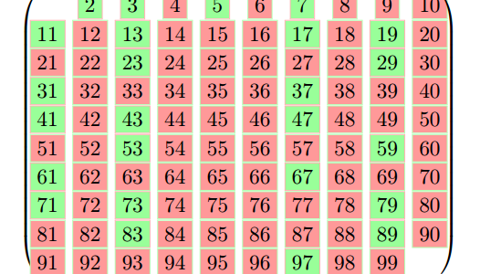
Common Array Algorithms
Learning Target:
Be able to implement common array algorithms

Slide 2
Outline
Dry run practice with arrays
Introduce the programs and resources
Use your resources to be able to use arrays to solve some common algorithms.

Slide 3
Dry run 1
int[] egArray = { 2, 4, 6, 8, 10, 1, 3, 5, 7, 9 };
for ( int index= 0 ; index < 5 ; index++ )
System.out.print( egArray[ index ] + " " );

Slide 4
Dry Run 2
int[] egArray = { 2, 4, 6, 8, 10, 1, 3, 5, 7, 9 };
for ( int index= 0 ; index < egArray.length ; index++ )
System.out.print( egArray[ index ] + " " );

Slide 5
Dry Run 3
int[] egArray = { 2, 4, 6, 8, 10, 1, 3, 5, 7, 9 };
for ( int index= 0 ; index < egArray.length ; index = index + 2 )
System.out.print( egArray[ index ] + " " );

Slide 6
#4) Modify the code
Fill in the blanks of the following code fragment so
that the elements of the array are printed
in reverse order, starting with the last element.
int[] egArray = { 2, 4, 6, 8, 10, 1, 3, 5, 7, 9 };
for ( int index= ________ ; _____________ ; ______________ )
System.out.print( egArray[ index ] + " " )

Slide 7
Dry Run 5
int[] array = { 1, 4, 3, 6, 8, 2, 5};
_{int what = array[0];}
for ( int index=0; index < array.length; index++ )
{
_{if ( array[ index ] > what )}
_{what = array[ index ];}
}
_{System.out.println( what );}

Slide 8
Arrays are Powerful
There are many things you can do with arrays. You will need to be familiar with some of the common array algorithms.
Finding the Maximum/minimum values in an array
Finding the total
Average, handling if there are 0 elements
Determining which values are in a arrange of values
Using arrays with a for loop and a for..each loop.
Sorting

Slide 9
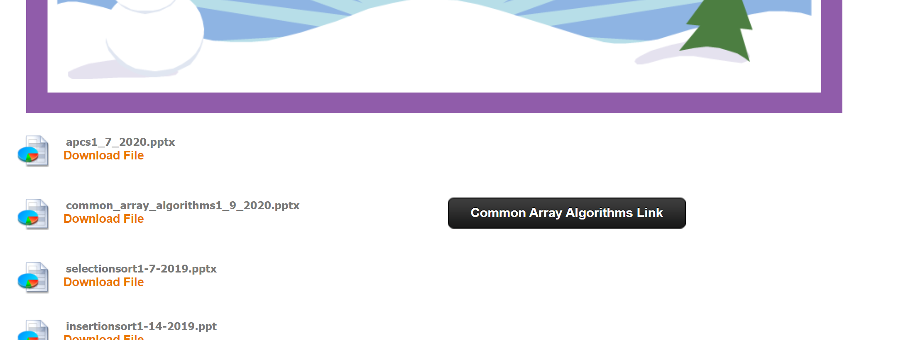
Resources
‘Common Array Algorithms’ link on class website
Walks through developing code for common algorithms
Past notes/Pascal programs
Many of these were covered in Computer Science 1 and 2. Your old solutions would work well as pseudocode for these assignments..
Hands on, pseudo code, dry run,…
A little work, but a good way to be sure you understand the program requirements.
Other students in class

Slide 10
Activities
After studying, ….
You will write two array algorithm programs
1) Sieve of Eratothsenes
2) Average Tweek
Details for these are on the following slides.

Slide 11
Array Algorithm Program 1
Use an array to calculate and show all prime numbers <=1000
Use the sieve of Eratosthenes
Cross out 1, because it is not prime.
Circle 2, because it is the smallest positive even prime. Now cross out every multiple of 2; in other words, cross out every second number.
Circle 3, the next prime. Then cross out all of the multiples of 3; in other words, every third number. Some, like 6, may have already been crossed out because they are multiples of 2.
Circle the next open number, 5. Now cross out all of the multiples of 5, or every 5th number.
Continue doing this until all the numbers through 100 have either been circled or crossed out. You have just circled all the prime numbers from 1 to 100!
Write a program to use this process in finding all primes less than or equal to 1000.
How many primes will Java let you find using this method?

Slide 12
Algorithm Program 2: Data Tweeker
You are interested in computing the average acid level of coffee as served by coffee shops in your hometown. You visit many coffee shops and dip your pH meter into samples of coffee. You record your results such as the following.
The first number gives the number of values that follow.
13 5.6 6.2 6.0 5.5 5.7 6.1 7.4 5.5 5.5 6.3 6.4 4.0 6.9
Unfortunately, your pH meter sometimes produces false readings. So you decide to disregard the reading that is most distant from the average.
Write a program that gets the data from the user into an array. Compute the average of all the data. Now scan through the array to find the value that is farthest (in either direction) from that average. Remember the index of this value, and now scan through the array again, computing an average that does not include this value.
Print the new average.
Here is a run of the program using the above data:
average: 5.930769230769231
most distant value: 4.0
new average: 6.091666666666668

Slide 13
Push: Further Tweeking
Your pH meter has become much less reliable (ever since you dropped it on the floor due to uncontrollable shaking after ten cups of coffee). You decide to compute several averages from your data:
The average of all values. (Call this average A1.)
The average of all values, excluding the one furthest from A1. (Call this average A2.)
The average of all values, excluding the two furthest from A2. (Call this average A3.)
The average of all values, excluding the three furthest from A3.
Write a program that computes these averages for the above or similar data.

Slide 14
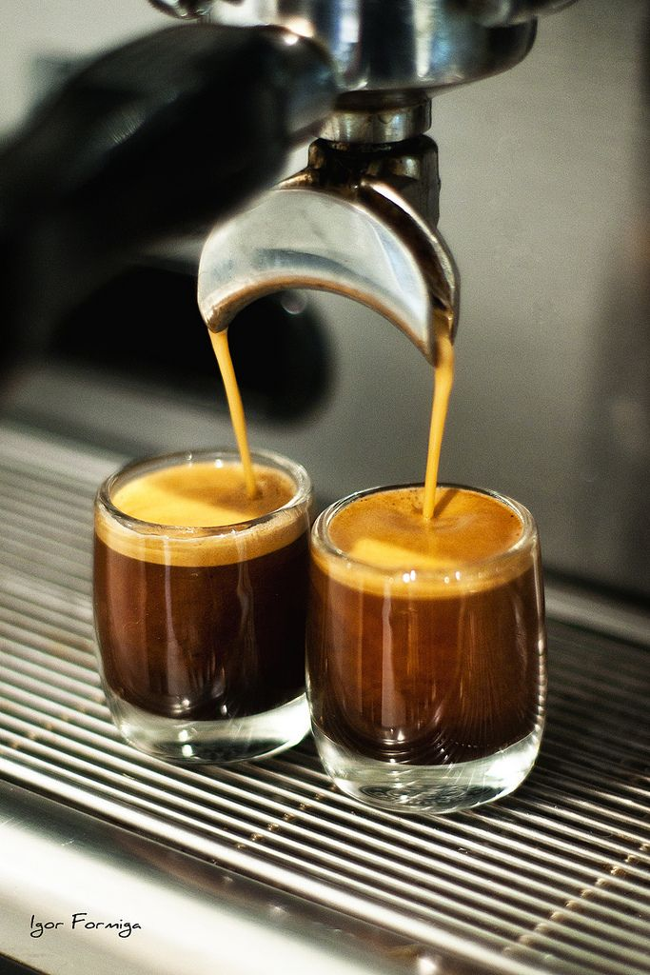
Push: Tweeker’s Delight
Your Brain has started shaking, you have a couple of double espressos, and you notice that with an array of N values you can compute N averages:
The average of all values. (Call this average A1.)
The average of all values, excluding the one furthest from A1. (Call this average A2.)
The average of all values, excluding the two furthest from A2. (Call this average A3.)
The average of all values, excluding the three furthest from A3.
. . .
The average of all values, excluding the N-1 furthest from A(N-1). (This is the average of just one element; in other words, the value of that element itself.)
Write a program that computes these averages and prints them out.

