Slide 1
Computer Science 2
Dry Run
Fix it
Write a program

Slide 2
Learning Objectives
Students will be able to read a program that incorporates arrays.
Students will be able to write code to declare, input, output and compare values in an array.
Students will be able to fix a program that uses arrays.
Students will be able to write a program that uses arrays.

Slide 3
Dry Run (Assume the array has been declared previously)
for (int pos= 0;pos<5;pos++)
info[pos]= pos*2;
for (int pos= 0;pos<5;pos++)
{
if ((pos % 2) == 1)
info[pos]= info[pos] + pos
else
info[pos]= info[pos]*pos;
}
for (int pos= 0;pos<5;pos++)
SOP(info[pos]);

Slide 4
Fix it
On the Web page there is a program called fixary1.pas
It is supposed to input 10 scores, calculate the average of these score and the show all of the scores that are below average.
See if you can fix it!!

Slide 5
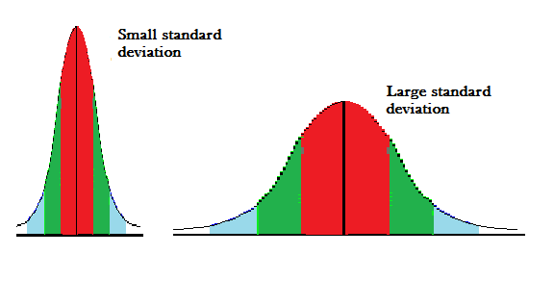
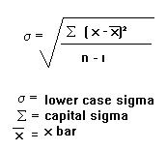
Array Program 1
Input: 10 scores (integers)
Output:
The high score
The low score
The average
The number of scores within 3 of the average
Push: Show the numbers in order low to high
Input: 9 scores and calculate the sample standard deviation
The standard deviation is a measure of central tendency. It will describe how much variation exists from the average. A low standard deviation means that the numbers tend to be close to the average.
Notes:
Accommodations:
Provide notes accessible at school and at home for this lesson.
Include scaffolding activities to check for understanding during the lesson
Have Java language available for students to complete activities and explore applying the ideas at home.
Provide extended time to complete the assignment.
Modifications:
Students can complete either of the assignments for full credit
Add an option for simple input to/output from the array.
Input 10 names and output the names in reverse order.
Model rolling a pair of dice 100 times and save the rolls in an array. Then show the rolls from the array.
Students dry run a program, drawing a picture of the array and demonstrating how the values change while the program is running.

Slide 6
Standard Deviation Example.
Find the standard deviation of 4, 9, 11, 12, 17, 5, 8, 12, 14
First work out the mean (Average, xbar,…):
(4 + 9 + 11 + 12 + 17 + 5 + 8 + 12 + 14)/9 = 10.222
Now, subtract the mean individually from each of the numbers in the question and square the result. This is equivalent to the (x - xbar)² step. x refers to the values in the question.
x 4 9 11 12 17 5 8 12 14 (x - xbar)² 38.7 1.49 0.60 3.16 45.9 27.3 4.94 3.16 14.3
Now add up these results (this is the ‘uppercase sigma' in the formula):
139.55
Divide by n-1. n is the number of values, so in this case n-1 is 8:
139.55 / 8 = 17.44
And finally, square root this:
4.18

