Slide 1
AP Java 1/14/2016
Inheritance Review

Slide 2
Learning Objectives
Be able to understand how to create classes that use inheritance.
Be able to dry run programs that involve inheritance.

Slide 3
Outline for the day
Dry run a program as a class
Take notes on an inheritance unit
Program

Slide 4
public class Messages
{
public static void main(String[] args)
{
Thought parked = new Thought();
Advice dates = new Advice();
parked.message();
dates.message();
}
}
Dry Run
public class Thought
{
public void message()
{
System.out.print("I feel like I'm diagonally parked in ");
System.out.println("a parallel universe.");
}
}
public class Advice extends Thought
{
public void message()
{
System.out.print("Warning: Dates in calendar are closer ");
System.out.println("than they appear.");
super.message();
}
}

Slide 5
Inheritance Notes
http://chortle.ccsu.edu/java5/Notes/chap50/ch50_1.html
In your notes include….
Questions
Ideas: At least one idea from each page of the notes
Fill in notes, answer questions before looking at the answer.
Code samples

Slide 6
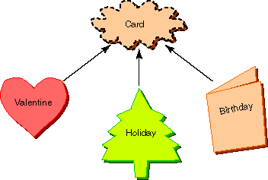
Card Project
Create a project with the following classes.
Card Class
Constructor
Instance Variable: name
getName method that returns the name
setName method that is sent a String and uses it to set the name of the variable.
greeting method that displays : name “gets a card”
Holiday Card Class
Constructor
greeting method that displays.
“Dear “ name
Seasons Greetings!
Birthday Card Class
Age instance variable
Constructor
greeting method that displays
Dear name
Happy age Birthday!!
Valentines Class
Instance variable kisses
Constructor
greeting method that displays
Dear Name
Love and Kisses
XXXXXX… (The number of Xs is found in the kisses variable)
Driver Class to test each of these

