Slide 1
AP Java
9/21/2018

Slide 2
Learning Targets
Be able to fix a program that uses the for loop
Be able to develop code that uses for loops

Slide 3
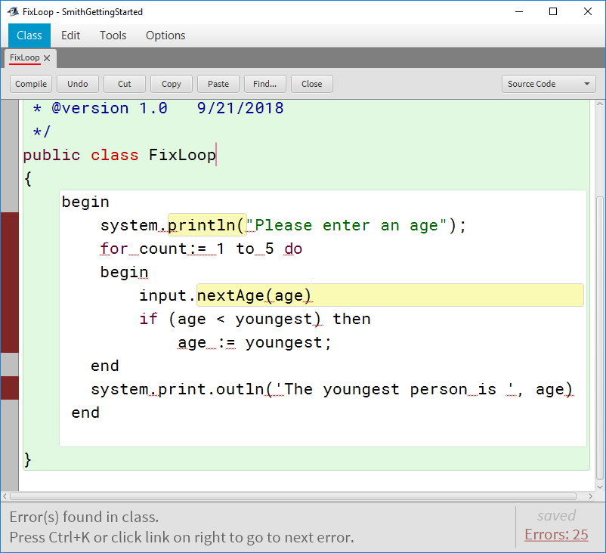
Fix IT!
Open from the class website ‘fixloop.java’ file and fix the program.
It is supposed to input 5 ages and find the youngest age.

Slide 4
Programs if/for (At least one from each section)
For Program Options
Enter a number: Output it’s factorial
Enter a base and an exponent: Using a for loop calculate base^exponent using the for loop. (No Math.pow())
Combined Program options
Enter 10 scores. Output the total, average, highest and lowest score.
Enter 5 ages and calculate the number of teenagers in the list.

