Slide 1
AP Class Methods

Slide 3
Learning Objectives
Be able to use methods from one class in another class.
Be able to create and use class methods.

Slide 4
Class Methods
Like Math.pow() you can create your own methods in one class and use them in another class.
They need to be static and public in order to do this.
The call statement from the application class in the same project is
ClassName.methodName(arguments);

Slide 6
Your Turn: Using the Class you created on Tuesday complete one of options described on the following pages
Electricity Chart
Movement Chart
Statistics Chart

Slide 7
Electricity
Use the methods defined in the Electricity class to complete the following program
Input: Voltage
Create a chart for the entered voltage with different resistance values
So the user enters the voltage and the program creates the chart.
Resistance (Ohms) Current (Amps) Power (Watts)
0
1
2
…
30

Slide 8
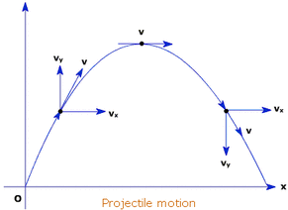
Movement
Use the ‘Movement’ class from the previous assignment to complete the following
Input:
Initial Distance (d0)
Initial Velocity (v0)
Acceleration (Constant Acceleration for this problem)
Output: Distance/Velocity Chart
Time (Seconds) Distance Velocity
0
1
…
30
Push: Modify this by giving an initial velocity and direction (angle in degrees) of a projectile.
Vx = V * cos(angle)
Vy = V* sin(angle)
Acceleration = -9.8 m/second^2 in the y direction
Push: Using the graphics from last class. Model the object flying by plotting it’s x and y position for 30 seconds.

Slide 9
Statistics
Using the Statistics Class complete a program that will
Input the total number of items (n)
Output a chart
Items take at a time(r) Permutations Combinations
1
2
…
n

Slide 10
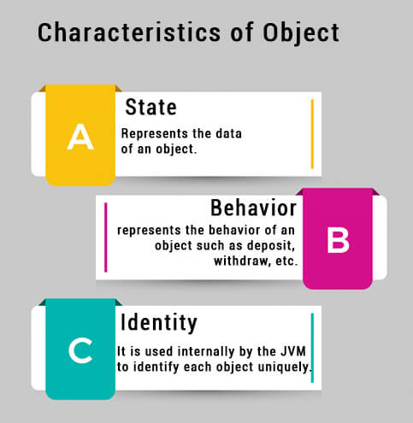
When Finished with the Class Methods Assignment
Click on the ‘Intro to Objects’ button, read and takes notes on Chapter 25 and 26.
Vocabulary
Object
Class
Static methods
Dot notation
Constructors
primitive
reference variable
Garbage
.equals
==

