Slide 1
Advanced Computer Projects

Slide 2
Introductions
Take Notes as needed to help with introductions.
You will introduce the people next to you
Name, first and last
What helps you feel welcomed?
What stresses you out the most about school?
What do you like most about school?
If you had to pick a career today, what would it be?

Slide 3
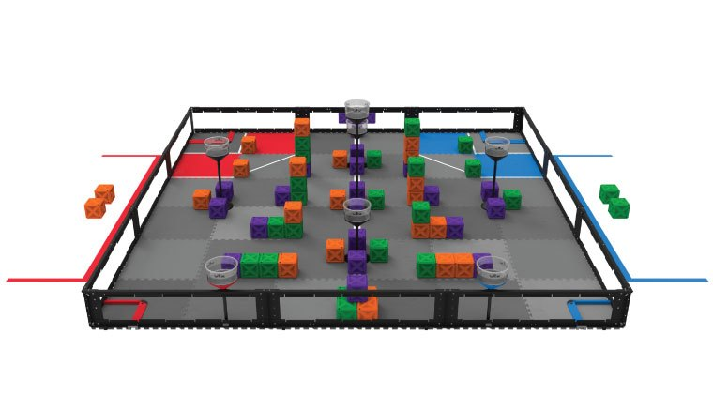
Mr. Smith’s Schedule Fall 2019
1st Period Computer Science I (D130)
2nd Period Prep
3rd Period AP Computer Science (A116)
4th Period Advanced Computer Projects (A116)
Lunch
5th Period Prep
6th Period Computer Science 1 (D130)
7th Period Robotics Projects (A116)
8th Period Robotics Projects (A116)

Slide 4
4th Period Talking Points: Lunch Schedule
All Meet Monday (A/B day): Look where you are 5th period…
if you are in the A, B, C wing you have: 1st lunch 10:42 – 11:12
if you are in the portables, D or E wing you have: 2nd lunch 11:29 – 11:59
Tuesday and Wednesday (A/B Day): Look where you are 3rd or 7th period…
if you are in the A, B, C wing or portables you have: 1st lunch 10:40 – 11:10
if you are in the portables D or E wing you have: 2nd lunch 12:15 – 12:45
Thursday and Friday (B Day): Look where you are 3/7th period…
if you are in the A, B, C wing you have: 1st lunch 11:00 – 11:30
if you are in the portables D or E wing you have: 2nd lunch 12:25 - 12:55
Special Lunch Schedule for today:
A Lunch 11:00-11:30
B Lunch 11:42- 12:12
Lunch time must be spent in the commons, the courtyard near the commons or the main hall on the 1st floor next to the commons. The areas that are closed during lunches are: the gyms, the wings that are having classes and anywhere upstairs.

Slide 5
4th :Transportation/Parking
In order to park on school grounds, permits must be displayed at all times. Remember that parking on the West Campus is a privilege and may be revoked by administration at any time.
Student vehicles parked on school property must be free of writing or pictures that would be derived as in appropriate or appear threatening. This also includes alcohol and drug related material.
Students without parking passes that continue to park on campus risk their chance of attaining a parking pass their senior year.
If you are parking off campus behind the school on neighborhood streets, it is important that you remember:
do not park on a corner.
do not block mailboxes
do not park in front of new construction.
do not block driveways
please pick up garbage if you are parking in the neighborhoods.
we need to be good neighbors

Slide 6
4th Period
Riding the Bus
If you have any questions about a route, please go to the counseling Center. Busses usually leave from the back of the school at 2:30. When riding the bus please follow the school guidelines on managing yourself.
A Lunch will happen after this period.

Slide 7
Advanced Computer Projects
Can work independently or in teams
Will employ the Scrum Framework
Daily Scrum Meetings (Updates)
Sprint Reviews (Project Demonstrations)
Sprint Retrospectives (Mid project evaluations)

Slide 8
Today
Brainstorm

