Slide 1
Welcome to Advisory
Thursday, May 23, 2019
End of Year reflection and celebration
Grades 9 & 10

Slide 2
Learning Target
Today I will reflect on my learning throughout this past year: my challenges, successes and how I will use my strengths in the future. I will express gratitude to the people that have helped me get where I am.
Notes:
30 seconds

Slide 3
Can You Count to 20?
Circle up (whole group or two small groups)
One person begins; others continue
No one repeats, no same times, no gestures nor cues.
If any of #3 are broken, start over!
Notes:
2-3 minutes

Slide 4
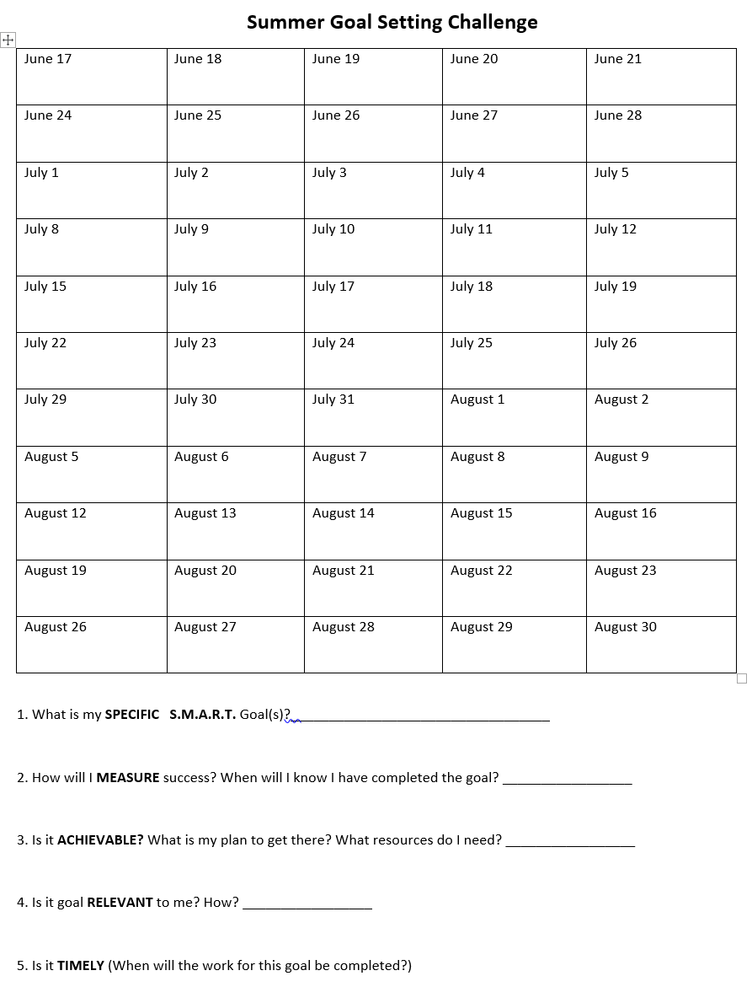
Summer Challenge -
The 11 weeks you have over the summer is a
great time to learn and do something new - for you!
Look over a calendar for the summer and choose
when you will accomplish new goals.
Read ___ books each week.
Learn how to do something new. Play an new
instrument, become artistic, learn a new sport,
write a story, ….
3. Go on an adventure and write about what you
learned.
4. Help out others who can use your skills and
abilities.
5. ???
Make each goal SMART! Choose a date, make a plan, reach your goal!
Notes:
3-5 minutes

Slide 5
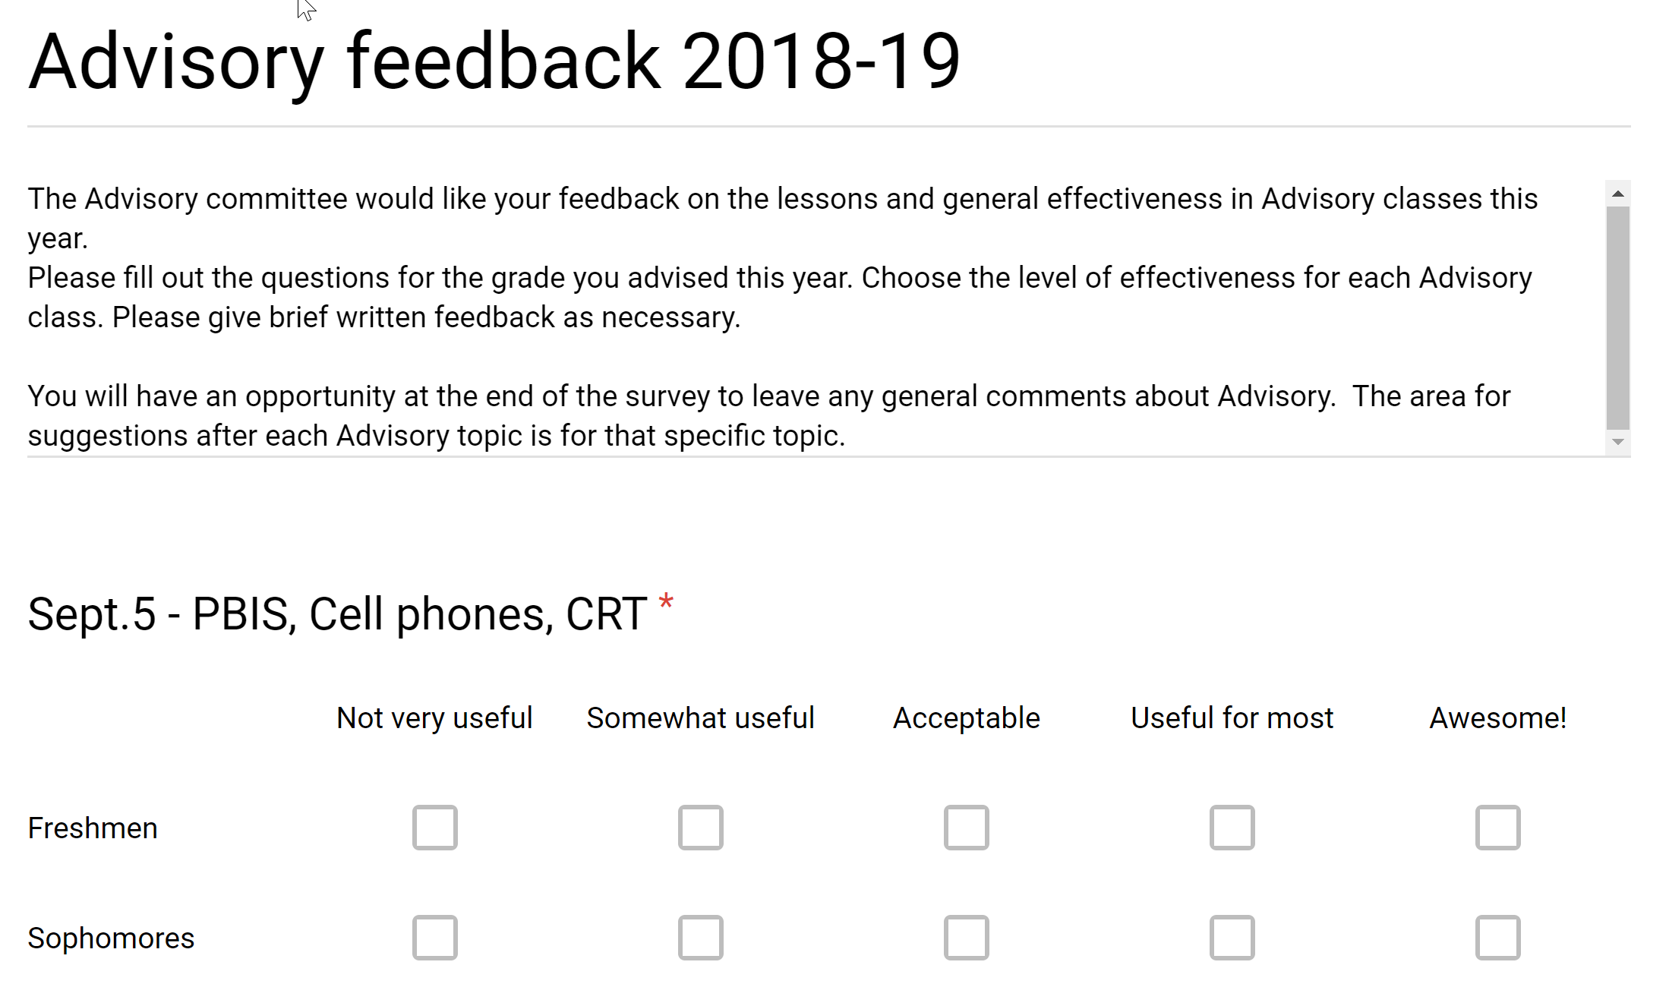
We need your input:
Using your smartphone or a chromebook, fill out the survey about the advisory topics for the year. We would like thoughtful feedback on how to make Advisory even more useful to you, beyond the mandatory topics we have to discuss.
Notes:
3-5 minutes

Slide 6
A BIG THANKS!
Being thankful and acknowledging that thanks is an important part of being in a community. Here is your opportunity. Write a short Bee-Hive note to a friend, peer to be posted on the Bee-Hive in the commons. Your teacher will collect these and pass them on to Mr. Haws to be posted.
You also have the option of writing a thank you note to a teacher, advisor, or coach that has helped you. If you choose this option, please do your best to fill out the contact information on the green postcard so we can deliver these in a timely manner. Your teacher will collect these and pass them on to Mr. Bruey-Finck to be delivered.
Notes:
5-7 min.

Slide 7
Reflection
Fill out the blue half-sheets provided by your advisory teacher to reflect on your year.
*Be prepared to share a few answers!*
Notes:
5 minutes to fill out reflection
5 minutes to share (10 min. total)

Slide 9
What you do every day is more important than what you do once in awhile. (Gretchen Rubin)

Slide 10
Good luck!
See you next year!

