Slide 1
Geometric Shapes and Area
Get out your notes.

Slide 2
Learning Objectives
Be able to calculate areas of different geometrical figures and combinations of figures.
Be able to calculate measures of geometric figures given their areas.
Notes: Include sketches, descriptions and associated formulas.

Slide 3
Shape
Shape describes the two-dimensional contour that characterizes an object or area, in contrast to a three-dimensional solid. Examples include:

Slide 4
Area
Area is the extent or measurement of a surface. All shapes represent enclosed two-dimensional spaces and thus have area.

Slide 5
Circles
A circle is a round plane figure whose boundary consists of points equidistant from the center.

Slide 6
Circles
The circle is the simplest and strongest of all the shapes. Circles are found within the geometry of countless engineered products, such as buttons, tubes, wires, cups, and pins. A drilled hole is also based on the simple circle.

Slide 7
Area of a Circle
In order to calculate the area of a circle, the concept of π (pi) must be understood. π is a constant ratio that exists between the circumference of a circle and its diameter.
The ratio states that for every unit of diameter distance, the circumference (distance around the circle) will be approximately 3.14 units.

Slide 8
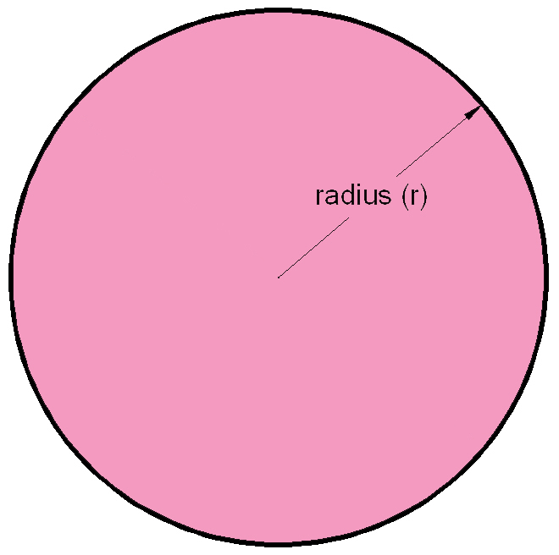
Area of a Circle
To calculate the area of a circle, the radius must be known.
A = π r ²
π ≈ 3.14
r = radius
A = area

Slide 9
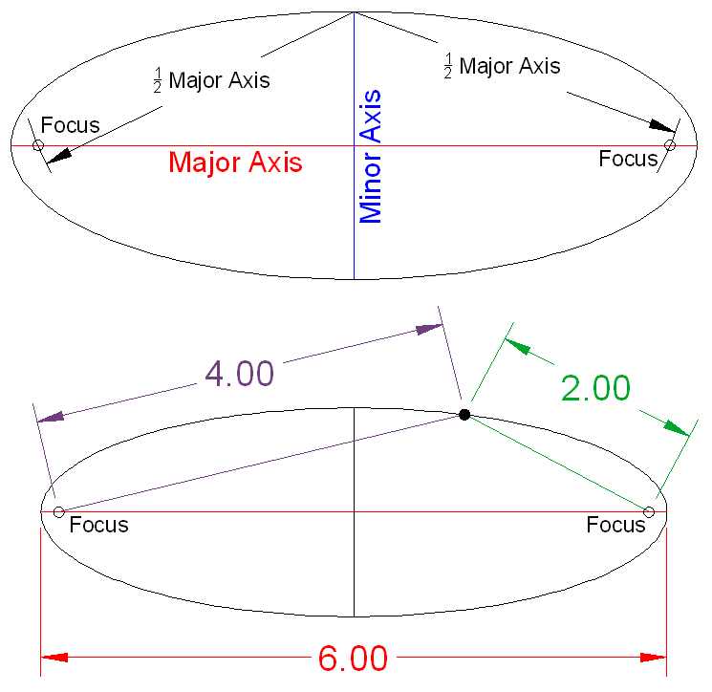
Ellipses
An ellipse is generated by a point moving in a plane so that the sum of its distances from two other points (the foci) is constant and equal to the major axis.

Slide 10
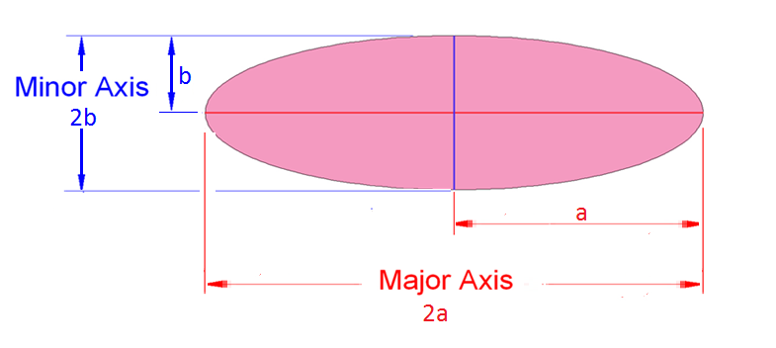
Ellipses
To calculate the area of an ellipse, the lengths of the major and minor axis must be known.
A = π ab
2a = major axis
2b = minor axis
π = 3.14
A = area

Slide 11
Polygons
A polygon is any plane figure bounded by straight lines. Examples include the triangle, rhombus, and trapezoid.

Slide 12
Angles
An angle is the figure formed by the intersection of two rays. Angles are differentiated by their measure.
Acute
Less than 90º
Right
Exactly 90º
Obtuse
Between
90º and 180º
Straight
Exactly 180º

Slide 13
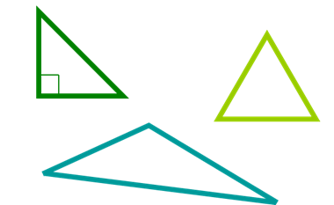
Triangles
A triangle is a three-sided polygon. The sum of the interior angles will always equal 180º.

Slide 14
Triangles
All triangles can be classified as:
Right Triangle
One interior right angle
Acute Triangle
All interior angles are acute
Obtuse Triangles
One interior obtuse angle

Slide 15
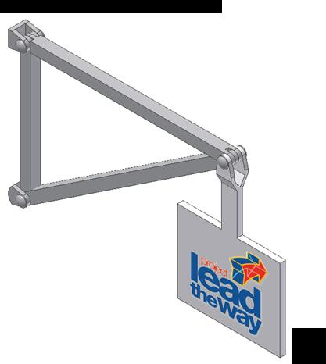
Triangles
The triangle is the simplest and most structurally stable of all polygons.
This is why triangles are found in all types of structural designs. Trusses are one such example.
Sign support truss based on a right triangle

Slide 16
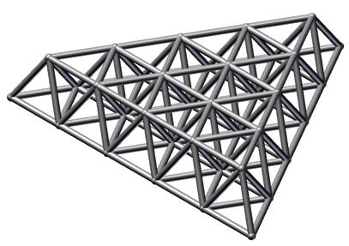
Triangles
Light weight space frame roof system based on the equilateral triangle

Slide 17
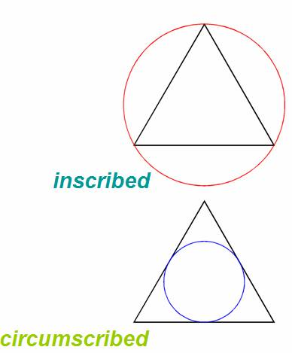
Triangles
Sometimes the terms inscribed and circumscribed are associated with the creation of triangles and other polygons, as well as area calculations.
Notes:
An inscribed polygon is defined as a polygon placed inside a circle so that all the vertices of the polygon lie on the circumference of the circle. A circumscribed polygon is a polygon drawn around a circle

Slide 18
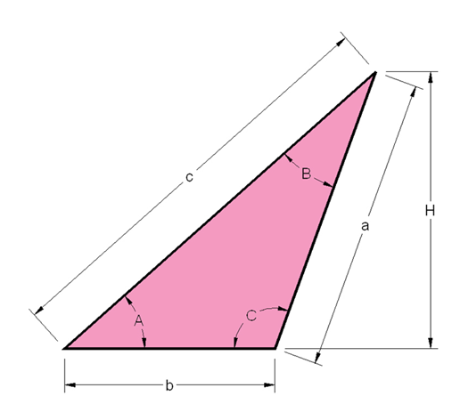
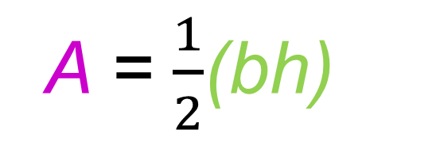
Area of Triangle
The area of a triangle can be calculated by
b = base
h = height
A = area
A = $\frac{1}{2}$(bh)
h
b

Slide 19
Quadrilaterals
A quadrilateral is a four-sided polygon. Examples include the square, rhombus, trapezoid, and trapezium:

Slide 20
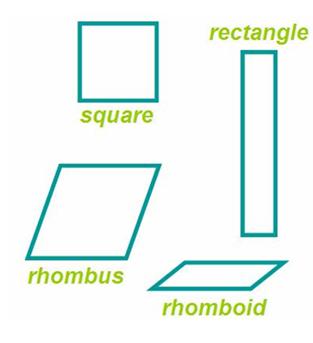
Parallelograms
A parallelogram is a four-sided polygon with both pairs of opposite sides parallel. Examples include the square, rectangle, rhombus, and rhomboid.

Slide 21
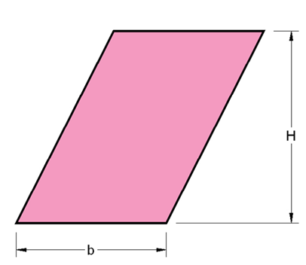
Parallelograms
The area of a parallelogram can be calculated by
A = bh
h
b = base
h = height
A = area

Slide 22
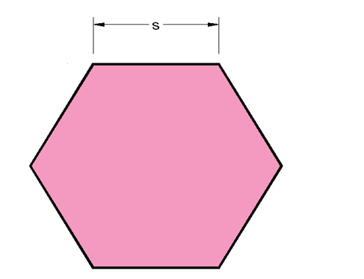
Multisided Regular Polygons
A regular polygon is a polygon with all sides equal and all interior angles equal.

Slide 23
Multisided Regular Polygons
A regular polygon can be inscribed in a circle
An inscribed polygon is a polygon placed inside a circle so that all the vertices of the polygon lie on the circumference of the circle

Slide 24
Multisided Regular Polygons
A regular polygon can also circumscribe around a circle.
A circumscribed polygon is a polygon placed outside a circle so that all of sides of the polygon are tangent to the circle

Slide 25
Regular Multisided Polygon
Examples of regular multisided polygons include the pentagon, hexagon, heptagon, and octagon.

Slide 26
Multisided Polygons
The area of a multisided regular polygon can be calculated if a side length and the number of sides is known.

Slide 27
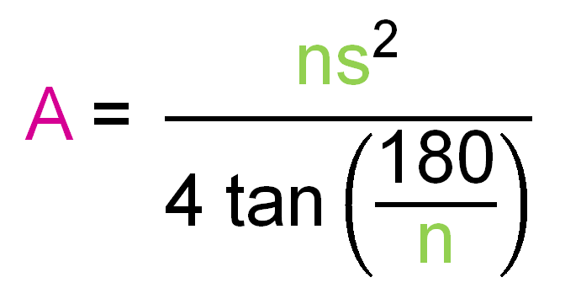
Multisided Polygons
Area calculation of a multisided regular polygon:
A = area
s = side length
n = number of sides
Notes:
The tangent function (tan) is a trigonometric function that you may or may not be familiar with, however most scientific and graphing calculators have the trigonometric functions available. Be sure that you calculator is set to use angle input in degrees (rather than radians) before using this formula.

Slide 28
Assignment
Complete Activity 5.1Calculating Properties of Shapes Worksheet.
Show your work on the worksheet.

