Slide 1
Computer Science 2
More Trees

Slide 2
Learning Targets
Be able to dry run a program that uses a binary tree
Be able to find the total and average values from a tree.

Slide 3
Show the tree, and the screen
Dry run given the tree on the left.
What would be the result of the calculation?
function one(top:ptrtype);
Var
leftCount, rightCount:integer;
begin
if top = nil then
one := 0
else
begin
leftCount:= one(top^.left);
rightCount:= one(top^.right);
if rightCount>leftCount then
one := rightCount + 1
else
one:= leftCount + 1;
end;
end;
Top
50
10
70
Begin
{** Code that created the above tree**}
writeln(one(top));
end.
60

Slide 4
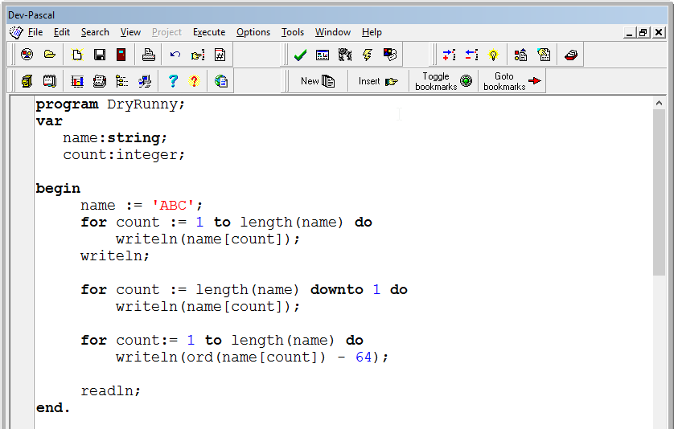

Slide 5
Today: Tree Math
Write a program that uses a tree as the data structure with the following menu options
Add to the tree
Show all
Calculate the average score from the tree
Show the highest score from the tree
Show the lowest score from the tree
Calculate how many scores are within 6 of the average score
Remove a score
Pushes
Count the number of generations in the tree

