Slide 1
Tank Game
Part 3 of 6

Slide 2
Secondary Weapons and Pick ups
Pick ups will appear randomly in the battle area and can be collected by driving into them.
Each tank can only have one secondary weapon at a time, so picking up a new weapon will remove the current one.
Toolboxes can be created to repair some of the tank’s damage, but these will remove any secondary weapons also.
All secondary weapons will have limited ammunition, so the players must take care to make the most of them.

Slide 3
We’ll use one object for all these different kinds of pick-ups and change its appearance depending on the type of pickup.
We’ll use a variable kind to record what sort of pickup it is by setting its value to 0, 1, 2, or 3.
0 = Homing rocket
1 = Bouncing bomb
2 = Shield
3 = toolbox
Also, the pickup will change its kind from time to time and jump to a new position. It will also jump to a new position when it is collected by a tank.

Slide 4
Creating a Pickup Object
1) Create Sprite
2) spr_pickup
3) Load Sprite
4) resources/chapter10/pick.gif

Slide 5
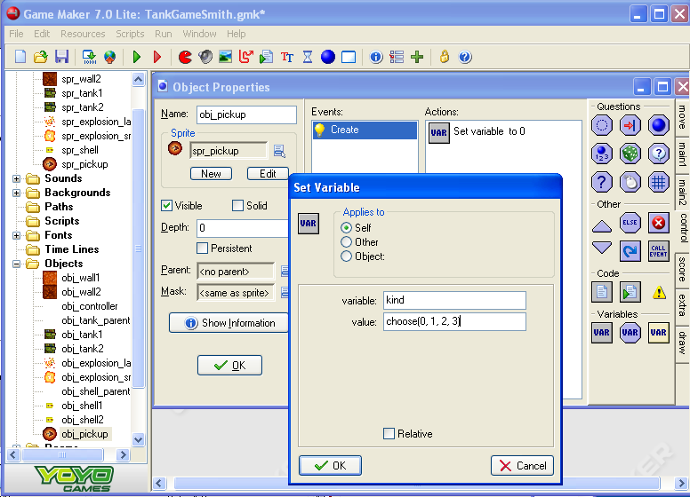
2) obj_pickup
1) Create Object
3) spr_pickup
5) Set Variable
4) Add Event
Create
6) variable: kind
Value: choose(0, 1, 2, 3)
7) OK

Slide 6
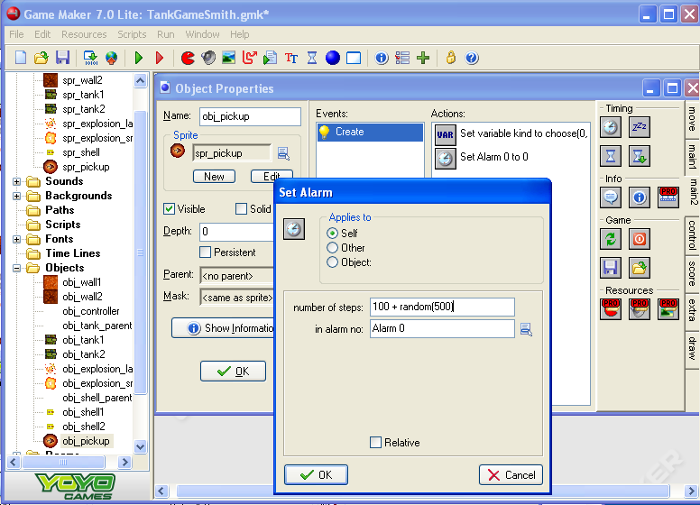
Random Alarm
2) Number of steps: 100 + random(500)
In alarm no: Alarm 0
1) Set Alarm
3) OK

Slide 7
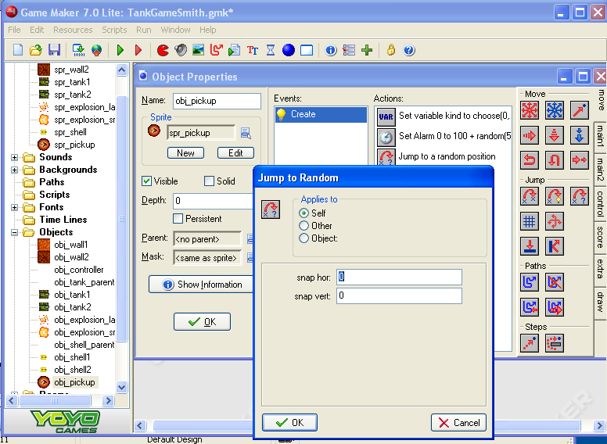
Random Jump
OK

Slide 8
Alarm Event to have Pickups Move
This will have it randomly select a pickup object type when it jumps.
4) Set Variable
Add Event
Alarm
Alarm 0
6) OK
5) variable: kind
Value: choose(0, 1, 2, 3)

Slide 9
Set an Alarm
1) Set Alarm action
2) Number of steps: 100 + random(500)
In alarm no: Alarm 0
3) OK

Slide 10
Jump
1) Jump to Random
2) OK

Slide 11
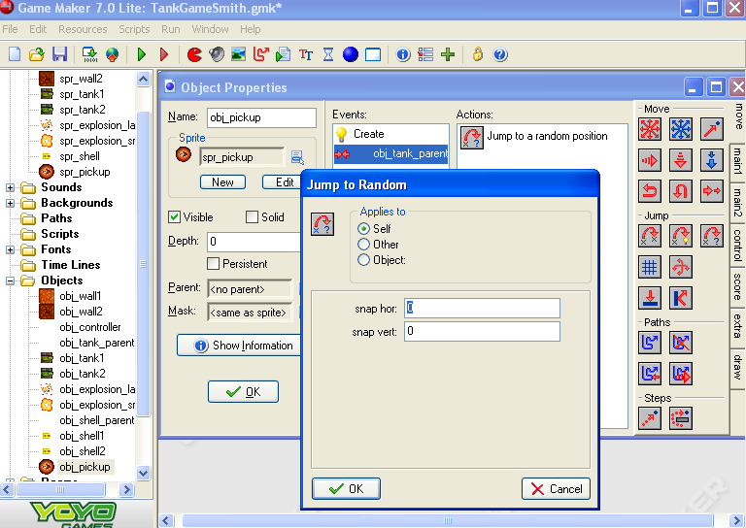
Jump When Hit By Tank
4) Jump to Random
Add Event
Collision
Obj_tank_parent
5) OK

Slide 12
Draw the Pick Up Sprite
4) Draw Sprite
4)Sprite: spr_pickup
X: 0
Y: 0
subimage: kind
Add Event
Draw
5) Check the relative box
3) Draw Tab
6) OK

Slide 13
Test it
Open the room and add some instances pickup objects.
Do they have different images?
Do they change their type and position from time to time?
What happens when you drive over a pick?

Slide 14
Now time to Record the Pickups
Need to record the pickup and the kind of item picked up so it can change the secondary weapon
We use the variable weapon for this where -1 means no weapon.
The variable ammunition will indicate how many shots the tank has left of this weapon type.
When ammunition = 0 then weapon will be set to -1.
We’ll check the value of eth pickup object’s kind variable in the collision event and use it to set the tank’s weapon accordingly.

Slide 15
Create a weapon variable
2) Open the Create event.
3) Set Variable
1) Open the obj_tank_parent object
5) OK
4) variable: weapon
Value: -1 (For no secondary weapon)

Slide 16
Add an ammunition variable
1) Set Variable
2) Variable: ammunition
Value:0
3) OK

Slide 17
Tank Collides with Pickup
4) Test Variable
Add Event
Collision
Obj_pickup
A collision with the toolbox will repair some of the tank’s damage.
5) Variable: other.kind
Value: 3 (for the toolbox)
Operation: equal to
6) OK

Slide 18
Collision with Tool Box block of Code
1) Add a ‘Start of a Block’ action
2) Set Variable
3) variable: weapon
Value:-1
4) OK
This will erase any secondary weapons the tank had.

Slide 19
Reduce the damage by 50
1) Set Variable
max will return the higher value, either 0 or damage -50. This will take 50 points from the tank’s damage, but not let the damage go below 0.
2) Variable: damage
Vallue: max(0, damage – 50)
3) OK

Slide 20
Else (not a toolbox) set the weapon
3) Start block
2) Else (Not a toolbox)
5) variable: weapon
Value: other.kind
1) End block
4) Set Variable
6) OK

Slide 21
Add Some Ammo
1) Set Variable
2) Variable: ammunition
Value: 10
3) OK

Slide 22
End Block
1) End Block

Slide 23
How to tell which type of ammo the tank has.
We’ll display the type of ammo below each tank using a small image of the pickup.
These images have been combined into one sprite again, so we’ll need to test the value of weapon and draw the corresponding sub image if it is equal to 0, 1, or 3.
Then we can draw the value of the variable ammunition next to it.

Slide 24
Displaying the secondary weapon in the parent tank
1) Create a sprite
2) spr_weapon
3) Load sprite
4) resources/chapter10/weapon

Slide 25
Create an Ammunition Font
1) Create a font
2) fnt_ammunition
3) OK

Slide 26
Checking the Weapon to Draw
1) Open the obj_tank_parent object
2) Open the Draw event
3) Test Variable action.
4) variable: weapon
Value: -1
Operation: larger than
5) OK

Slide 27
Draw the Sprite
3) Draw Sprite
2) Draw Tab
1) Start block
4) sprite: spr_weapon
X: -20
Y: 25
Subimage: weapon
5) Check the relative box
6) OK

Slide 28
Set the color to Black
1) Set color
2) Select Black
3) OK

Slide 29
Set the Font
1) Set Font
2) Font: fnt_ammunition
Align: left
3) OK

Slide 30
Draw the Ammunition Variable
1) Draw Variable
2) variable: ammunition
X: 0
Y: 24
4) OK
3) Check the relative box.

Slide 31
End Block
1) End Block

Slide 32
Test it
Do the pick up weapons show up under the tank?
The repair kit will not show up and currently it will do nothing

