Slide 1
Intro To Programming
Competitive Multiplayer Game
Tanks
This project is taken from “The Game Maker’s Apprentice” by Jacob Habgood and Mark Overmars, Chapter 10

Slide 2
Learning Objectives
Be able to create a two player game with tanks, shells, power-ups, score, lives, maps and much more.

Slide 3
Tank War
Tank war is a futuristic tank combat game for two players. Each player drives his or her own tank through a walled battle arena with the aim of obliterating the other’s tank. Once a tank is destroyed, both tanks are respawned at their start position, and a point is awarded to the surviving player.
Most walls provide permanent cover, but some are temporarily demolished to create a way through. Players play until someone gives up.

Slide 4
Properties
Each tank has a primary weapon that it can fire indefinitely. Pickups provide a limited amount of ammunition for a secondary weapon, or repair some of the tank’s damage.

Slide 5
Weapons
Homing Rockets: Always move in the direction of your opponent
Bouncing Balls: Bounce against walls and can be used to fire around corners.
Shields: Are activated to provide a temporary protective shield
Toolbox: Repairs part of the tank’s damage

Slide 6
More Game Details
Split screen view with a mini-map. The two spit screens will be centered on each of the tanks.
The mini map at the bottom of the screen is for locating pick ups and the other player

Slide 7
Controls
Player 1
ADWS for driving
Space Bar for shooting (primary)
Ctrl key for secondary
Player 2
Arrow keys for shooting
Enter key for shooing (primary)
Delete key for secondary.

Slide 8
Resources
The files for this project are located in the Chapter 10 folder of the resources for this class.

Slide 9
The Arena
1) Create a background
2) Label it ‘background’
3) Load ‘Background’ from the Resources/Chapter10 folder

Slide 10
Wall1 Sprite
1) Create Sprite
2) Name it spr_wall1
3) Load Sprite
5) Disable the Transparent property
4) Wall1

Slide 11
Wall 2 Sprite
Same as Wall1 but use the Wall2 image and name

Slide 12
Wall Objects
Create an obj_wall1 object using the spr_wall1 sprite.
Make it solid

Slide 13
Wall 2
Create an obj_wall2 using eh spr_wall2 sprite, enable the solid property
Set the Parent to obj_wall1
Parent Property:
Now wall1 will inherit all of wall1s events and actions. Also as a child of wall1, wall2 ‘is a wall1’ so the controller object automatically includes it in its count to see how many wall1s are left in a room.

Slide 14
Controller Object
This game will include a controller object.
For now it will control playing the music but later it will also be responsible for displaying the score

Slide 15
Music, Controller Object and Room
1) Create a Sound
2) Name is snd_music
‘Music.mp3’ file.
3) Load sound

Slide 16
Obj_Controller
1) obj_controller
Set depth to -100
Add Event
Other
Game Start

Slide 17
Play Sound Action
Snd_music
Loop = true

Slide 18
Room
2) Go to the ‘settings’ tab
1) Create a Room
3) Name it room_main
4) Give it a caption

Slide 19
Background
1) Switch to the ‘backgrounds’ tab
2) Select ‘background’

Slide 20
Wall in the Field
2) Select the ‘objects’ tab
1) Set Snap X and Snap Y to 32.
4) Create a wall around the entire field. Note: You can hold the ‘shift’ key to create multiple instances of an object.
3)Select the obj_wall1

Slide 21
Create Wall Obstacles of Both Types

Slide 22
The Tanks
We need to make two different tank objects, but they will behave the same.
So we will make a parent tank object with the common events and actions.
We will control the tanks with direction (0 – 360) and speed (+ forward, - backward)

Slide 23
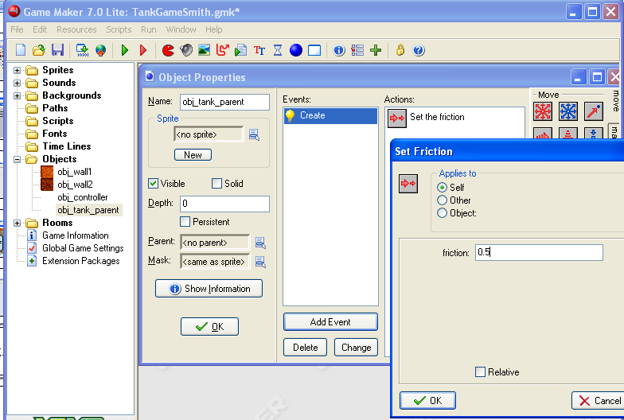
Parent Tank
2) Name it obj_tank_parent
1) Create new Object
3) No sprite
5) Set Friction to 0.5
This will have the tank slow down when not accelerating.
4) Add Event -> Create

Slide 24
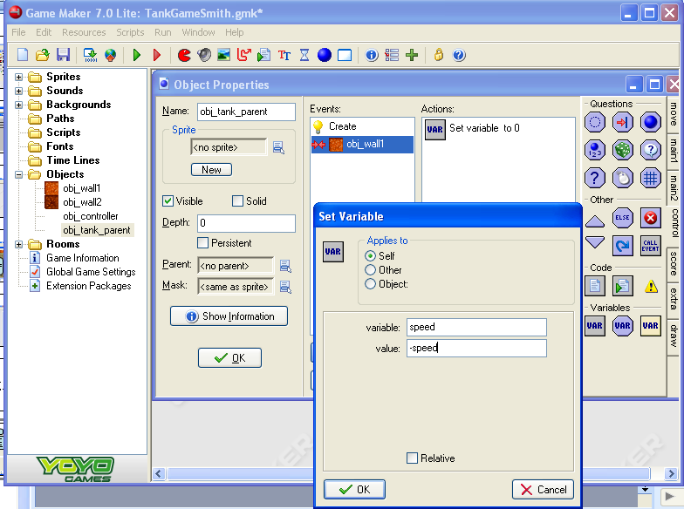
Parent Bounces Off Wall
2) On the ‘Control’ tab select the Set Variable method
1) Create a collision event with obj_wall1
3) Set variable to ‘speed’
And value to ‘-speed’

Slide 25
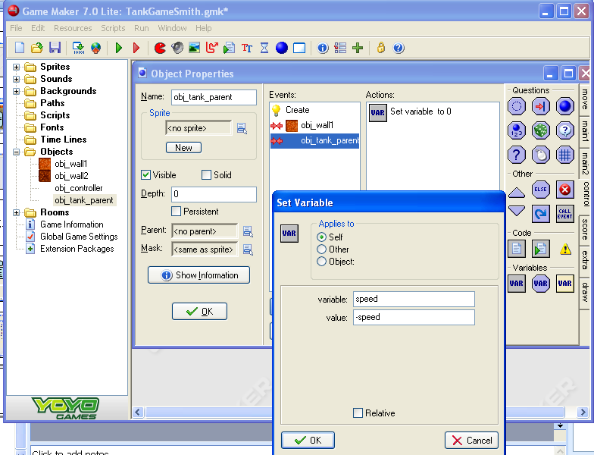
Parent Bounces Off Parent
1) Create a collision event with an obj_tank_parent
2) Set Variable method
Variable: speed
Value: -speed

Slide 26
Now for the Children
You will create two tanks (tank1 and tank2)
Give them methods needed to drive and change images accordingly
Then you can finally test it.

Slide 27
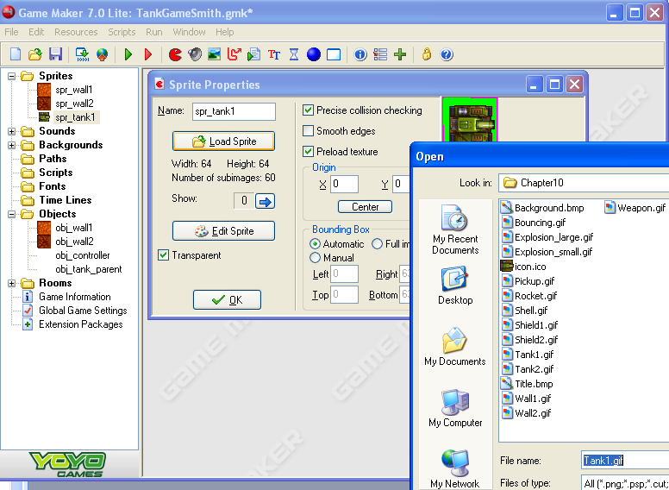
Tank1 Sprite
1) Create a sprite
4) Resources, Chapter 10
Tank1.gif
2) Name it spr_tank1
3) Load a Sprite
6: Note: This GIF has 60 images
5: Set the Origin to Center

Slide 28
Tank1 Object
1) Make an object
2) Label it obj_tank1
3) Use the spr_tank1 sprite
4) Make it solid.
5) Set the depth to -5 so it can go in front of shells, …
6) Set the parent to obj_tank_parent

Slide 29
Add Movement to the Tank: Turn Left
2) Set Variable
Direction
6
Check the Relative box
This will rotate the tank counter clockwise
1) Add Event
Keyboard
Letters
A

Slide 30
Turn Right
2) Set Variable
Direction
-6
relative
1) Add Event
Keyboard
Letters
‘D’
-6

Slide 31
‘W’ forward If not already at the top speed of 8…
1) Add Event
Keyboard
Letters
W
3) Variable: speed
Value: 8
Operation: smaller than
2) Drag Test Variable

Slide 32
Speed up
1) Set Variable
2)
Variable: speed
Value: 1
Click the relative box.

Slide 33
S to Backup If not already at a top speed of -8…
1) Add Event
Keyboard
Letters
S
2)
Test Variable
Variable: speed
Value: -8
Operation: larger than

Slide 34
Back up!!!
2) Variable: speed
Value: -1
Check the relative box
1) Set Variable

Slide 35
Rotate the Tank with the Direction
1) Add Event
Step
End Step
2) Change Sprite
Spr_tank1
subimage: direction/6
Speed: 0
3) Sub image calculation:
360 directions (degrees) per 60 sub images ->
direction / 6 to calculate the sub image.

Slide 36
Draw Event
2) In the Draw Tab select Draw Sprite
3) sprite: spr_tank1
x: 0
y: 0
subimage: -1
Check the relative box
1) Add Event
Draw

Slide 37
Repeat
Repeat slides 26 through 35 for tank2
This time use the arrow keys for the different directions
Then test it
It should go forward/backward/turn/ bounce off walls and tanks.

Slide 38
Firing Shells
Coming up…
Players Scores
Large Explosions
Small Explosions
Damage
Health Bars
Parent Shell
Destructible Walls Reappear
Creating shell objects
Firing Events

