Slide 1
Tank Game
Part 6 of 6

Slide 2
Views
You’ll make a larger play area but limit the views for each of the tanks
Create a split screen where the left area is for tank 1 and the right area is around tank2
Later you’ll make a third area to display a mini map as well.

Slide 3
Room vs. View
Rooms: Any size you want
View: The specific area of the room you can see
We’ll create a room with twice the width and the same height of a normal room
The green rectangle will show the dimension of a normal room

Slide 4
View in a Room
The area of the room that needs to be displayed in the view. The X and Y positions define the top-left corner of this area and W and H specify the width and height.

Slide 5
Port on screen
This is the position on the window where the view should be shown.
The X and Y positions define the top-left corner of this area.
W and H define the width and height.
If the width and height are different from the size of the view area, then the view will be automatically scaled to fit. Game Maker will also automatically adapt the size of the window so that all ports fit into it.

Slide 6
Object Following
Specifying an object here will make the view track that object as it moves around the room. Hbor and Vbor specify the size of the horizontal and vertical borders that you want to keep around the object.
The view will not move until the edge of the view and Vbor to half the height of the view will therefore maintain the object in the center.
Finally, Hsp and Vsp allow you to limit the speed with which the view moves (-1 means no limit)

Slide 7
How many views
You can specify up to eight different views, but you’ll probably only need one or two.

Slide 8
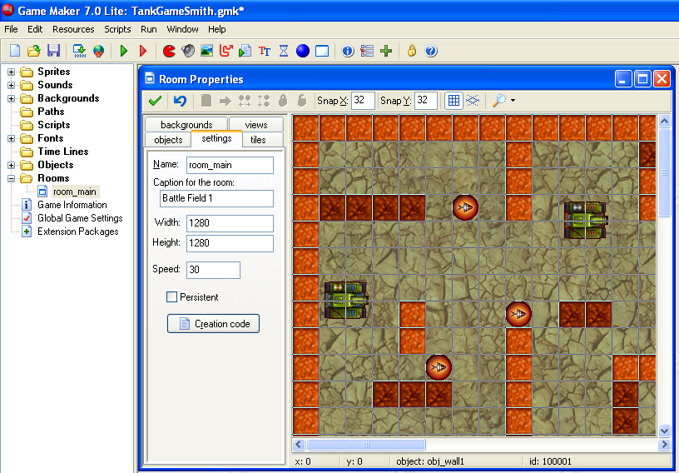
Editing the Room
2) Select the Settings tab
3) Change the Width to 1280
And the height to 1280
1) Open room_main

Slide 9
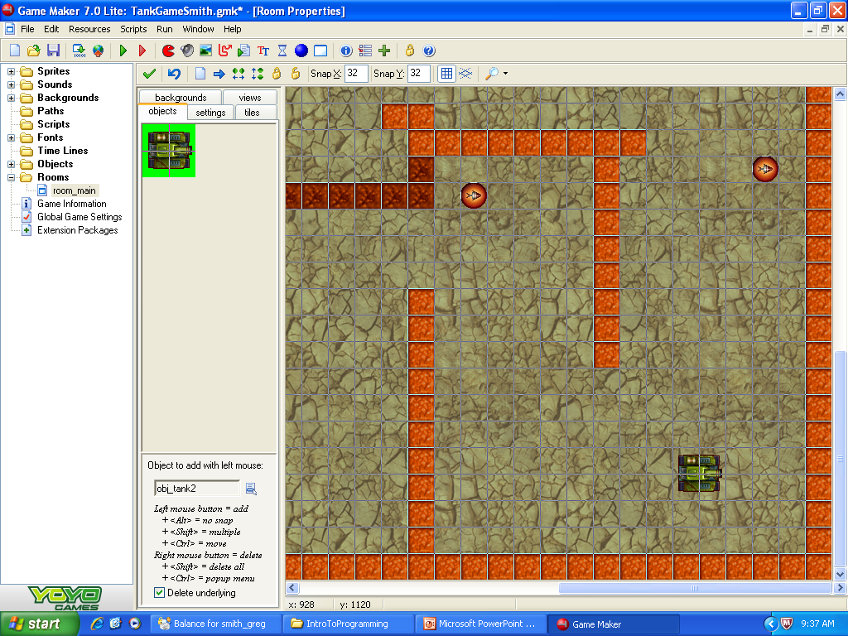
Add More Stuff
1) Select the Objects tab
2) Add elements into the room
Place the tanks in opposite corners.
Add 6 pick up instances

Slide 10
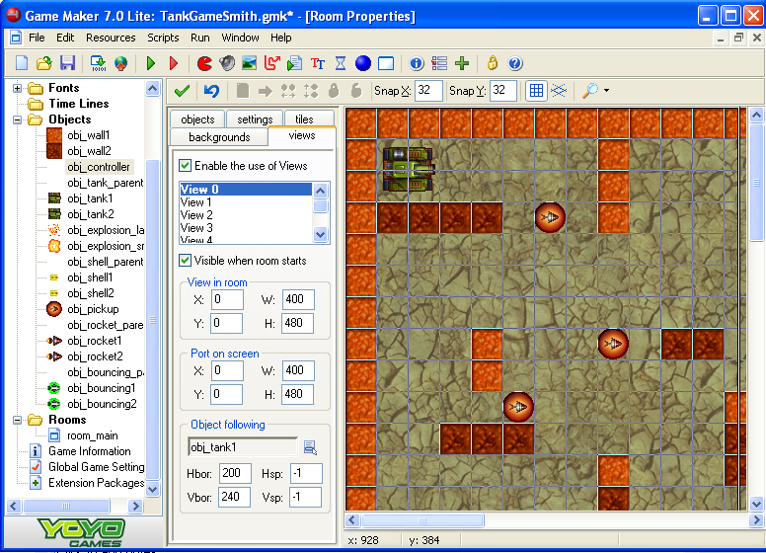
Set the View port for Tank1
1) Select the views port
2) Enable the use of Views
5) View in Room
X: 0 W: 400
Y: 0 H: 480
3) View 0
4) Visible when room starts
6) Port on screen
X: 0 W: 400
Y: 0 H: 480
Object following
Obj_tank1
Hbox: 200 Hsp: -1
Vbox: 240 Vsp: -1

Slide 11
Set the View Port for Tank2
1) Select View 1
2) Check the Visible when room starts
3) View in Room
X: 0 W: 400
Y: 0 H: 400
4) Port on Screen
X: 420 W: 400
Y: 0 H: 480
5) Object Following
Hbox: 200 Hsp: -1
Vbox: 240 Vsp: -1

Slide 12
Now you have a 2 view game!!!
But…
The score is displayed in a fixed position in the room so you can only see it if you drive next to it.
So you need to edit the controller object to draw the score relative to the view position.

Slide 13
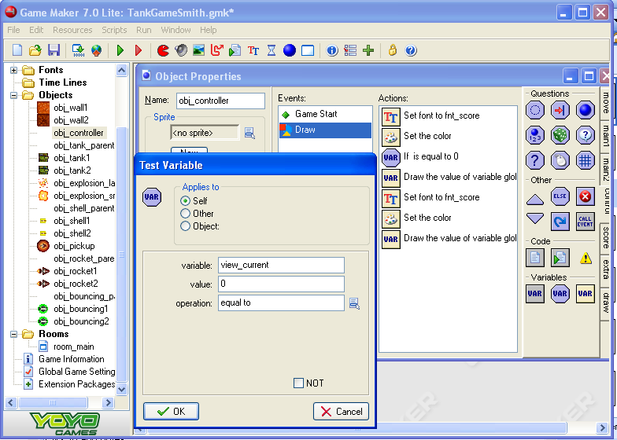
If viewing player 1 (Value 0)
1) Open the Controller Object
2) Add a test Variable action just before the Draw Variable Action
3) variable: view_current
Value: 0
Operation: equal to
4) OK

Slide 14
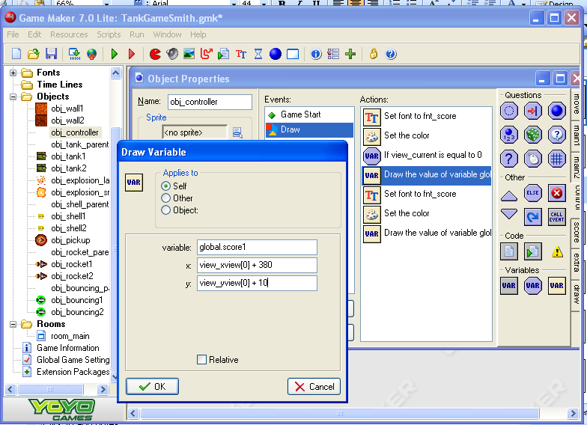
Then draw global.score1 in player 1’s (0) area
1) Double click on the ‘Draw Variable’ action
2) Change X, and Y values to track with the tank.
X: view_xview[0] + 380
Y: view_yview[0] + 10
3) OK

Slide 15
If viewing player 2 (Value 1)
1) Open the Controller Object
2) Open the Draw event
3) Insert a ‘Test Variable’ action before the ‘Draw Variable’ action.
4) variable: view_current
Value: 1
Operation: equal to
5) OK

Slide 16
Then draw global.score2 in player 2’s (view 1) area
1) Edit the ‘Draw Variable’ action
2) Change the X and Y values to map with player 2.
X: view_xview[1] + 20
Y: view_yview[1] + 10
3) OK

Slide 17
Test the Game
Drive both robots
Check that the score stays in the window with the robot
Try to find the other robot and shoot it.
Check to see if the score is updated correctly.

Slide 18
Mini Map
Next you will create a mini map to help the players see where they are.
The mini map will show the entire room.

Slide 19
Mini Map
2) Select the ‘Views’ tab.
4) Check ‘Visible when room starts’
3) Select View 2
5) Set the view in the room to see the entire room
X: 0, w: 1280
Y: 0, H: 1280
1) Open your room_main
6) Set the port on the screen to be in the bottom middle of the screen.
X: 350, W: 120
Y: 355, H: 120

Slide 20
Test it

Slide 21
Adding Comments
1) Click on ‘Change the Game Information’
2) Add a description of the game including
The goal of the game,
How to drive and shoot,
Credits…

Slide 22
Create a Loading Image
1) Open ‘Global Game Settings’
2) Select the ‘Loading’ tab
3) Check ‘Show your own image while loading.
5) In the resources folder you can use ‘Title’
4) Change image
6) Open

Slide 23
Make an .exe of your game
This will let you play it on a computer that does not have Game Maker
1) Create a stand alone executable for your game
2) Find a place to save it and give it a name
3) Save

Slide 24
YOU DID IT!!!
What’s next
Complete the game and add some sort of extension
Potential extensions
Create different arenas
Add other types of walls
Create muddy areas that reduce traction
Add other types of weapons
Drop mines
Create holes with the tank
..
On Thursday you will demonstrate your games to the class

