Slide 1
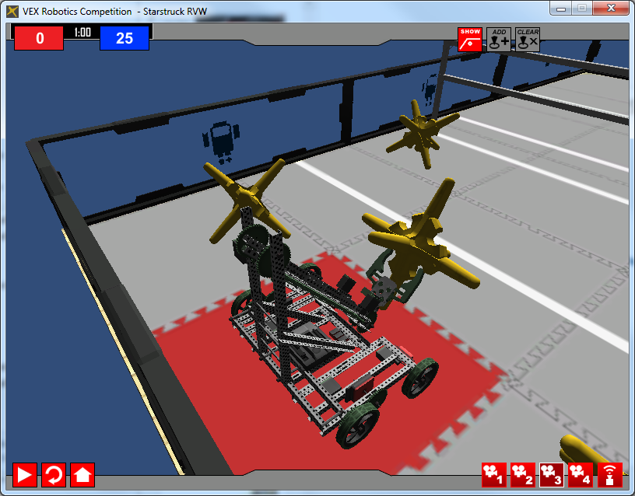
StarStruck in a Virtual World: Fantasticbot Version

Slide 2
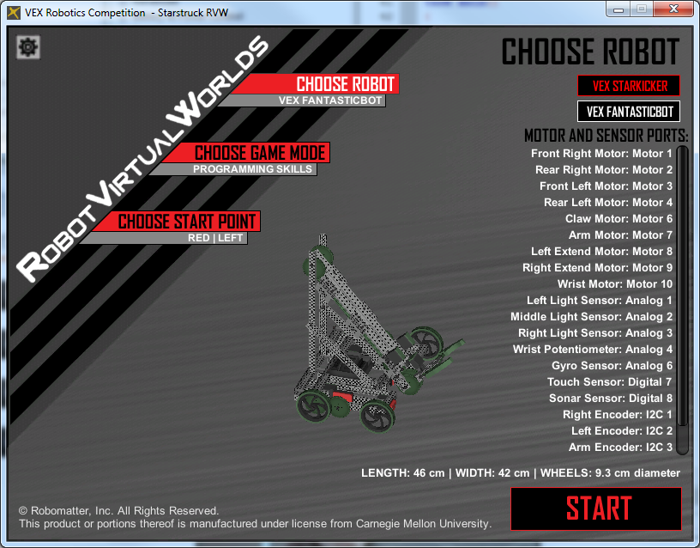
Your Robot

Slide 3
Learning Objectives
Students will be able to configure the Motors and Sensors for the VEX Kickstarter robot in the RobotC Virtual World.
Students will be able to develop an autonomous program for the Programming Skills Challenge
Students will be able to incorporate motor[] and wait1Msec() commands.
Students will be able to incorporate sensors into their autonomous programs

Slide 4
Getting Started in RobotC
Open RobotC
Select VEX 2.0 Cortex Platform
Robot-> Platform ->VEX 2.0 Cortex
Make the robot compile to Virtual Worlds
Robot-> Compiler Target -> Virtual Worlds
Select Virtual World
Window->Select Virtual World to Use -> VEX Starstruck

Slide 5
Configuring the Robot: Just the motors for now.
Robot-> Motors and Sensors Setup

Slide 6
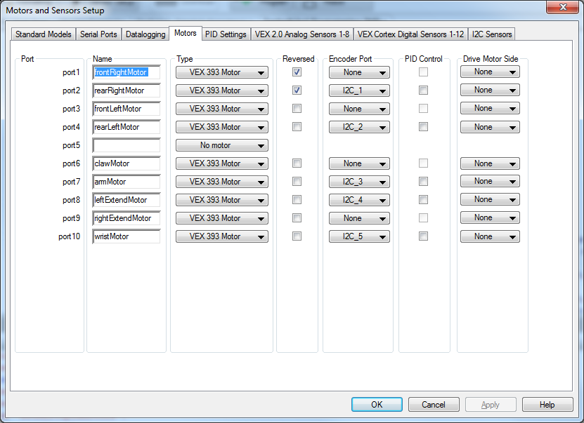
Configuring the Robot: Just the motors for now.
Set the Encoder Port
1: frontRightMotor
2: rearRightMotor
3: frontLeftMotor
4: rearLeftMotor
5:
6: clawMotor
7: armMotor
8: leftExtendMotor
9: rightExtendMotor
10: wristMotor
Note the ‘right’ drive motors are reversed.
Click ‘Apply’ and ‘OK’ when finished.

Slide 7
Mapping the Motors

Slide 8
Two Commands that can help you conquer the World!
motor[elMotor] = 127;
The motor[] command is used to send power to one of the motors
[elMotor]
The name of the motor as set in the motors in sensors setup (Like rearLeftMotor)
port1 Will send the power to port 1. You can use this for any of the 10 motor ports. Although this works it is not good style.
127
An value -127 to 127
Can just put in a number of use integer variables or fancy math to generate a number
127 = Full Power Ahead
-127 = Full Power Backwards
0 = Stop!!!
wait10Msec(100);
100 This will continue what the robot is doing for 100 of the 10/1000 ths of a second (1 second total in this example)
Can just put in a number of use fancy math to generate a number

Slide 9
Motors and their values
1: frontRightMotor
2: rearRightMotor
3: frontLeftMotor
4: rearLeftMotor
5:
6: clawMotor – Positive = pinch, negative = release
7: armMotor – Positive = go up, negative = go down
8: leftExtendMotor – Positive = go out, Negative = go in
9: rightExtendMotor - Positive = go out, Negative = go in
10: wristMotor – Positive – go up, Negative = Go down

Slide 10
Getting Started: Open the RobotC Sample Program
File ->
Open Sample Program

Slide 11
Open the ‘VEX StarStruck’ Folder

Slide 12
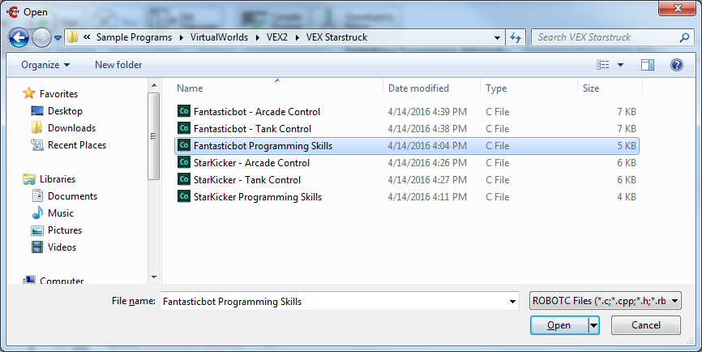
Open the ‘Fantasticbot Programming Skills’ program

Slide 13
Don’t Worry about the errors. Click ‘OK’ and we will delete the code

Slide 14
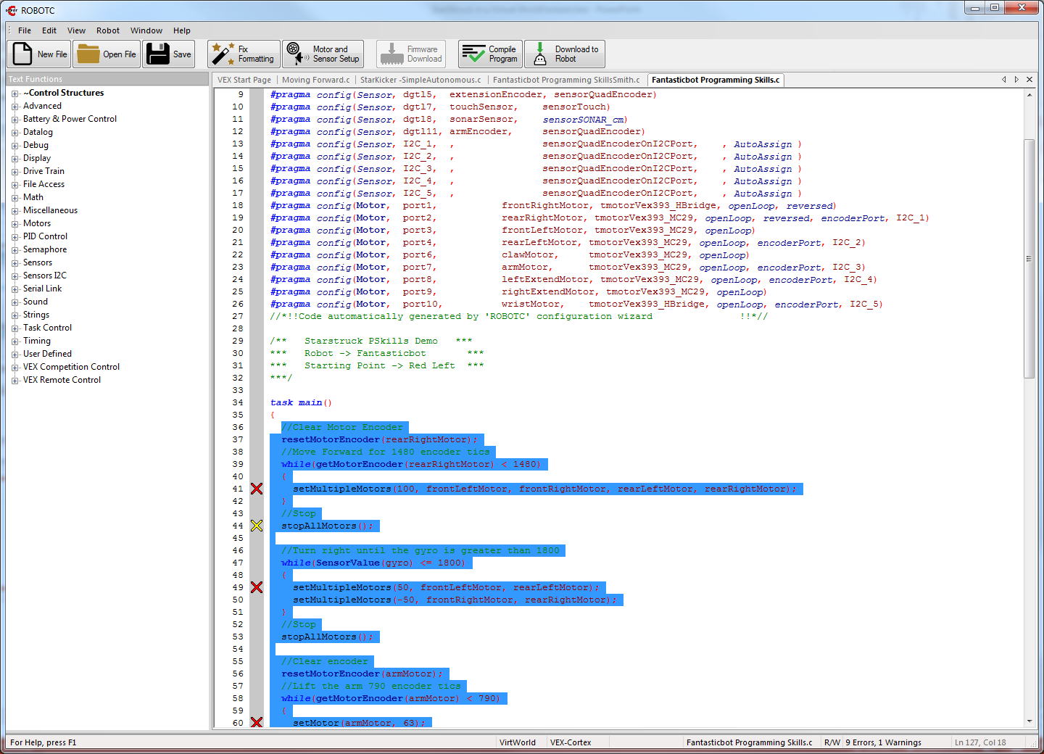
Delete
Highlight and Delete everything after task main()

Slide 15
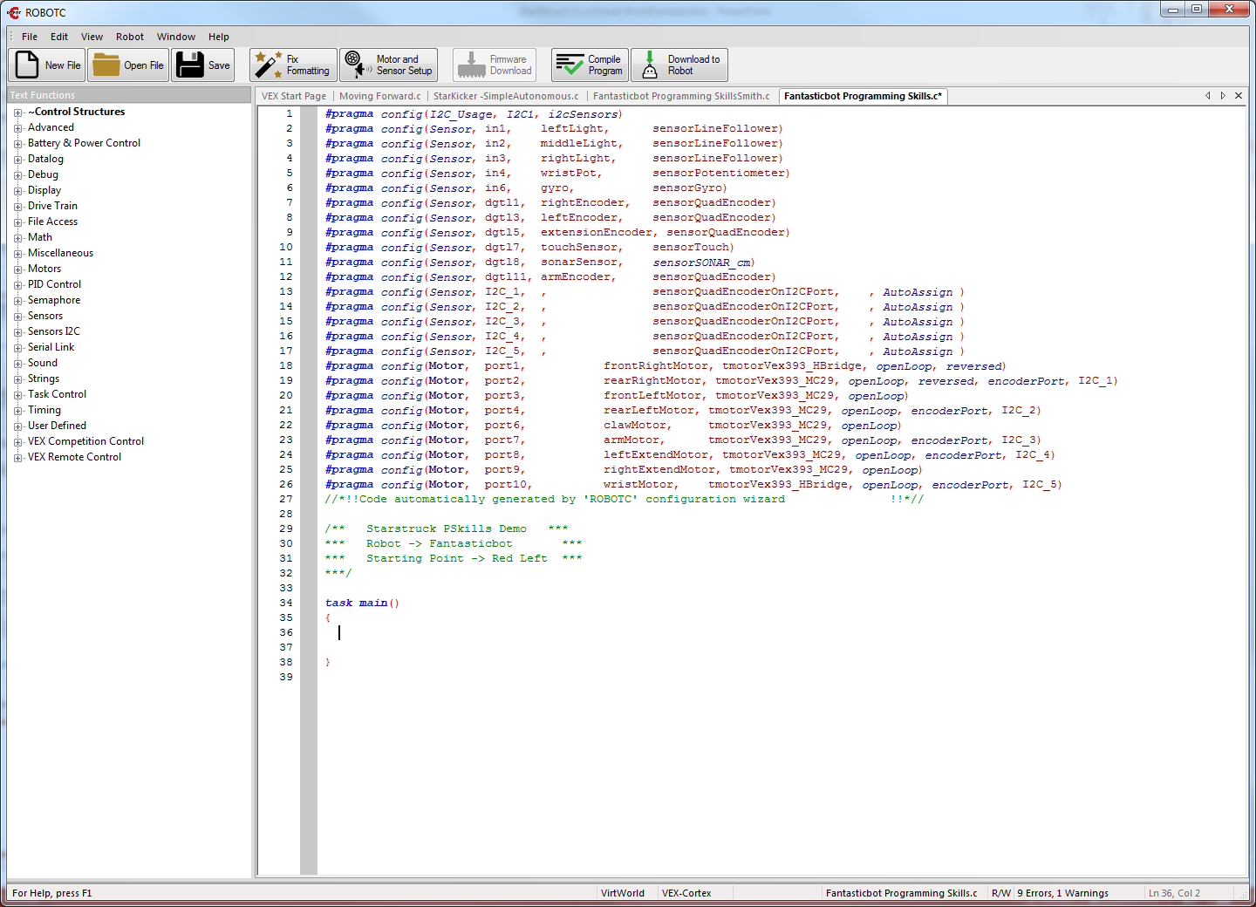
Ready to start!!!
Enter your code here!

Slide 16
Example
What do you think this will do?
How can you test it?
6: clawMotor – Positive = pinch, negative = release
7: armMotor – Positive = go up, negative = go down
8: leftExtendMotor – Positive = go out, Negative = go in
9: rightExtendMotor - Positive = go out, Negative = go in
10: wristMotor – Positive – go up, Negative = Go down

Slide 17
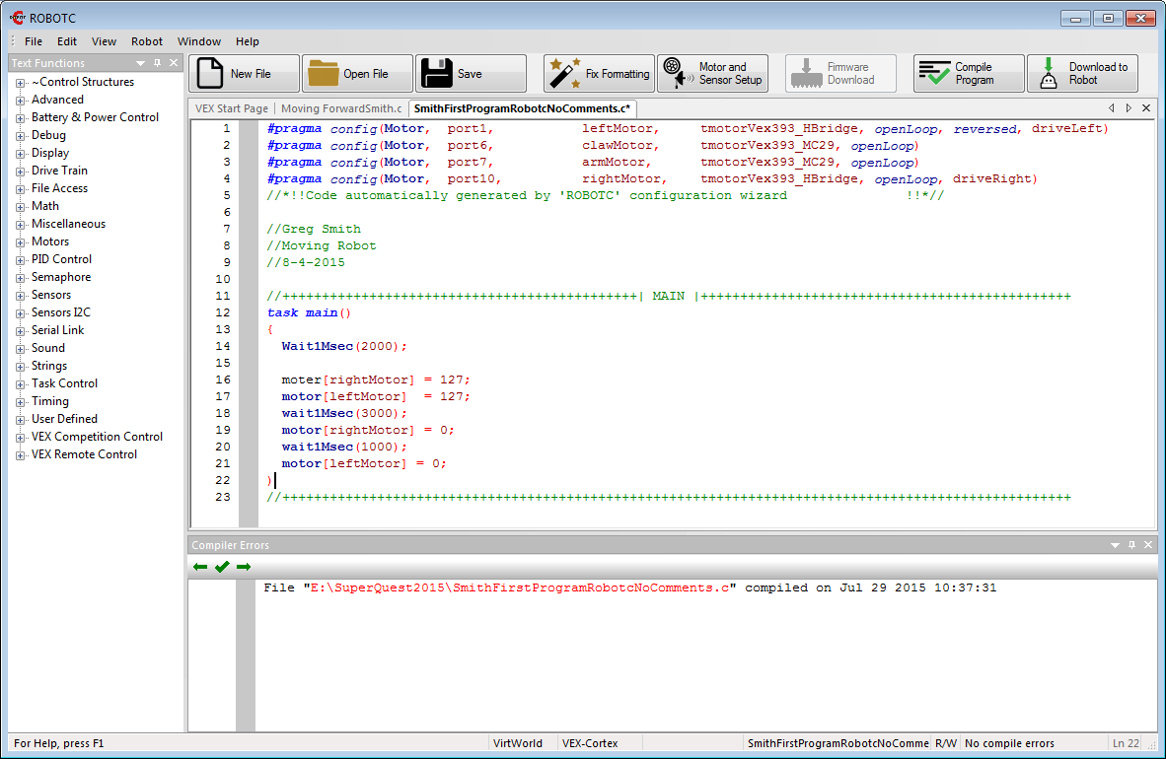
Compiling the Program

Slide 18
Oops!
The compiler catches syntax (typing) errors and gives some hints on how to fix them.

Slide 19
Errors
Red X = error
Yellow X = Warning
Errors and hints on the bottom of the page. If you click on an error it will highlight the line of the error.
Any guesses on how to fix these mistakes?

Slide 20
Corrected and Compiled

Slide 21
Download the program
Since we set it up to map to Virtual Worlds it will download to a Virtual Robot.

Slide 22
Set up and Account with CS2N. It will track progress. Can log in locally as a guest without tracking.

Slide 23
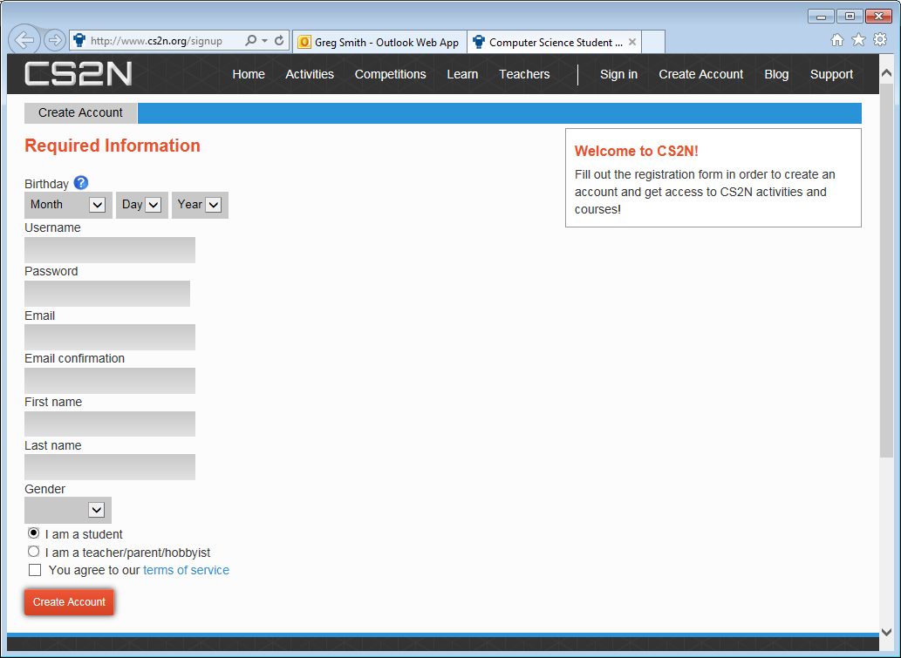

Slide 24
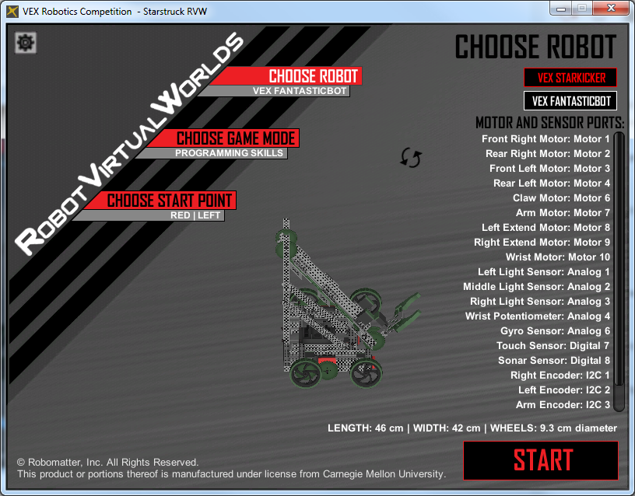
Make sure VEX FANTASTICBOT is chosen.
Click START to test the code.

Slide 25
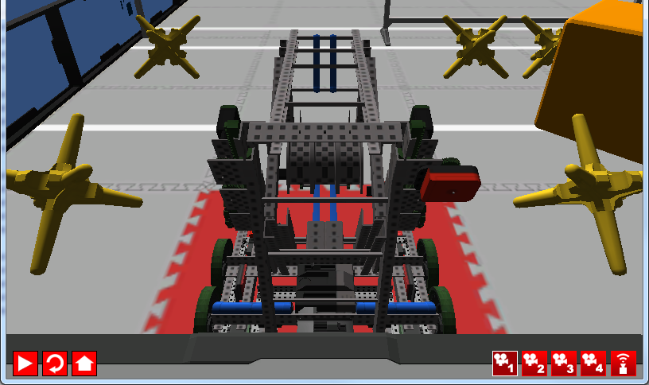
4) Fixed Driver’s point of View
Show Sensors Toggle
Play: Run the program
Follows Right
Scroll: Zoom
2) Top Down View
3) Free Movement:
Scroll: Zoom
Click-Drag: Rotate View
Home
Reset

Slide 26
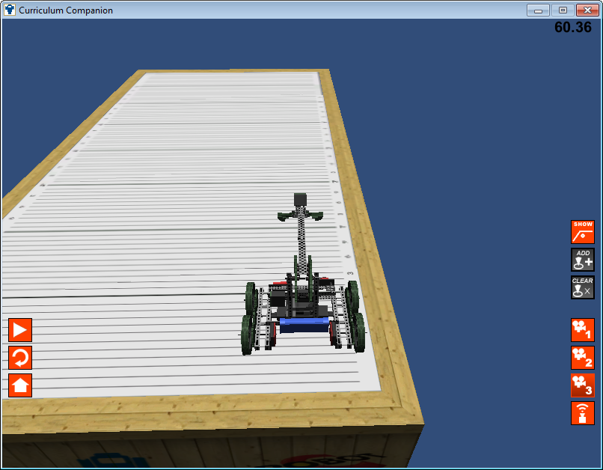
Select Camera and Go
Follows Right
Scroll: Zoom
2) Top Down View
Play: Run the program
3) Free Movement:
Scroll: Zoom
Click-Drag: Rotate View
Reset
Home
Show Sensors Toggle

Slide 27
Example
What do you think this will do?
How can you test it?
6: clawMotor – Positive = pinch, negative = release
7: armMotor – Positive = go up, negative = go down
8: leftExtendMotor – Positive = go out, Negative = go in
9: rightExtendMotor - Positive = go out, Negative = go in
10: wristMotor – Positive – go up, Negative = Go down

Slide 28
Your FantasticBot Challenge:
Get the highest score possible.
Programming (20 Points = 100%)
____ Motors are setup correctly by you (2 points)
___ Program compiles (2 points)
___ Header complete with names, description (include the robot and commands available and the date (2 points)
___ Code is properly indented (1 points)
___ Comments in the program describing the code (3 points)
Performance (10 points)
____ Robot Moves (2 point)
____ Robot Scores at least 2 points (2 points)
____ The Slider movers (2 points)
____ The Kicker Arm moves (2 points)
____ The Kicker Moves (2 points)
____ Top scoring robot in class ( 2 Point Bonus)
____ Second scoring robot in class (1 point Bonus)

