Slide 1
Advanced Projects
9/9/2019
Set up engineering notebook

Slide 2
Today
Create a gmail account if you do not have one.
Create a Google ‘Slides’ document for your engineering notebook.
Log in (create if needed) to your gmail account
Name it ‘YourNameEngineeringNotebook2019-2020’
Share it with
‘SmithTitanRobotics@gmail.com’
When teams are finalized you will need to share it with your teammates as well.

Slide 3
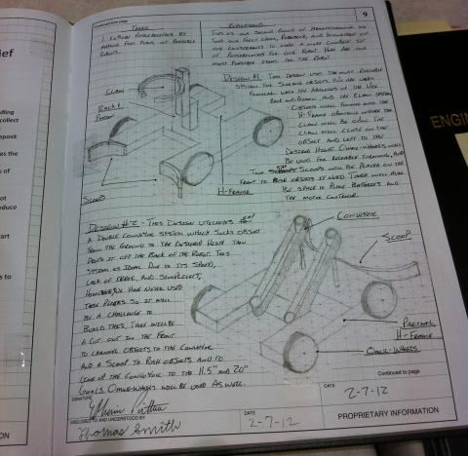
Individual Engineering Notebook
Page 1:Introduction
Name, age, Picture of you, year in school
Hobbies interests, what you want to do for a career, colleges considering for after high school
Page 2
Table of Contents (Just a header at this point in time)
Page 3
Potential Project Ideas
Page 4
Project for first sprint
Page 5
Tasks to complete
Page 6
Tasks to complete by the end of the sprint
Page 7 …
What you completed last class
What you intend to complete today
What is getting in the way of your success

