Slide 1
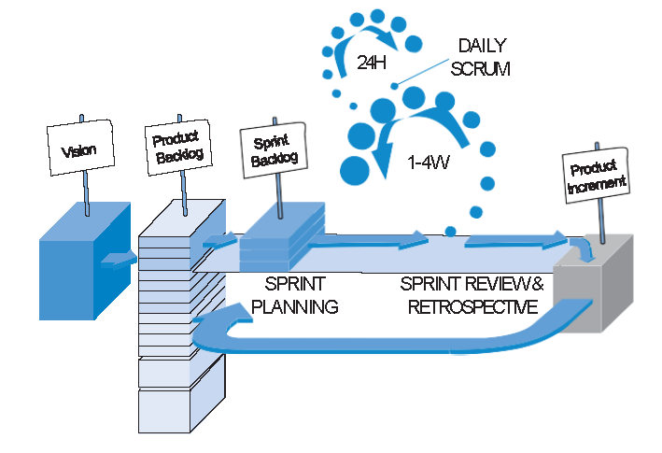
Sprint Review

Slide 2
Learning Targets
Be able to conduct a Sprint Review and demonstrate your product
Be able to conduct a Sprint Retrospective to find ways your team can better work together.

Slide 3
Sprint Review 10/5/2018:
Meet with your teams to discuss and add to the team engineering notebook.
Enter in your team engineering journal
What items from the Sprint Backlog did you complete?
What items from the Sprint Backlog did you not complete?
What other things were completed or in progress at this point?
Thoughts on what you would like to complete for the next Sprint (Sprint Review is November 9th)

Slide 4
Demonstrating a Working Product
Peer evaluation topics
Names of Members
Team Number
How well did the team use the Sprint Backlog to guide their direction
How well did the team work together
Did the entire team participate in the presentation
Was the team clear in describing what was done
Name two things the team did well
Name one suggestion for improvement.

Slide 5
Sprint Retrospective:
Enter into you team Engineering Journal
What went well
What did not go well
What improvements can be made for the next sprint
After doing this for the team, we will do this for the class as well.

