Slide 1

Robotics Projects
On a piece of paper:
Name
Goal for the year
Roles you would like to have on a team(Mechanical Engineer, Software Engineer, Electrical Engineer, Engineering Manager, Anything the team needs),
Time you can and are willing to work on the Robot
Introductions
Vision for the Course
Schedule for the Year
Grading
Setup Engineering Notebooks

Slide 2
Today’s Schedule
Introductions
Student Expectations
Lab Rules
Course Overview
Questions
Log in /Set up Shortcuts

Slide 3
Are you VEXed?
Line up by how well you know the VEX Robotics Platform
Introductions:
Name
Goal for the year
Roles you would like to have on a team (Mechanical Engineer, Software Engineer, Electrical Engineer, Engineering Manager, Anything the team needs),
Time you can and are willing to work on the Robot

Slide 4
Student Expectations
Behavior/Discipline Plan:
Students are expected to be safe, responsible and respectful.
Students not following these expectations may expect: verbal warnings, removal from class pending conference, parent contact, or referral to administration.

Slide 5
To be successful in this course:
Stay focused and productive in the classroom
Excellent attendance
Let your projects, daily work, quizzes and tests display your best effort
Feel free to talk with me about your projects, questions, etc.

Slide 6
Computer Lab Rules
No gum in class
No food or drink in the lab (except water with a lid at approved locations)
No headphones or music except on days selected by teacher
Absolutely no off-task Internet usage (e-mail, games, chat, etc – anything other than class related)
Absolutely no off-task Computer usage (ask teacher permission to use equipment for anything other than class assignments)
Do NOT download any software (games, utilities, music, etc.)
Do NOT use any “chat” software
No CELL PHONE use in class without permission of Mr. Smith.

Slide 7
Grading for Robotics Projects
To get a ‘B’ in the class complete the following
  Engineering Notebooks (10 points / week)
    Tasks, activities, pictures, reflections for the week.
  Add Value/Participation (10 points per week)
  Activities ( 5 – 50 points each)
  November 8th, Setup (10) November 9th tournament (20) and November 9th Cleanup (10) points)
  January 24th Setup and Host (10), January 25th Tournament (20), January 25th Cleanup (10)
To get an ‘A’ in class you will need to complete one of the following ‘Above and Beyond’ activities every six weeks.
Outreach
  Help at October In-service
  Help at Concessions/Fund raising activity.
  Help with new VEX Team(s) outside of West High.
  Help FIRST LEGO League/ VEXiQ team(s)
  Time spent outside of class on robot, Three hours per 6 weeks.
  Submit a quality VEX ‘Online Challenge’ entry.
  WORK MUST BE DOCUMENTED IN YOUTR ENGINEERING NOTEBOOK.
  … If you have a proposal, check with Smith.
Everyone needs to have a journal!
Once teams are determined, if you are updating the ‘Team’ journal you do not need a separate individual journal.

Slide 8
Grading Scale
‘A’ 90%+
‘B’ 80 – 89 %
‘C’ 70 – 79%
‘D’ 60 – 69 %
‘F’ Below 60%

Slide 9
Robotics at West 2019-2020: Smith’s Vision
Have fun
  Students design, build, program robots to competed in the VEX Robotics Competitions.
  Prototyping with FTC, LEGO, PVC, .. parts available. Parts could be a little tight so you might need to be creative in your designs.
Sportsmanship
  Atmosphere where it is OK to make mistakes, ask questions, encourage others, take chances, and make mistakes.
Hustle
  All Teams incorporate the Scrum Framework for developing robots.
  All students are actively engaged in training activities and their team’s robot.
  Students complete training challenges
  Teams create quality engineering notebooks
  Teams maximize their time to meet the goals
  Students take advantage of open lab times.
  Students willing to do what it takes to keep the team successful.

Slide 10
Smith’s Performance Goals (Last year)
Teams
  Six + teams compete in VEX Robotics Challenge (8 in 2019)
  At least one SkillsUSA Mobile Robotics Team (2 in 2019)
  At least one SkillsUSA Urban Search and Rescue Team (2 in 2019)
  Two + teams submit an Online Challenge entry
  Four + teams compete in the Platinum Division at the State Championship. (6 teams in 2019)
  Dream … Win the State Championship (Both teams on winning alliance)
  Dream… Qualify at least one team for VEX Words! (Qualified 3 teams )
  Dream… Division Quarterfinalist at Worlds!!!!!!!! (One team to the Sweet 16!)
  Dream… Qualify for SkillsUSA Nationals (Placed 2nd, and 3rd at state)
  Dream… Place at SkillsUSA Nationals (Did not make it to Nationals)

Slide 11
Team Goal Attainment
Six + Vex Robotics Teams
  Attain funding (Need $$ for this year to compete at State)
    Concessions help (Can sign up now to get on the list)
    Hosting VEX Tournaments
    Letter writing and visiting campaign
    Pursue student contacts.
  Build quality robots with quality team members
    Incorporate the Scrum Framework
    Do the little things
    Be creative in prototyping/testing when parts are not available
    Encourage others
    Improve another’s idea if the team so decides
    Do your team role with excellence!!

Slide 12
VEX Events
10/12 VEX Idea Factory: We are hosting this optional event. 9:00 am to 4:00 pm.
11/8 West Salem VEX Tournament Setup. After school until 5:00 pm.
11/9 West Salem VEX Tournament and Cleanup. Students
11/14 Optional VEX League at West 5:00 – 7:00 pm
11/23 Optional North Marion Tournament
12/6 Optional VEX League 5:00 – 7:00 pm (Location To be determined)
12/14 Optional Central Oregon (Bend) Tournament
1/10 Optional VEX League 5:00 – 7:00 pm (Location to be determined)
1/11 Optional Sandy High School Tournaments
1/18 Optional North Marion Tournament (Rookies only event)
1/24 Tournament at West (Host – All help) 8:00 – 11:00 am Setup, 3:00 – 9:30 pm tournament.
1/25 Tournament at West (Host – All Compete) 8:00 am to 6:30 pm counting cleanup.
2/1 Optional Klammath Falls Tournament
2/8 Optional Willamette High School (Eugene) Tournament
2/14 Optional VEX League 5:00 – 7:00 pm (Location To Be Determined)
2/15 Optional The Dalles Tournament
2/26 Optional VEX League Finals at West. 5:00 – 7:00 pm
2/29 Marcola Tournament
3/14-3/15 VEX State Championship at Chemeketa CC. All compete. Times not yet set.
4/22-4/25/2020 VEX World Championship, Louisville, KY. (If teams qualify)

Slide 13
Autonomous Score Achievement
Autonomous score
  Incorporate training in programming in VEXcode
    Some for all
    More for programmers
  Have running drive trains for the programmers by the 3rd week of class
    VEX Squarebot or Clawbot for rookie teams
  Always have a running test bed for programmers and drivers!!!
  Create in-house challenges based on this year’s challenge.

Slide 14
To be Captain
Incorporating Scrum (an Agile Product Development strategy) into the engineering design cycle this season to help create quality products more rapidly.
Maintain an excellent Engineering Journal.
  Document the journey
  Update at least twice a week: Monday’s and Fridays with pictures and descriptions
Have teams create a rigorous method for evaluating their design that can also be used for scouting other teams.
Practice, practice, practice
Plan for anything
Take advantage of open lab times.
Always have a running test bed for programmers and drivers!!!

Slide 15
Log in and Create Class Folder
Log onto the network
  Your log in number is on your student ID number
  Your password is your First Initial Last Initial Birthdate.
  Example
    Susie Kalahan 1/1/2002
    sk112002
    Jose Mahindra 10/15/2001
    jm10152001
Open YourName Folder
  In to top left of the desktop
  Make a new folder called RoboticsProjects
Keep your RoboticsProjects Folder open

Slide 16
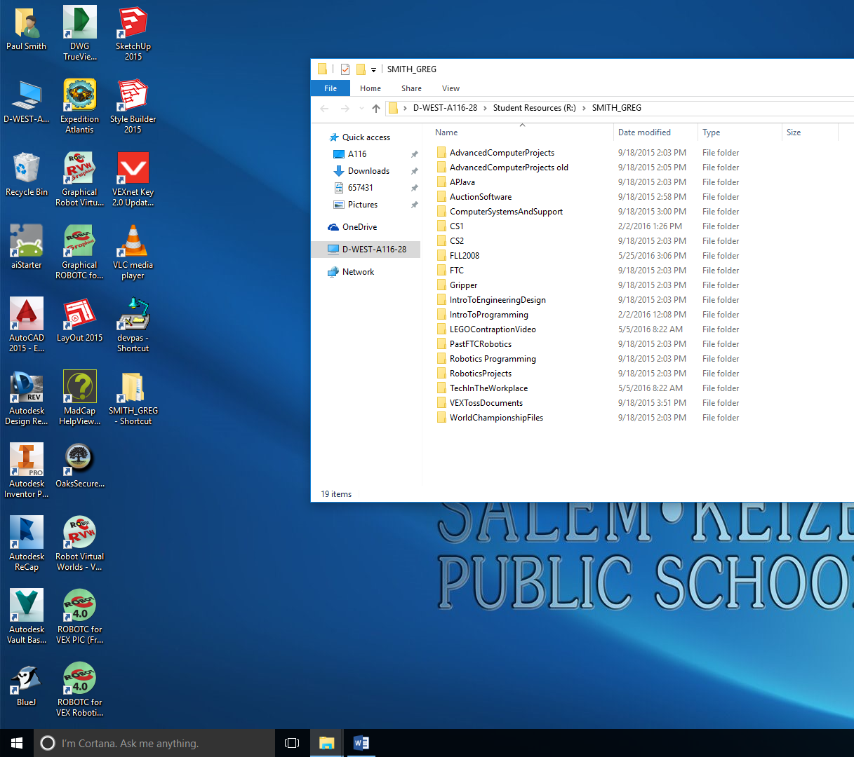
Creating Shortcuts
2) Double Click on the ‘RoboticsProjects’ Folder
1) Double Click on SMITH_GREG-Shortcut

Slide 17
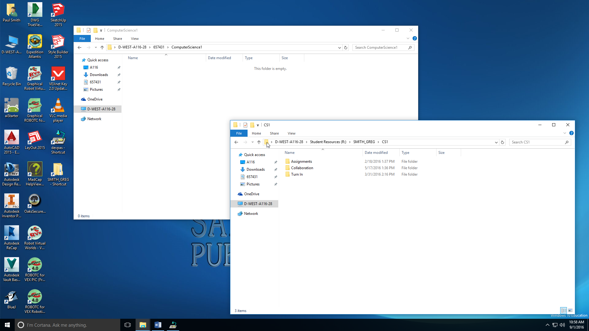
Drag and Drop into your ‘Engineering Design’ Folder.
Drag and Drop Into Your ‘Robotics Projects’ Folder
Drop

Slide 18

Shortcut to Class Website
www.smithcsrobot.weebly.com
Click on ‘Robotics Projects’

Slide 19
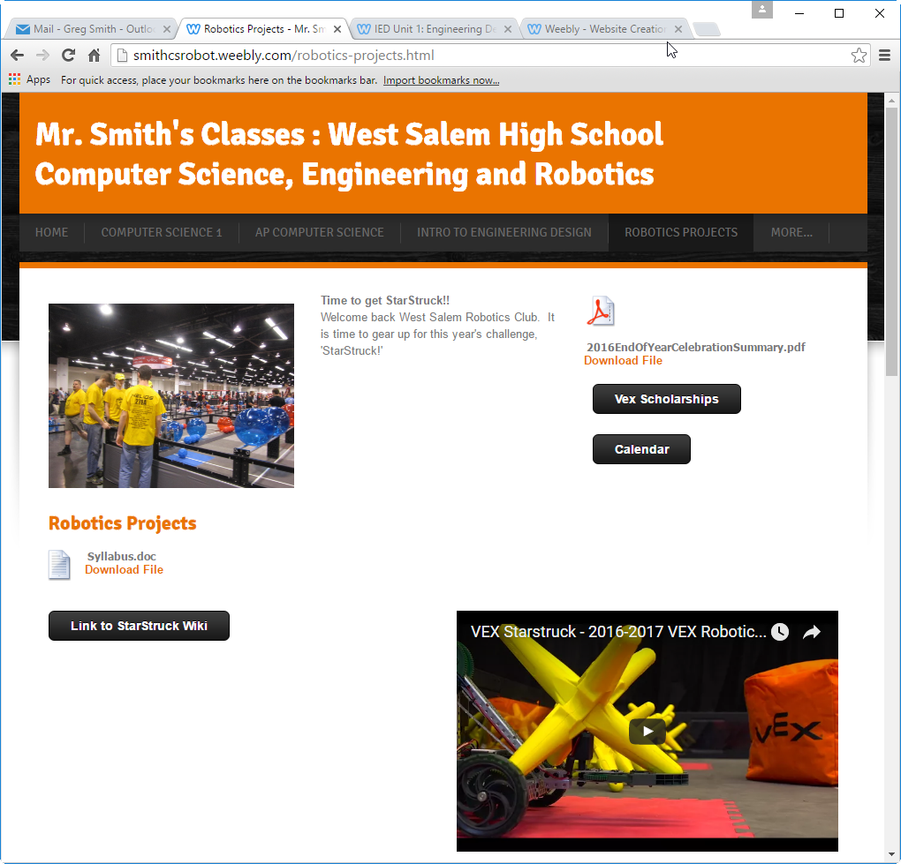
Print out the Syllabus at Home, get it signed and returned.

Slide 20
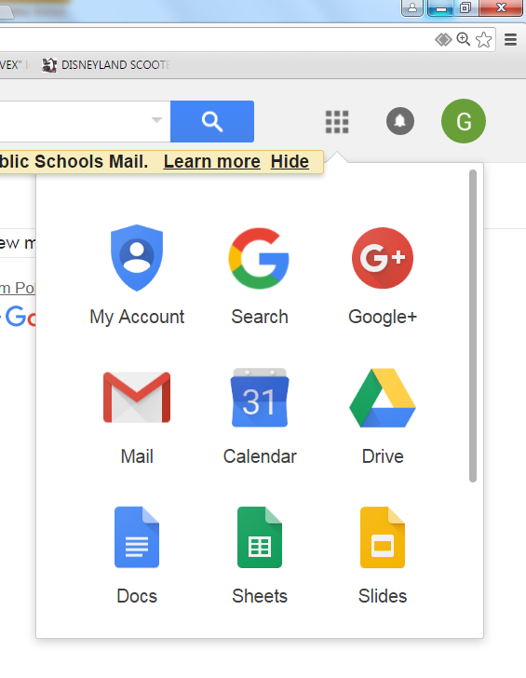
Today
Create a gmail account if you do not have one.
Create a Google ‘Slides’ document for your engineering notebook.
  Log in (create if needed) to your gmail account
Name it ‘YourNameEngineeringNotebook2019-2020’
Share it with
‘SmithTitanRobotics@gmail.com’
When teams are finalized you will need to share it with your teammates as well.

Slide 21
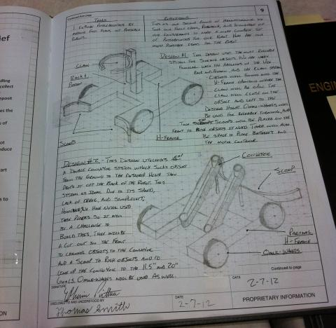
Individual Engineering Notebook
Page 1:Introduction
  Name, age, Picture of you, year in school
  Hobbies interests, If you had to pick a career, what would it be?
Page 2
  Table of Contents
Page 3
  The time commitment you are willing to put into your team.
  Are you taking this class one, or both semesters
  Skill Set: Classes, abilities, skills that you bring to the robotics team.
  Roles you would like to take: Builder, programmer, captain, driver, research, promotions, fund raising, product owner, Scrum master…
Page 4 (Delete names from the page)
  Describe a ‘Dream Team’. Focus on skill sets, not names. I will talk individually with you about people you are willing to have on your team. No guarantees, but it will help me in finalizing the teams.

Slide 22
Video for This Years Challenge

Slide 23
Getting to Know the Game
Jigsaw
Each person will be assigned pages from the Game manual to become the expert. (What is important, key ideas, you will be able to teach this section to others) (10 minutes)
Have a written summary of main ideas.
Expert Groups meet and each person will share on what they see as being important to share with the class. Discuss and agreed to key ideas(10 minutes)
Expert Groups prepare presentation (15 minutes)
The expert groups will present their material to the class. All members part of presentation.
Expert Team Roles
Time Keeper (Youngest Person)
Encourager
Scribe: Record important information in PowerPoint or Slides
Scrum Master: (Oldest Person)
  Make sure everyone gets an opportunity to share
  Run the meeting
  Assign roles if no volunteers

Slide 24
Sections: The Game Section of the Game Manual
The Game Manual is on the class Website
Line up by Day of the Month you were born.
Pages 3-7
Pages 8-12
Pages 13-17
Pages 18-23

Slide 25
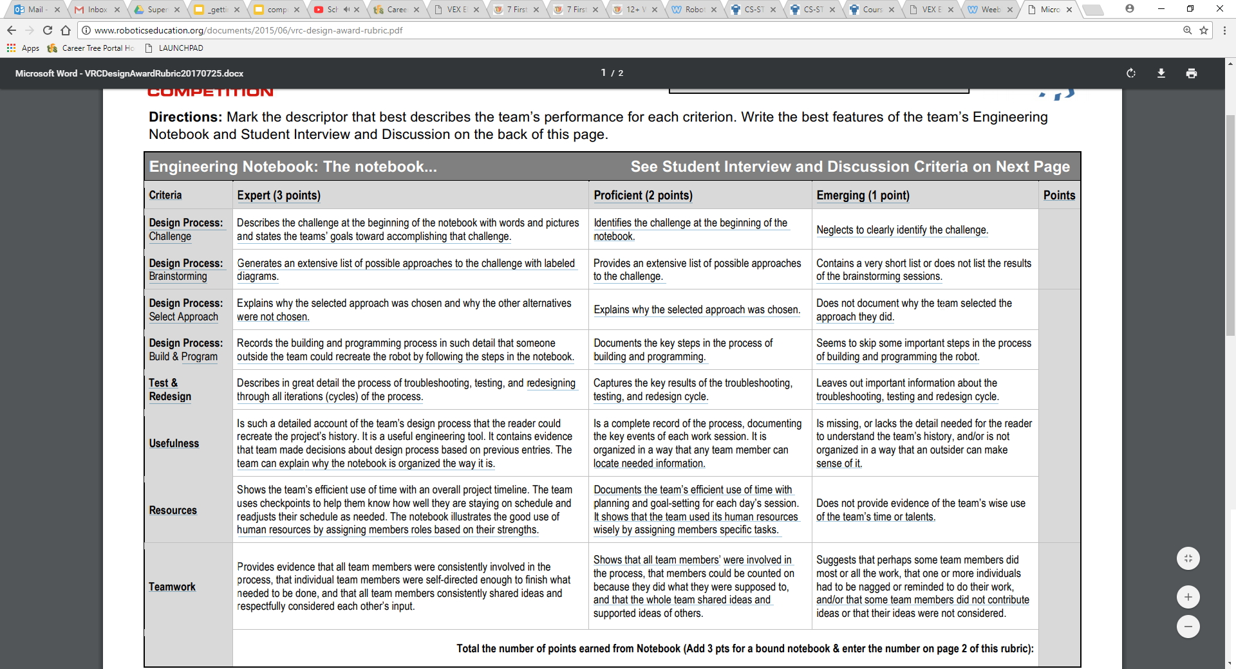
Page 5: The Challenge
Research and describe the Challenge for this season
  You can work solo or in groups of to two to three (Do not need to be on the same team). Each person will document their description in their notebook.
Resources
  Smithcsrobot.weebly.com
    Robotics Projects
      Watch the Video
      ‘Link to In The Zone Documents’
Be prepared to share your description of the challenge, and your goals toward completing the challenge with another group.

Slide 26
Defend your Position
Group 1 Share : Group 2 listens
  Group 2 ask clarifying questions
Group 2 shares: Group 1 listens
  Group 1 asks clarifying questions
Both groups return and refine their Positions as needed.

Slide 27
Individual
Engineering Notebook: Content will be added to this later.
Page 5: Sprint Backlog: This page will only have a title today
  Copied from the results of Sprint Planning Meeting
  This page will have the tasks your team commits to complete during the next Sprint.
  At the start of each sprint (3 weeks) you will have another sprint backlog page.
Page 6, … Scrum Meeting (Daily Update) Only a title for today
  Have a ‘Yesterday’, ‘Today’ and ‘In the Way’ columns.
  A place for the date and a place for pictures, sketches, date and comments.
End Of Sprint Review
  Describe the ‘Shippable Product’
    Include 3+ pictures of your robot
  Describe what has been completed.
End of Sprint Retrospective
  What went well
  What did not go well
  What improvements will be incorporated in the next Sprint

Slide 28
Make a Team Notebook:
Team Name and Number
For Each Sprint (There will be 4-6 sprints this semester)
Product Backlog after Grooming
Sprint Backlog
Copy Scrum Meeting Info from each
individual Journal
Sprint Table
Updated as Tasks move to the Doing and
Done Columns
Pictures and updates from individual journals
Sprint Reflection
  Include 3+ pictures of your robot
  Description of what is ‘Done’ (Taken from individual journals as needed)
Sprint Retrospective
  What went well
  What did not go well
  What changes need to be made
Table of Contents
Our Team (Bios for the Team members copied from the Individual Engineering Notebooks)
Team History
Game Analysis
Game Strategies
Design Process Summary
Design Requirements (Specifications and Constraints driven by your strategy)
Drivetrain Selection
Arm Selection
Hand Selection

Slide 29
Engineering Notebook Rubric

Slide 30
Design Process
Robot Requirements To meet Gaming Strategies
Design Ideas
Chassis
Arm
Hand
Select a Design to Prototype
Decision Matrix
Build and Program Robot
Evaluate Performance
-Weaknesses
Strengths
Decision on Rebuilding
All or Part of Design

Slide 31
Today: Focus on Expert Level Design Process

Slide 32
Day 2: Learning Objectives: Analyze StarStruck
Break into teams
Brainstorm different strategies for the robot you are designing.
As a team, set a direction for the strategy your team will begin pursuing this season.
As a team develop a problem statement for your team.
  We will design program and build a robot that will be able to …
  Include how it can score
  How it can move
  Something that can be used to promote your robot to teams that do not know you.
  Three + sentences.

Slide 33
Defining the Problem
Use the info from your research, your strategy and your team discussions to create a three+ sentence definition describing what you want your robot to be able to do.
This should be something you could put on a business card to market your robot to other teams.
Make sure a copy of this is in your team and individual journals.
Notes:
Literacy and Teamwork. Summarizing the problem.
Science/Engineering: Engineering Design Cycle

Slide 34
Day 3: Learning Objectives
Using your team strategy and problem statement develop Robot Requirements (specifications and constraints) for your robot.
Begin brainstorming ideas for your robot design.

Slide 35
Robot Requirements: Specifications and Constraints
Specifications: What your robot can do/be
  Stable: Will not tip over if placed on a 45 degree angle
  High Traction: Will not slip when pushed with 8 lb. force
  …
Constraints: What your robot can’t do/be
  Must fit into an 18”x18”x18”
  May not use more than 12 motors, or 10 with pneumatics
As a team develop at least 8 specifications and 8 constraints for your robot.
Use your team strategies to guide the specifications and constraints that you see as important to your design.
Record these in your team and individual journals.
Notes:
Science/Engineering: ETS1A: Defining and Delimiting an Engineering Problem
Literacy: Summarizing the required specifications and constraints.

Slide 36
Brainstorming
The goal is to generate as many ideas as possible to help you develop the best product as early as possible
Brainstorming Rules
Every person and every idea has equal worth
Every (school appropriate) idea is a good idea!
Encourage wild and exaggerated ideas
Go for quantity at this stage, not quality
Build on ideas put forward by others
Notes:
Science/Engineering: ETS1B: Developing Possible Solutions.

Slide 37
Time for the Storm
Team Roles
  Recorder (Into the team Engineering Journal)
  Encourager
  Thought provoker(s) (Idea generators)
Rotate roles every 3 minutes
Brainstorm and record ideas for your robot I’ll tell you when to rotate rolls
Notes:
Science/Engineering: ETS1B: Developing Possible Solutions.
Technology: ISTE 1: Creativity and Innovation

Slide 38
Day 5 Learning Objectives
Research to find options for your design.
Continue to brainstorm ideas for your design.
Start assembling ideas, specifications and constraints to help in selecting your robot design.

Slide 39
Research
Each individual will use the internet to research ideas for your robot designs
Research 5 minutes
Share 5 minutes (Every person shares!)
  Add ideas to your brainstorm list
Research 5 minutes
Share 5 minutes (Every person shares!)
  Add ideas to your brainstorm list
Notes:
Science/Engineering: ETS1B: Developing Possible Solutions.
Technology: ISTE 3: Research and information fluency

Slide 40
Selecting your Design Direction
The team will be using a Decision Matrix to help in determining your direction.
Record this in your team journal and copy into your individual journal
Notes:
Science/Engineering: ETS1B: Developing Possible Solutions
Science/Engineering: ETS1C: Optimizing the Design Solution
Technology: Critical thinking, problem solving and decision making

Slide 41
Prioritize: What is the best idea?
Weigh the advantages and disadvantages of each alternative?
Set up alternatives in a matrix for analysis (See next slide.)
Mark the grid (Can use other scales)
  + = 1: Better. (Above Average)
  0 = 0: No appreciable difference. (Average)
  - = -1: Worse. (Below Average)

Slide 42
Simple Decision Matrix
Put your Specifications and Constraints along the top row
Specifications / Constraints | Economical | Feasible | Practical | Reliable | Size | Performance | Total
Alternatives
Tracts
Dune Buggy
2 Legs
Propeller
Rack and Pinion+Diff.
Helicopter
Hoover Craft
6-wheel:Banana Split
Rate (+, 0, -) each alternative for each specification/constraint in the grid.
Total the score for each alternative in the totals column.
Place your brainstorm and researched ideas along the first column. Do not include the ‘off-the-wall’ suggestions.
Notes:
Science/Engineering: ETS1B/C. Developing Possible Solutions/ Optimizing the Design Solution
Technology: ISTE 6. Technology operations and concepts.

Slide 43
Weighted Decision Matrix Option
Specifications and Constraints
How the alternative rates x Importance of specification = score in grid
Specifications | Economical | Feasible | Practical | Reliable | Size | Performance | Total
Weighted Importance of specification/ constraint (1 to 5) | 1 | 4 | 5 | 5 | 2 | 5
Alternatives
Trackbot with Scissor | 5x1=5 | 5x4=20 | 4x5=20 | 4x5= 20 | 3x2 =6 | 3x5=15 | 86
Omni-bot with 6-bar | 4x1=4 | 4x4=16 | 4x4=16 | 3x5= 15 | 5x2 =10 | 3x5=15 | 76
Rack and Pinion + Differential | 3x1=3 | 1x4=4 | 3x4=12 | 3x5= 15 | 3x2 =6 | 3x5=15 | 55
6 wheel: Banana Split | 4x1=4 | 3x5=15 | 5x5=25 | 5*5= 25 | 4x2 =8 | 5x5=25 | 102
Weights based on the importance of the specification/constraint.
Score = Weight x Rating of alternative
Alternatives
Totals
Notes:
Science/Engineering: ETS1B/C. Developing Possible Solutions/ Optimizing the Design Solution
Technology: ISTE 6. Technology operations and concepts.
Math: Number and quantity, algebra (Formulas in spreadsheet)

Slide 44
Day 6 Learning Objective
Time to select your team robot design.

Slide 45

Select your design
Use the rating from the Decision Matrix to help you select the design.
You do not have to select a particular design that rated highest in the Decision Matrix.
  Sometimes a robot that is OK at everything but good at nothing comes out high in the ranking
Your team has the final say in your design direction, but you should be able to justify it.
Record your design choice and why in your engineering journal.
Notes:
Science/Engineering: ETS1B/C. Developing Possible Solutions/ Optimizing the Design Solution
Technology: ISTE 4. Critical thinking, problem solving and decision making.

Slide 46
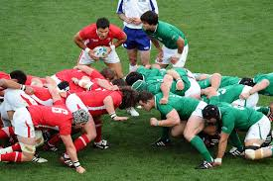

Using Scrum to Improve Teamwork, Communication, Quality and Speed

Slide 47
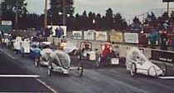
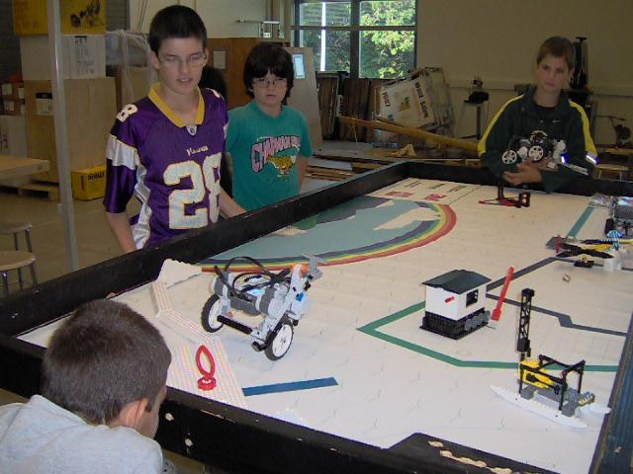
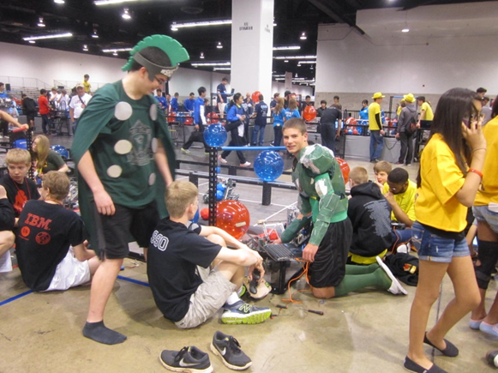
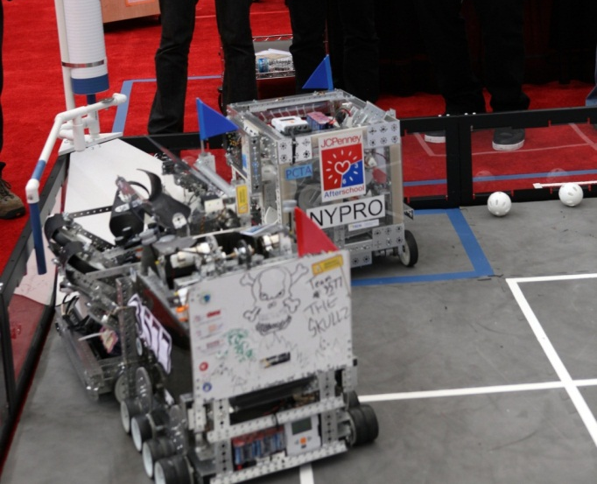
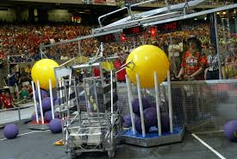
STEM Projects Over the Years
How can I help students work more effectively in teams?
Notes:
Electrathon
FRC $$$$$$
FLL Only to 14
FTC$$$
VEX
47

Slide 48
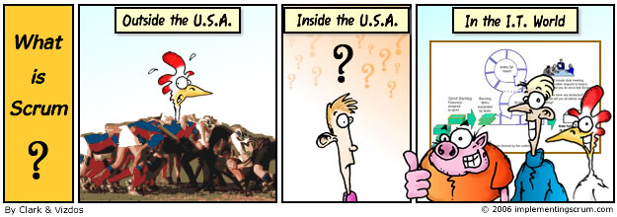
Goals for this session
You will have a basic understanding of…
  The Principle behind Scrum: Agile Manifesto
  The People: Committed vs. Involved
  The Plane: Hands on Example
  The Process: From idea to product
  The Potential: You can see how it could help your students succeed.

Slide 49
The Principle:
Agile Manifesto
Scrum is one application of Agile product development.
We are uncovering better ways of developing
products by doing it and helping others do it.
Through this work we have come to value:
Individuals and interactions over processes and tools
Working products over comprehensive documentation
Customer collaboration over contract negotiation
Responding to change over following a plan
That is, while there is value in the items on
the right, we value the items on the left more.

Slide 50
Why Scrum?
Yahoo’s Survey of Teams that Switched to using Scrum
Improved Productivity (Productivity up 38%)
Improved Morale (52% yes vs. 9% no)
Improved Accountability/Ownership (62% yes vs. 6% no)
Improved Collaboration/Cooperation (81% yes vs. 1% no)
Improved quality (44% yes vs. 10% no)
85% of new users prefer to continue using Scrum
Notes:
Data from http://www.rallydev.com/documents/scrumprimer.pdf
50

Slide 51








Some Companies that use Scrum

Slide 52
What is Scrum?
Scrum is a way for teams to work together to develop a product.
Product development, using Scrum, occurs in small pieces, with each piece building upon previously created pieces.
Building products one small piece at a time encourages creativity and enables teams to respond to feedback and change, to build exactly and only what is needed.
Notes:
Tak(Taken from Scrum.org)
Taken from Scrum.org

Slide 53
From Industry to My Classroom (Robotics)
Part 1. Pre-Scrum: Determined Initial Design Direction
–Defined what the robot is to do
–Set Specifications and Constraints
–Researched and Brainstormed Solutions
–Selected the Original Design Direction
Part 2. Develop the product in Teams using Scrum
Establish Roles
Apply Process

Slide 54
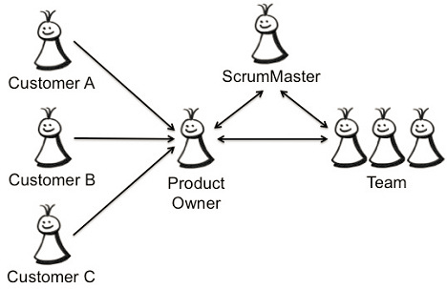
Role: Product Owner
Represents the Customer to the Scrum Team.
Decides what will be built and in which order. (Organizes Product Backlog)
Maximizes the Return on Investment (ROI) of the team.
Decides when something is ‘Done.’
Class: Role rotates between team members.
Notes:
ROI = Return on Investment
https://milindageorge.wordpress.com/2013/03/26/an-agile-team-scrum-team-roles-responsibilities/
Product Owner: The final word in prioritizing items, Quality Control, Product Manager. (One member from your team, each team member will have an opportunity to be the Product Owner)
Image: http://productiveandfun.com/2014/03/31/selecting-your-product-owner/
54

Slide 55
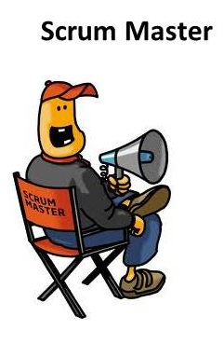
People: Scrum Master (Team Leader)
Servant Leader
Conductor of Ceremonies (Meetings)
  Daily Scrum
  Sprint Planning
  Sprint Reviews
  Sprint Retrospectives
Monitoring and Tracking
Shields the Team from distractions.
Class: Runs the team meetings and helps eliminate impediments.
Notes:
Scrum Master: Represents Management, Servant Leader, responsible for ensuring Scrum is understood and implemented. (One member from your team. Each team member will have an opportunity to be the Scrum Master)
55

Slide 56
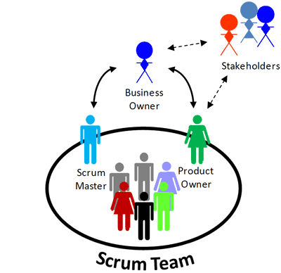
People: Scrum Team
A Scrum Team is a collection of individuals working together to deliver the requested and committed product increments.
Scrum Master
Product Owner
Class: Your Student team.
Notes:
Scrum Team: Cross-functional group that is responsible for incrementing (finishing/improving) the product (Your robotics team)
Image: http://www.executivebrief.com/agile/how-to-scrum/
56

Slide 57
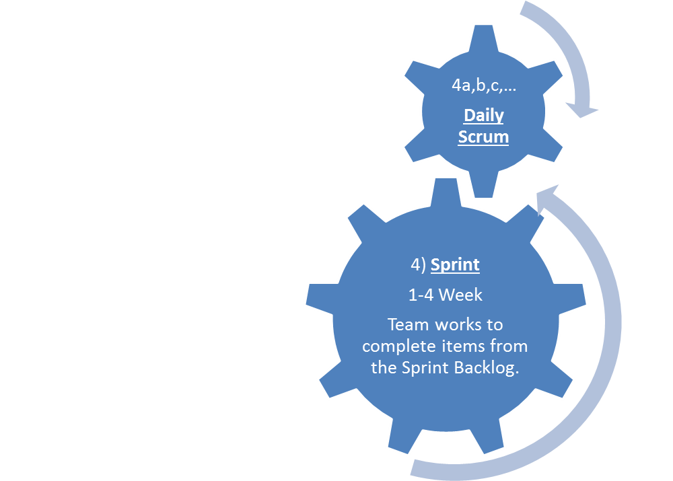
Scrum Process
1) A Project Begins “We want to build a robot to …”
Yesterday
Today
In the Way
5) Sprint Review:
Demonstrate potentially shippable product.
2) Product Owner with help from the team, prioritizes list of tasks into a ‘Product Backlog.’
6) Sprint Retrospective
What went well?
What did not go well?
What changes need to occur?
3) Scrum Master leads team in the Sprint Planning Meeting to create a Sprint Backlog. A list of top Product Backlog entries that can be completed in the next Sprint.
Notes:
https://www.scrumalliance.org/why-scrum
See more at: https://www.scrumalliance.org/why-scrum#sthash.vpaHfCmt.dpuf
Learn Scrum in 7 Minutes (https://www.youtube.com/watch?v=kYajjGi5-qM)
By TechExcel
57

Slide 58
Tracking Progress
Problems: Impediments
Product Backlog | To do Sprint Backlog | Doing (Tasks) | Done (Tasks)
Prioritized list of tasks
Prioritized list of tasks the team has committed to complete in this Sprint.
The Tasks currently in progress.
Approved by the Product Owner
After the Sprint answer the questions:
What went well?
What did not go well?
What can we do better?
Retrospective: End of Sprint
Notes:
Literacy/ Problem Solving

Slide 59
Scrum Getting Started Task
I put together a list of potential tasks to help students generate their Sprint Backlog
Sprint Planning Meeting
Using the Link to potential items for your product backlog, as a team select items that you will commit to complete in the next two weeks.
https://docs.google.com/spreadsheets/d/1GcX-He1I54ns9twiONBjoNB52DP72vPJ7zqWnAndmx8/edit?usp=sharing
There is also a link on the class website.
Place items that you intend to complete, but cannot commit to completing in the next sprint.

Slide 60
If you did not complete this on Monday
Select Product Owner: Quality Control
Select Scrum Master: Team Leader
Build Sprint Backlog:
  Tasks you can get done by next Friday

Slide 61
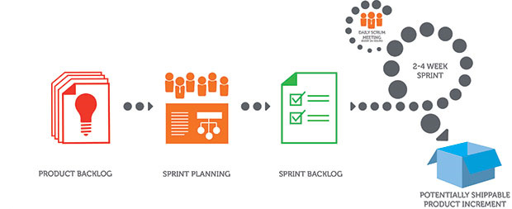
Sprint…
Daily Scrum Meeting:
  What was done yesterday?
  What do you intend to do today?
  What is getting in your way of success?
Work:
  Select a task
    Add your name to the sticky note
    Move the note to the ‘Doing’ column
  When you finish a task, demonstrate it to your Product Owner. If it passes, the product owner signs off and the note is moved to the ‘Done’ Column.
  At the end of the sprint your team will demonstrate the ‘Done’ items.

Slide 62
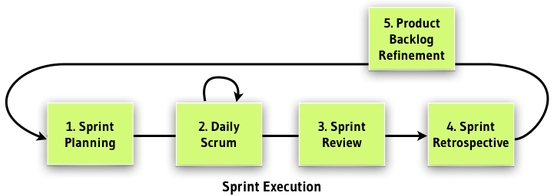
End of Sprint Meetings (At the end of the Sprint. I use 3-weeks for the Sprint Time Length)

Slide 63
Outline for the Day on Friday
Sprint Review Meetings: Demonstrate your product to the class
  Class gives feedback
Sprint Retrospective Meetings:
  First within the team
  Next with the entire class
Demonstrate Team Notebook to Mr. Smith
  Show the work of each team member.
Sprint Planning Time
  Committing to what you will accomplish by Wednesday, November 18th
  Friday November 20th is an in-class tournament

Slide 64
The Sprint Review
Team presents what it accomplished during the sprint
Typically takes the form of a demo of new features or underlying architecture
Informal
  No slides
Whole team participates
Invite the world

Slide 65
Sprint Review Outline
Demonstrate what is working on your product
Product owner declares what is ‘Done’
Stick to the goals of the Sprint.
Add new ideas/tasks to the Product Backlog. Your team can determine if they should be added to the next Sprint.
If something did not get done, put it on the product backlog. On Monday your team can determine to place it in the next Sprint.

Slide 66
Sprint Retrospective
Periodically take a look at what is and is not working
Typically 15–30 minutes
Done after every sprint
Whole team participates
  ScrumMaster
  Product owner
  Team
  Possibly customers and others

Slide 67


Sprint Retrospective: Good/ Bad/ Change
Whole team gathers and discusses:
What went well.
What did not go well.
This is just one of many ways to do a sprint retrospective.
What should change

Slide 68

Sprint planning
Team selects items from the product backlog they can commit to completing
Sprint backlog is created
  Tasks are identified and each is estimated (1-16 hours)
  Collaboratively, not done alone by the ScrumMaster
High-level design is considered
As a driver I want the robot to be able to move using the competition template.
Complete the frame
Attach motors, controller battery
Write the drivers control code
Test the driving code
Move code into competition template.

Slide 69
Scrum Process
1) A Project Begins “We want to build a robot to …”
Yesterday
Today
In the Way
5) Sprint Review:
Demonstrate potentially shippable product.
2) Product Owner with help from the team, prioritizes list of tasks into a ‘Product Backlog.’
6) Sprint Retrospective
What went well?
What did not go well?
What changes need to occur?
3) Scrum Master leads team in the Sprint Planning Meeting to create a Sprint Backlog. A list of top Product Backlog entries that can be completed in the next Sprint.
Notes:
https://www.scrumalliance.org/why-scrum
See more at: https://www.scrumalliance.org/why-scrum#sthash.vpaHfCmt.dpuf
Learn Scrum in 7 Minutes (https://www.youtube.com/watch?v=kYajjGi5-qM)
By TechExcel
69

Slide 70
Tracking Progress
Problems: Impediments
Product Backlog | To do Sprint Backlog | Doing (Tasks) | Done (Tasks)
Prioritized list of tasks
Prioritized list of tasks the team has committed to complete in this Sprint.
The Tasks currently in progress.
Approved by the Product Owner
After the Sprint answer the questions:
What went well?
What did not go well?
What can we do better?
Retrospective: End of Sprint
Notes:
Literacy/ Problem Solving

