Slide 1
Computer Science 1
Random Day 2

Slide 2
Learning Targets
Be able to read and write code in java related to random numbers
Be able to fix a program that uses random numbers
Be able to write a program that uses random numbers.

Slide 3
Describe the range of random values generated from the following.
int one = (int)(14*Math.random()) + 10;
int roll = (int)(11*Math.random()) + 2;
int roll = (int)(9*Math.random()) - 6;
int roll = (int)(20*Math.random()) + 16;
int roll = (int)(5*Math.random()) - 8;
int roll = 2*((int)(6*Math.random())) + 8;
In your notes summarize how to go from code to the range of values.

Slide 4
Write the code needed to generate the following ranges of random numbers.
1 to 10
9 to 17
40 to 85
-4 to 40
-3 to 21
20 to 60 even values only
A pair of 10-sided dice
Rolling a three-sided die
In your notes summarize how to go from a desired range of values to code.

Slide 5
Fix it!!!
Open the program ‘pairish.java’ from the class website and fix it.

Slide 6
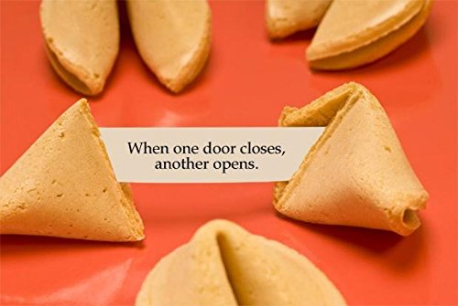
Program options
Flip a coin 100 times, show the total number of heads and tails AND which occurred the most often.
Roll a pair of 6-sided dice 100 times. Find out which occurs most often, 3 or 11. Show how often each of these rolls occur and which occurs most often.
Fortune Cookie:
Write a program that will generate a random fortune cookie saying.
You will need to include at least three different fortune cookie saying options.

