Slide 1
Door

Slide 2
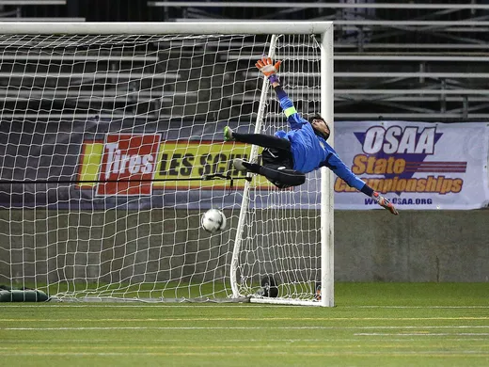
Welcome to Advisory
October 26, 2018
Goal Setting!

Slide 4
What holds you back?
Advisory is a safe place to take academic risks and GROW!
Scrap paper: Write down your biggest fear or source of anxiety about school.
Holding onto that fear prevents growth
Throw that fear away!

Slide 5
Learning Target
Today I will reflect on my learning progress, and I will create a SMART Goal to help keep me focused on my academic success!

Slide 6
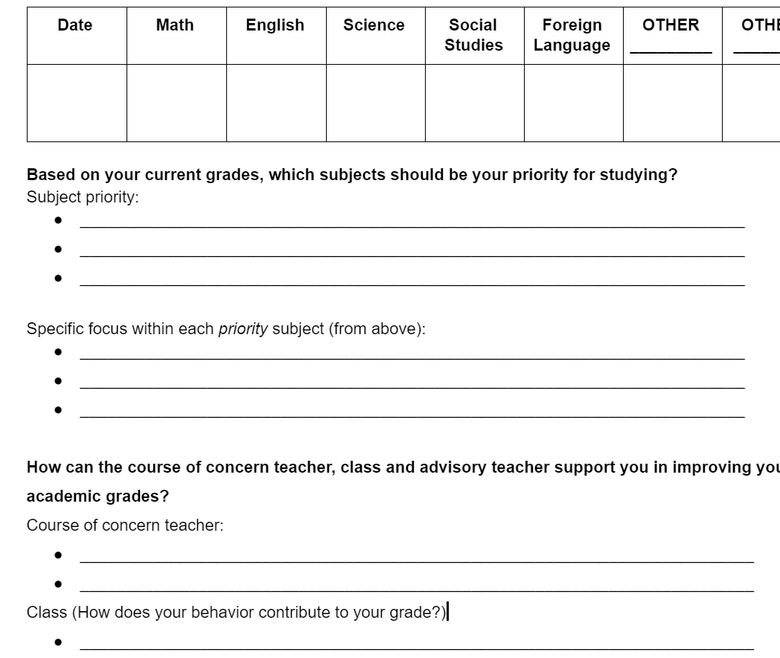
Reflecting on your academic progress
Fill out this form with integrity
If your grades are great, how can you improve your LEARNING?

Slide 7
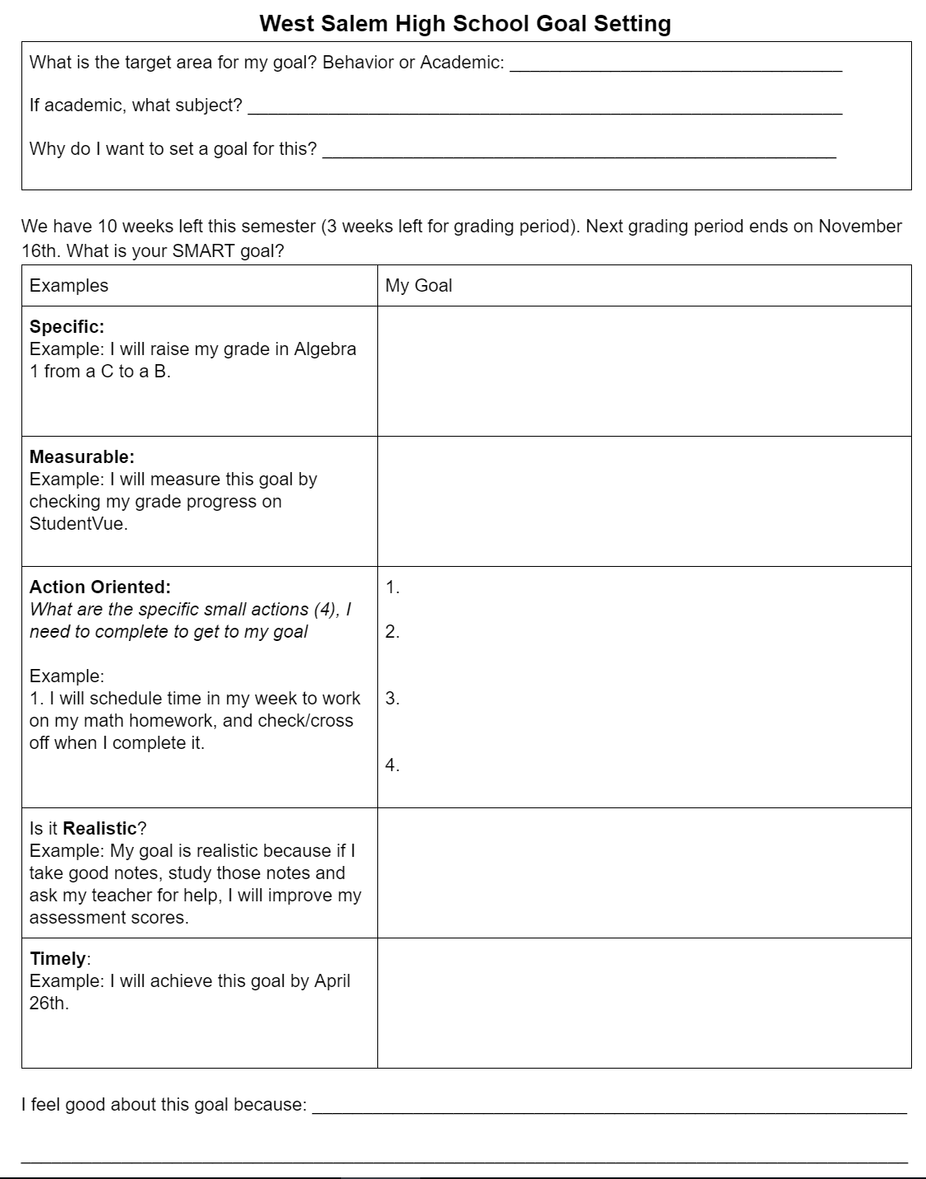
Goal setting based on front of sheet
Focus on one SPECIFIC area you want to improve
Use the examples to guide your through the graphic organizer

Slide 8
You can do this!!

