Slide 1
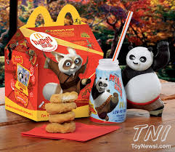
Reverse Engineering
Team Project

Slide 2
Learning Objectives
Apply reverse engineering principles to reverse engineer and improve an existing product.
Incorporate principles of design in developing a new product
Work as a team in developing an awesome product

Slide 3
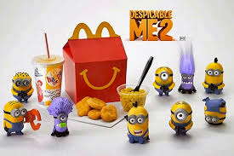
You are to Develop a new Happy Meal Toy that will fit with LEGOs
Use a theme for your toy
Movie
Video Game
Sport/Hobby
Something that will interest 3 – 10 year olds

Slide 4
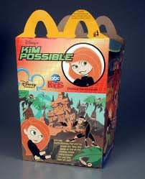
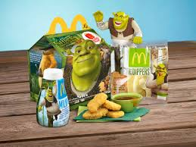
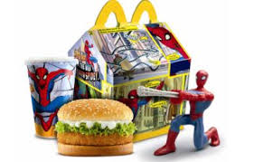
Step 1: Pick a Theme
Record your theme in your PowerPoint

Slide 5
Step 2: Reverse Engineer Existing LEGOs
Reverse Engineer four to six LEGO Pieces (2 for each member of the team)
A beam with the holes for Axles (Beam)
A piece with bumps and a place for connecting bumps (Brick)
A piece that will fit an axle (Wheel/Gear)
A connecting peg (For connecting beams/gears/…)
To reverse Engineer … (Record initial descriptions in your PowerPoint. They will be an appendix section of your presentation PowerPoint)
Your name
Visual Analysis: Looks
Functional Analysis: Purpose, functions, input and outputs
Structural Analysis: Types of connections, some things that can be made from this element
Measure and model the piece in Inventor

Slide 6
Step 3: New Creation
It will need to use at least twice as many different pieces as you have team members.
Each person must create at least one original piece that will fit with LEGOs and is part of the final product
You will create an assembly of the pieces into the Happy Meal Toy
You can use multiple copies of a piece in creating your assembly
Each team member will make a different assembly taking advantage of the flexibility of the LEGO system.
Select at least one of the assemblies for your presentation
Place all assemblies in the appendix of your presentation

Slide 7
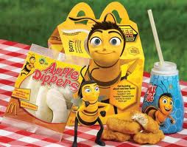
Step 4: Team Presentation
Team Presentation (PowerPoint)
Names (Team Name) and Theme
Executive Summary Slide
Picture of your assembled toy
Why it is awesome
Reverse Engineering Slides
The pieces modeled and who modeled them (Screen Captures)
Descriptions of what they do
Custom Pieces Slides
Screen Captures
Descriptions
Summary Slide
Final Product Assembly
Happy Kid enjoying your product
Appendix
Reverse Engineering Slides
Each members assembly
Websites and resources used for this project

Slide 8
What is turned in
Team Presentation (PowerPoint)
Names (Team Name) and Theme
Executive Summary Slide
Picture of your assembled toy
Why it is awesome
Reverse Engineering Slides
The pieces modeled and who modeled them (Screen Captures)
Descriptions of what they do
Custom Pieces Slides
Screen Captures
Descriptions
Summary Slide
Final Product Assembly
Happy Kid enjoying your product
Appendix
Reverse Engineering Slides
Each members assembly
Websites and resources used for this project
CAD Files for each of the pieces (Parts, assemblies, …)
YourNamePartDescription
YourNameAssemblyDescription

Slide 9
Timeline
Step 1: Theme: 4/13/2016
Step 2: Reverse Engineer LEGO Parts: Two parts per team member: 4/15/2016
Step 3: New Creation
Custom Parts: 4/20/2016
Assemblies Toy: 4/22/2016
Step 4: Team Presentation: 4/25/2016
Presentation completed and rehearsed by the end of the period
Class presentations: 4/27/2016

