Slide 1
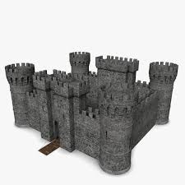
Intro to Engineering Design

Slide 2
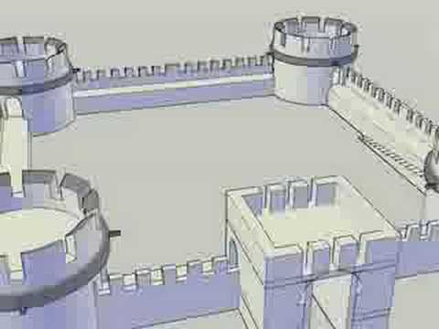
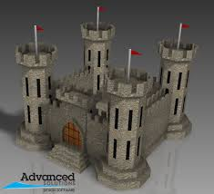
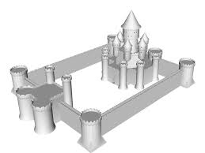
Learning Objectives
Review ‘Constraints’
Improve on your Sketching skills by completing the ‘Sketching’ tutorials.
Apply what you have learned to create a Castle in Inventor. Let the castle display your best efforts
Walls
Doors
Moat
Drawbridge
Walkway on walls
Stairs to get to the Walkway
Weaponry
…

Slide 3
Constraints Review
For a name pick one of the menu options in Inventor
Sketch
Revolve
Circle
Test
Fillet
…

Slide 4
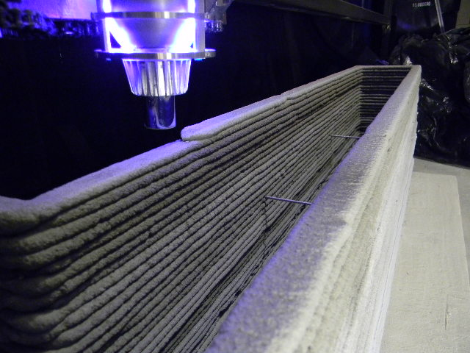
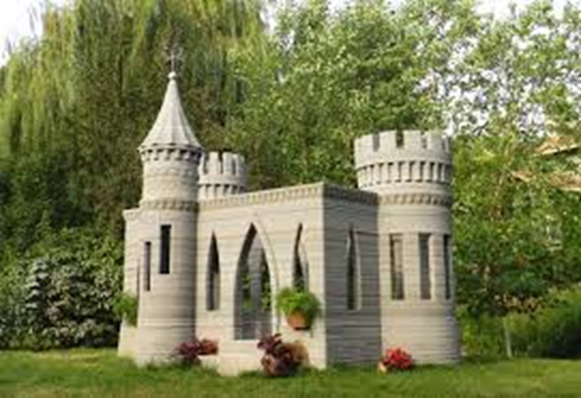
Castle Project
Apply what you have learned to create a Castle in Inventor. Let the castle display your best efforts
Walls
Doors
Moat
Drawbridge
Walkway on walls
Stairs to get to the Walkway
Weaponry
…

