Slide 1
Welcome to Advisory!
September 20, 2018

Slide 2
Questionnaire Extraordinaire
Look at your questionnaire from our last Advisory meeting and find some matches to these questions:
Find someone who has the same favorite color you have and write down their name.
Find at least two people who chose the same place to live. The categories: A) a big city, B) a city the size of Salem, C) a small town, D) the country, or E) other). Write down the names in this new group.
Thinking about the farthest you have ever travelled, as an advisory class, line up moving from smallest distance travelled to largest distance travelled.

Slide 3
Let’s review: Purpose of Advisory
Build a classroom community
Connect with each other
Connect with advisory teacher
Share a common message about
Behavior
Curriculum
Academic Goals
Create and reflect throughout the year
Why?
Because your success MATTERS!

Slide 4
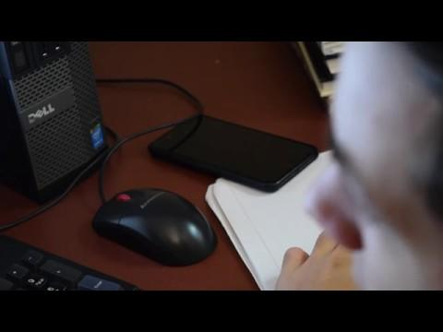
Cell phones: What happens to school work?

Slide 5
Because we care about your &

Slide 6
Critically read: “The mere presence of your smartphone reduces brain power, study shows”
Number paragraphs
Underline main claim
On the back: I agree with this claim because ________.
On the back: I disagree with the idea in paragraph ___ because ____________________________________.

Slide 7
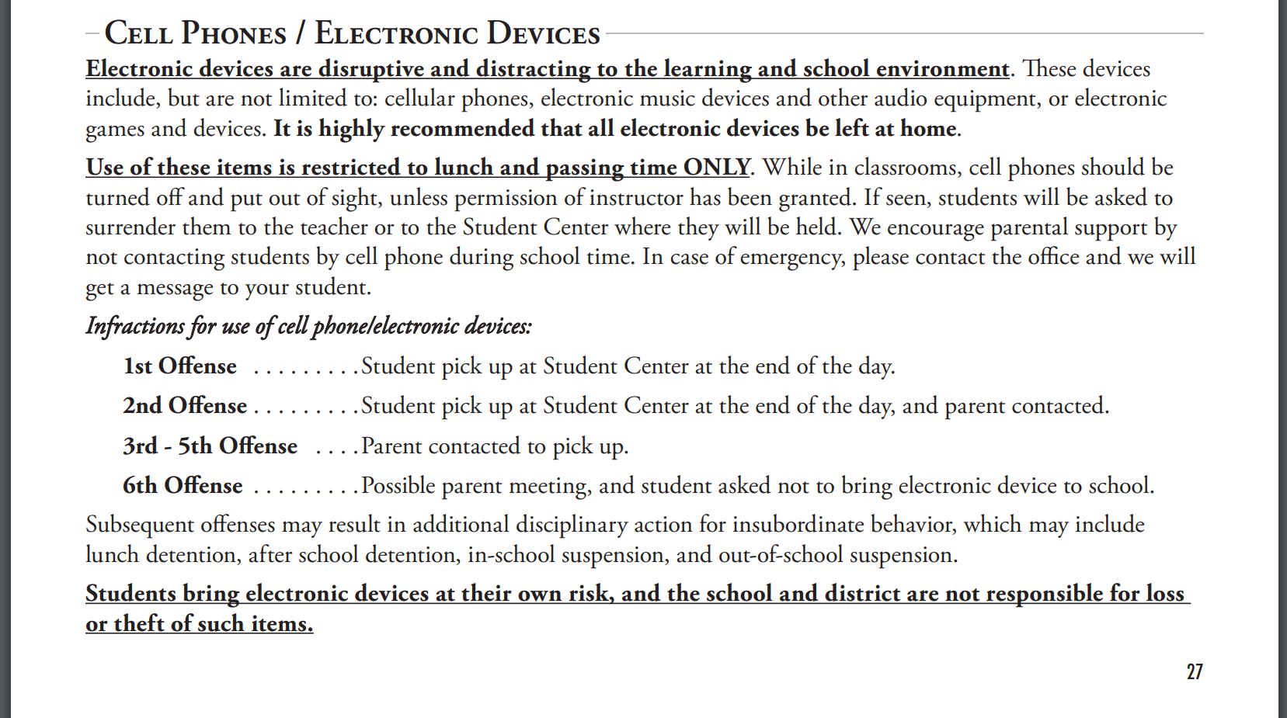
From the West Salem High School Handbook

Slide 8
Have an EPIC Year!
INTEGRITY
EFFORT
PRIDE
COURTESY

Slide 9
Effort in Advisory
EPIC

Slide 10
Pride in Advisory
EPIC

Slide 11
Integrity in Advisory
EPIC

Slide 12
Courtesy in Advisory
EPIC

