Slide 1
Welcome to Advisory!
2018-2019

Slide 2
How was your Summer?
Best Summer ever!
Pretty good Summer
Pretty boring Summer
Worst Summer ever!

Slide 3
Purpose of Advisory
Build a classroom community
Connect with each other
Connect with advisory teacher
Share a common message about
Behavior
Curriculum
Academic Goals
Create and reflect throughout the year
Why?
Because your success MATTERS!

Slide 4
Questionnaire: Getting to know YOU!

Slide 5
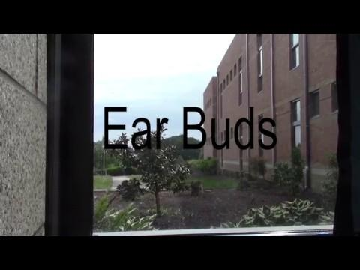
Cell phones at West

Slide 6
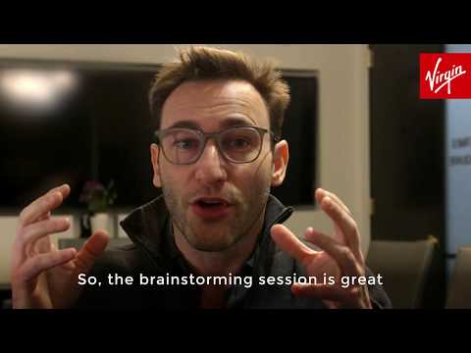
Because we care about your &

Slide 7
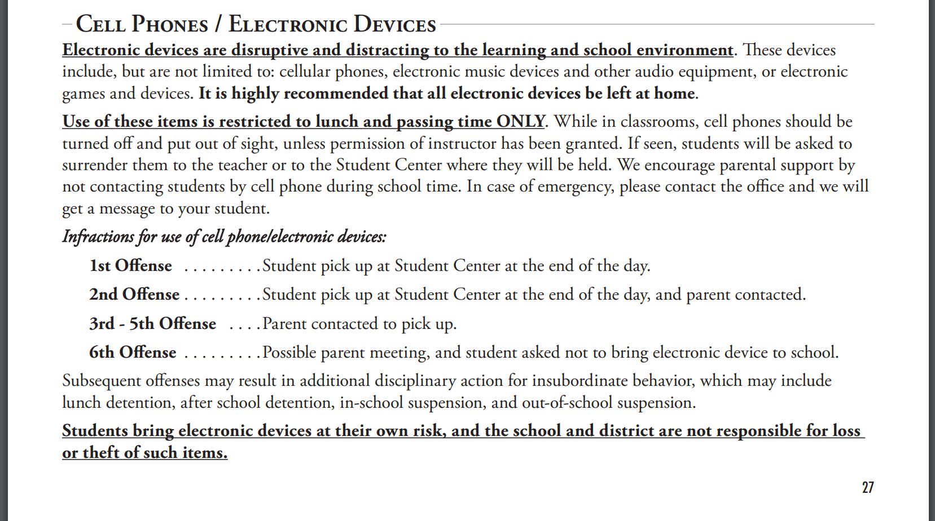
From the West Salem High School Handbook

Slide 8
Have an EPIC Year!
INTEGRITY
EFFORT
PRIDE
COURTESY

Slide 9
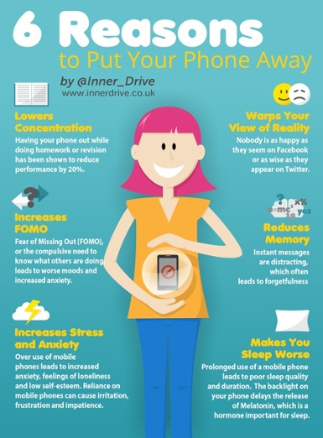
Effort in Advisory
EPIC

Slide 10
Pride in Advisory
EPIC

Slide 11
Integrity in Advisory
EPIC

Slide 12
Courtesy in Advisory
EPIC

