Slide 1
Creating Drawings in CAD

Slide 2
Creating A Drawing
Drawings communicate ideas
Standards define drawing properties
Inventor process
Create a part
Create a drawing
Place base view
Project views from base (multi-view and isometric)
Dimension multi-views

Slide 3
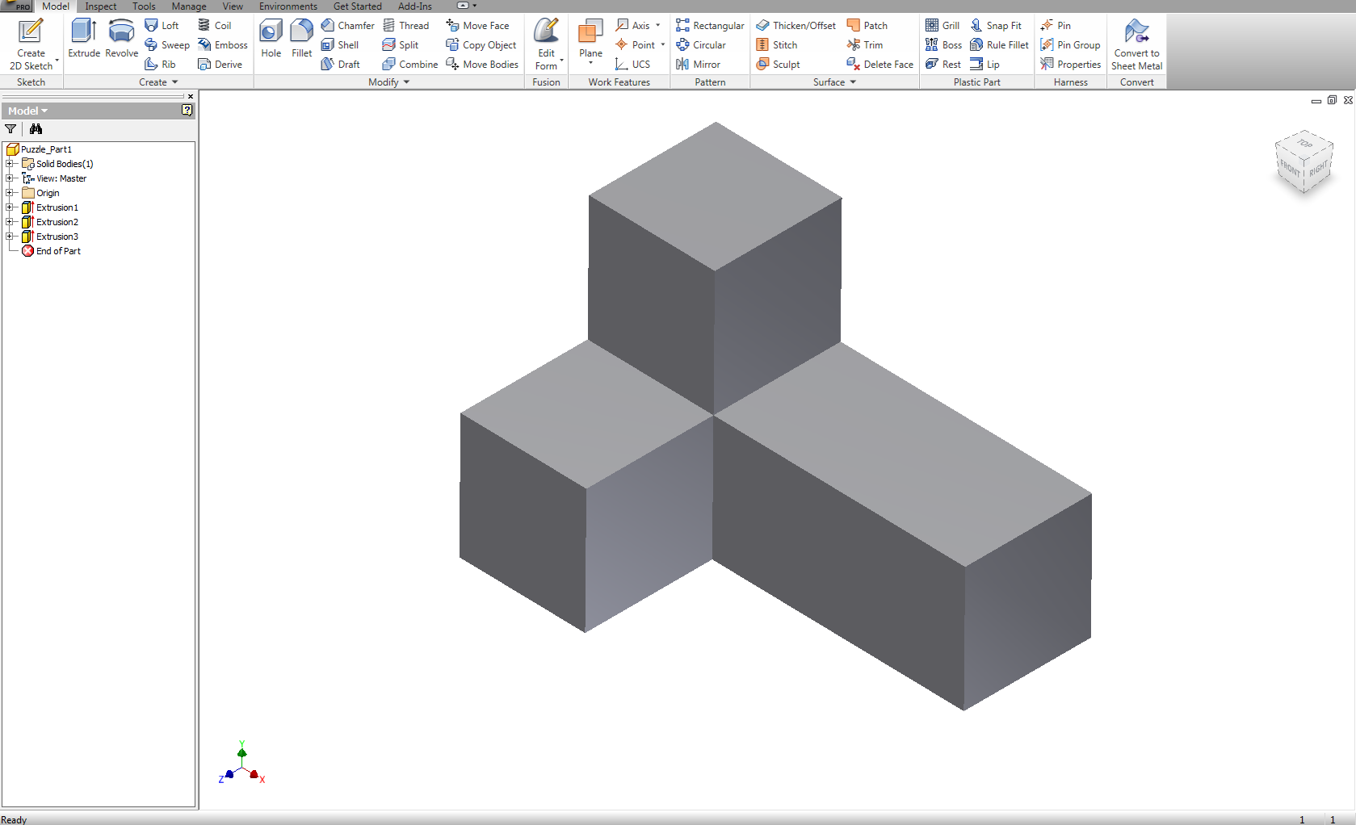
Drawing Creation
Create a part (.ipt file)

Slide 4
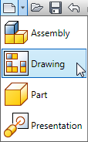
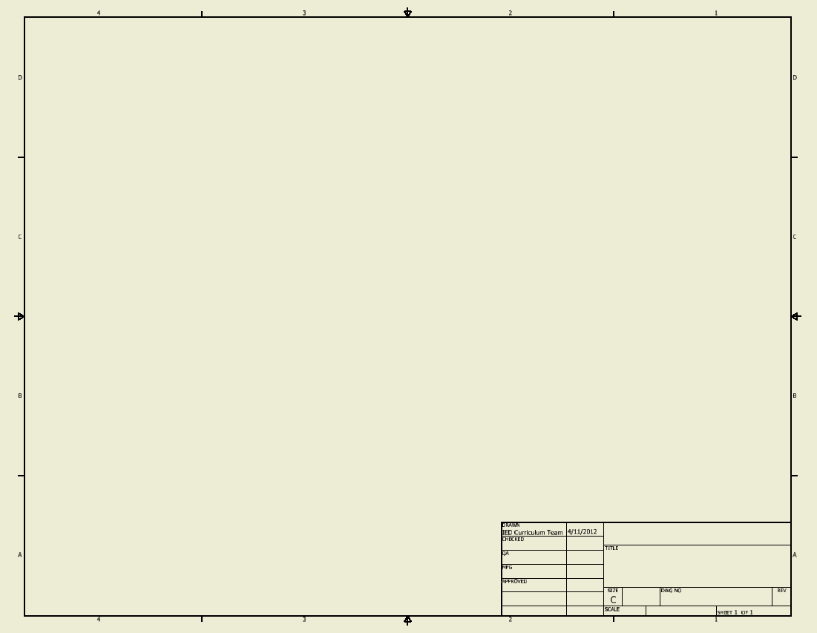
Drawing Creation
Create a drawing file (.idw file)

Slide 5
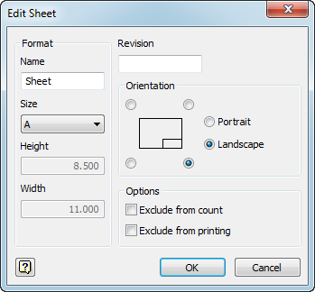
Change Sheet Size
Change sheet size to A (8.5 in. x 11in.)
Right click Sheet
Click Edit Sheet
Select A-size

Slide 6
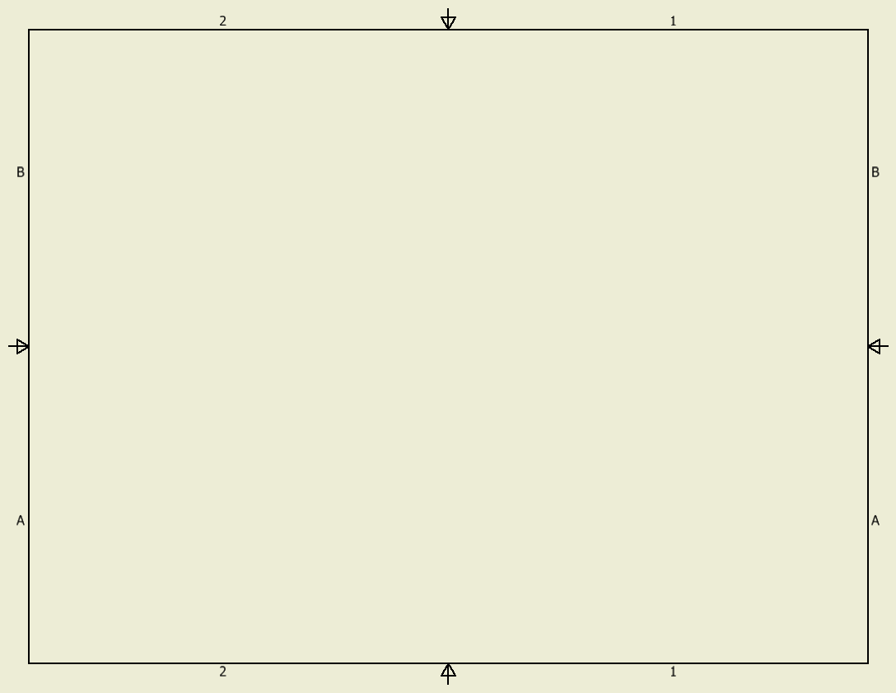
Delete Title Block
Delete ANSI title block
Right click ANSI – Large
Click Delete

Slide 7
Add Title Block
Add A-size title block
Expand Drawing Resources in browser
Expand Title Blocks
Right click ANSI A
Click Insert

Slide 8
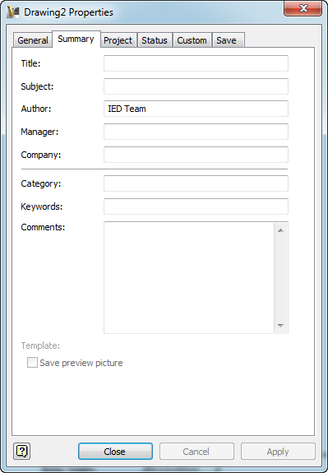
Edit Title Block Information
Enter title block text
Single click Pro icon
Click iProperties
Complete fields
For this project select the summary tab and give the title.
YourName 7.1 Problem Number

Slide 9
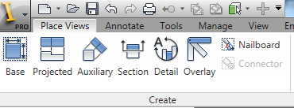
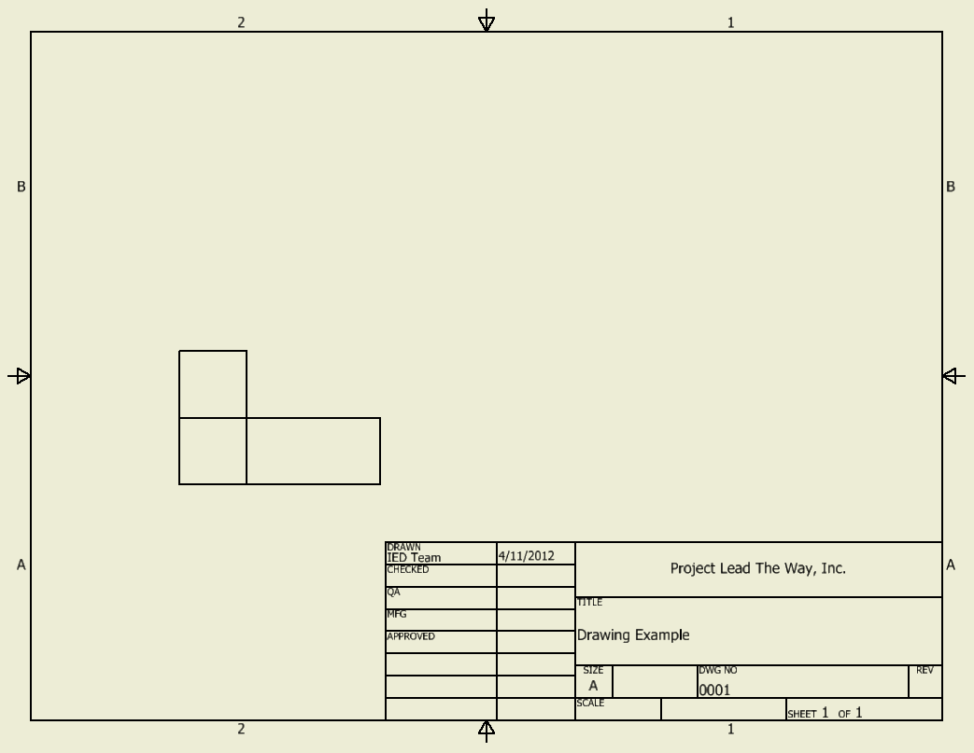
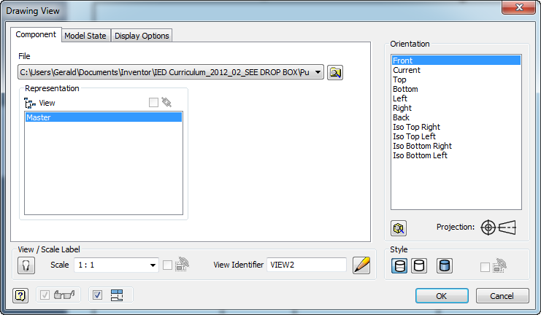
Create Base View
Click Base
Select part file, orientation and scale
Click to place base view

Slide 10
Project Views
Click Projected
Click where want views to be placed
Click Create

Slide 11
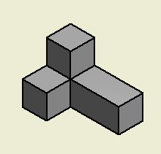
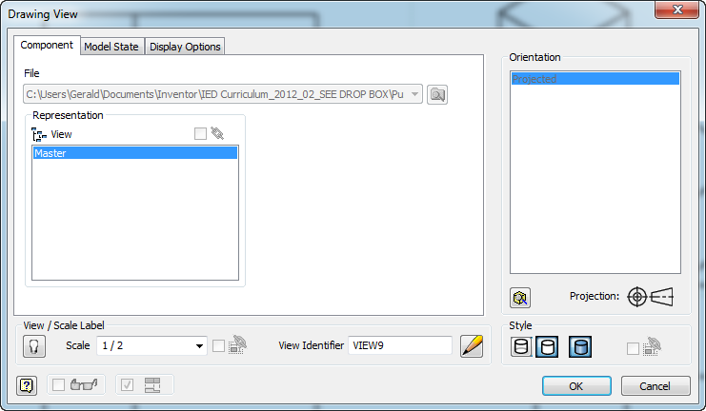
Change Isometric Color
Right click isometric view
Click Edit View
Shaded and Scale

Slide 12
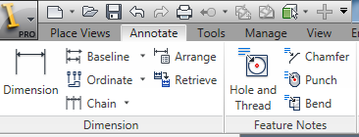
Dimension Multi-View
Click Dimension
Click reference for extension lines
Move cursor away from view
Click to place dimension

Slide 13
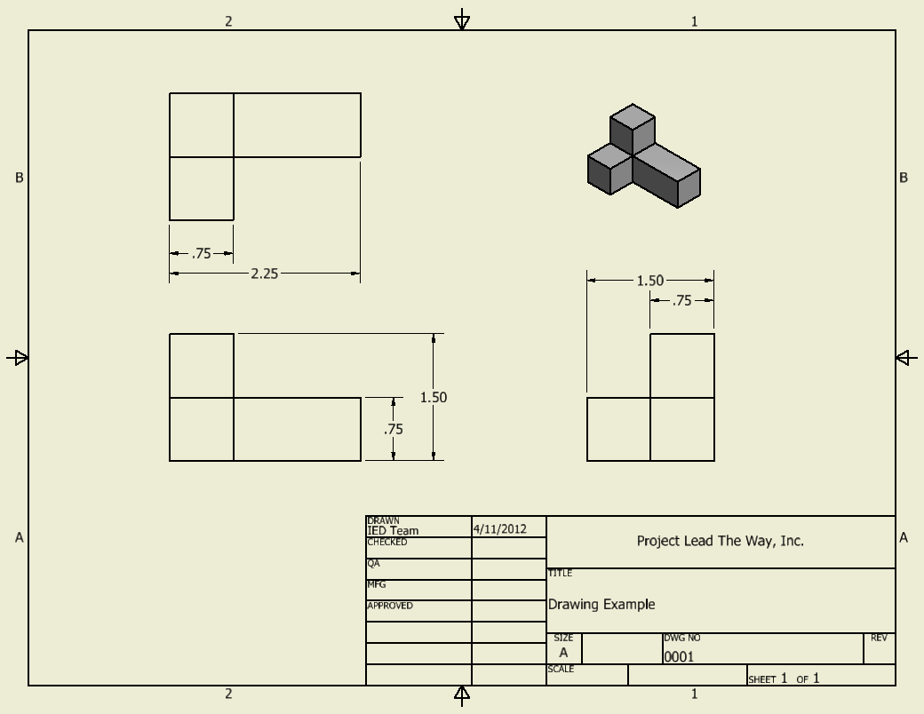
Example Drawing

